Slide 1

Medicare Project
Virtual Internship
27-Sep-2021

Slide 2
Background
Group Name: Ignotus
Problem Description:
One of the challenge for all Pharmaceutical companies is to understand the persistency of drug as per the physician prescription. To solve this problem ABC pharma company approached an analytics company to automate this process of identification.
Objective:
Build a ML model that will gather insights on the factors that are impacting the persistency
Team Members:
Corey Hamren, hamhams86@gmail.com, USA, Self-Taught, Data Science
Motamen MohammedAhmed, Motamen.salih@hotmail.com, UAE, Zayed University, Data Science
Francis Kim, fkim39@gmail.com, Fkim39@gmail.com, USA, University of Maryland, Data Science
Inna Soltsman-Groysman, innasol90@gmail.com, USA, Data Science

Slide 3
Data Exploration
Dataset Information:
Number of datasets: 1
Number of rows: 3424
Number pf columns: 69
Approach:
We used Excel’s duplicate identification feature to identify and remove duplicate addresses.
We found the column value: “Unknown” to be useful and not the same of a null value. The reason being is that column value “Unknown” is an important count for analyzing the distribution count of data we do have Vs. the unknown values.
Dataset cleaned through the lowering of column titles in Python.
GitHub Repository Link:
https://github.com/TheHamhams/dg_group_project

Slide 4
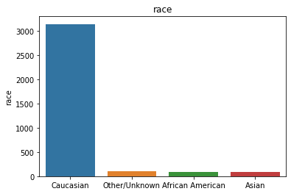
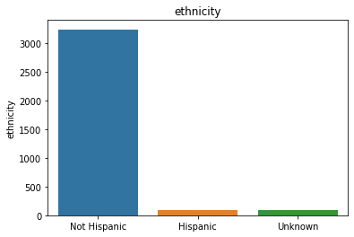
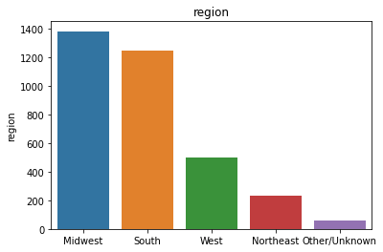
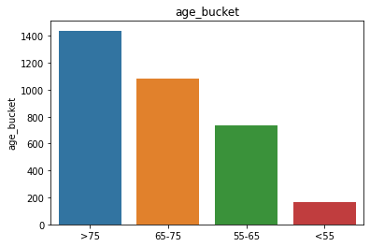
EDA - Participant Demographics
The vast majority of participants were Caucasian and Not Hispanic
Most participants lived in weather the Midwest or Southern region of the USA
Most participants were over the age of 65

Slide 5
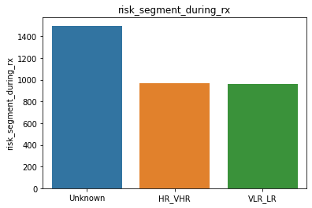
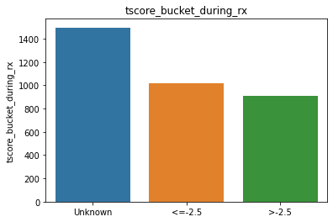
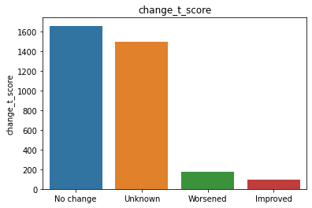
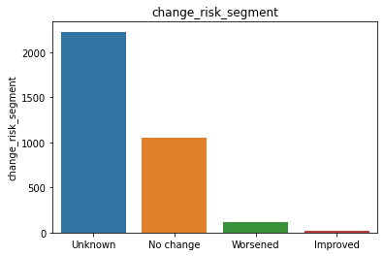
EDA - Unknown Values
Multiple columns have ‘Unknown’ values as the largest or close to the largest value count
We can not remove these values as they might have significant meaning.

Slide 6
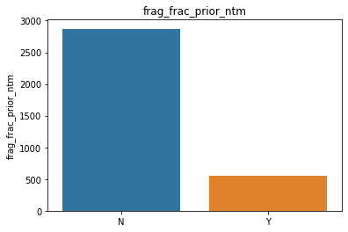
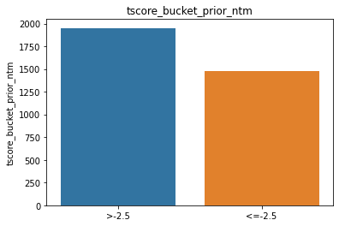
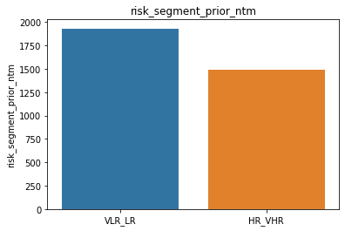
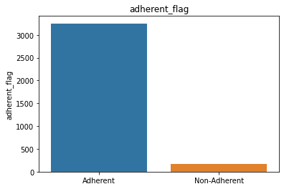
EDA - Binary Values
Most of the columns have binary data
Many of those columns have the vast majority of values fall into one category.

Slide 7
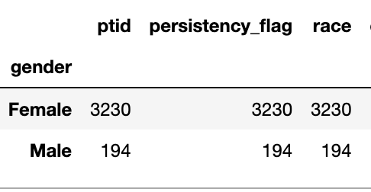
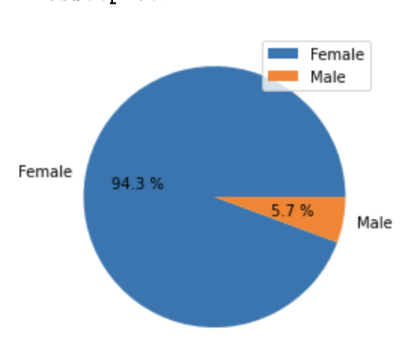
EDA - Gender
EDA - Gender
Our dataset, however, is heavily female with 94.3% of the dataset being female and 5.7% being male.

Slide 8
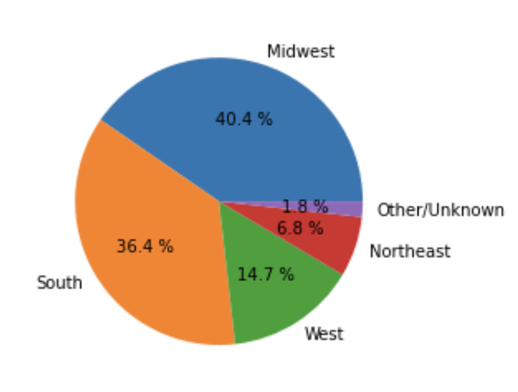
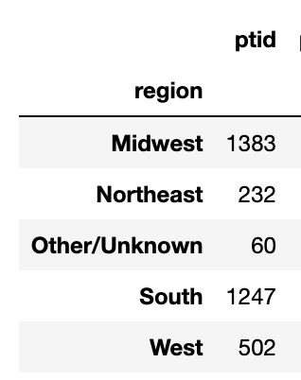
EDA - Region
EDA - Region
Our dataset has a higher percentage of participants from the Midwest (40.4%) and the South (36.4%) whilst the West, Northeast, and other take a smaller portion.

Slide 9
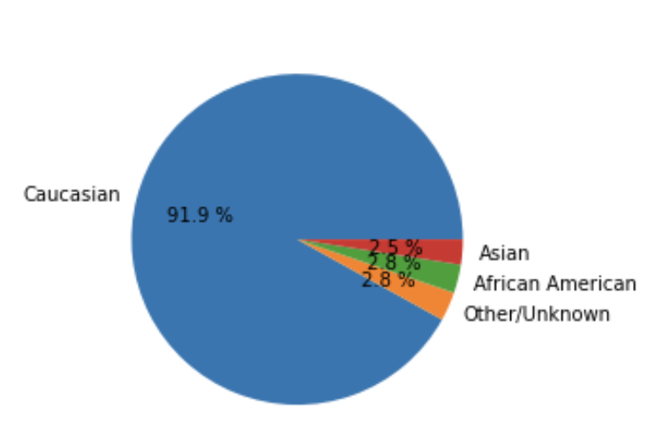
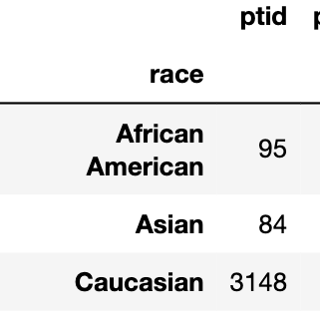
EDA - Race
EDA - Race
Our Dataset is also heavily Caucasian (91.9%) with other minorities like Asian and African American have much smaller percentages.

Slide 10
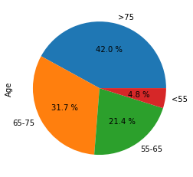
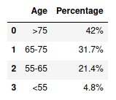
EDA - Age
EDA - AGE - TO EDIT!
In the dataset , 42% of the participants are over 75 years-old.

Slide 11
Models Selection
EDA - AGE - TO EDIT!
We applied different models on our dataset to choose one and deploy it as our solution for the defined problem.
The choice (recommendation) of the model depends on different measures. It can be the computational complexity, execution time, Classification measures, or even the ability to interpret the model.
In case of choosing the interpretability, the model must not be a black box.
For our work, we will recommend the model based on the classification measures.

Slide 12
Models - SVM
EDA - AGE - TO EDIT!
SVM Model with Holdout
Accuracy: 0.80253
Precision: 0.78788
Recall: 0.62567
f1-measure: 0.69747
SVM Model with Cross Validation
Mean accuracy: 0.79759
Mean precision: 0.79383
Mean recall: 0.63152
Mean f1-measure: 0.69976

Slide 13
Models - Random Forest
EDA - AGE - TO EDIT!
Random Forest with Holdout
Accuracy: 0.80447
Precision: 0.75516
Recall: 0.68449
f1-measure: 0.71809
Random Forest with Cross Validation
Mean accuracy: 0.80401
Mean precision: 0.77623
Mean recall: 0.65557
Mean f1-measure: 0.70859

Slide 14
Models - Gradient Boosting
EDA - AGE - TO EDIT!
Gradient Boosting Model with Holdout
Accuracy: 0.80837
Precision: 0.74652
Recall: 0.71658
f1-measure: 0.73124
Gradient Boosting Model with Cross Validation
Mean accuracy: 0.79613
Mean precision: 0.75838
Mean recall: 0.68738
Mean f1-measure: 0.71719

Slide 15
Models - Recommendation
Conclusion:
All models performed similarly on the dataset.
Recommendation
The group recommends the Gradient Boosting model

