Slide 1
Machine Learning and Diamonds
By Manuel Perez-Faura

Slide 2
Table of Contents
Goal
Diamond Grading
Pricing
Data Features
Results
Accuracy Improvements
Conclusion

Slide 3
Goal
Create a ML Model to give diamond prices.
Find largest factor of price.

Slide 4
Grading
Diamond prices are based on 4 things:
Cut
Color
Clarity
Carat

Slide 5
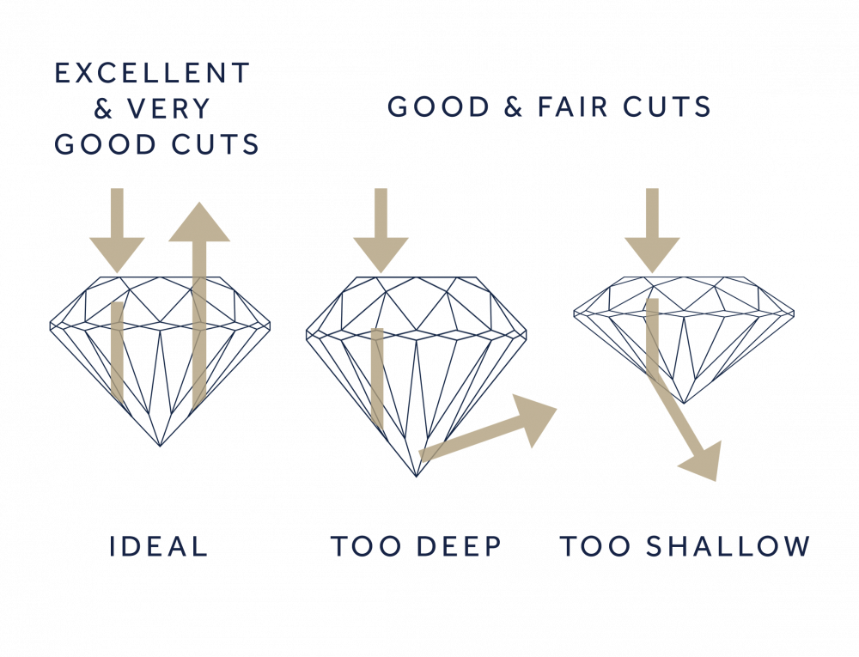
Grading
Cut Grading:
How well cut it is.
Cuts affect the “sparkle” and brightness of a diamond.

Slide 6
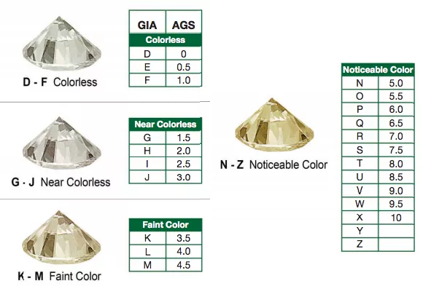
Grading
Color Grading:
The higher the letter the more “crystal clear” it is.
Colors vary from a yellowish goldish color to no color at all.

Slide 7
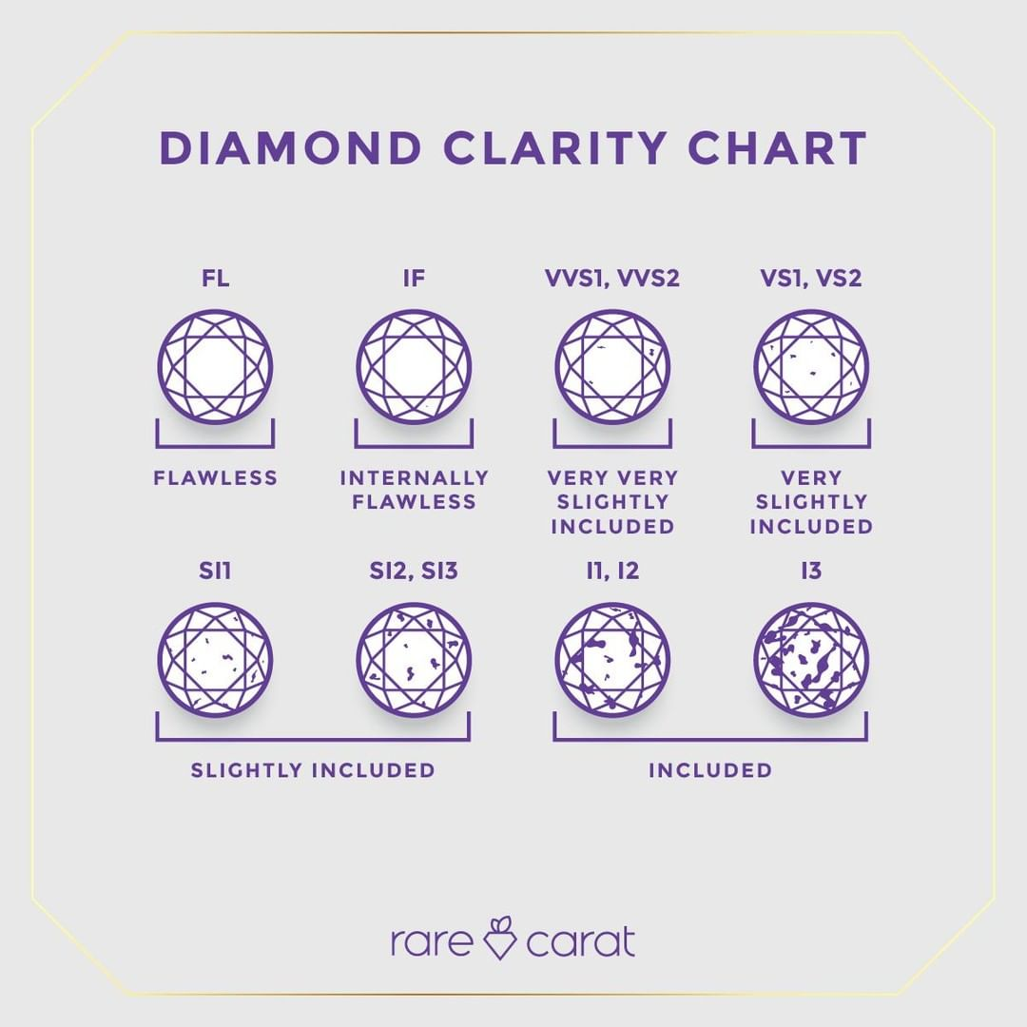
Grading
Clarity Grading:
Clarity Grades based on blemishes and fractures.
Clarity Grading also includes any flaws inside the diamond.

Slide 8
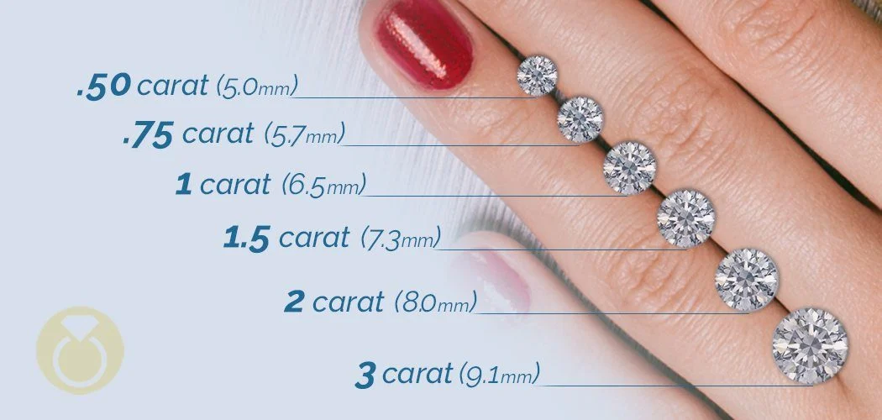
Grading
Carat Sizing:
Carats are used to represent the size of the diamond.
Formula is: width * height * depth * .006

Slide 9
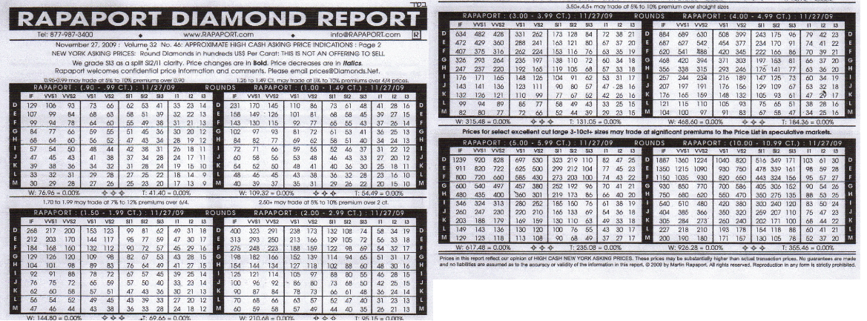
pricing

Slide 10

Data Features
Categorical
Numerical
Cut
Color
Clarity
X (Width in MM)
Y (Height in MM)
Z (Depth in MM)
Depth
Table
Carat
Y
X
Z

Slide 11
Results
Model Name | Score (AR2)
Linear | 91.50%
Ridge | 91.50%
Bayesian | 91.50%
KNeighbor | 96.43%
Tree | 96.93%
SVR | 96.91%

Slide 12
Improving
Different Scaling Methods
Different Test Sizes
Drop unnecessary columns
Feature Engineering

Slide 13
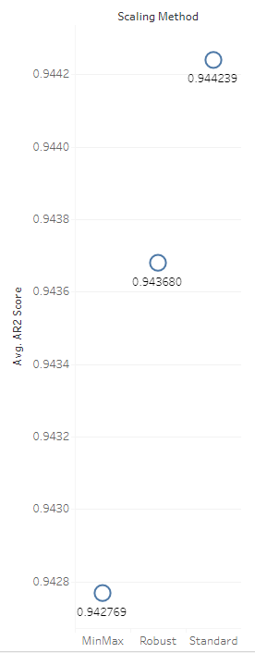
IMPROVING
Scaling Methods
Use different scaling methods to improve accuracy.
Methods include:
Robust
Standard
MinMax
This did NOT bring up my score.

Slide 14
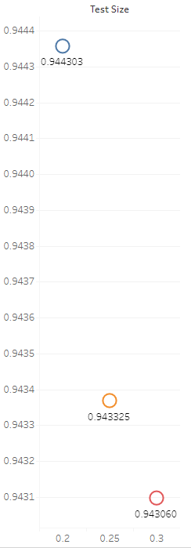
IMPROVING
Testing/Training Sizes
Test/Training sizes have a heavy impact on model success.
Sizes I tried were:
80% Training, 20% Test
75% Training, 25% Test
70% Training, 30% Test
This brought up my score by 0.097%

Slide 15
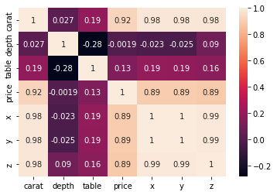
IMPROVING
Unnecessary Columns
Columns lacking correlation
Causing confusion in model
Dropped “depth” column
This brought up my score by .099%

Slide 16
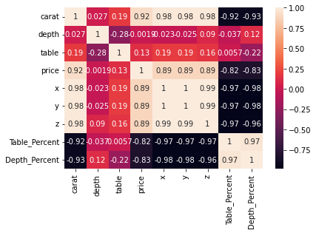
IMPROVING
Feature Engineering
Table Percentage
Table size compared to diameter (X)
Depth Percentage
Depth size compared to diameter (X)
This did NOT bring up my score.

Slide 17
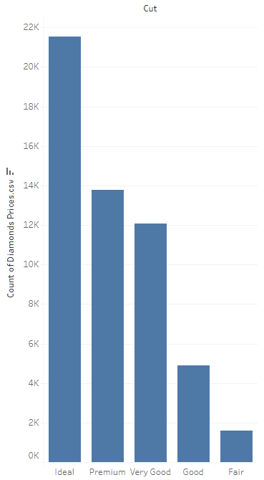
Conclusion
Best Score: 97%
Model Type: SVR
Biggest Influence: Carat
Things I would’ve done:
SMOTE (Sampling)
Hypertuning parameters for each individual model.
More advanced feature engineering.

Slide 18
Thank you!

