Slide 1
ECE 8920 Final Project: Multi-depot Vehicle Routing Problem with Per-vehicle Weights
Nicholas West

Slide 2
Background
A logistics application needs to minimize the cost of a routing problem
Some # of employees (drivers) need to visit some # of houses (customers)
Each employee:
  Takes off from their own house (depot)
  Has different hourly pay, MPG, etc.
    Different costs per driver, per graph edge traversed by said driver
This is a modified multi-depot vehicle routing problem (MDVRP)
  Generalization of the traveling-salesman problem (TSP) – NP-Hard!

Slide 3
Easy Problem – MDVRP
Use WA state graph from Homework 3 as an example
  3 drivers, two in Tacoma, one in Pullman
  Bellingham cannot be accessed via a cycle, so remove it
Dantzig-Fulkerson-Johnson mixed-integer LP formulation of TSP is extensible to MDVRP [1]
Given G = (V, E) and D ⊆ V, let:
  xi,j := Binary variable, whether or not edge i → j was traversed (i, j ∈ V)
  ci,j := Weight of edge i → j
  di := # of vehicles at depot i ∈ D
  i ~ j := vertex i is adjacent to vertex j

Slide 4
Easy Problem – MDVRP
Notice: this is over the
power set of V / D!

Slide 5
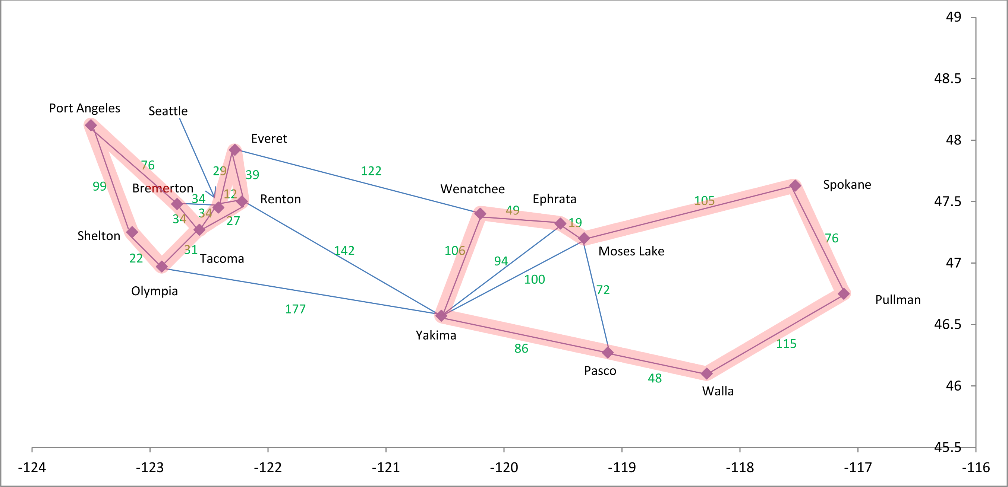
Easy Problem – MDVRP

Slide 6
Harder Problem – MDVRP w/ per-vehicle weights
Previously, all drivers have the same cost for all edges
Introduce the following biases:
  Driver 1 from Tacoma: multiply edge weight by ½ if the destination vertex is north of Tacoma
  Driver 2 from Tacoma: multiply edge weight by ½ if the destination vertex is south of Tacoma
  Driver 3 from Pullman: don’t go to vertices west of Moses Lake (add M >> 0 to edges that do so)

Slide 7
Harder Problem – MDVRP w/ per-vehicle weights
Harder to setup than expected
  Simply treating xi,j as the sum of some x⁽¹⁾i,j + x⁽²⁾i,j + … just makes the LP solver choose the minimum cost at each edge
The trick is to introduce |D||V / D| binary constraints to force customer vertices to be serviced by one specific driver
Also need extra constraints to ensure each vehicle only departs/returns to its individual depot
  let D* := set of drivers

Slide 8
Harder Problem – MDVRP w/ per-vehicle weights

Slide 9
Harder Problem – MDVRP w/ per-vehicle weights

Slide 10
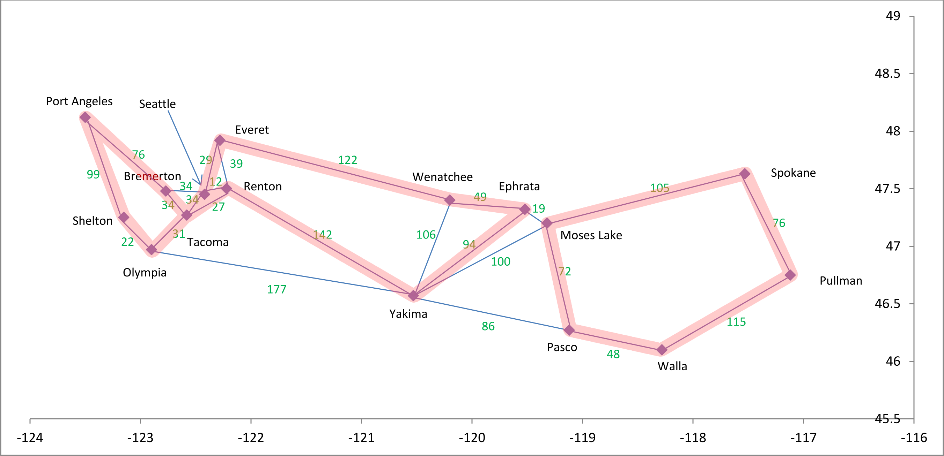
Harder Problem – MDVRP w/ per-vehicle weights

Slide 11
Very Hard Problem – MDVRP w/ per-vehicle weights on a real road network
Let’s construct a more “realistic” MDVRP to solve
OpenStreetMap data for Knox County, TN [2]
  143336 vertices
  3373605 edges
  Our new problem will have 12 customers and 3 depots
Naively plugging this into LP solver would create ~2¹⁴³³³⁶ constraints
  You would need on the order of 10⁴⁰⁰⁰⁰ GiB just to represent in memory!

Slide 12
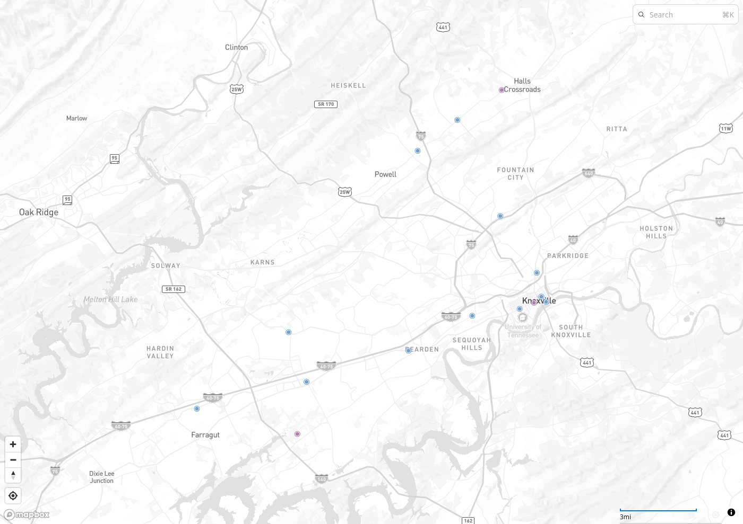
Very Hard Problem – MDVRP w/ per-vehicle weights on a real road network

Slide 13
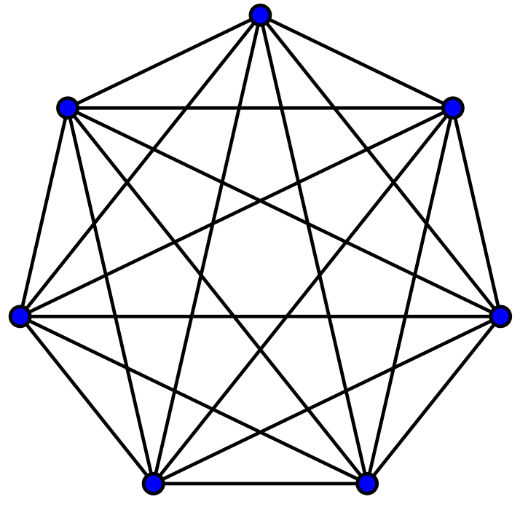
Very Hard Problem – MDVRP w/ per-vehicle weights on a real road network
Given our set of customers/depots U ⊆ V, form the complete graph K|U| where:
  Each vertex in K|U| represents a vertex in U
  Each edge in K|U| represents the shortest path between two vertices in U (solvable via A*)
Solve the mixed-integer LP for K|U|

Slide 14
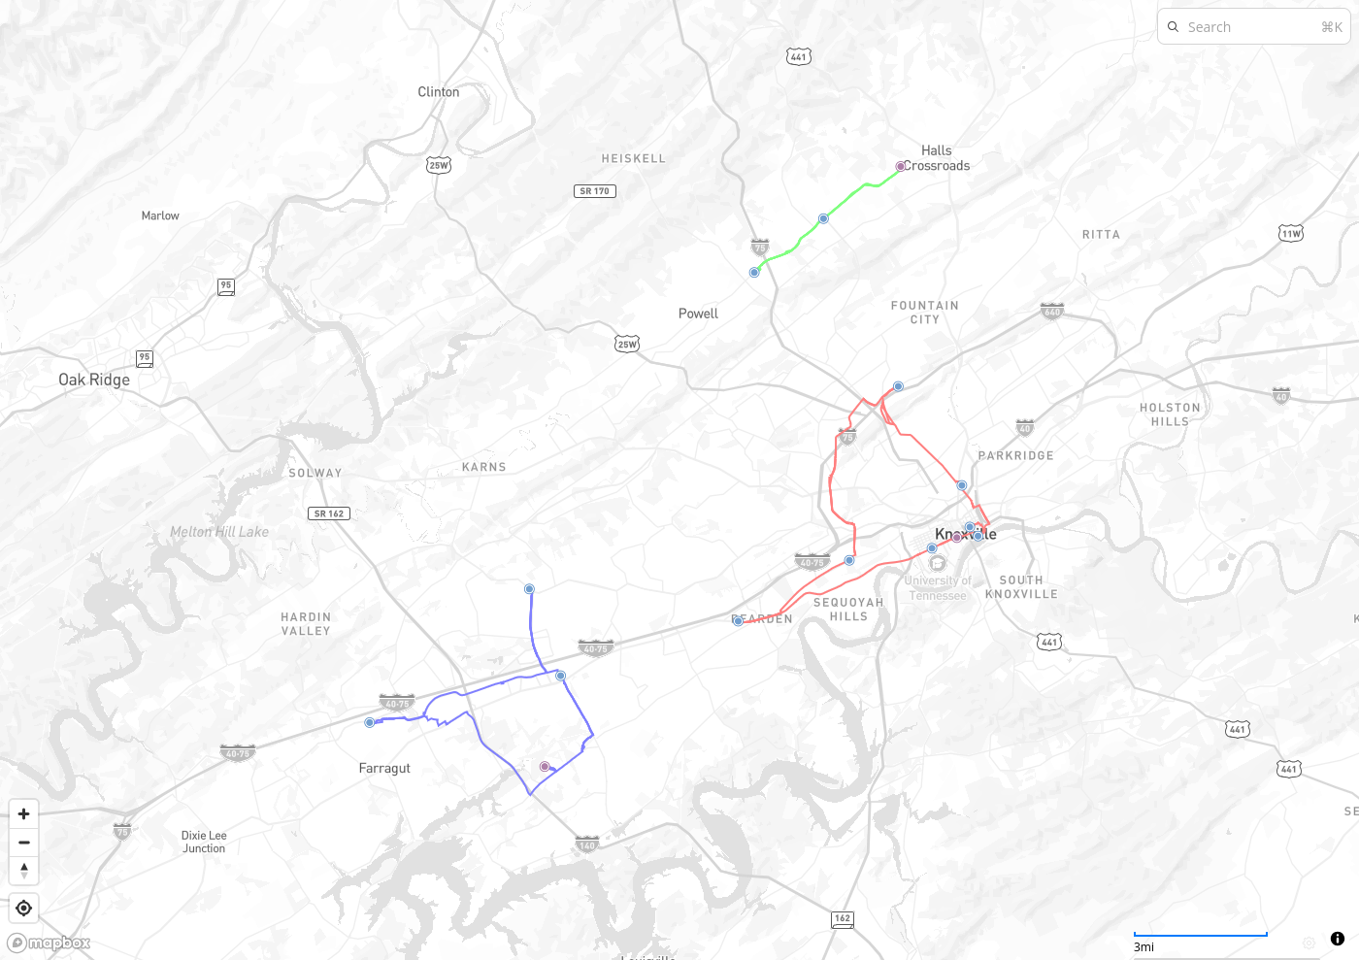
Very Hard Problem – MDVRP w/ per-vehicle weights on a real road network

Slide 15
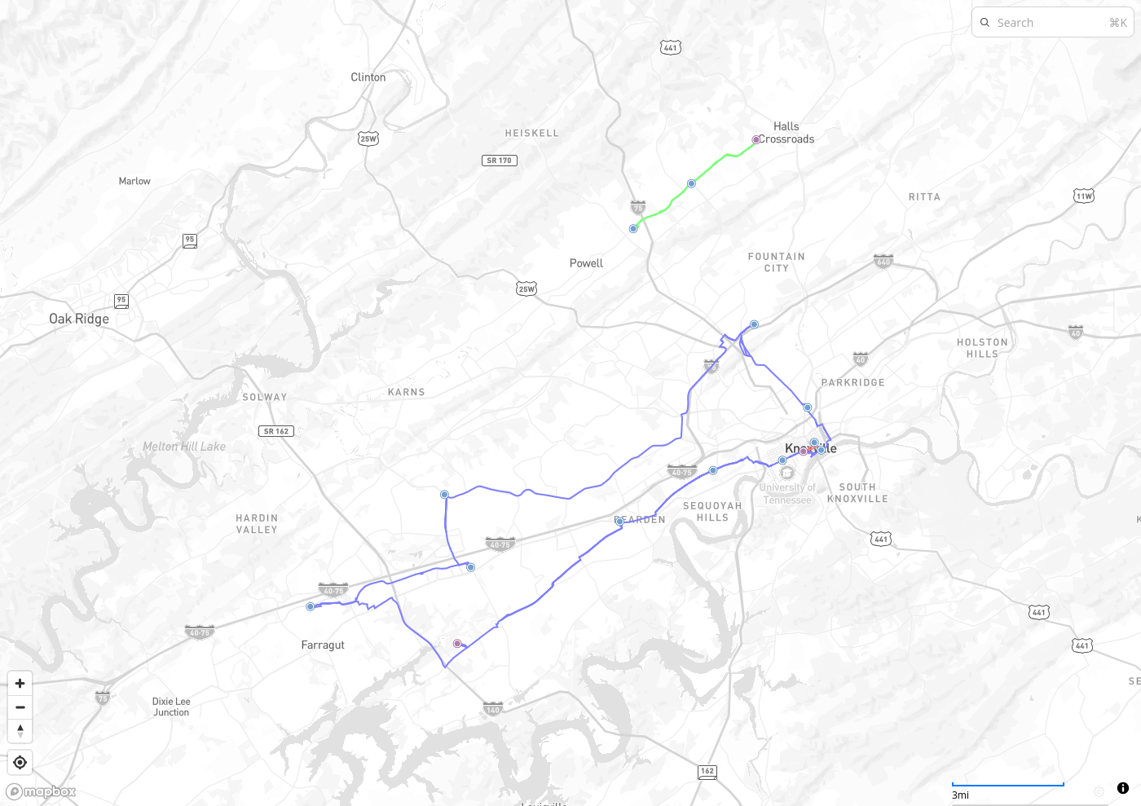
Very Hard Problem – MDVRP w/ per-vehicle weights on a real road network
(After making red driver
50% less efficient than
other drivers)

Slide 16
Practical Considerations
Linear differences in weights leads to one vehicle dominating all others
  A time-constrained Lagrangean relaxation may solve this
  Alternatively, we can adjust the depot constraints if we don’t care whether or not all vehicles visit at least one customer
On such a large graph, even A* is slow
  The subproblems are embarrassingly parallel – take advantage of this
  Great-circle distance is consistent, but expensive to calculate – use simple heuristics!
  “Real-world” routing software employs lots of geospatial optimizations (e.g. contraction hierarchies) to get fast results with A* [3]

Slide 17
Practical Considerations
This is still O(2^{n}) time/space complexity
  Some recent probabilistic/heuristic-based approximations used for certain cases of the VRP:
    Swarm intelligence and genetic algorithms [4]
    Simulated annealing [5]
    Adaptive Large-Neighborhood Search [6]

Slide 18
References
P. Toth and D. Vigo, The Vehicle Routing Problem, in SIAM Monographs on Discrete Mathematics and Applications, Philadelphia, PA, USA: Society for Industrial and Applied Mathematics, 2002, doi:10.1137/1.9780898718515.
Various OpenStreetMap contributors. “tennessee-latest.osm.pbf.” Distributed by Geofabrik GmbH Karlsruhe. https://download.geofabrik.de/north-america/us/tennessee.html (accessed Apr 23, 2026).
GraphHopper GmbH, "GraphHopper," ver. 11.0, Open Source, Oct 2025, [Online]. Available: https://github.com/graphhopper/graphhopper/releases/tag/11.0.
Wang, Chun Bo, and Jun Guo, “A New Hybrid Algorithm Based on Artificial Fish Swarm Algorithm and Genetic Algorithm for VRP.” Applied Mechanics and Materials, vol. 325–326, pp. 1722–25, Jun 2013, doi:10.4028/www.scientific.net/AMM.325-326.1722.
Lin, Shih-Wei, et al,“Solving the Truck and Trailer Routing Problem Based on a Simulated Annealing Heuristic.” Computers & Operations Research, vol. 36, no. 5, pp. 1683–92, May 2009, doi:10.1016/j.cor.2008.04.005.
R. Stefan, and D. Pisinger, “A Unified Heuristic for a Large Class of Vehicle Routing Problems with Backhauls.” European Journal of Operational Research, vol. 171, no. 3, pp. 750–75, Jun 2006, doi:10.1016/j.ejor.2004.09.004.

Slide 19
Questions/Comments?
Code: https://github.com/TheHashTableSlasher/ece8920_final

