Slide 1
CSS Grid Layouts
KMS LH FE conference, November 15, 2021

Slide 2
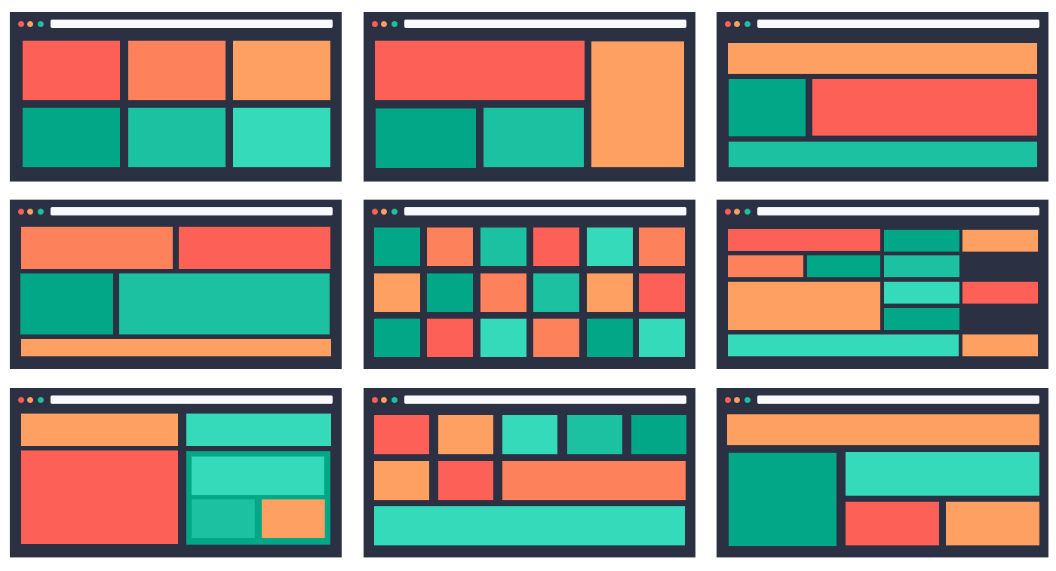
Introduction to CSS Grid
+ Introduction to CSS Grid
- Browser support
- Grid Container and Gaps
- Grid template colums and rows
- Grid rows height
- Alignments
- Grid column and rows, lines concept
- References
CSS Grid Layout (aka “Grid” or “CSS Grid”), is a two-dimensional grid-based layout system

Slide 3
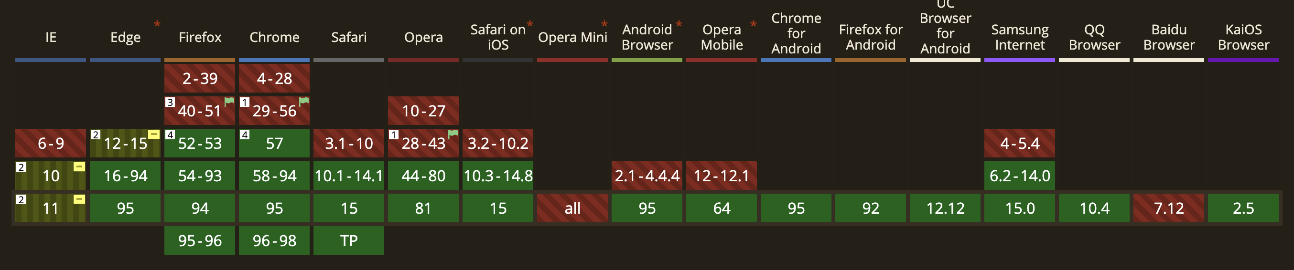
Browser support
- Introduction to CSS Grid
+ Browser support
- Grid Container and Gaps
- Grid template colums and rows
- Grid rows height
- Alignments
- Grid column and rows, lines concept
- References

Slide 4
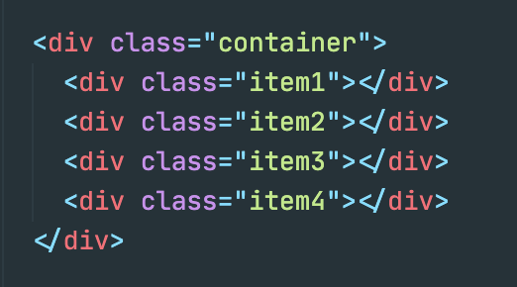
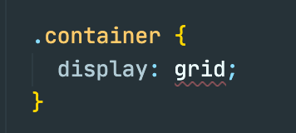

Grid Container and Gaps
- Introduction to CSS Grid
- Browser support
+ Grid Container and Gaps
- Grid template colums and rows
- Grid rows height
- Alignments
- Grid column and rows, lines concept
- References
Grid container represents element that holds grid items on which display: grid or inline-grid is applied
Grid gaps used to change spaces between grid items:

Slide 5
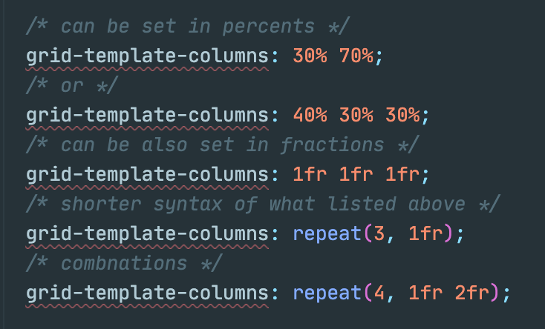
Grid Template Columns & Rows
- Introduction to CSS Grid
- Browser support
- Grid Container and Gaps
+ Grid template colums and rows
- Grid rows height
- Alignments
- Grid column and rows, lines concept
- References
Defines columns and rows of the grid
Can be defined in pixels, percents or fractions

Slide 6
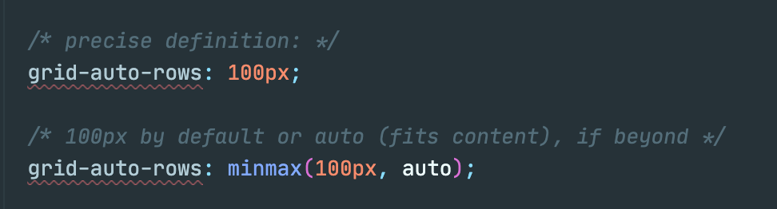
Grid rows height
- Introduction to CSS Grid
- Browser support
- Grid Container and Gaps
- Grid template colums and rows
+ Grid rows height
- Alignments
- Grid column and rows, lines concept
- References
Grid rows height can be specified using grid-auto-rows. Can be set precisely, like grid-auto-rows: 100px or to fit the content, like: minmax(50px, auto)

Slide 7
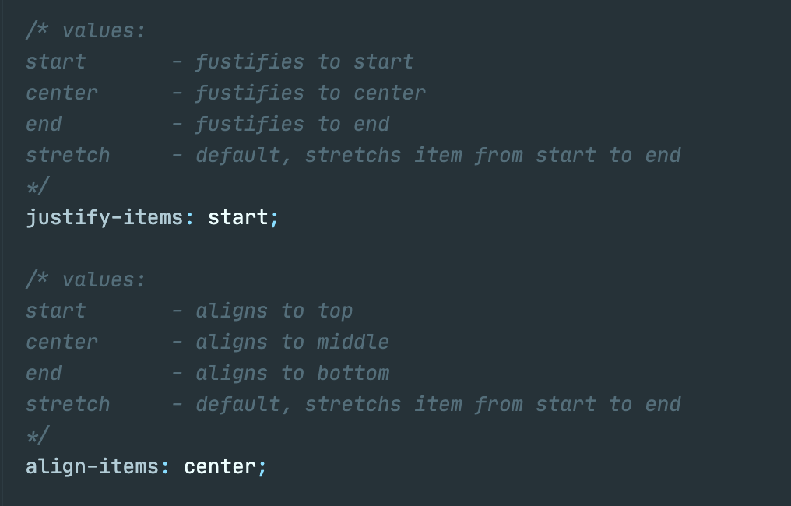
Alignments
- Introduction to CSS Grid
- Browser support
- Grid Container and Gaps
- Grid template colums and rows
- Grid rows height
+ Alignments
- Grid column and rows, lines concept
- References
Can be set for all items on grid container level:

Slide 8
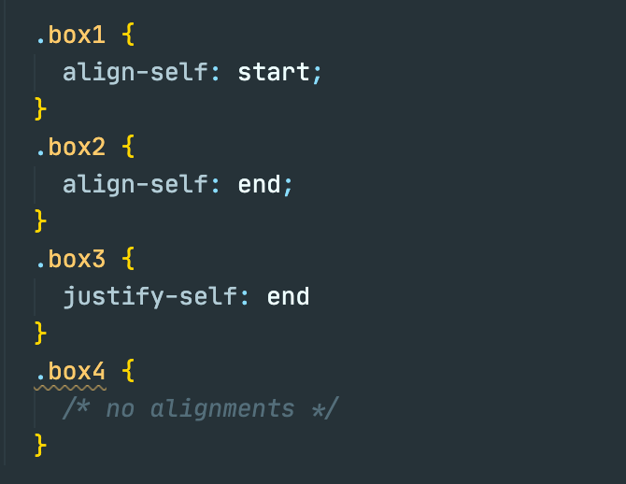
Alignments
- Introduction to CSS Grid
- Browser support
- Grid Container and Gaps
- Grid template colums and rows
- Grid rows height
+ Alignments
- Grid column and rows, lines concept
- References
Or individually for each item:

Slide 9
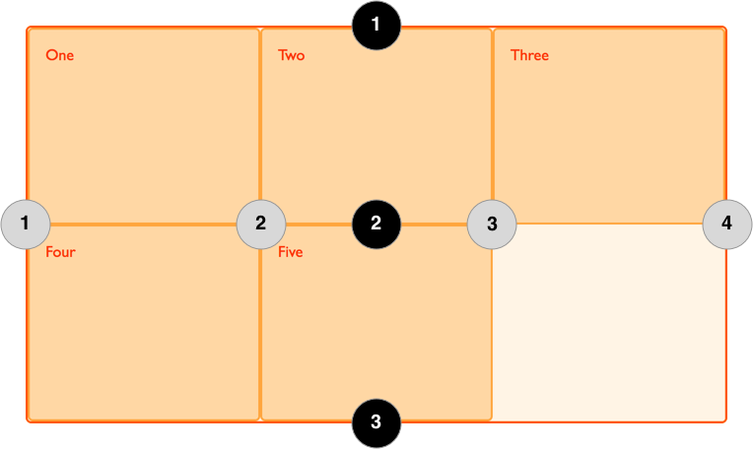
Grid columns and rows, lines concept
- Introduction to CSS Grid
- Browser support
- Grid Container and Gaps
- Grid template colums and rows
- Grid rows height
- Alignments
+ Grid column and rows, lines concept
- References
Grid line represents the dividing lines that make up the structure of the grid:
They can be either vertical (column grid lines) or horizontal (row grid lines)

Slide 10
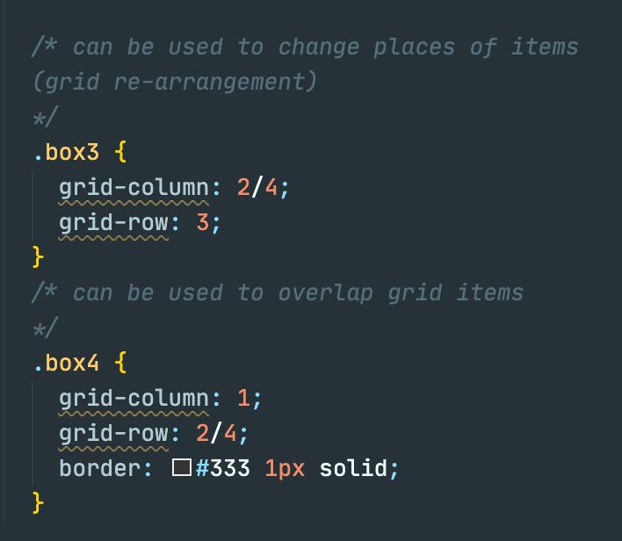
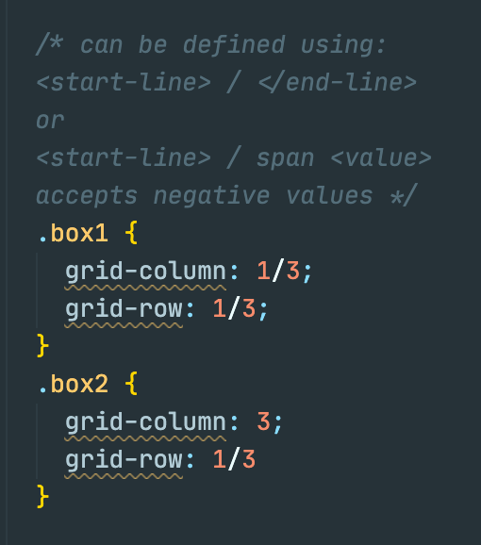
Grid columns and rows, lines concept
- Introduction to CSS Grid
- Browser support
- Grid Container and Gaps
- Grid template colums and rows
- Grid rows height
- Alignments
+ Grid column and rows, lines concept
- References
Grid columns and rows - determine a grid item’s location within the grid by referring to specific grid lines:

Slide 11
References
- Introduction to CSS Grid
- Browser support
- Grid Container and Gaps
- Grid template colums and rows
- Grid rows height
- Alignments
- Grid column and rows, lines concept
+ References
A complete guide to Grid (https://css-tricks.com/snippets/css/complete-guide-grid/)
Основные понятия Grid Layout на русском (https://developer.mozilla.org/ru/docs/Web/CSS/CSS_Grid_Layout/Basic_Concepts_of_Grid_Layout)
Grid Garden (https://cssgridgarden.com/#ru) – обучение позиционированию элементов грида играя в игру
Project source code (https://github.com/TheHelmsman/css-grid-layout)

