Slide 1
The best strategy to win pubg game
By
Viveksinh Solanki

Slide 2
?
What is the pubg game?
Motivation?
Who is my target audience?

Slide 3
Data
Downloaded from Kaggle
Includes 4.4m players’ post game stats
Train set size = 628Mb
Rows = ~4.4m, columns = 29
Target variable = winPlacePerc
developer.pubg.com

Slide 4
Tools & techniques
Pandas
Numpy
Matplotlib, seaborn
Jupyter Notebook
Pearson correlation coefficient

Slide 5
strategies

Slide 6
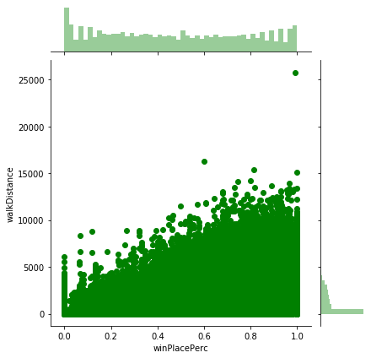
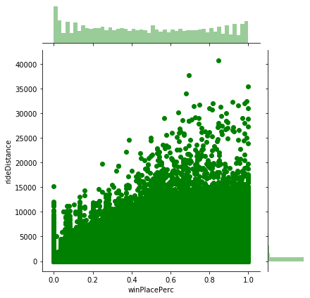
Should I walk more or drive more(use vehicle to move around)?

Slide 7

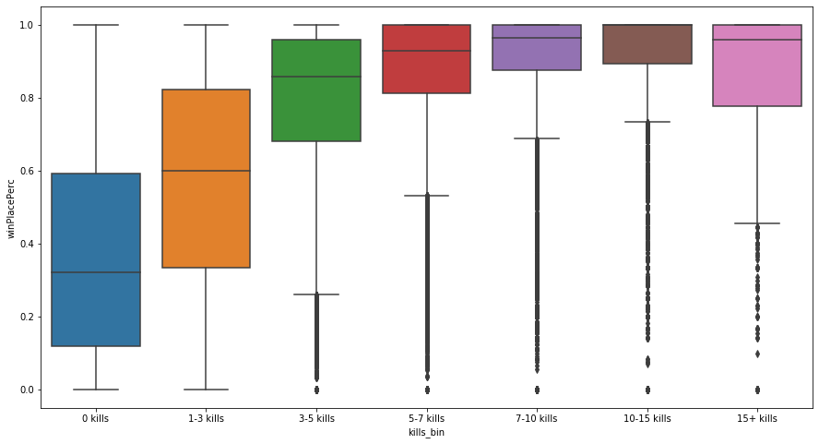

More kills mean more wins?

Slide 8
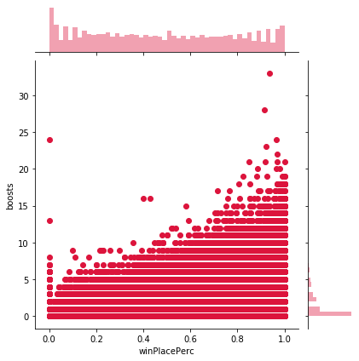
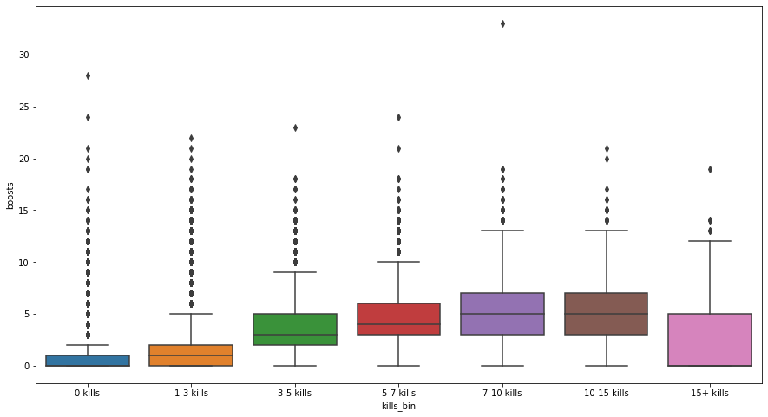
Do boosts help to win the game?

Slide 9
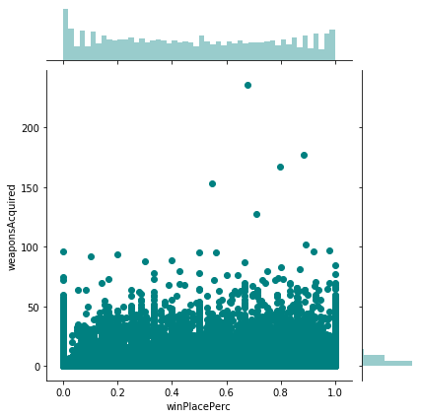
Do more weapons imply higher chances of winning?

Slide 10
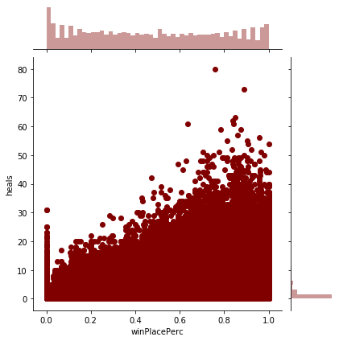
My pubg friend told me that, "Heals(Health packs) can be game changer!"

Slide 11
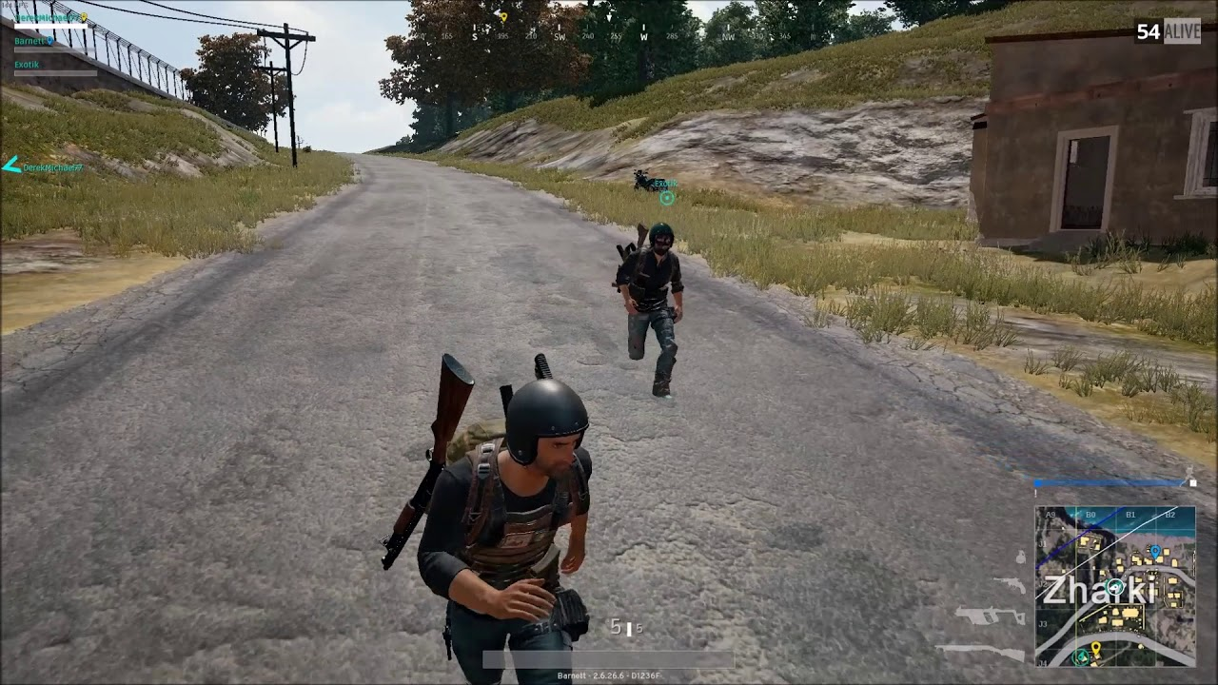
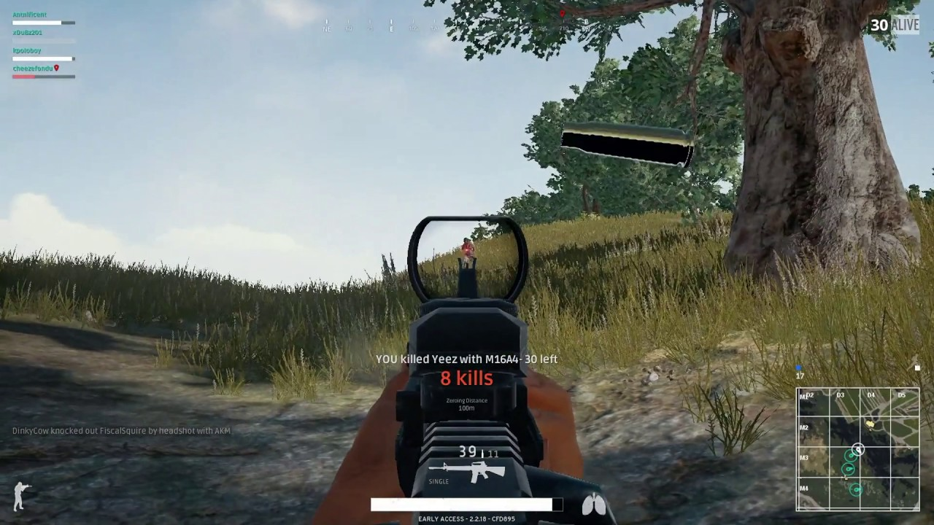
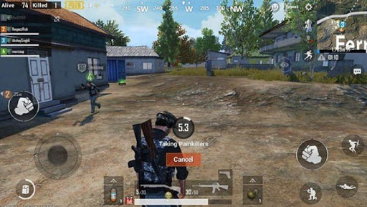
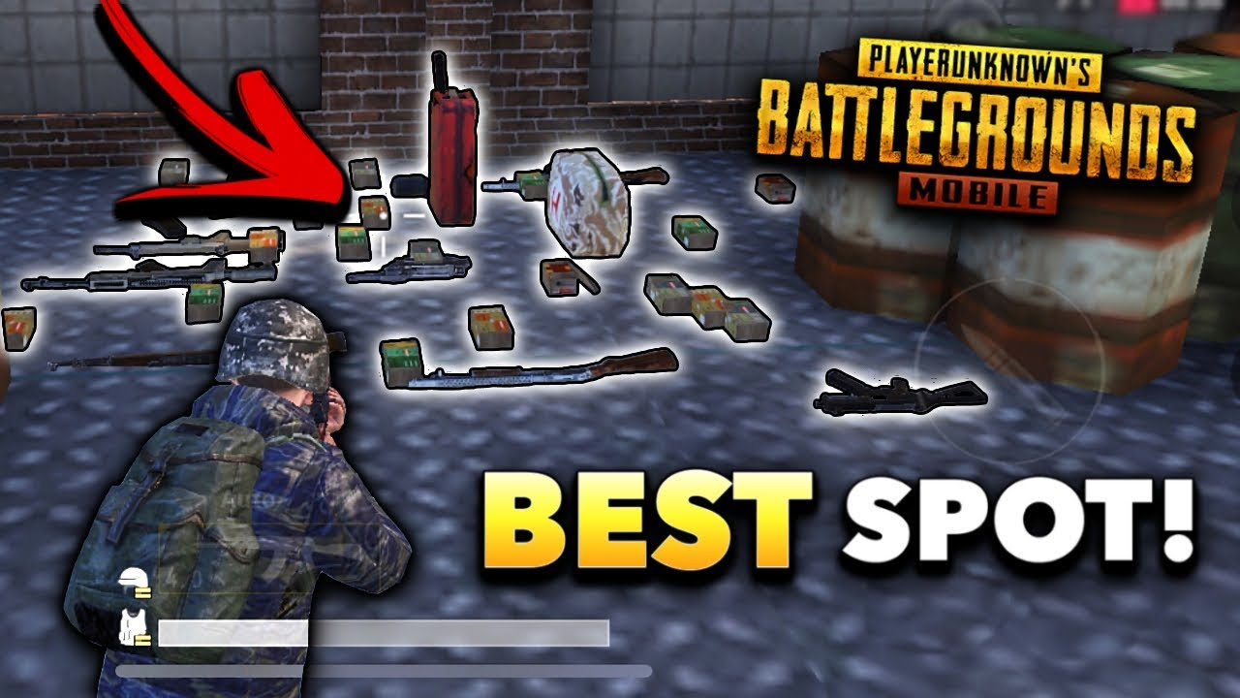
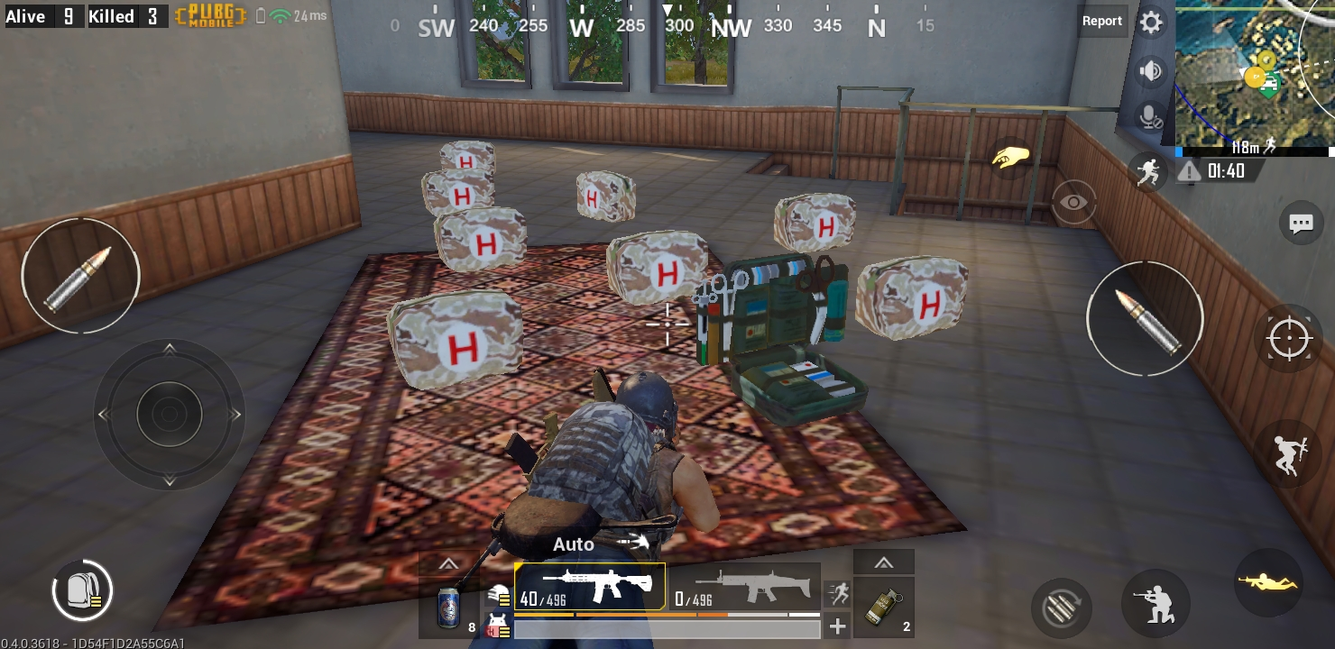
Actions to take
1.
The Driving Dead – Walk more
Shoot at sight – Get as many kills as possible
Keep yourself ‘boosted’!
More weapons don’t help!
Healer Healer, Chicken Dinner!
2.
3.
4.
5.

Slide 12
To dO
developer.pubg.com – to get more data
dropLocation, time frequency of changing locations etc..
More EDA
based on game modes
Find cheaters/hackers
Feature engineering
Train a model
Evaluation
Make players pro in pubg game!

Slide 13
Happy Gaming!

