Slide 1
Cheating’Quine
Viveksinh Solanki
CWID : 10441787
Stevens Institute Of Technology
12/08/2018

Slide 2
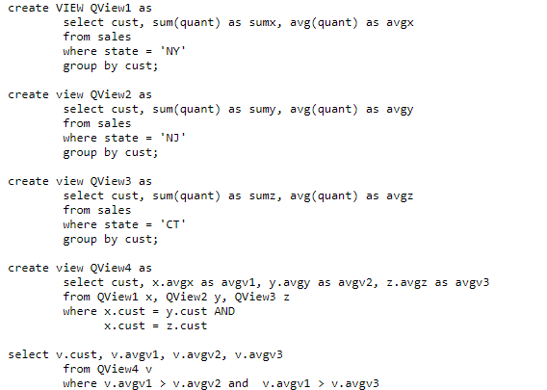
Problem
Q: Find for each customer the average sale in “NY”, the average sale in “CT” and the average sale in “NJ”, if New York’s average is greater than the other two
Length of query
Redundancy
Some basic queries are difficult to express in SQL
i.e. repeated grouping and aggregation over the same groups
Additional joins needed or to construct additional subqueries
Hence, those queries hard to maintain

Slide 3
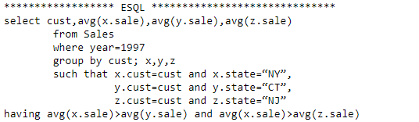
Project?
Takes a query as input in specific format and generates the JAVA program, which interacts with database system
Program can evaluate any query, which is represented in Φ operation, on top of any standard database system faster than their standard counterpart
Φ = a new relational algebra operation that concisely represents several levels of aggregation
The only DB operation - scanning (or indexed scanning)
Program is written in JAVA, which is widely available and platform independent framework. Scalable and Efficient

Slide 4
Demo checklist
High level architecture
Input format
Technologies used
Technical limitations
Demo of program

Slide 5
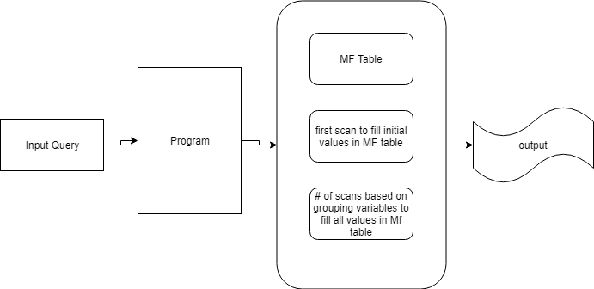
Architecture
Generated Program
MF-Table -> This table has as columns of the grouping attributes and all the aggregates mentioned in the query

Slide 6
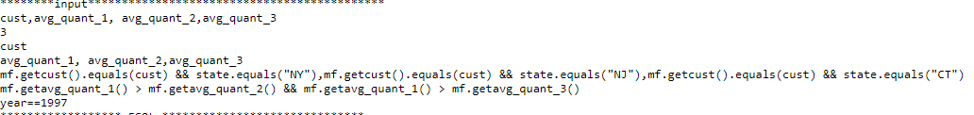
Input Format
Selection variables (comma separated)
no of grouping variables(positive number)
grouping attributes(comma separated)
aggregate functions(comma separated)
Conditions in suchthat clause(in JAVA notation and comma separated)
Conditions in having clause(in JAVA notation and comma separated)
Conditions in where clause(in JAVA notation and comma separated)

Slide 7
Technologies
Database - PostgreSQL
Framework – JAVA
Library for database in JAVA - postgresql-42.2.5.jar
Tools - Eclipse

Slide 8
Technical limitations
Can only run for this schema :
sales(cust,prod,day,month,year,state,quant)
Can only take conditions like “such that, having and where” in JAVA notation/format
No error checking for presence of table/columns
Number of scans = # of grouping variables + 1 (At least 1)
Cannot handle conditions like +(addition),-(subtraction),*(multiplication) in selection statement

Slide 9
Demo

Slide 10
Discussion
SQL syntax is redundant for repeated grouping and aggregation over the same groups
Can be represented succinctly to optimize performance
Project :
Scalability
Parallelism

Slide 11
Future Work
Can scale it for different schemas
Can implement efficient parser to parse suchthat, where, having conditions
Even further >
“can implement super parser to parse standard SQL query in Φ operation”

Slide 12
Q&A

