Slide 1
Predicting Bank Loan Status

Slide 2
Final Project Presentation
FE 582-A - Foundation of Financial Data Science
Under the guidance of Prof. Dragos Bozdog
Presented By:
Ronald Fernandes
Vivek Solanki
Yatri Kalathia

Slide 3
Introduction
Financial institutions incur significant losses due to the default of vehicle loans. This has led to the tightening up of vehicle loan underwriting and increased vehicle loan rejection rates.
Doing so will ensure that clients capable of repayment are not rejected and important determinants can be identified which can be used for minimising the default rates.
As part of this project, we aim to identify the probable parameters of loan default by applying various data analysis methods and machine learning models. Our model will be able to predict whether the customer will pay off the loan or not.

Slide 4
Research Questions
Whether the customer will default on a loan given their financial details?
Which are the factors that might lead to a loan default?
Which customers are not capable of repayment of loans?

Slide 5
Data Source
We are using the data provided by Kaggle.
The files provided include: 1) train.csv that contains the training data with details on loan as described. 2) test.csv will be used to test our models
Some of the relevant information regarding the loan and loanee are provided in the datasets as follows:
Customer Information (Customer ID, Annual Income, Home ownership etc.)
Loan Information (Loan ID, Current Loan amount and terms etc.)
Bureau data & history (Credit score, number of active accounts, the status of other loans, credit history, bankruptcies etc.)

Slide 6
Data Cleaning
Basic Cleaning Methods:
Removing NA’s: Data contain NA strings like “”(blanks), NA, n/a etc.
Deleting Month’s Delinquent as it contained more than 50% NAs
Deleting duplicate records by “Loan. ID”
Credit Score:
Some credit scores were were between the range 5000-8000 which is not possible so we divided it by a factor of 10 to get it in range

Slide 7
Outlier Detection
Numerical Columns:
Removed visible extreme values e.g 99999999 in many records in Current Loan Amount column
Implemented an outlier range as:
25% - 1.5*IQR to 75% + 1.5*IQR.
Values 1.5 times interquartile range below 25 percentile and 1.5 times interquartile range above 75 percentile were considered outliers
Categorical Columns:
All categorical values were balanced. They were one hot encoded.

Slide 8
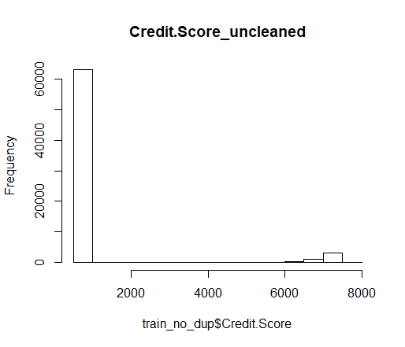
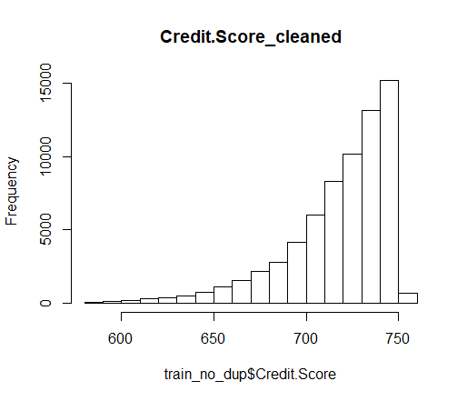
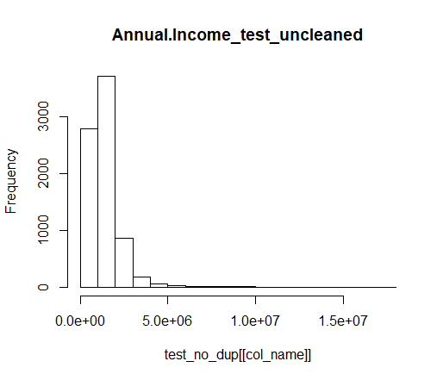
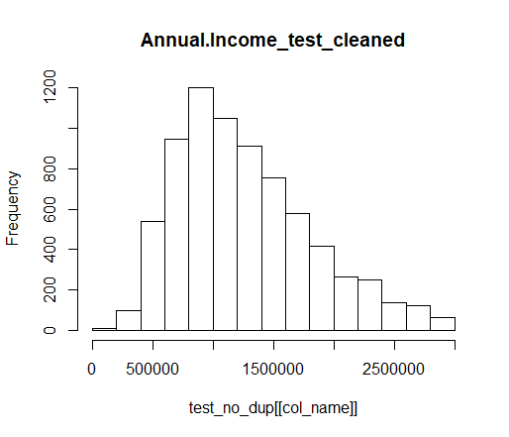
Results of Preprocessing

Slide 9
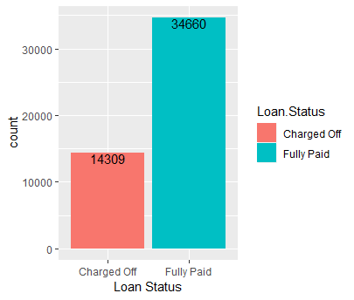
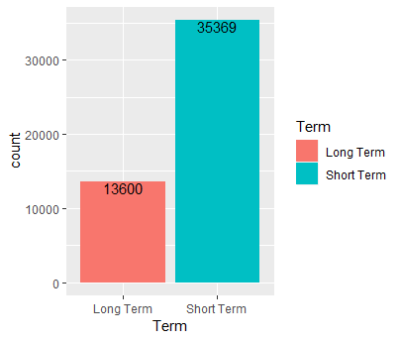
Exploratory Data Analysis

Slide 10
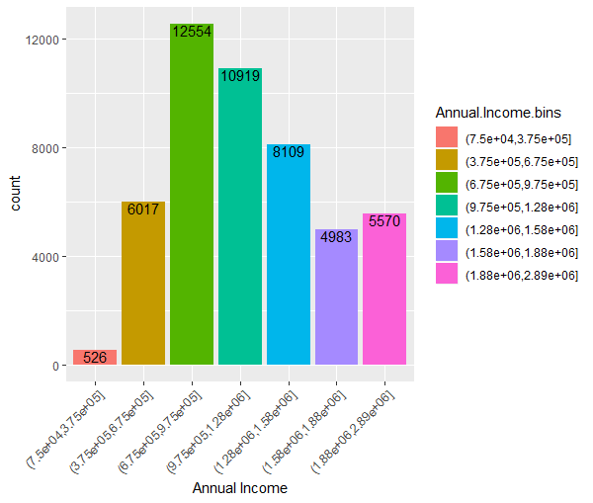
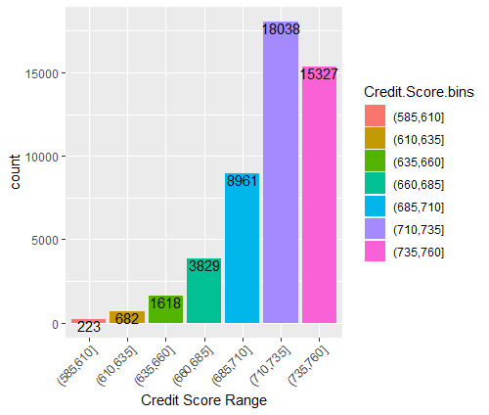
Cont..

Slide 11
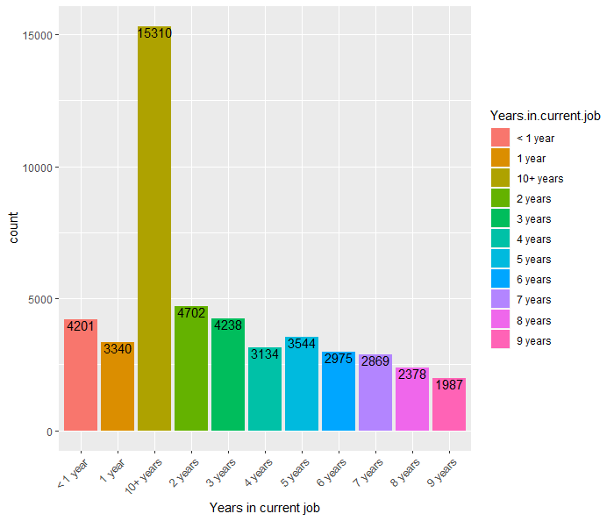
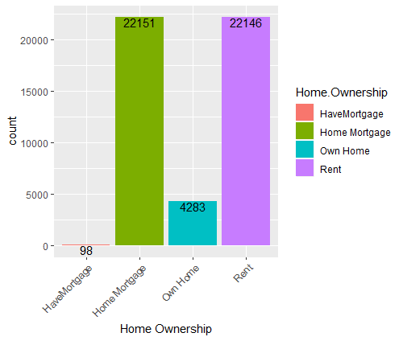
Cont..

Slide 12
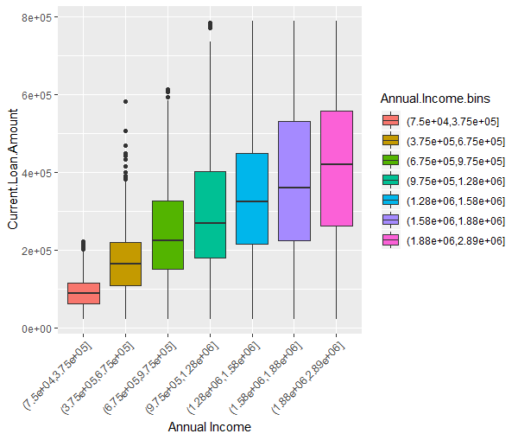
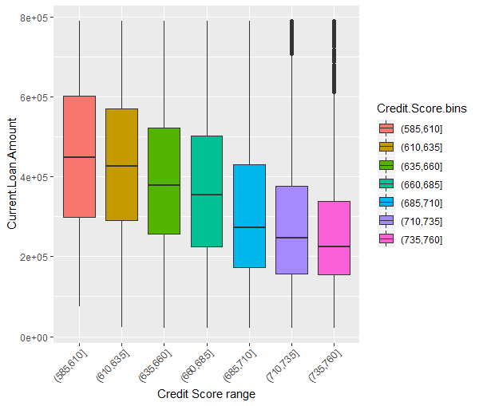
Cont..

Slide 13
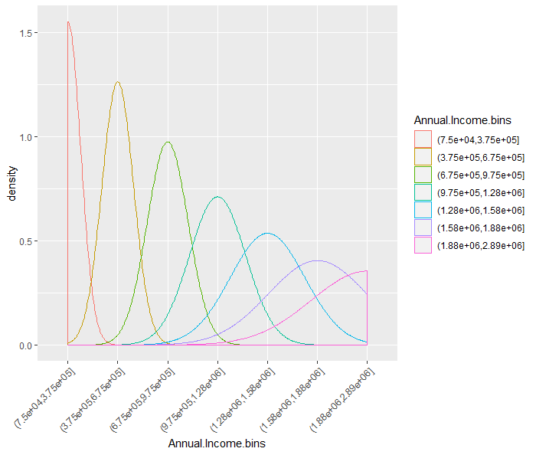
Cont..

Slide 14
Algorithms Used
The following algorithms were implemented for this problem:
Naive-Bayes Classification
k-NN Classification
Logistic Regression
Random Forest
Gradient Boosting Machine

Slide 15
Naive Bayes Classification
It is a technique based on Bayes’ Theorem with a “naive” assumption of conditional independence between every pair of features.
In simple terms, a Naive Bayes classifier assumes that the presence of a particular feature in a class is unrelated to the presence of any other feature.
Naive Bayes model is easy to build and particularly useful for very large data sets. Along with simplicity, Naive Bayes is known to perform quite decently especially when assumption of independence holds.
Due to these reasons, we implemented this model initially since it would provide us with a benchmark to compare the other models with.
When we run it against our dataset, we get an ACCURACY of 0.6674

Slide 16
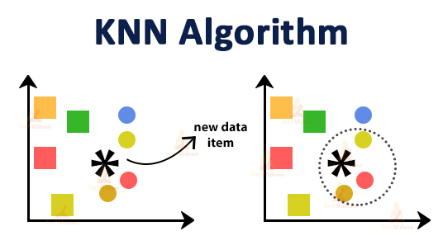
k-Nearest Neighbour
The k-Nearest Neighbor algorithm is an example of instance-based learning
where training set records are first stored.
Next, the classification of a new unclassified record is performed by comparing it to records in the training set it is most similar to.
After running this algorithm against our dataset, we found the most efficient solution to be when k was chosen to be 9
ACCURACY: 0.6561

Slide 17
Logistic Regression
Since, our dependent variable is categorical in nature, we also performed logistic regression.
For logistic regression, we first standardized our data since all the variables were not in the same units.After that, we removed highly co-linear features of our data.
We ended up considering 41 features out of 44 to train our data since 4 features were highly correlated.
Using this algorithm against our data, we could get a model with 67% of accuracy.

Slide 18
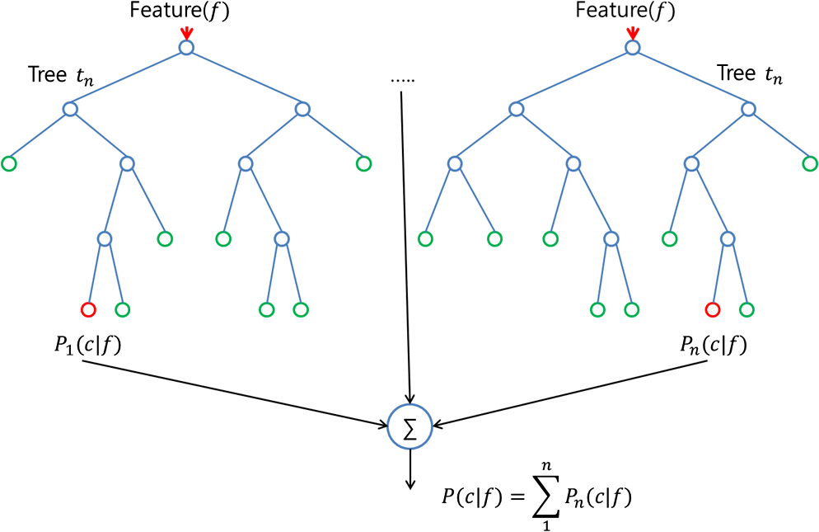
Random Forest
Decision trees tend to have high variance since they tend to overfit on training data.
The random forest builds an ensemble of
Decision Trees.
The Random Forest algorithm randomly
selects observations and features to build
several decision trees and then averages the
results.
Random Forest prevents overfitting most of the time, by creating random subsets of the features and building smaller trees using these subsets. Afterwards, it combines the subtrees

Slide 19
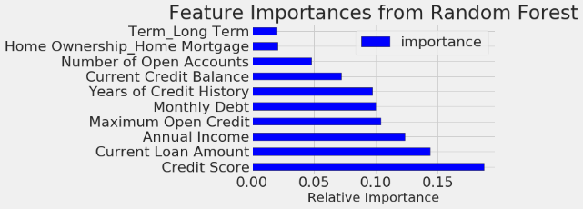
Random Forest
Here, we see the top features obtained from random forest.

Slide 20
Gradient Boosting Machine
GBM is an efficient and powerful algorithm for classification and regression problems.
GBM is unique compared to other decision tree algorithms because it builds models sequentially with higher weights given to those cases that were poorly predicted in previous models, thus improving accuracy incrementally instead of simply taking an average of all models like a random forest algorithm would.
By reducing the error iteratively to produce what will become the final model.
ACCURACY: 0.7093

Slide 21
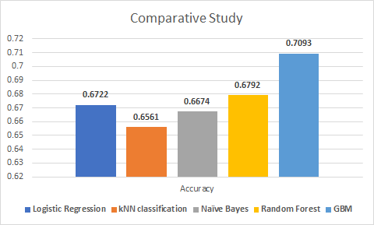
Conclusion

