Slide 1
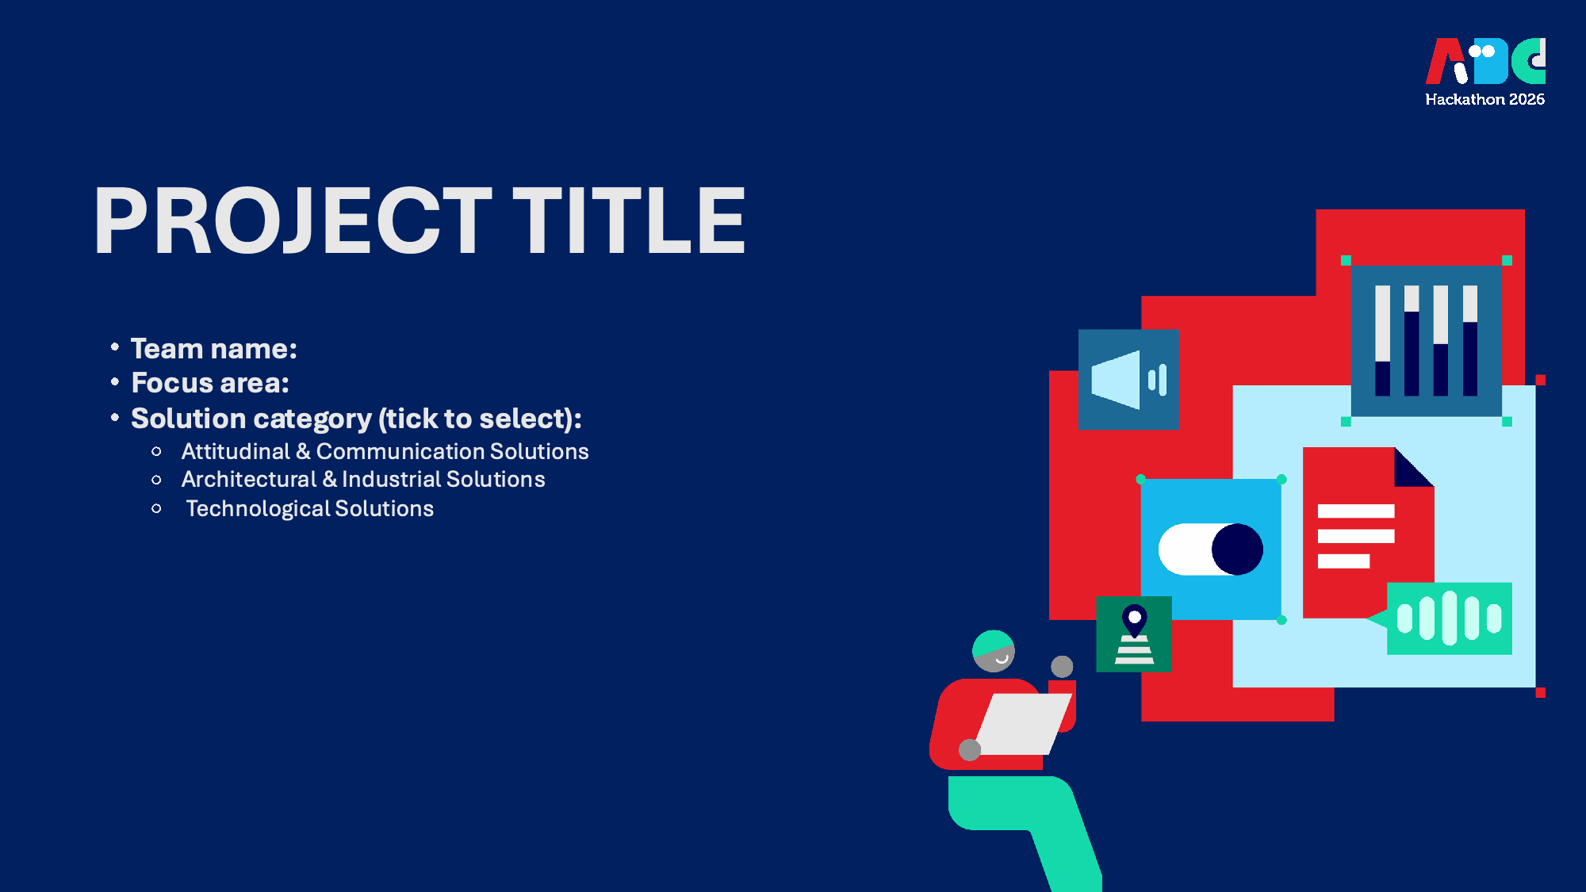



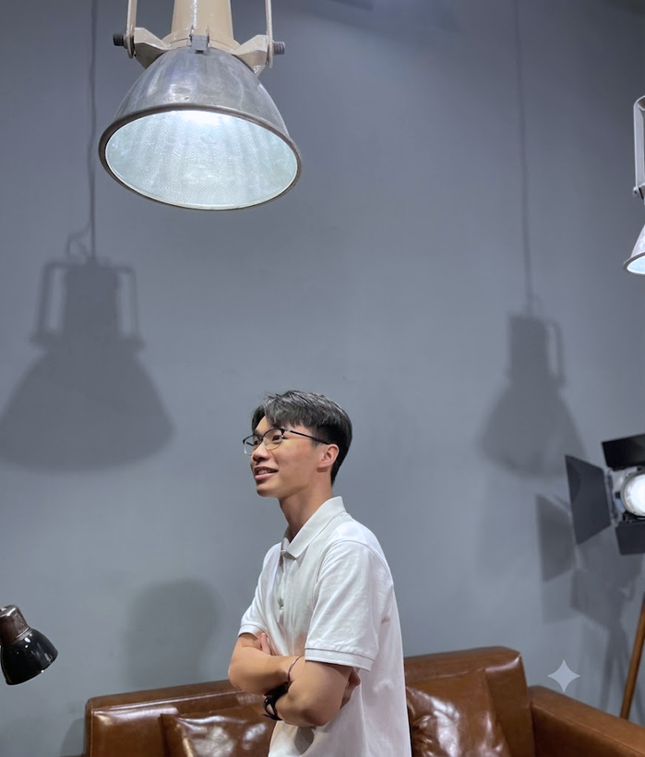
ALTONOMY
Alternative Access. Full Autonomy.
Digital work opens the gate but inaccessible systems gatekeep autonomy
Focus area: Employment and digital accessibility
Solution category: Technological Solutions
L!T-a-Byte

Slide 2
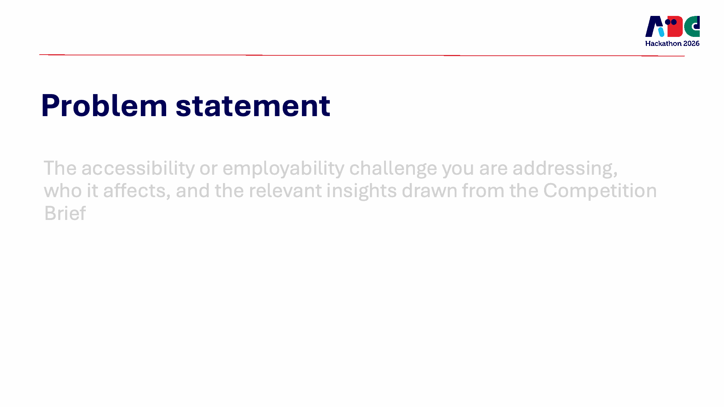
Blind or low-vision new hires need to familiarize themselves with internal systems independently during probation, but existing interfaces and training provide insufficient accessible context for their screen-reading tools
57.5%
70.6%
Screen readers encountered required workplace software that was inaccessible
(McDonnall et al., 2026)
They relied on a sighted coworker when blocked (McDonnall et al., 2026).
HOW MIGHT WE
How might we help blind or low-vision new hires learn internal-system tasks through company training materials, so they can demonstrate independent learning during probation?
Notes:
Evidence supplied by the project team: McDonnall et al. (2025/2026), Access Technology in the Workplace Study. Percentages should be checked against the final reference list before submission.

Slide 3
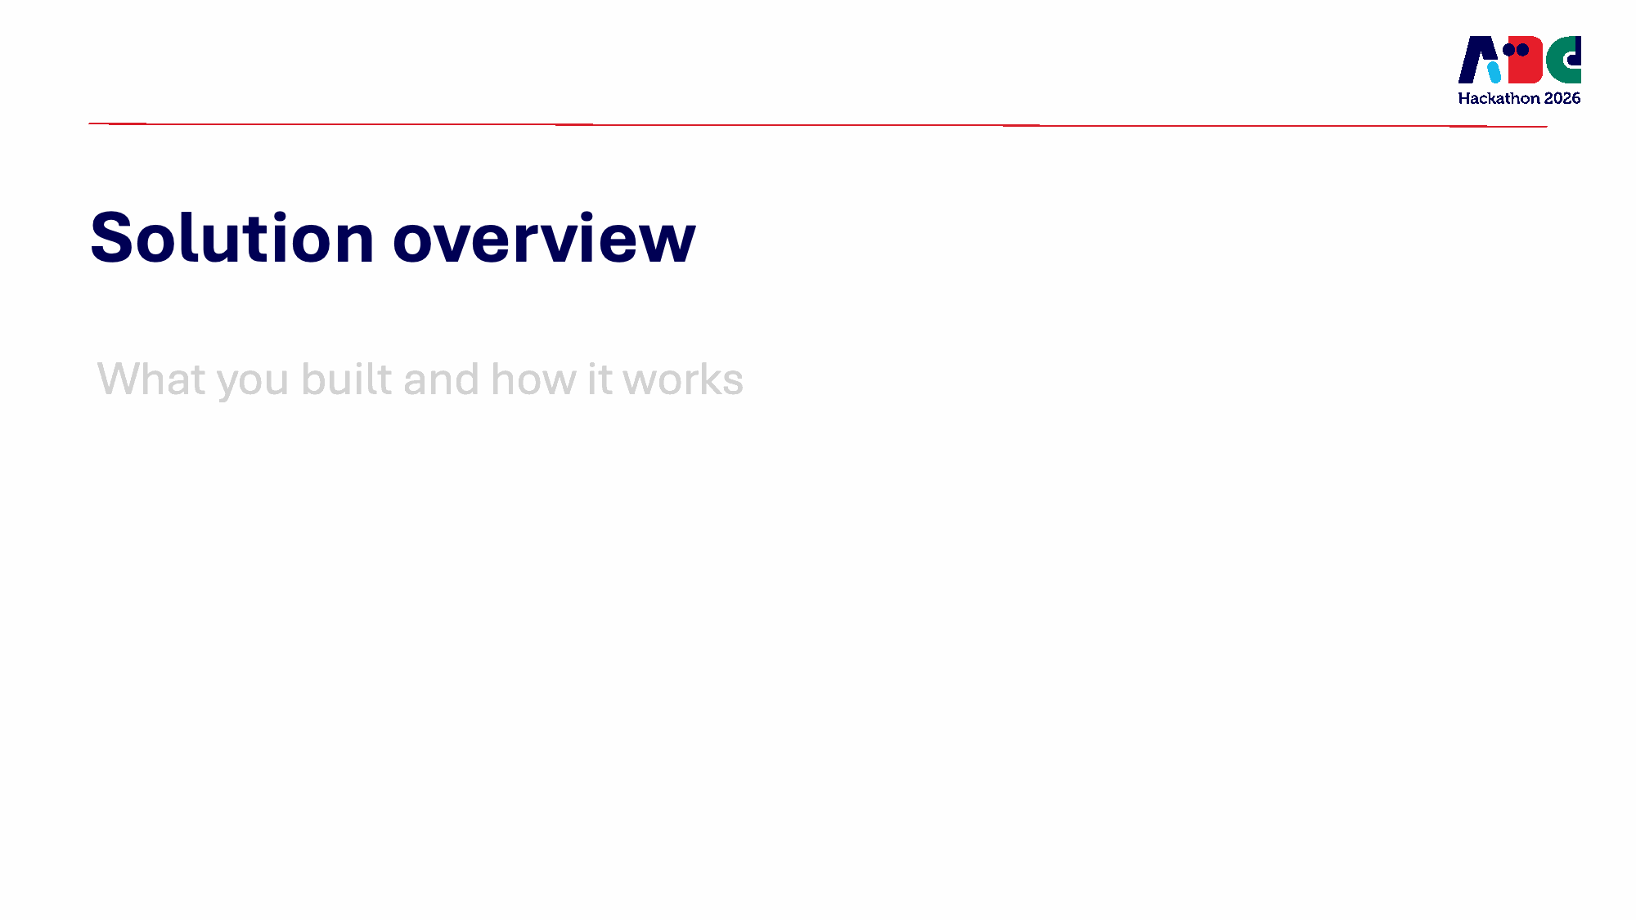
ALTONOMY
  An AI-powered app that helps blind or low-vision employees learn unfamiliar internal systems through company-provided training materials
  It adds contextual guidance while allowing employees to control and complete tasks themselves.
NEED
APPROACH
  Blind or low-vision new hires need to learn internal systems independently during probation.
  Conventional training often relies on visual cues that screen readers cannot interpret.
  Dependence on coworkers limits opportunities to demonstrate autonomy and capability.
  The company uploads its existing training materials to the app.
  AI converts them into accessible, contextual, step-by-step guidance.
  The app interprets the live interface and connects each instruction to the relevant on-screen element.
  Users navigate, verify and complete each action themselves.
For visual - impaired employees
  Learn unfamiliar systems with less trial and error.
  Reduce dependence on sighted coworkers.
  Demonstrate independent learning during probation.
  Retain control over every important action.
For companies
  Accelerate accessible onboarding.
  Reduce repetitive support from coworkers and HR.
  Extend the usability of existing systems without immediate replacement.
Current alternatives
  Screen readers: Read accessible labels and text but cannot reliably interpret unlabelled or visually dependent elements.
  Coworker assistance: Resolves immediate blockers but creates dependence and interrupts both employees’ work.
Point of difference of ALTONOMY
  Faster self-learning during onboarding
Reducing manual exploration with a screen reader during probation
  Support beyond screen-reader limits
Interprets and explains interface elements that current screen readers cannot identify or access
BENEFITS
COMPETITION

Slide 4
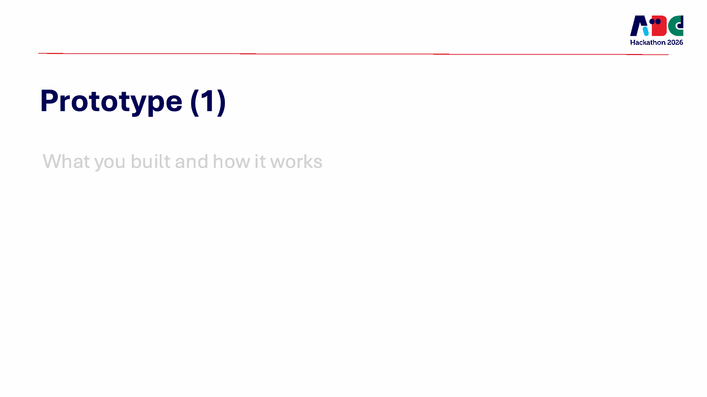
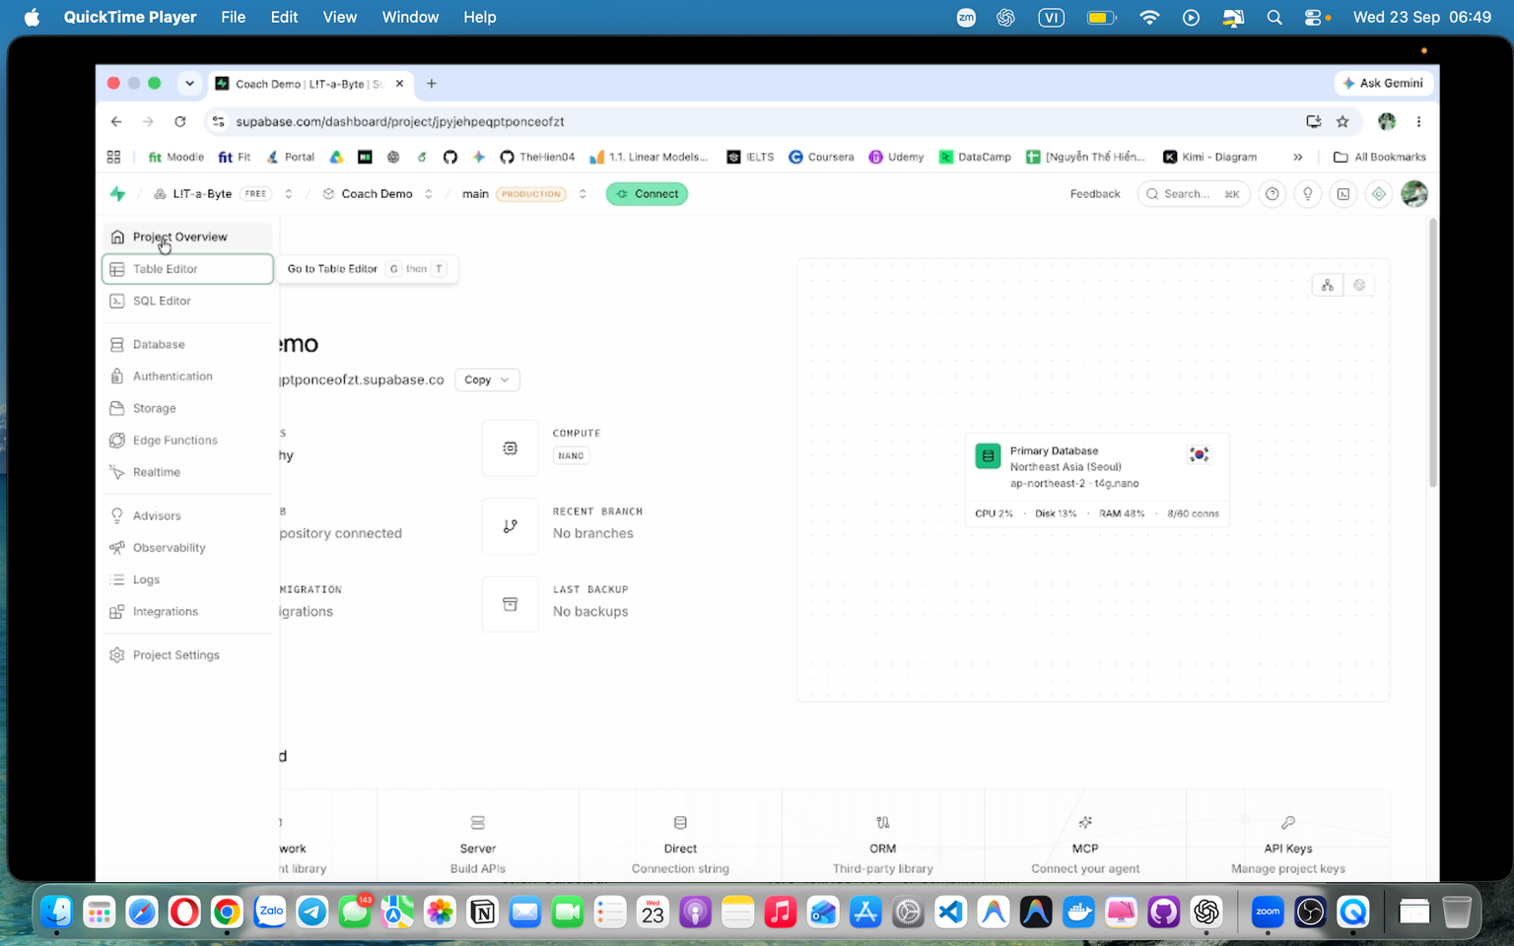
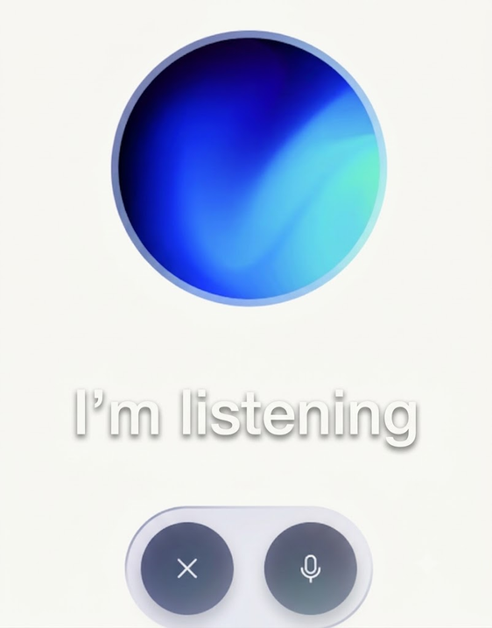
END-TO-END LEARNING FLOW

Slide 5
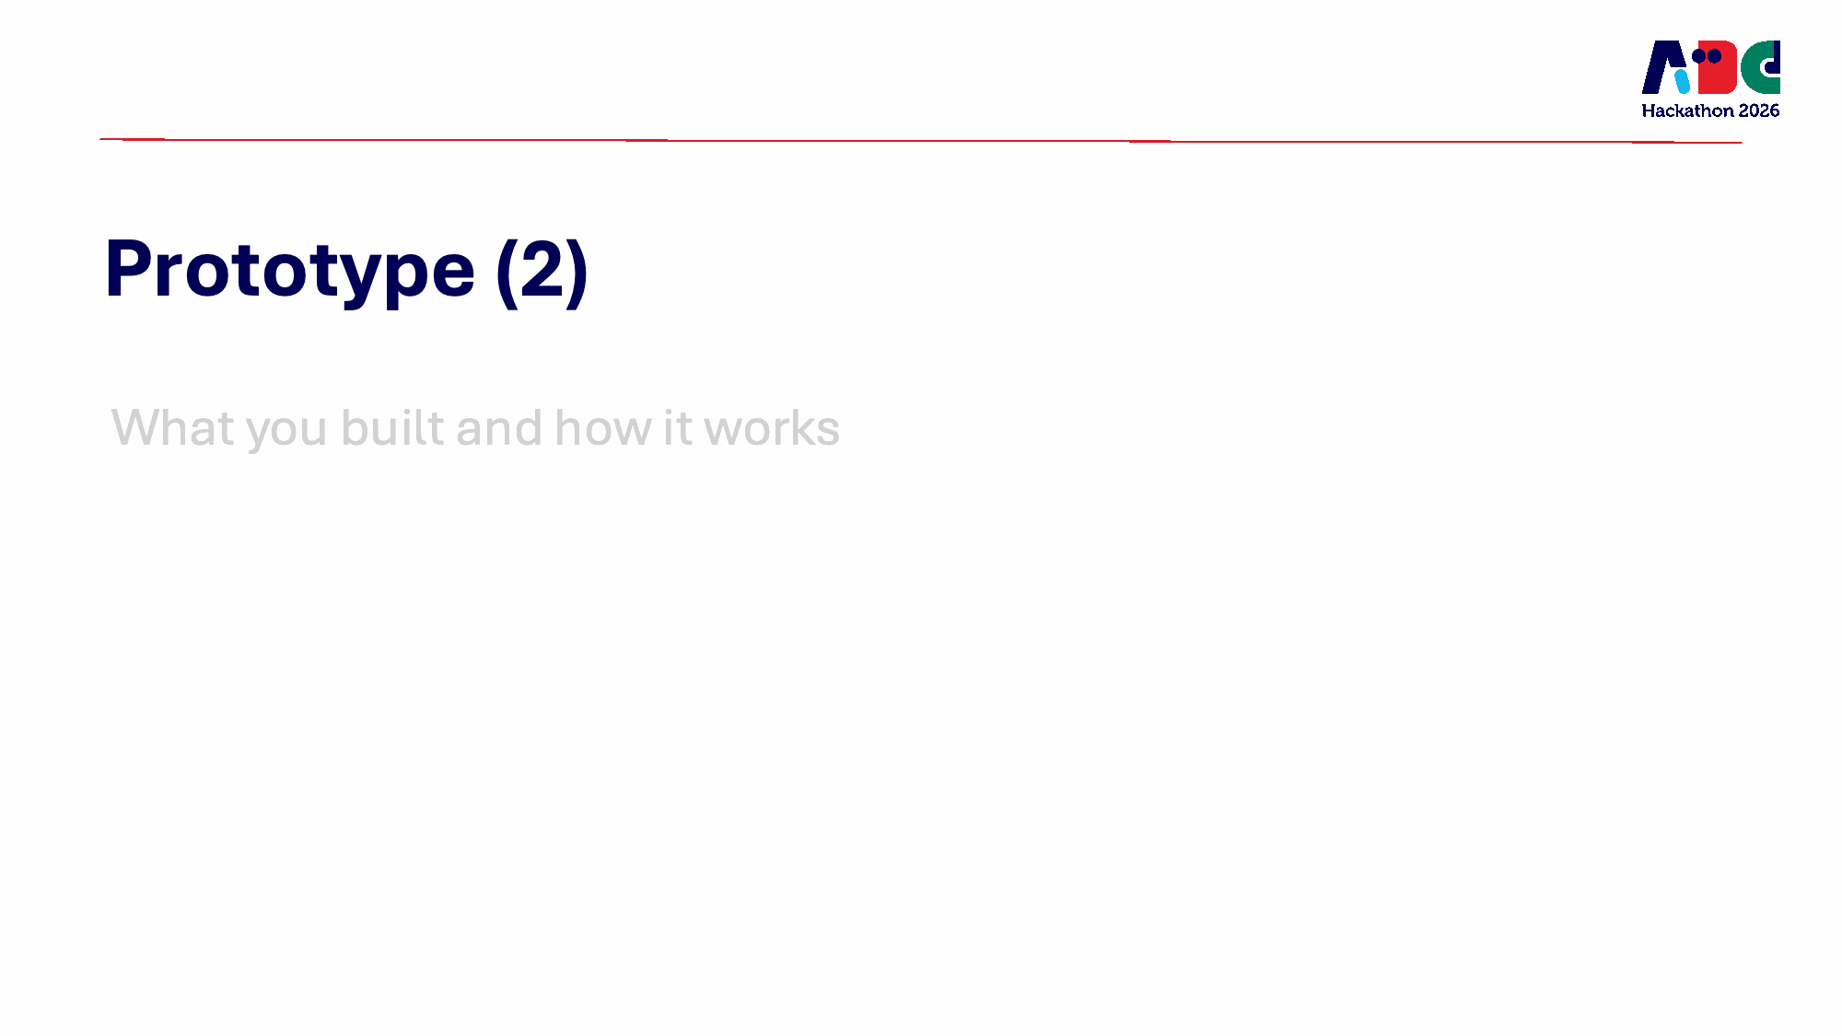




GUIDANCE-IN-CONTEXT
Screen readers provide access to interfaces. Our AI provides guidance through workflows.
Screen Readers: Explore on Your Own
Altonomy: Learning with guidance

Slide 6
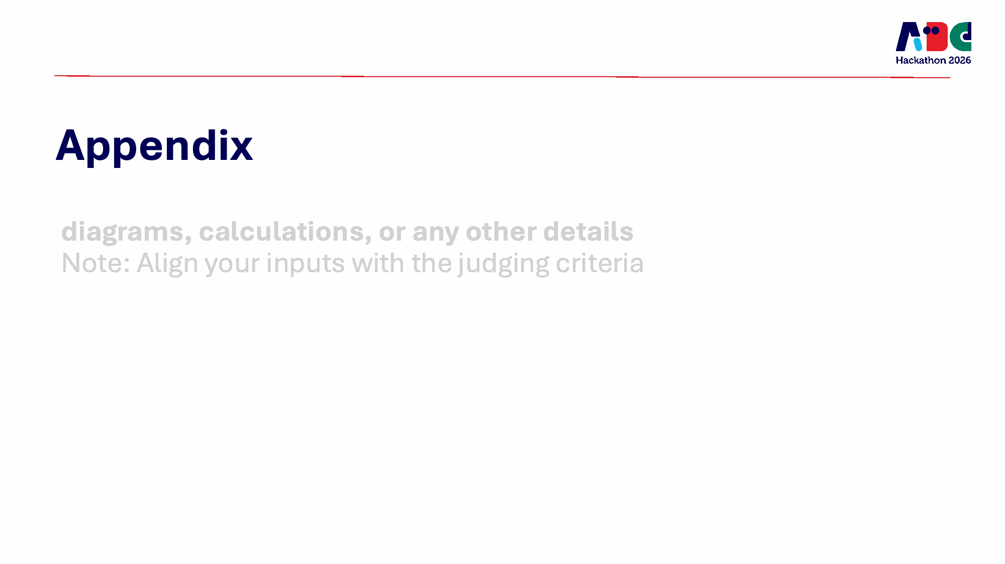
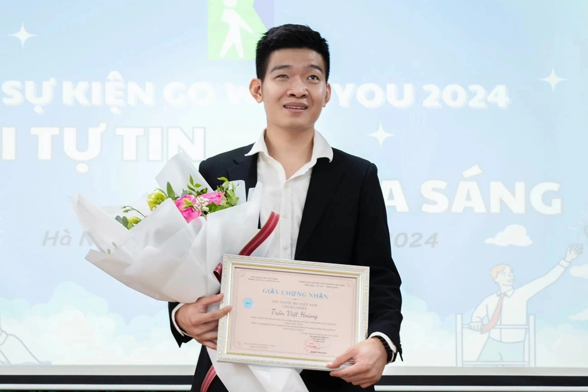
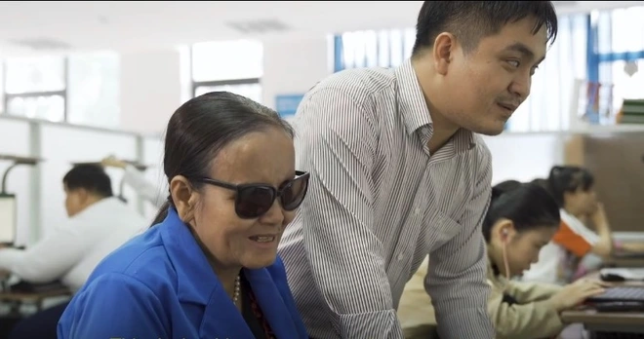
APPENDIX | CONTEXT AND EVIDENCE
Digital work opens the gate but inaccessible systems gatekeep autonomy
Why this solution matters?
Digital opportunity
Digital transformation can expand employment opportunities for people with disabilities through remote work, digital occupations, and assistive technologies (Trần, 2026).
But more opportunities don’t mean there is no difficulty..
Among employed screen-reader users in a study, 57.5% encountered inaccessible workplace software; when this occurred, 70.6% relied on a sighted coworker to complete their tasks (McDonnall et al., 2026).
They can listen to the training - but when the workplace system won’t speak to their screen reader, how can they learn by doing?
Notes:
Sources supplied by the project team: Trần (2026); NSO Vietnam (2024); McDonnall et al. (2025/2026). Verify final APA references and year consistency before submission.

Slide 7

Empathy map | Accessible onboarding
APPENDIX |
THINKING AND FEELING
• Wants to prove their ability to learn independently
• Feels frustrated and dependent when forced to ask for help
• Feels insecure and stressed when unable to understand or verify tasks
HEARING
• Wants to stay in control and contribute like other colleagues
• May feel isolated when inaccessible systems create barriers
PERCEIVING
  “This is the system the company already uses.”
  “Changing the platform will take time.”
  They hear generic, visually dependent directions such as: “Click A to open B,” “select C,” or “delete D.” when using screen recorder read the training materials
  Colleagues offering immediate help when they struggle
  Contribute without waiting for system replacement.
  Legacy systems that cannot be changed immediately.
  Unlabelled or screen-reader-incompatible interface elements.
  Sighted colleagues completing the same tasks with fewer barriers.
  Limited accessible alternatives.
“I know I can do it, but my learning tool is incompatible”
  Try screen readers and keyboard navigation.
DOING
SAYING
“You can’t just come into a company and ask them to change the workflow.”
“I want support without asking help from my collegues”
  Explore unfamiliar systems independently but it takes time
  Ask sighted colleagues for help when blocked.
  Suggest long-term accessibility improvements.
PAINS
GAINS/DESIRES
  Screen readers cannot interpret key interface elements.
  Visual instructions lack the context needed to act.
  Asking for help reduces autonomy during onboarding.
  Learn unfamiliar systems independently and more quickly
  Navigate and verify each step with confidence.
  Stay in control without replacing existing systems of the new workplace

Slide 8
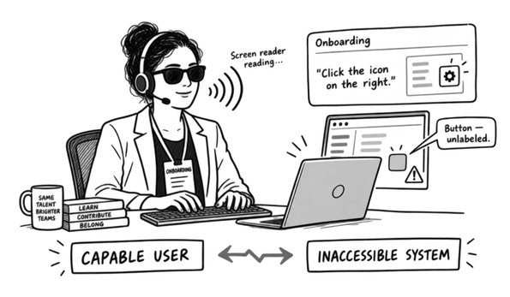
User Persona
APPENDIX |
  Role: Newly hired knowledge worker
  Vision: Blind; experienced screen-reader user
  Context: Learning internal systems during onboarding
Mrs. NGOC
  Age: 28
  Ho Chi Minh City, Vietnam
  Income: 15 million
  Job: Data Specialist
  Lifestyle: Lives independently; uses digital services daily
  Personality: Curious, self-directed and careful with details
  Career goal: Build a long-term career and earn trust at work
  Functional
Learn unfamiliar internal systems.
Locate, understand, and operate interface controls.
Complete and verify onboarding tasks accurately.
  Emotional
Feel confident and in control.
  Social
Demonstrate capability without repeatedly requesting help.
J2BD
INFLUENCERS
  Manager: Defines expectations and measures performance.
  Colleagues: Provide immediate sighted assistance.
  HR/L&D: Own onboarding and training materials.
  IT/accessibility team: Control tools and accommodations.
  Software vendors: Determine system accessibility.
INSIGHT
During onboarding, I want to demonstrate that I can learn independently, but when internal systems are incompatible with my screen reader, I must ask for help just to understand the interface. I need a way that lets me navigate, learn, and verify each step while remaining in control.
PAINS
  Screen readers cannot interpret key interface elements.
  Visual instructions lack the context needed to act.
  Asking for help reduces autonomy during onboarding.
TRENDS
  More workplace tasks are moving to digital platforms.
  Remote and hybrid work increase reliance on digital systems.
  Demand for digitally skilled employees is growing.
  AI and voice interfaces are creating new accessibility options.
  Legacy workplace systems remain difficult to replace.
USES CASE/ APPLICATION SCENARIO
  Follow digital onboarding and training materials.
  Navigate HR, learning, and internal work platforms.
  Complete forms and multi-step workflows.
  Understand inaccessible or unlabelled controls.
  Verify results before submitting an important action.
  Request assistance only when necessary.
GAINS
  Learn unfamiliar systems independently and more quickly
  Navigate and verify each step with confidence.
  Stay in control without replacing existing systems of the new workplace

Slide 9
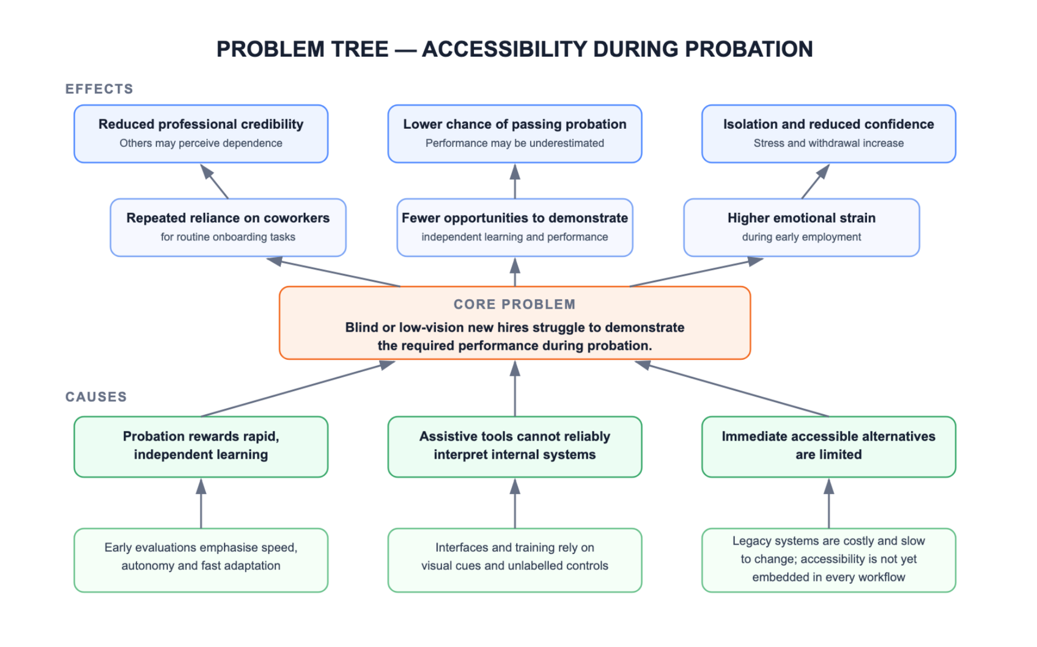
APPENDIX | FIVE WHYS SYNTHESIS
Problem tree

Slide 10
Pre-market prototype testing
APPENDIX | TESTING SHEET
TESTING SHEET
FEEDBACK CAPTURE GRID
SCENARIO
TEST CRITERIA
  5–8 blind or low-vision users
  one onboarding task in a safe sandbox
  screen reader alone vs. screen reader + prototype
  ≥80% task completion.
  ≥75% without human help.
  ≥20% faster than baseline.
  Zero critical errors or accessibility blockers.
I LIKE
I WISH
What improved clarity, confidence or independence?
What felt confusing, inaccessible or excessive?
PROCEDURE
KEY QUESTIONS
Baseline → prototype → retrospective interview → feedback grid.
  Where did you feel blocked?
  Was the guidance clear and actionable?
  Did you understand and control each action?
  When would you still ask a colleague for help?
QUESTIONS
IDEAS
Which actions, trust or privacy concerns remain?
What should be simpler? Which context would help?
OBJECTIVE
Test independence, speed, confidence, understanding and user control. ALWAYS READY TO BE ITERATIVE.
ROLES
Participant: performs task · Facilitator: prompts neutrally · Observer: records behaviour and metrics.
Planned test; results and learnings will be filled after participant sessions.

Slide 11
Risk management
APPENDIX |
AREA
KEY RISK
SCORE
MITIGATION
AI guidance
Wrong action
5×4 = 20
Confirm before action
IMPACT × LIKELIHOOD
Accessibility
Screen-reader blocker
5×4 = 20
Keyboard and reader testing
5
10
15
20
25
Sensitive actions
Unintended submit/delete
5×3 = 15
Read-only, confirm, undo
4
8
12
16
20
IMPACT
Data privacy
A third-party tool may expose company data.
5×3 = 15
In-house deployment; controlled data access.
3
6
9
12
15
2
4
6
8
10
User autonomy
AI acts for the user
4×3 = 12
Guidance first, user control
1
2
3
4
5
Interface change
Guidance becomes outdated
4×3 = 12
Version checks, regression test
LIKELIHOOD
Adoption
An unfamiliar interface slows users down.
3 × 3 = 9
Preserve familiar keyboard shortcuts & screen-reader interaction; no mouse required.
Critical score 15–25
STOP until mitigated
Competition
Similar tools may already exist
3 × 2 = 6
Benchmark alternatives; validate our POD with users.
Risk score = Impact × Likelihood

Slide 12
REFERENCE
Lewrick, M., Link, P., & Leifer, L. (2020). The design thinking toolbox: A guide to mastering the most popular and valuable innovation methods. John Wiley & Sons. Publisher page
McDonnall, M. C., Boydstun, J., & Steverson, A. (2026). Access technology in the workplace study: Final report. National Research and Training Center on Blindness and Low Vision, Mississippi State University. Full report
McDonnall, M. C., Steverson, A., Sessler Trinkowsky, R., & Sergi, K. (2024). Assistive technology use in the workplace by people with blindness and low vision: Perceived skill level, satisfaction, and challenges. Assistive Technology, 36(6), 429–436. https://doi.org/10.1080/10400435.2023.2213762
Trần, T. H. T. (2026, June 29). Việc làm cho người khuyết tật trong bối cảnh kinh tế số tại Việt Nam [Employment for people with disabilities in the context of the digital economy in Vietnam]. Nghiên cứu Kinh tế–Tài chính. https://nghiencuu.tapchikinhtetaichinh.vn/viec-lam-cho-nguoi-khuyet-tat-trong-boi-canh-kinh-te-so-tai-viet-nam-160365.html
Primary Research in the Interview session with End Users at RMIT university

Slide 13

ALTONOMY
Alternative Access. Full Autonomy.
Digital work opens the gate but inaccessible systems gatekeep autonomy
WE ARE
L!T-a-Byte
THE KEY IS YOURS

