Slide 1
Subnetting software
Presentation

Slide 2
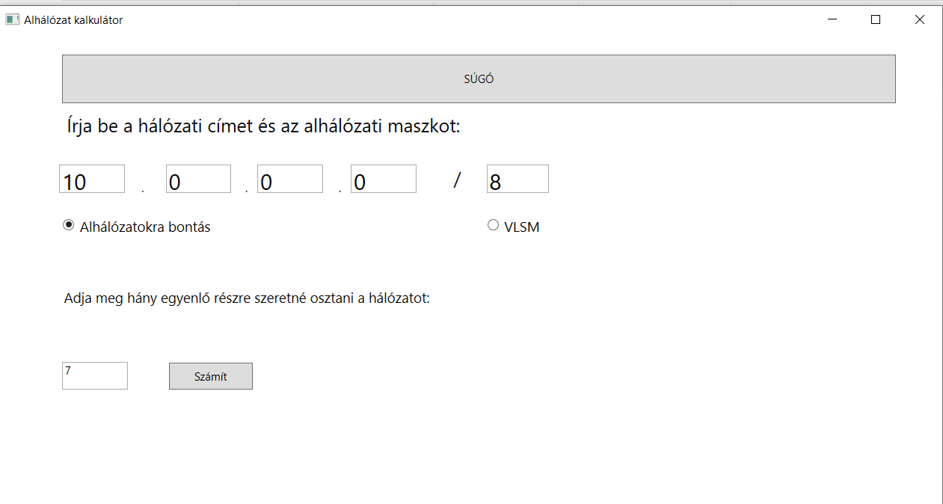
The function
After you open this calculator you can choose what kind of subnetting you want to use (CIDR or VLSM).
Then type the appropriate address and subnet mask in the input field.
Pressing the „Calculate” button will show the subnetted addresses on the screen.

Slide 3
Subnet calculator
The subnet can be understood as the main networks partial piece.
With its help we can break down IP addresses to different or equal sized parts.

Slide 4
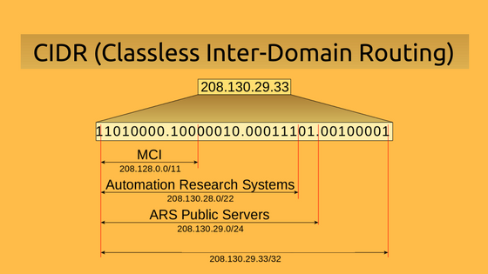
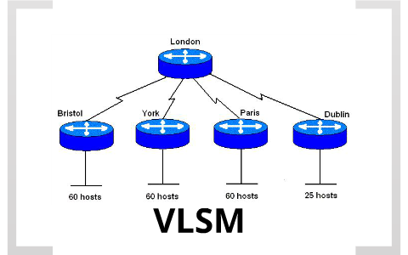
The 2 different types of breakdowns
Cidr
VLSM
Routing between classless domains.
Enables the routers to group the routes
Variable length subnet masking.
Makes the available addresses optimisation easier.

Slide 5
VLSm (Variable Length subnet mask)
The VLSM is a technology, which provides different sized subnetts within one network address.
Not all routing protocolls support the use of VLSM(e.g.: RIPv1).

Slide 6
the cidr (Classless inter-domain routing)
Firstly the CIDR is used for the solution of IP addresses efficient usage and routing table explosion.
Depletion of addresses space, insufficiency of two levels of hierarchy in title ⇨ The CIDR provides solutions for these problems.
The point of this method is that when using a post not only one, but more networks can be provided towards the routing direction .
Unlocked the inner fixed structure of the IP addresses: there is no network address just only prefixes.
Address aggregation.

Slide 7
Sources:
https://hu.jf-balio.pt/fix-default-notification-sound
https://www.szabilinux.hu/trendek/trendek5322.html
http://rendszer-gazda.blogspot.com/2012/05/vlsm-hasznalata.html
https://hu.education-wiki.com/7501202-what-is-cidr

Slide 8
Thanks for watching!
Made by: Pap róbert dávid

