Slide 1
Hamiltonian-Encoded Quantum LSTM for Learning Higher-Order Dependencies in Multivariate Time-Series Forecasting
First Review
Student Name 1 (Register No.)
Student Name 2 (Register No.)
Student Name 3 (Register No.)
Guided by: Dr./Mr./Ms. Supervisor Name, Designation
Department of Computer Science and Engineering
Sri Sivasubramaniya Nadar College of Engineering
Academic Year 2026–2027

Slide 2
Presentation Outline
1
Introduction
2
Literature Review
3
System Design
4
Project Management
H-QLSTM Forecasting
Department of Computer Science and Engineering
2/19

Slide 3
Background and Motivation
▶ Multivariate time series from power grids, transformers, and climate systems exhibit nonlinear, multi-scale, higher-order temporal dependencies.
▶ “Higher order” is precise, not a slogan: an order-p dependency needs the joint interaction of p lags — no strict subset carries information (the k-wise-independence property of parity). A long lookback of independent linear terms is still order-1.
▶ Classical LSTM and existing angle-embedding QLSTM models embed data through shallow, static gate rotations, limiting representational capacity.
▶ Hamiltonian embedding has improved expressivity for static (image) data, but has not been used inside a recurrent cell for sequential/temporal data.
Core Motivation
A dynamical, Hamiltonian-driven encoding may capture coupled temporal dependencies that static angle-embedding QLSTM cells cannot.
H-QLSTM Forecasting
Department of Computer Science and Engineering
3/19

Slide 4
Problem Statement
Problem
Classical and hybrid quantum recurrent models struggle to capture higher-order temporal dependencies due to limited representational capacity and shallow (angle-embedding) data encodings; no systematic framework exists to design, optimize, and benchmark a Hamiltonian-driven QLSTM against classical and variational-quantum baselines.
▶ What is the exact technical problem? Shallow VQC data encoding limits temporal-dependency capacity in QLSTM cells.
▶ What causes it? Angle embedding maps inputs to static rotation gates, not continuous dynamics.
▶ Why are existing approaches insufficient? No Hamiltonian-encoded QLSTM has been designed, implemented, or benchmarked for time-series forecasting.
▶ What constraints must the solution satisfy? Classically simulatable circuits; identical data/metrics across classical LSTM, existing QLSTM, and proposed H-QLSTM.
H-QLSTM Forecasting
Department of Computer Science and Engineering
4/19

Slide 5
Project Objectives
1. To implement and validate a classical LSTM and an existing angle-embedding QLSTM as baseline models for multivariate time-series forecasting.
2. To design a Hamiltonian-Encoded QLSTM (H-QLSTM) cell in which input features parameterize a learnable Hamiltonian, with the recurrent state evolving under its time-evolution operator.
3. To implement the proposed H-QLSTM using PennyLane and PyTorch, integrated into the existing preprocessing / training / evaluation pipeline.
4. To evaluate all three models on the ETTh1, Electricity Load Diagrams, and Jena Climate datasets using RMSE, MAE, and MAPE.
5. To compare the proposed H-QLSTM against both baselines, particularly for longer lookback windows and higher-order dependency capture.
H-QLSTM Forecasting
Department of Computer Science and Engineering
5/19

Slide 6
Scope and Expected Outcomes
Included
Excluded / Constraints
▶ Classical LSTM, existing QLSTM, and proposed H-QLSTM implementations
▶ Simulated quantum circuits (PennyLane default.qubit, ~6-8 qubits)
▶ ETTh1, Electricity Load Diagrams, Jena Climate datasets
▶ Evaluation via RMSE, MAE, MAPE across lookback horizons
▶ Execution on physical quantum hardware
▶ Real-time or streaming deployment
▶ Forecast horizons beyond the validated windowed single/multi-step setting
▶ Circuit depth/qubit count bounded by classical simulation cost
H-QLSTM Forecasting
Department of Computer Science and Engineering
6/19

Slide 7
Literature Review
Ref. | Method / Technology | Key Contribution | Limitation / Research Gap
[1] | Kea et al. (2024) - 4-gate angle-embedding QLSTM | Competitive stock-price forecasting vs. classical LSTM/GRU | Static angle embedding; no continuous temporal dynamics
[2] | Wang et al. (2025) - Quantum Hamiltonian embedding | Richer expressivity, better trainability on image data | Static data only; no recurrent/sequential architecture
[3] | Moon et al. (2025) - QSegRNN | Fewer parameters, improved quantum-RNN forecasting | Still angle-embedding based; limited long-range capacity
[4] | Hochreiter & Schmidhuber (1997) - Classical LSTM | Standard gated recurrent baseline, mitigates vanishing gradients | Purely classical representational ceiling
H-QLSTM Forecasting
Department of Computer Science and Engineering
7/19

Slide 8
Research Gap and Proposed Contribution
Identified Gap
Proposed Contribution
▶ Existing QLSTM/quantum-RNN designs use shallow, static angle embedding
▶ Hamiltonian embedding demonstrated only for static (image) data
▶ No systematic Hamiltonian-QLSTM design/benchmark framework exists
▶ Hamiltonian-Encoded QLSTM cell: input parameterizes a learnable Hamiltonian
▶ State evolves via Trotterized U = exp(-iHΔt) in place of static rotation gates
▶ Open benchmark vs. classical LSTM and existing QLSTM across 3 public datasets
H-QLSTM Forecasting
Department of Computer Science and Engineering
8/19

Slide 9
Existing System vs. Proposed System
Criterion | Existing (Angle-Embedding) QLSTM | Proposed H-QLSTM
Data encoding | Static per-timestep angle rotations | Learnable Hamiltonian H(x,θ)
State evolution | Discrete variational gate sequence | Trotterized U = exp(-iHΔt)
Temporal dynamics | Not explicitly modelled | Continuous, physically motivated
Higher-order dependencies | Limited by shallow encoding | Expected improvement (to be benchmarked)
Evaluated datasets (this project) | ETTh1 (Phase I checkpoint) | ETTh1, Electricity Load, Jena Climate
H-QLSTM Forecasting
Department of Computer Science and Engineering
9/19

Slide 10
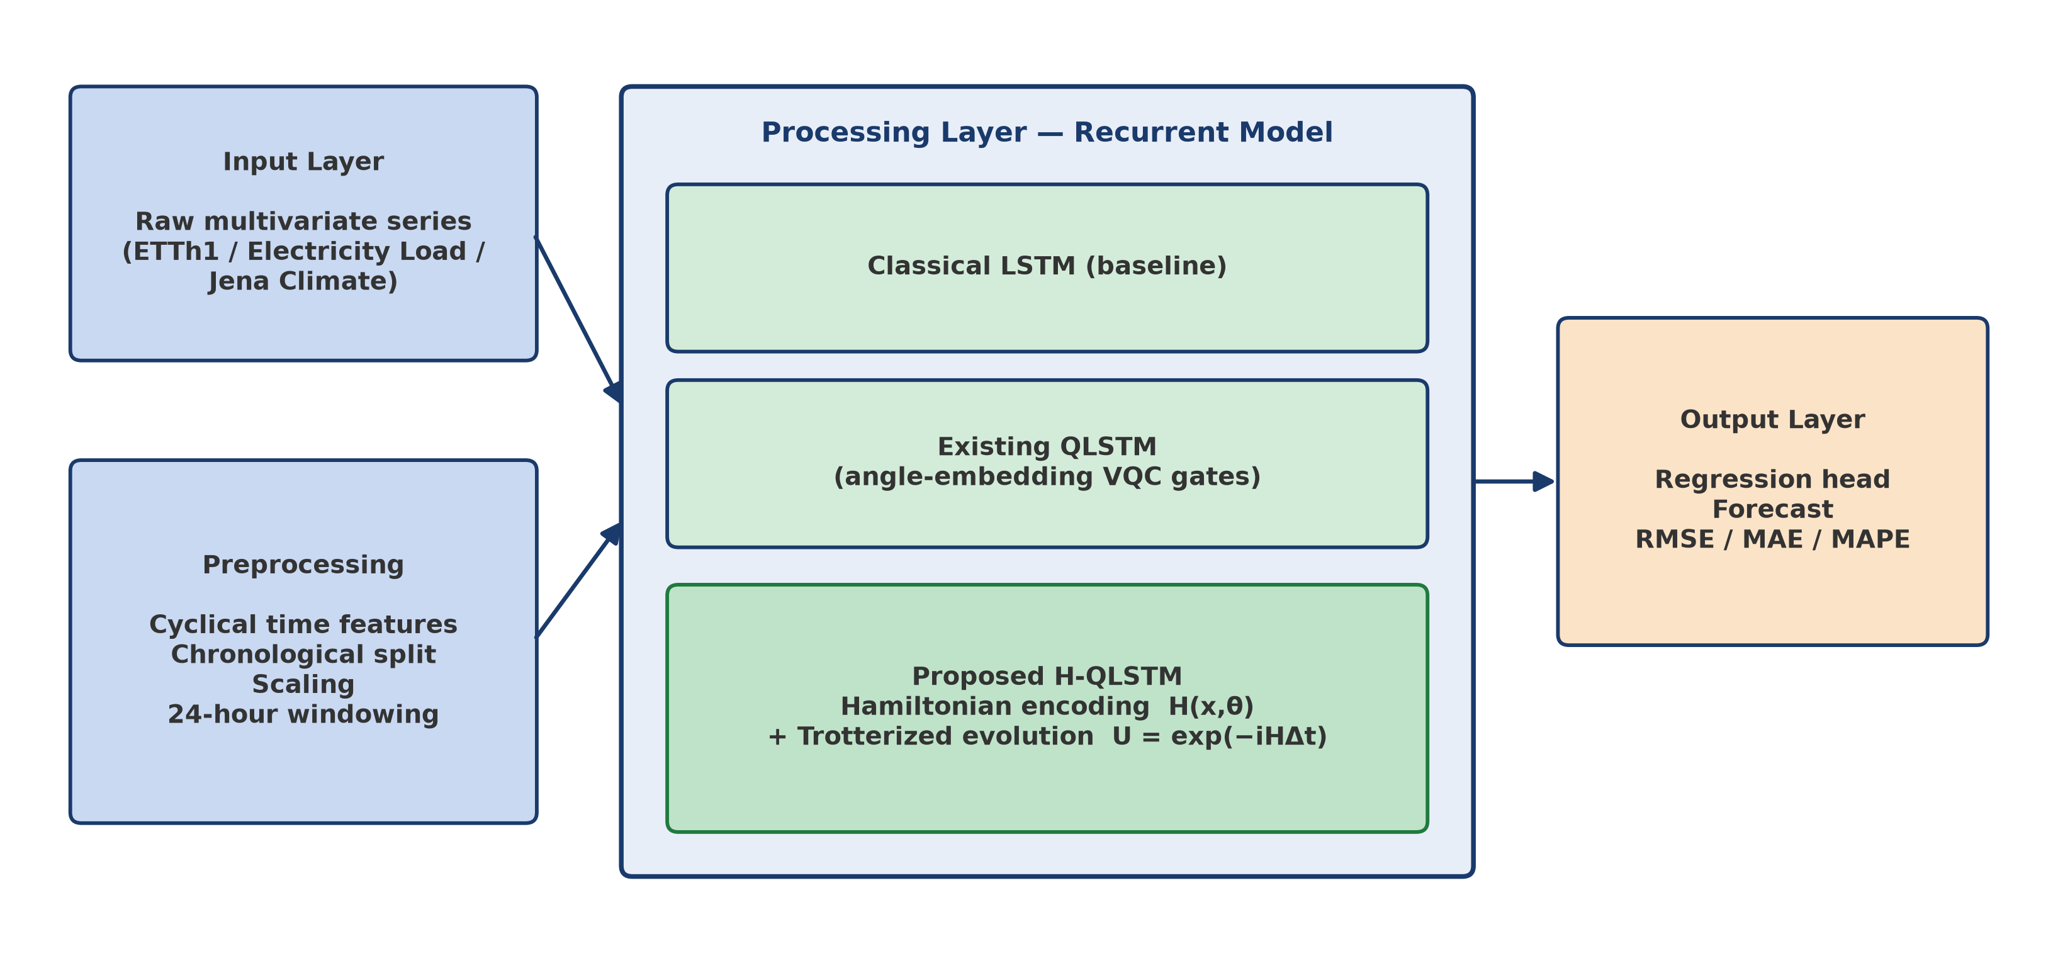
Proposed System Architecture
Three interchangeable recurrent components share one preprocessing pipeline and evaluation harness for direct comparison.
H-QLSTM Forecasting
Department of Computer Science and Engineering
10/19

Slide 11
System Modules
1. Data/Input Management: loads ETTh1 / Electricity Load / Jena Climate, cyclical time features, chronological split.
2. Preprocessing: scaling and 24-hour lookback windowing for sequence-to-one learning.
3. Core Processing: classical LSTM, existing angle-embedding QLSTM, and proposed H-QLSTM cells.
4. Storage / Pipeline: run_pipeline.py orchestrates preprocessing, HPO, training, evaluation.
5. Evaluation: train.py (early stopping), hyperparam_search.py (Optuna), utils.py (RMSE/MAE/MAPE).
H-QLSTM Forecasting
Department of Computer Science and Engineering
11/19

Slide 12
Methodology / Workflow
1. Requirement analysis and dataset selection (ETTh1, Electricity Load, Jena Climate)
2. Data preprocessing and windowing
3. Classical LSTM and existing QLSTM baseline development
4. H-QLSTM design and implementation (Hamiltonian encoding block)
5. Integration, training, and hyperparameter optimization
6. Comparative evaluation and reporting
Evaluation Metrics
▶ RMSE / MAE / MAPE on real datasets
▶ Order-p parity diagnostic (sign-accuracy vs. chance)
▶ Training wall-clock time
▶ Parameter / circuit-depth efficiency
H-QLSTM Forecasting
Department of Computer Science and Engineering
12/19

Slide 13
Core Algorithm: Hamiltonian-Encoded QLSTM Cell
Algorithm: H-QLSTM gate evaluation
▶ Receive input x_t and previous hidden state h_{t-1}; concatenate as v_t.
▶ Map v_t to Hamiltonian coefficients: H(v_t, θ) = Σ_k c_k(v_t,θ) P_k (Pauli-string basis).
▶ Evolve the quantum state via the Trotterized unitary U = exp(-iH(v_t,θ)Δt), applied per QLSTM gate (input / forget / cell / output).
▶ Measure expectation values and map to classical gate activations via a linear readout.
▶ Update cell and hidden state as in a standard LSTM; pass to the regression head for the forecast.
H-QLSTM Forecasting
Department of Computer Science and Engineering
13/19

Slide 14
Technology Stack and Resources
Category | Selected Technology / Resource
Programming Language | Python 3.12
Frameworks / Libraries | PyTorch, PennyLane, Optuna, NumPy, pandas
Datasets | ETTh1 (ETDataset); Electricity Load Diagrams (UCI); Jena Climate (MPI-BGC)
Quantum simulation | PennyLane default.qubit, 6-8 qubits, 2-3 variational layers
Development Tools | Git, matplotlib for plots, JSON-based results tracking
Hardware | CPU (circuit simulation tractable at this scale); no GPU/QPU required
H-QLSTM Forecasting
Department of Computer Science and Engineering
14/19

Slide 15
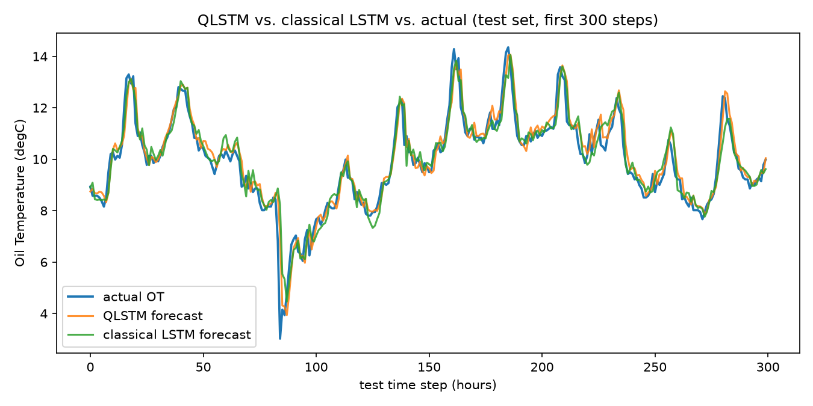
Preliminary Results (Phase I Checkpoint)
Metric | QLSTM | Classical LSTM
Test RMSE (°C) | 0.5919 | 0.6316
Test MAE (°C) | 0.3909 | 0.4021
Test MAPE | 4.89% | 5.15%
Trainable parameters | n/a (VQC circuit) | 681
Training wall-clock time | 52.3 min | 1.6 s
Both models trained on ETTh1 under an identical harness (same split, scaling, windowing, optimizer, early stopping); classical LSTM hidden size matched to the QLSTM's Optuna-selected configuration (6 qubits, 2 layers, hidden size 8) rather than separately tuned. QLSTM test RMSE is ~6.7% lower, at far higher parameter/compute cost — a single-seed, single-configuration result, not yet statistically validated.
H-QLSTM Forecasting
Department of Computer Science and Engineering
15/19

Slide 16
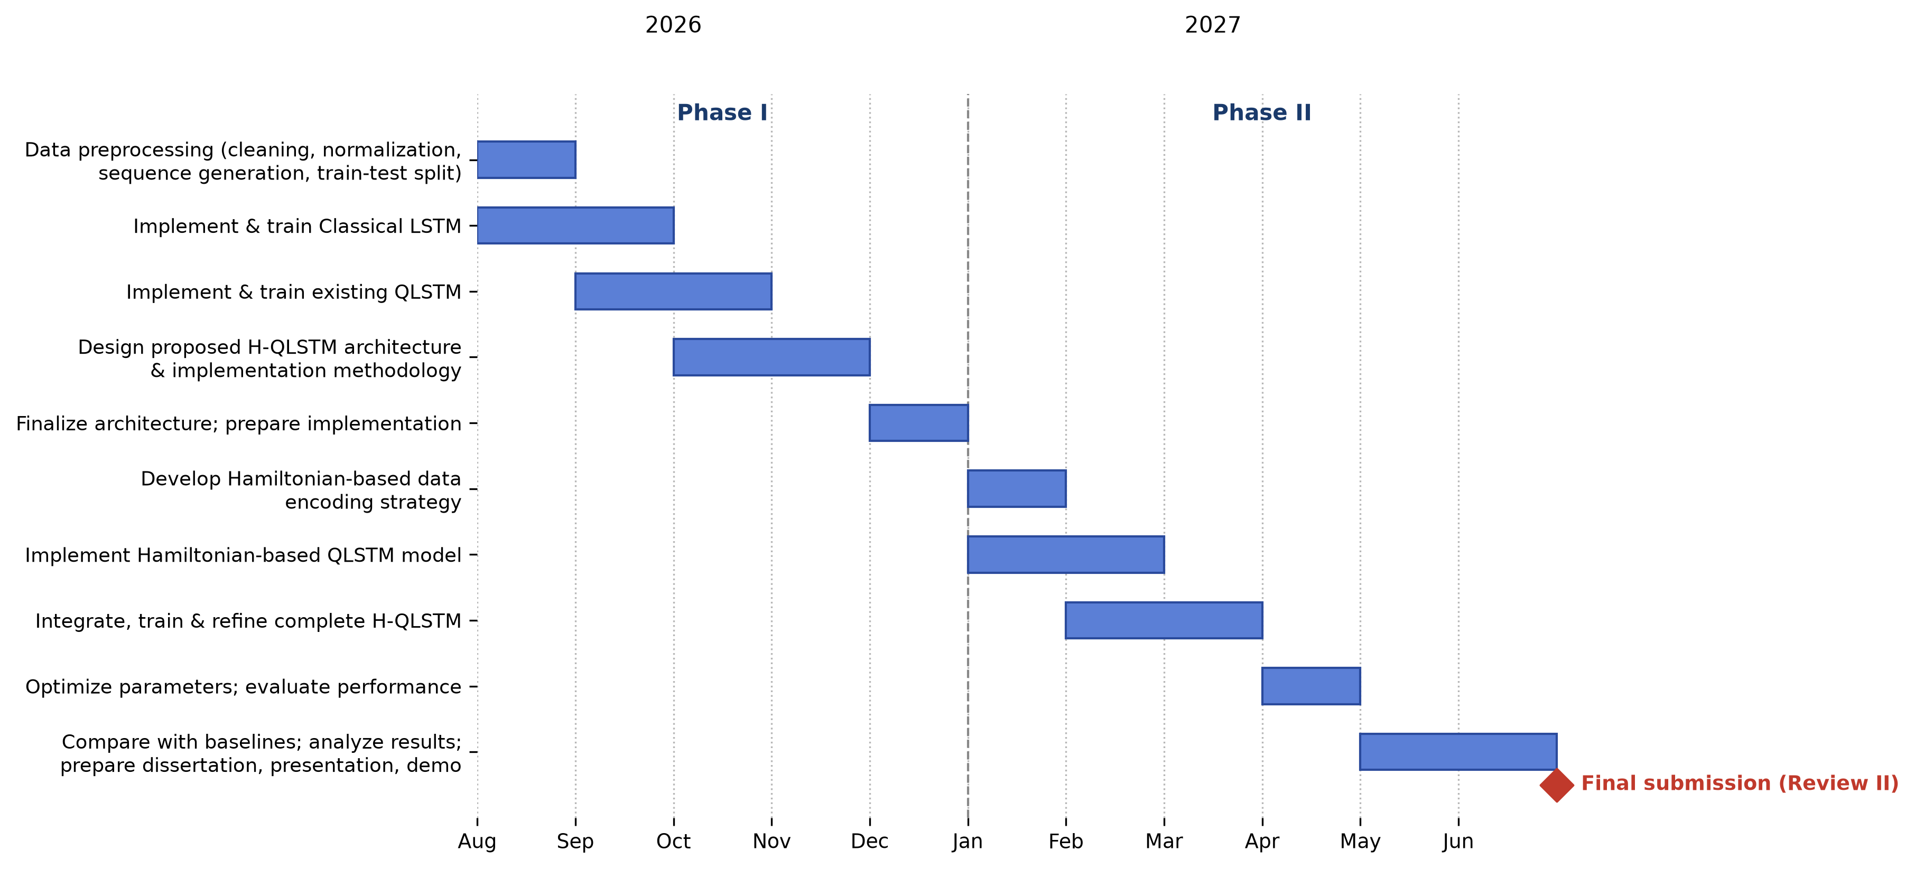
Project Timeline
H-QLSTM Forecasting
Department of Computer Science and Engineering
16/19

Slide 17
Team Responsibilities
Team Member | Responsibilities | Current Status
Student 1 | Literature review, problem formulation, report/documentation | In progress
Student 2 | Data preprocessing, classical LSTM & QLSTM baseline implementation | Completed (Phase I)
Student 3 | Hyperparameter search, training pipeline, evaluation metrics | Completed (Phase I)
Student 4 | H-QLSTM architecture design, Phase II integration planning | In progress
H-QLSTM Forecasting
Department of Computer Science and Engineering
17/19

Slide 18
References
[1] K. Kea, D. Kim, C. Huot, T.-K. Kim, and Y. Han, "A Hybrid Quantum-Classical Model for Stock Price Prediction Using Quantum-Enhanced Long Short-Term Memory," Entropy, vol. 26, no. 11, p. 954, 2024.
[2] P. Wang, C. R. Myers, L. C. L. Hollenberg, et al., "Quantum Hamiltonian embedding of images for data reuploading classifiers," Quantum Machine Intelligence, vol. 7, p. 35, 2025.
[3] K. H. Moon, S. G. Jeong, and W. J. Hwang, "QSegRNN: quantum segment recurrent neural network for time series forecasting," EPJ Quantum Technology, vol. 12, p. 32, 2025.
[4] S. Hochreiter and J. Schmidhuber, "Long Short-Term Memory," Neural Computation, vol. 9, no. 8, pp. 1735-1780, 1997.
[5] H. Zhou et al., "ETDataset: Electricity Transformer Temperature dataset," GitHub, 2021. [Online]. Available: github.com/zhouhaoyi/ETDataset
[6] A. Trindade, "ElectricityLoadDiagrams20112014 Data Set," UCI ML Repository, 2015.
[7] Max Planck Institute for Biogeochemistry, "Jena Climate Dataset," 2026. [Online]. Available: bgc-jena.mpg.de/wetter
H-QLSTM Forecasting
Department of Computer Science and Engineering
18/19

Slide 19
Thank You
Questions and Discussion

