Slide 1
Iframes, character entities, semantic elements, html5 elements

Slide 2
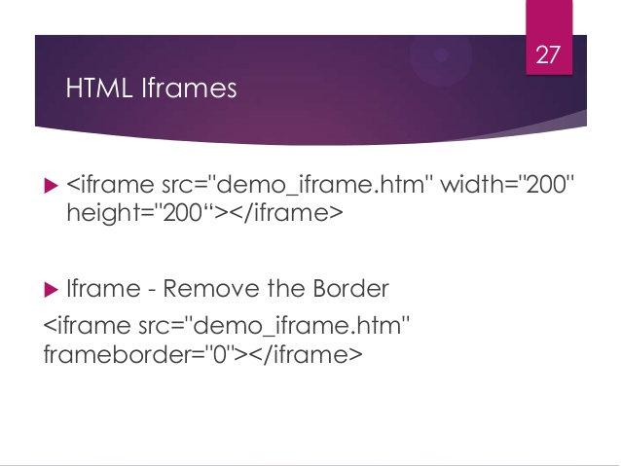

Slide 3
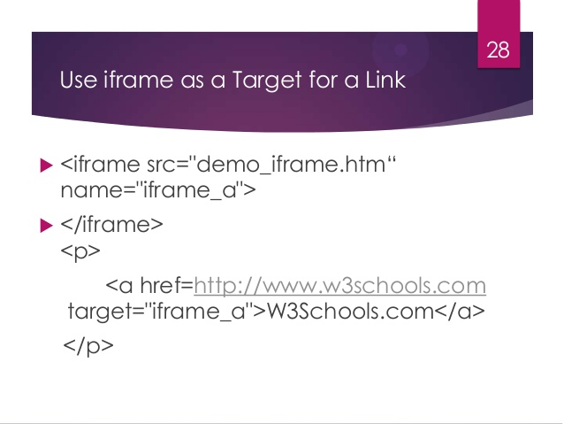

Slide 4
Style iframe
Inline
<iframe src=”www.amrita.edu” style=”border: 3px dotted; width: 300px; height: 300px;”> </iframe>
Other attributes
https://www.w3schools.com/tags/tag_iframe.asp

Slide 5
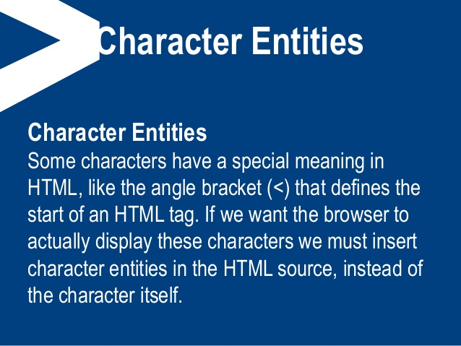

Slide 6
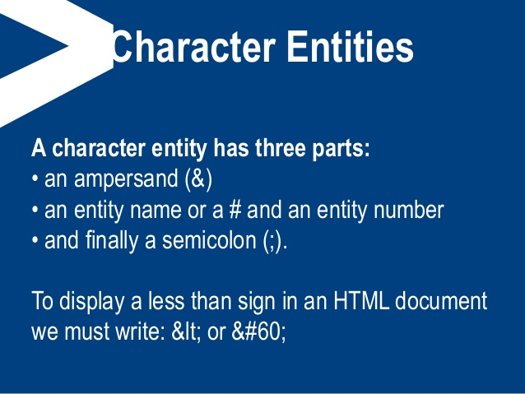

Slide 7
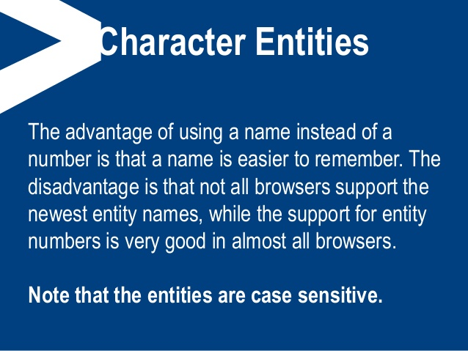

Slide 8
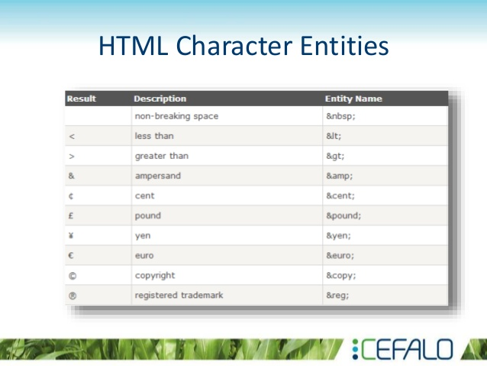

Slide 9
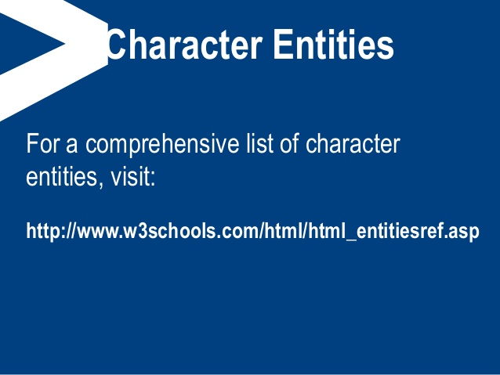
https://dev.w3.org/html5/html-author/charref

Slide 10
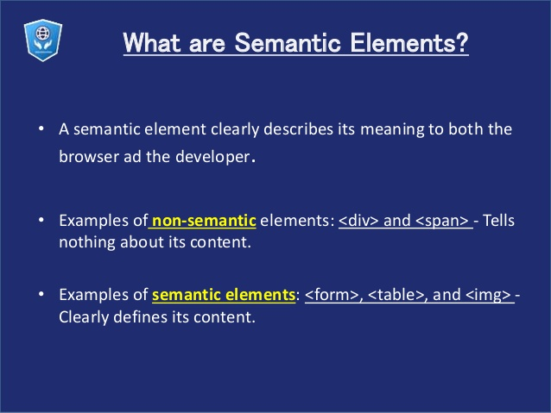
A div is a block-level element and a span is an inline element.
The div should be used to wrap sections of a document, while use spans to wrap small portions of text, images, etc.
The <div> element is used while creating CSS based layouts in html, whereas <span> element is used to stylize texts.

Slide 11
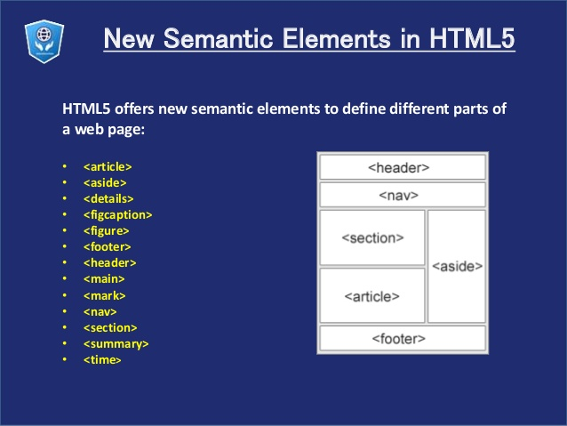
https://www.w3schools.com/html/html5_semantic_elements.asp

Slide 12
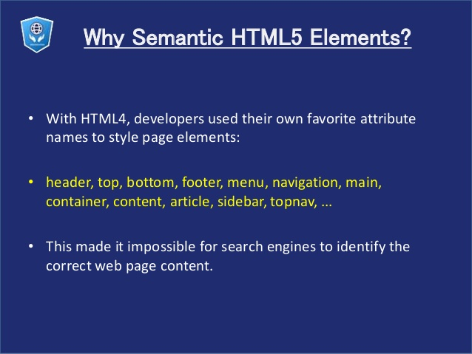

Slide 13
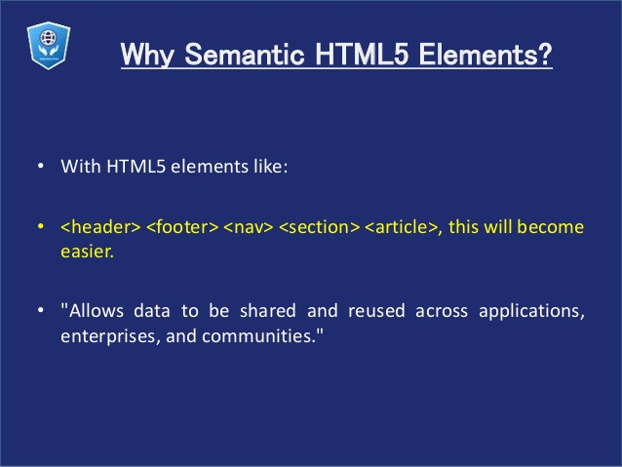

Slide 14
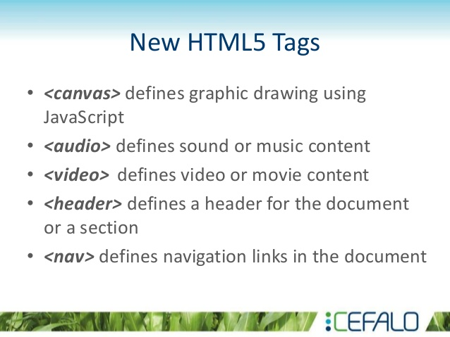

Slide 15
