Slide 1
Evaluation of Lung Nodule Variations Using Generative Variational Autoencoders
Charmi Patel
01-16-2025

Slide 2
Research Question
RQ: How effectively does the Between Class Fréchet Distance (BCFD) and Within Class Fréchet Distance (WCFD) evaluate the quality and semantic alignment of generated spiculated latent representations compared to original non-spiculated latent representations and vice-versa?
RH: A high BCFD and low WCFD score with varying alpha values would indicate that the latent representations of generated spiculated images are distinct from the latent representations of real non-spiculated nodules. This suggests successful transformation from non-spiculated to spiculated nodules.
Notes:
## check and go how the covariance matrix is calculated

Slide 3

Update
Task | Progress
Evaluation of Lung Nodule Variations
Computation of Between Class Fréchet Distance (BCFD)
Computation of Within Class Fréchet Distance (WCFD)
Medical Imaging and Database Consortium (MIDRC) Data
Data Exploration | In Progress
Journal Paper
Incorporated Feedbacks from Professors
Create Figure [1] for Methodology under Section 3.2.5 | In Progress
Innovation Day Showcase Project
Poster
[1] Shumailov, I., Shumaylov, Z., Zhao, Y., Gal, Y., Papernot, N. and Anderson, R., 2023. The curse of recursion: Training on generated data makes models forget. arXiv preprint arXiv:2305.17493. https://arxiv.org/pdf/2305.17493

Slide 4
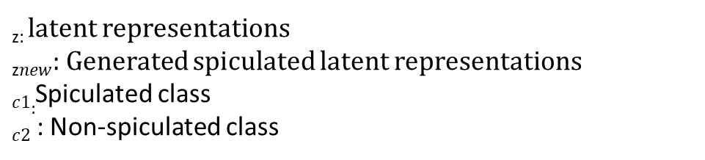
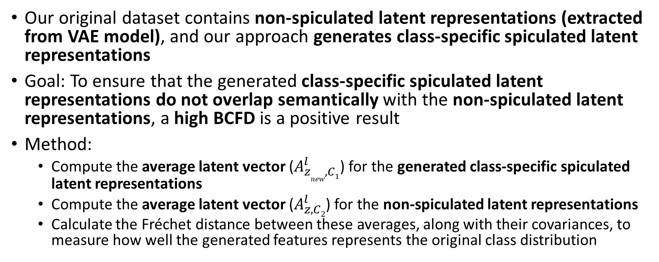

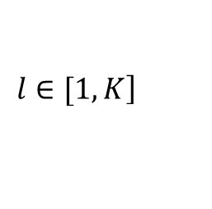
Our Experiment: BCFD
Our original dataset contains non-spiculated latent representations (extracted from VAE model), and our approach generates class-specific spiculated latent representations
Goal: To ensure that the generated class-specific spiculated latent representations do not overlap semantically with the non-spiculated latent representations, a high BCFD is a positive result
Method:
Compute the average latent vector ($A_{z_{new}, C1}^{l}$​) for the generated class-specific spiculated latent representations
Compute the average latent vector ($A_{z, C2}^{l}$​) for the non-spiculated latent representations
Calculate the Fréchet distance between these averages, along with their covariances, to measure how well the generated features represents the original class distribution
_{z:} latent representations
_{z}$new$: Generated spiculated latent representations
$c1:$Spiculated class
$c2$ : Non-spiculated class
$$\left.l∈[1,K\right]$$
K: Total no. of latent representations ($l$)

Slide 5
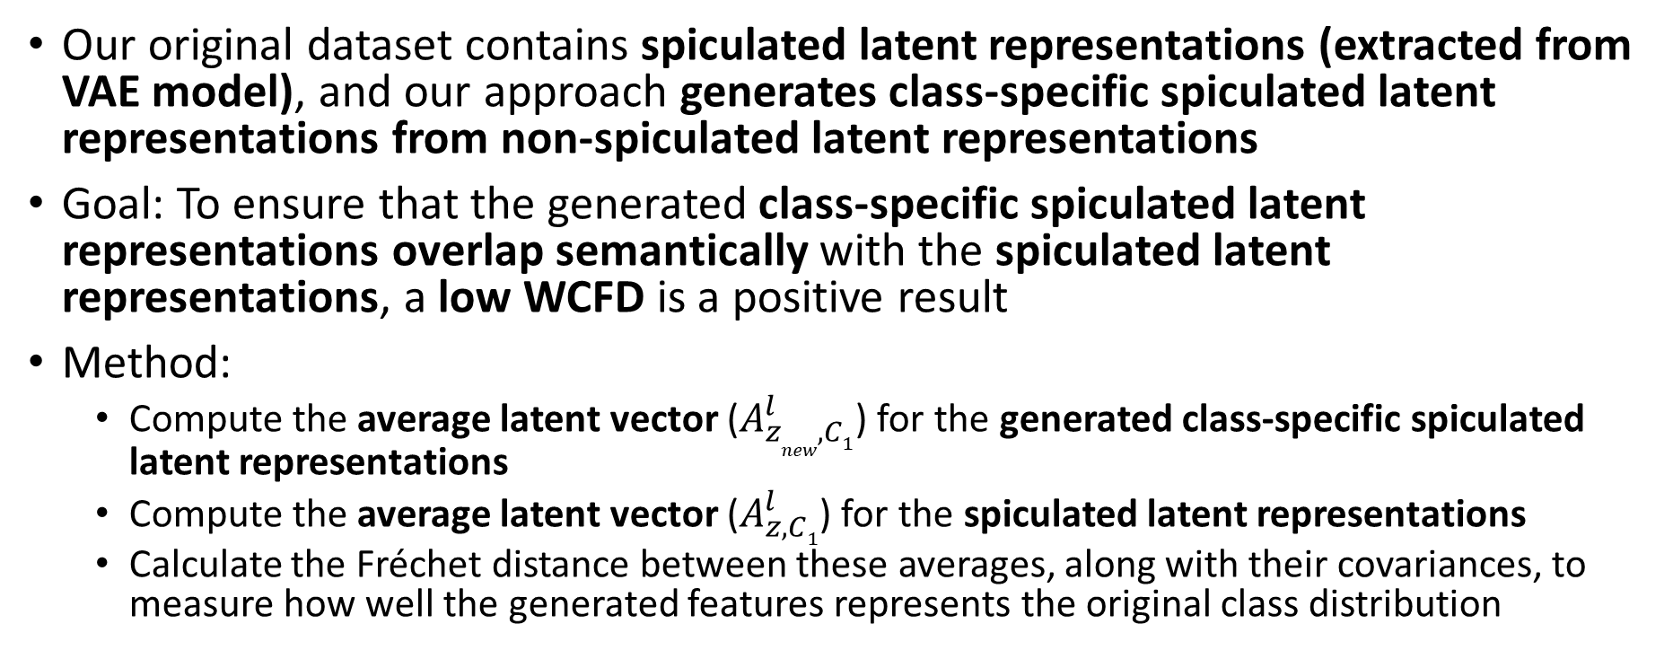
Our Experiment: WCFD
Our original dataset contains spiculated latent representations (extracted from VAE model), and our approach generates class-specific spiculated latent representations from non-spiculated latent representations
Goal: To ensure that the generated class-specific spiculated latent representations overlap semantically with the spiculated latent representations, a low WCFD is a positive result
Method:
Compute the average latent vector ($A_{z_{new}, C1}^{l}$​) for the generated class-specific spiculated latent representations
Compute the average latent vector ($A_{z, C1}^{l}$​) for the spiculated latent representations
Calculate the Fréchet distance between these averages, along with their covariances, to measure how well the generated features represents the original class distribution
_{z:} latent representations
_{z}$new$: Generated spiculated latent representations
$c1:$Spiculated class
$c2$ : Non-spiculated class
$$\left.l∈[1,K\right]$$
K: Total no. of latent representations ($l$)

Slide 6
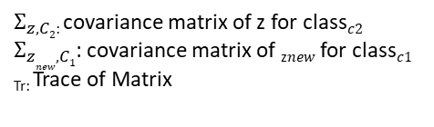
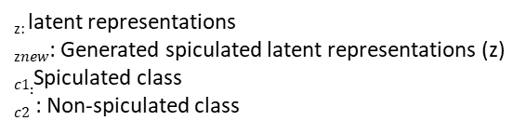

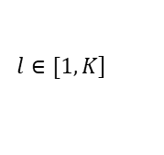
Computation of BCFD and WCFD
$$BCFD={\left\|A_{z, C2}^{l}− \right. \left.A_{z_{new}, C1}^{l}\right\|}^{2} +Tr(Σ_{z, C2}+Σ_{z_{new}, C1}−2{(Σ_{z, C2}Σ_{z_{new}, C1})}^{1/2})$$
Mean
Trace of Covariances
Quantifies the distance between the centers of the non-spiculated latent representations and generated class-specific spiculated latent representations
Evaluates the similarity in the spread or shape between the distributions of non-spiculated latent representations and the generated class-specific spiculated latent representations
W$CFD={\left\|A_{z,C1}^{l}− \right. \left.A_{z_{new}, C1}^{l}\right\|}^{2} +Tr(Σ_{z, C1}+Σ_{z_{new}, C1}−2{(Σ_{z,C1}Σ_{z_{new}, C1})}^{1/2})$
Mean
Trace of Covariances
Quantifies the distance between the centers of the spiculated latent representations and generated class-specific spiculated latent representations
Evaluates the similarity in the spread or shape between the distributions of spiculated latent representations and the generated class-specific spiculated latent representations
_{z:} latent representations
_{z}$new$: Generated spiculated latent representations (z)
$c1:$Spiculated class
$c2$ : Non-spiculated class
$Σ_{z, C2}$: covariance matrix of z for class$c2$
$Σ_{z_{new}, C1}$: covariance matrix of _{z}$new$ for class$c1$
_{Tr:} Trace of Matrix
K: Total no. of latent representations ($l$)
$$\left.l∈[1,K\right]$$

Slide 7
Transforming from Non-Spiculated to Spiculated
α values | Mean (BCFD) | Trace (BCFD) | Total BCFD | Mean (WCFD) | Trace (WCFD) | Total WCFD
0.1 | 0.56 | -5.33 | -4.77 | 44.47 | 1332.10 | 1376.58
0.5 | 13.99 | -5.24 | 8.75 | 13.97 | 1366.42 | 1380.40
1 | 55.33 | -5.6 | 49.70 | 4.41e-12 | 1342.39 | 1342.39
2 | 225.77 | -5.33 | 220.44 | 56.68 | 1365.43 | 1422.12
3 | 482.76 | -5.36 | 477.39 | 224.50 | 1355.86 | 1580.36
Computation of BCFD and WCFD for varying α values for Latent Representations Transforming Non-spiculated to Spiculated Images
Distance increases at varying α values
Remains constant
Dependent on Mean
Remains constant
Not able to interpret the results based on our hypothesis

Slide 8
Transforming from Spiculated to Non-Spiculated
α values | Mean (BCFD) | Trace (BCFD) | Total BCFD | Mean (WCFD) | Trace (WCFD) | Total WCFD
0.1 | 0.53 | -61.57 | -61.04 | 45.79 | 1354.31 | 1400.10
0.5 | 14.08 | -61.47 | -47.39 | 14.17 | 1337.57 | 1351.74
1 | 55.35 | -61.08 | -5.72 | 3.08e-12 | 1339.52 | 1339.52
2 | 225.76 | -61.44 | 164.32 | 54.83 | 1354.31 | 1409.15
3 | 485.96 | -61.34 | 424.62 | 221.89 | 1348.82 | 1570.71
Computation of BCFD and WCFD for varying α values for Latent Representations Transforming Spiculated to Non-spiculated Images
Distance increases at varying α values
Remains constant
Dependent on Mean
Remains constant
Not able to interpret the results based on our hypothesis

Slide 9
Next Steps
Evaluation of Generated Latent Variations using Generative Variational Autoencoders (VAEs)
Literature review on evaluation metrics of image generation
Medical Imaging and Data Resource Center (MIDRC) Data
Data exploration and pre-processing of COVID-19 CT scans
Use the pre-processed data to pre-train the ResNet 18 model from scratch
Journal Paper
Create a figure for methodology (Section 3.2.5)

