Slide 1
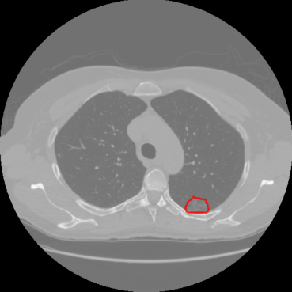
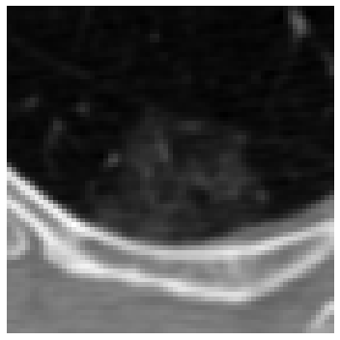
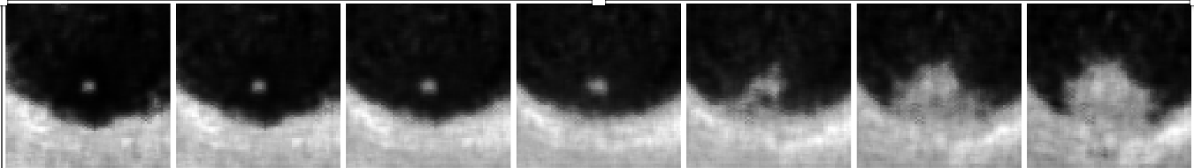
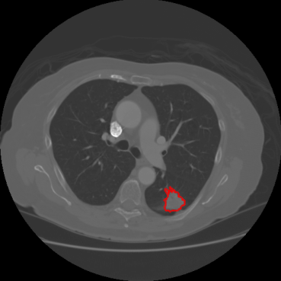
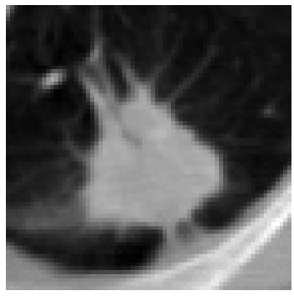
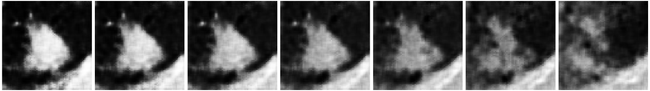
Research Idea: The idea is to compare the human label truth or (ground truth) images with algorithm-generated images to examine how accurately the algorithm captures the labels that radiologists or experts identify, such as spiculation.
1) By this, we can get how well the algorithm mimics expert labelling.
2) And where do the discrepancies occur?
Annotated Original Image
non-spiculated to spiculated
Original Image
alpha = -2
alpha = -1
alpha = 0
alpha = 1
alpha = 2
alpha = 3
alpha = -3
spiculated to non-spiculated
Annotated Original Image
Original Image
alpha = -3
alpha = -2
alpha = -1
alpha = 0
alpha = 1
alpha = 2
alpha = 3
Reconstructed
Image
Notes:
###1,2,3,4,5
We have different intensities for originl aimage and annotated (reason due to color map)

Slide 2
Research Question: How accurately do VAE-generated latent traversals differentiate between spiculated and non-spiculated lung nodules when evaluated using edge-based geometric metrics and unsupervised clustering?
Research Hypothesis: VAE-generated latent traversals will preserve spiculation characteristics such that quantifiable edge-based metrics (e.g., convex hull area, perimeter, ellipticity) and unsupervised clustering of latent features will align with expert-labeled spiculation categories in the LIDC dataset.
Research Workflow:
Workflow | Key Steps
Edge Detection (Baseline Feature Extraction) | Apply Canny Edge Detection Compute edge density Visualize and analyze edge maps
Convex Hull Analysis (Spiculation Spread & Area) | Compute Convex Hull Extract area, perimeter, and solidity Perform statistical validation
Ellipse Fitting (Shape-Based Validation) | Fit an ellipse to each detected contour Extract major/minor axis, orientation, eccentricity Compare shape variations
Clustering & Unsupervised Validation | Perform k-means & hierarchical clustering Evaluate cluster separation and performance Compare clusters with expert labels
Final Report & Interpretation | Summarize findings using visual comparisons & statistical results Evaluate VAE-generated spiculation quality Prepare structured presentation & research conclusions

