Slide 1

Static Analysis
Software Quality
Ricardo Caldas
December, 2016

Slide 2
Static program analysis
Static Analysis is a test performed on a software without executing the code itself.
The code is tested by another software tool.
Help to find bugs, redundance of code and malfuntion.
Opposition - Dinamic Analysis that evolves the software test when executing it.

Slide 3
Code revisioning
Is a static test performed manually.
Code revisioning seens to be more successful than the software used to check for static analysis.
Capable of detecting a larger amount of code errors and bugs (Code Redundancy).

Slide 4
Tool vs revisioning
A denfense contractor developed a safety-critical software application with aprox. 1 million code lines.
On a sample section of code, an inspector reviewed 75 lines of code in 1 hour before using a tool to perform the same task.
How many hours would it take to check te code manually by a reviewer?
13,700 Hrs

Slide 5
Static analysis goals
Better code quality and efficient quality control.
Identify erros, problems and malfunctions that are not so evident to software tester.
To prevent negative impacts of software instability, desing, security and software maintenance.
Used before and during integration test.

Slide 6
Features or characteristics of static analysis tools are:
To calculate metrics such as cyclomatic complexity or nesting levels (which can help to identify where more testing may be needed due to increased risk).
To enforce coding standards.
To analyze structures and dependencies.
Help in code understanding.
To identify anomalies or defects in the code.

Slide 7
Code standards
Classes name should start with capital letter.
Ex: “public class Pessoa{ }”
Methods name should start with small letter.
Code standards save a lot of time.
In Static Analyzer tool we enter the coding standards.
Developer can focus more on the programatic logic.

Slide 8
Data structure
Control flow structure: Dead code.
Data flow structure: Variables never used.

Slide 9
Benefits of static analysis tool
Quickly identify defects and other problems.
Provide reports and visual representation of software.
Detecting defects prior to executing the software.
Providing early warning of suspicious code and design.
Identifying defects not easily found by other testing.

Slide 10
Benefits of static analysis
Detecting incorrect dependencies and inconsistencies.
Improve maintainability of code and design by enforcing code standards.
Reducing complexity in designs and code.
Preventing defects by highlighting causes of problems.

Slide 11
Commercial usage
Static Analysis is been used in the verification of software used in safety-critical computer systems, locating potential vulnerabilities.
MEDICAL – Food and Drug Administration (FDA -US) – for medical software.
NUCLEAR SOFTWARE – Health and Safety Executive (HSE - UK) – Reactor Safety System.
Aviation Software (With Dynamic Analysis).

Slide 12
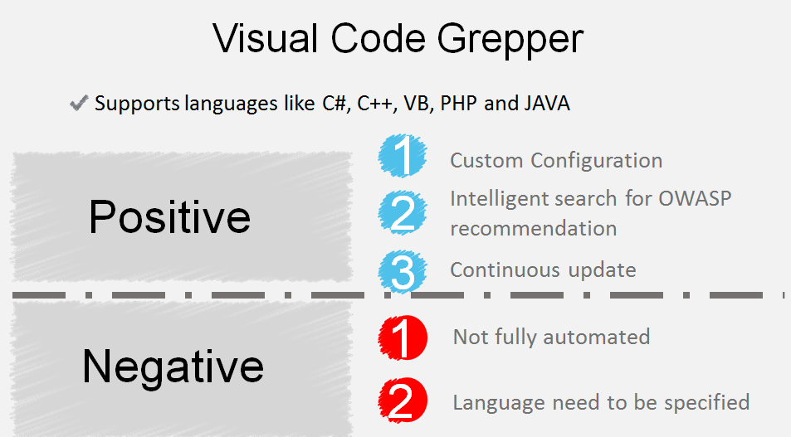
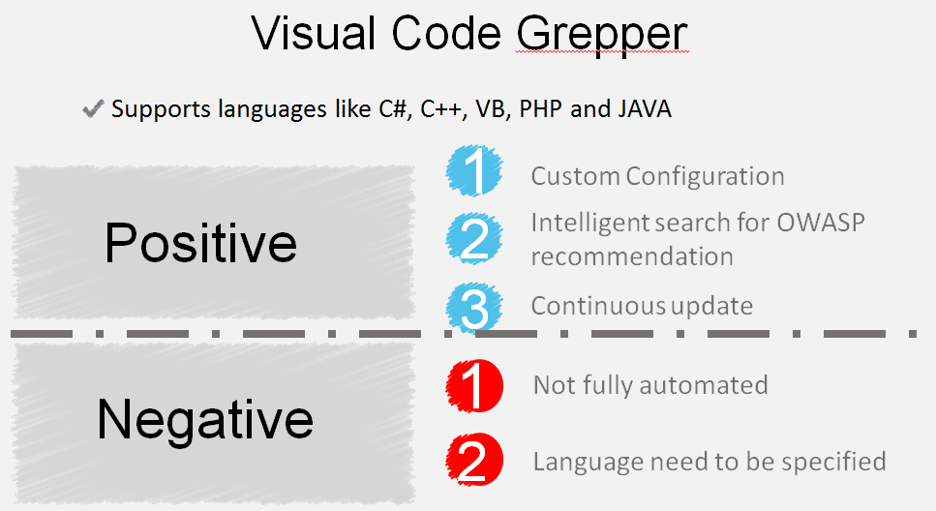
Tools

Slide 13
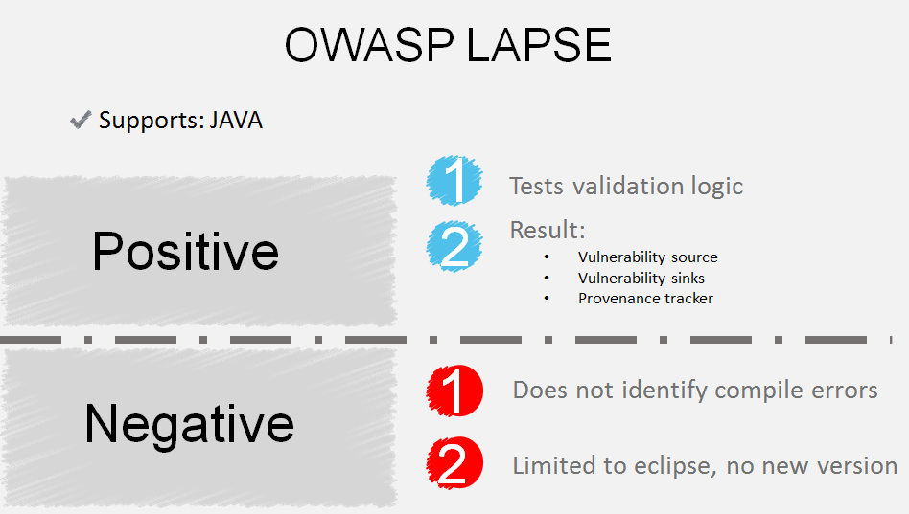
TOOLS

Slide 14
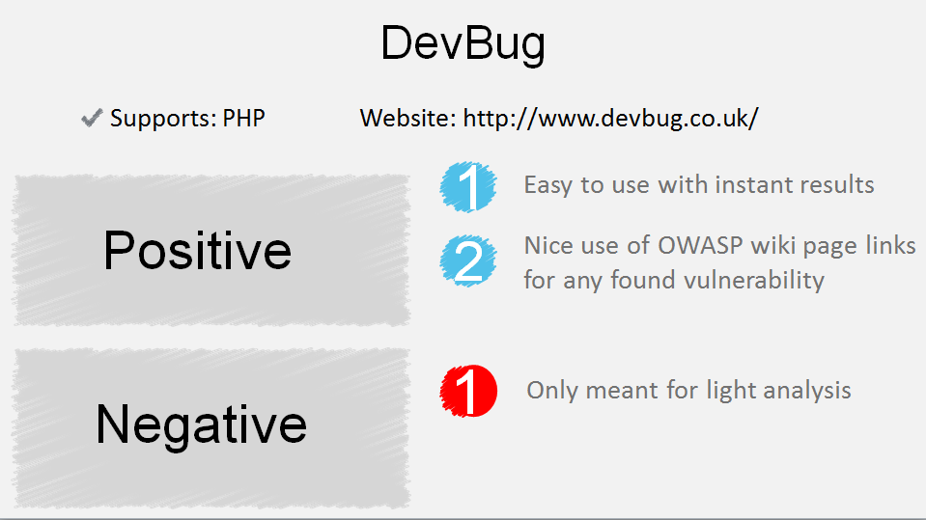
tools

Slide 15
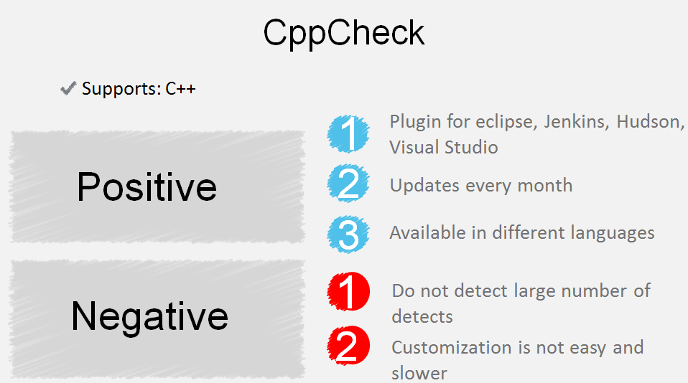
tools

Slide 16
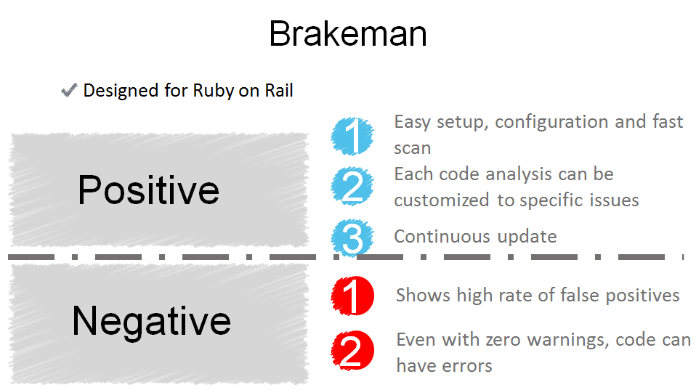
tools

Slide 17
Exercice 1 what are the benefits of static analysis?
1 - Provides early warnings of suspicious code?
2 - Evaluates real time performance?
3 - Finds incorrect dependencies?
4 - Verifies actual results from use of software?
5 - Reveals hard-to-find defects?
6 - Improves code maintainability?
7 - Helps prevent defects?

Slide 18
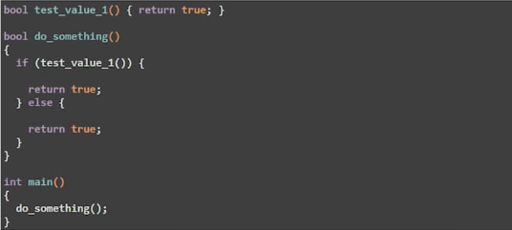
Exercice 2 what’s wrong?

Slide 19
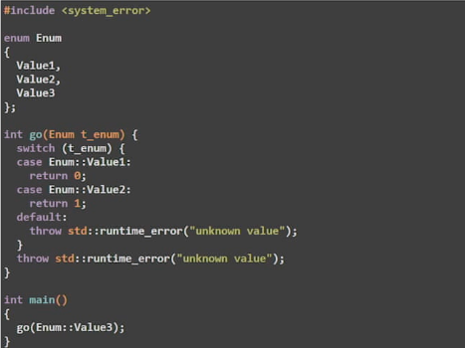
Exercice 3

