Slide 1

TARE
Hire for judgment.
Not just credentials.
Game-based behavioral assessment for law firms
Maddie Merrill • Founder
Notes:
Slide 1 — target 20 seconds
There is a hole in hiring. A résumé can tell you what someone has done, and an interview can tell you how well they prepared. Neither lets you watch how they make a difficult decision. Tare does. We turn judgment into something employers can observe before the offer letter.

Slide 2
Law firms discover fit after the hire.
83%
The missing evidence
How do they negotiate
when information is incomplete?
of associates who departed in 2025
left within five years of hire.
When do they question
authority, assumptions, or the rules?
What do they protect
when every choice has a cost?
Firms do not need another résumé filter. They need earlier evidence of fit.
NALP Foundation, 2026 report on 2025 associate departures (141 firms)
Notes:
Slide 2 — target 30 seconds
That blind spot is expensive, especially in law. The NALP Foundation found that a record 83 percent of associates who departed in 2025 left within five years of hire. Law firms do not merely need another résumé filter. They need earlier evidence of how a future lawyer negotiates, questions, notices details, handles risk, and responds when every available choice has a cost.
Sources / accuracy notes:
https://www.nalpfoundation.org/news/the-nalp-foundation-releases-latest-update-on-associate-attrition-and-hiring-%28cy-25%29

Slide 3
WATCH JUDGMENT HAPPEN.
Welcome to
The Weigh Station.
01
ASK
Spend limited inquiry points to uncover context.
02
WEIGH
Interpret conflicting facts, motives, and consequences.
03
DECIDE
Create a behavioral pattern across 30 questions.
Employer portal • candidate invitations • confidential reports
Notes:
Slide 3 — target 25 seconds
Tare’s first product is The Weigh Station. Candidates question visitors, spend limited inquiry points, and make rulings with incomplete information. We do not ask whether someone is thoughtful. We watch what they investigate, overlook, and choose across 30 connected decisions.

Slide 4
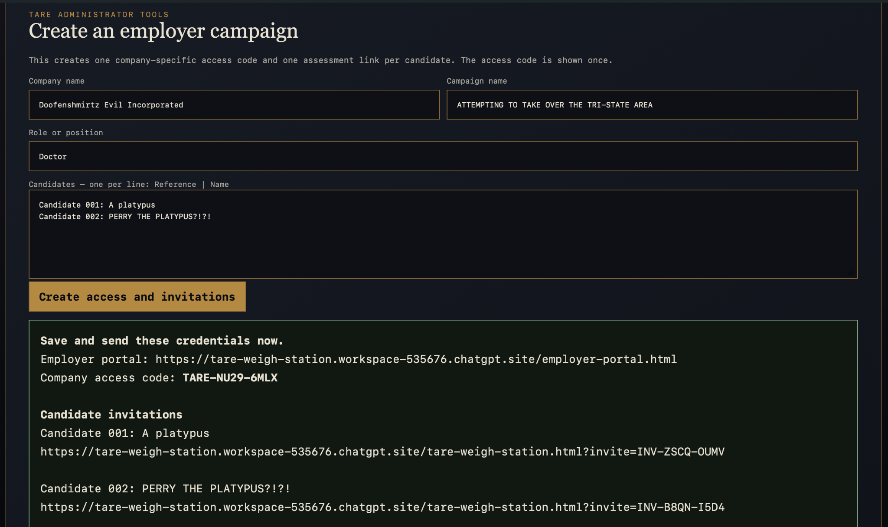
Notes:
Interactive demo — blank campaign — target 6 seconds
So first, Tare asks for your company name—which, of course… [CLICK]

Slide 5
Notes:
Interactive demo — company revealed — target 7 seconds
…is Doofenshmirtz Evil Incorporated. And their campaign is… [CLICK]

Slide 6
Notes:
Interactive demo — campaign revealed — target 7 seconds
…attempting to take over the Tri-State Area. Naturally, they are hiring a… [CLICK]

Slide 7
Notes:
Interactive demo — role revealed — target 6 seconds
…doctor. Their candidate pool includes… [CLICK]

Slide 8
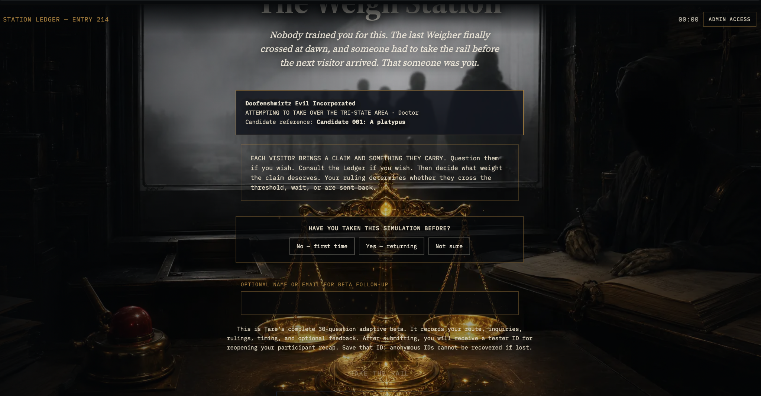
Notes:
Interactive demo — Perry payoff — target 12 seconds
…a platypus—and PERRY THE PLATYPUS?! Tare immediately creates the employer credentials and candidate invitations, and that personalized link opens the working assessment you see here. Across 30 questions, Tare records inquiries, timing, routes, and rulings. [CLICK]

Slide 9
A proven category—with room to go deeper.
Service first
Validate
r = .516
Paid pilots + firm-specific calibration
Compare patterns with real performance
moderate convergence between game-based and conventional personality measures
Scale
Expand
Repeatable assessment + employer platform
New scenarios for high-judgment industries
HireVue • Harver • SHL • Arctic Shores prove employers buy simulations.
Tare’s wedge is contextual judgment.
18 studies • 13 peer-reviewed articles
Fadillah, Hidayat & Santoso, 2025 meta-analysis (18 studies; r=.516; significant heterogeneity)
Notes:
Slide 9 — target 35 seconds
The category is credible. A 2025 meta-analysis of 18 studies found a moderate, statistically significant relationship between game-based assessments and conventional personality measures. That does not validate Tare yet—it tells us the signal is worth testing rigorously. We begin as a high-touch service: paid law-firm pilots, firm-specific calibration, and comparison against real performance. Then we turn the validated process into a repeatable platform and expand to other high-judgment industries.
Sources / accuracy notes:
https://journal.seriousgamessociety.org/~serious/index.php/IJSG/article/download/1028/636/6860

Slide 10
TARE
Help us prove
the signal.
“A scale shows a weight.
Tare accounts for what you’re weighing.”
The prize funds our first rigorous validation cycle.
BETA TESTERS
Build the dataset
MADDIE MERRILL • 17-YEAR-OLD FOUNDER
Working 30-question assessment
Employer portal + confidential reports
Built from idea to pilot-ready prototype
LAW-FIRM PILOTS
Validate against performance
I-O PSYCHOLOGY + HR
Strengthen the science
Notes:
Slide 10 — target 30 seconds
I am Maddie Merrill. I am 17, and I have already taken Tare from an idea to a working 30-question assessment, employer portal, candidate invitation system, and detailed report engine. Now I need the people who can help me prove the signal: beta testers, law-firm pilots, and experts in HR and industrial-organizational psychology. This prize would fund our first rigorous validation cycle. A scale shows a weight. Tare accounts for what you are weighing. Help me build a hiring process that can recognize the diamonds in the rough before they are overlooked.

