Slide 1

TARE
Hire for judgment.
Not just credentials.
B2B simulation assessment for early-career legal hiring
Maddie Merrill • Founder
Notes:
Slide 1 — target 18 seconds
There is a hole in the way law firms hire summer associates and entry-level lawyers. A résumé shows credentials, and an interview shows preparation, but neither lets a hiring partner watch how a candidate makes a difficult decision. Tare does: we turn judgment into something employers can observe before the offer letter.

Slide 2
Beachhead: law-firm early-career hiring.
83%
The missing evidence
How do they negotiate
when information is incomplete?
of associates who departed in 2025
left within five years of hire.
When do they question
authority, assumptions, or the rules?
What do they protect
when every choice has a cost?
For summer associate and entry-level lawyer hiring, firms need earlier evidence of fit.
NALP Foundation, 2026 report on 2025 associate departures (141 firms)
Notes:
Slide 2 — target 25 seconds
That blind spot is expensive. The NALP Foundation found that 83 percent of associates who departed in 2025 left within five years of hire. In legal hiring, candidates can look very similar on paper, but the job depends on how they negotiate, question assumptions, notice details, handle risk, and respond when every option has a cost.
Source: https://www.nalpfoundation.org/news/the-nalp-foundation-releases-latest-update-on-associate-attrition-and-hiring-%28cy-25%29

Slide 3
WATCH JUDGMENT HAPPEN.
Welcome to
The Weigh Station.
01
ASK
Spend limited inquiry points to uncover context.
02
WEIGH
Interpret conflicting facts, motives, and consequences.
03
DECIDE
Create a behavioral pattern across 30 questions.
Law-firm campaigns • candidate invitations • confidential reports
Notes:
Slide 3 — target 25 seconds
Introducing Tare: a B2B simulation-based assessment platform for legal hiring. Our first product is The Weigh Station, and it is already working on our website. Candidates question visitors, spend limited inquiry points, and make rulings with incomplete information. We do not just ask if someone is thoughtful. We watch what they investigate, overlook, and choose across 30 decisions.

Slide 4
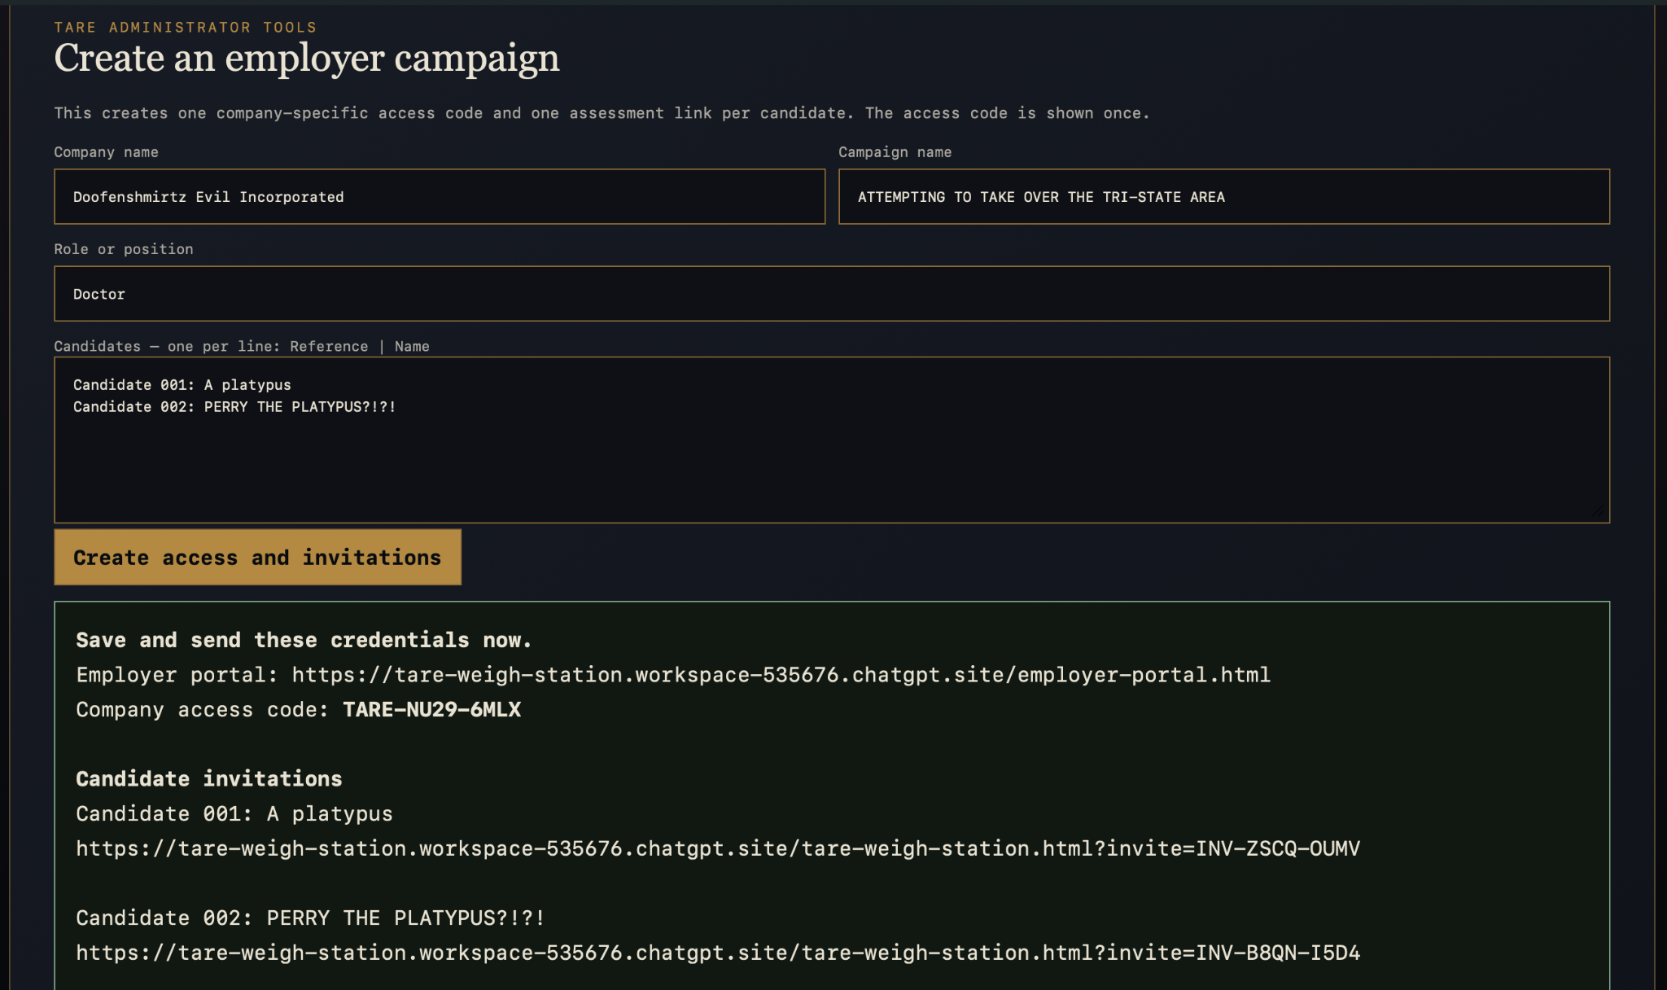
HOW A LAW-FIRM PILOT WORKS
Replace this frame with a silent 20–25 second looping product video.
LOOPING DEMO VIDEO
1. Create a law-firm campaign
2. Generate candidate invitations
3. Candidate completes The Weigh Station
4. Employer receives the report
01
CREATE
Firm sets role and hiring campaign.
02
INVITE
Candidates receive individual links.
03
OBSERVE
Tare tracks inquiries, timing, and rulings.
04
REPORT
Employer gets behavioral evidence—not just a score.
Beachhead customer: law firms hiring summer associates and entry-level lawyers.
Notes:
Slide 4 — target 25 seconds
Here is the pilot workflow. A law firm creates a campaign for a summer associate or entry-level hiring process. Tare generates individual candidate invitations. Candidates enter the simulation, spend inquiry points, and make decisions under uncertainty. Then the employer receives a confidential report showing what each candidate asked, missed, protected, and chose. This is not a marketplace. Tare sells assessment access and reporting tools directly to employers.

Slide 5
TARE
Start narrow. Validate deeply. Scale outward.
r = .516
moderate convergence
between game-based and
conventional personality
measures
Beachhead market
employers
Law firms hiring summer associates and entry-level lawyers.
Paid pilots → firm-specific calibration → validated legal hiring platform.
Expand
Adjacent
industries
Platform
Legal hiring
product
Validate
Performance
data
Beta
18 studies • 13 peer-reviewed articles
Now
Paid law-firm
pilots
Working
prototype
time
B2B assessment sold to employers — not a job marketplace.
Fadillah, Hidayat & Santoso, 2025 meta-analysis (18 studies; r=.516; significant heterogeneity)
5
Notes:
Slide 5 — target 42 seconds
The category is already credible. A 2025 meta-analysis of 18 studies found moderate convergence between game-based assessments and conventional personality measures. That does not prove Tare yet. It proves the signal is worth testing rigorously.
Our beachhead is narrow on purpose: law firms hiring summer associates and entry-level lawyers. We begin with paid pilots, calibrate Tare against each firm’s strongest performers, and validate the results against real workplace outcomes. From there, we expand across legal hiring, turn the process into a repeatable software platform, and eventually enter other high-judgment professions.
Source: https://journal.seriousgamessociety.org/~serious/index.php/IJSG/article/download/1028/636/6860

Slide 6
TARE
Help us prove
the signal.
“A scale shows a weight.
Tare accounts for what you’re weighing.”
The prize funds our first rigorous validation cycle.
LAW-FIRM BETA TESTERS
Build the dataset
MADDIE MERRILL • FOUNDER
Working 30-question assessment
Employer portal + confidential reports
Beachhead: early-career legal hiring
PAID LAW-FIRM PILOTS
Validate against performance
I-O PSYCHOLOGY + HR
Strengthen the science
Notes:
Slide 6 — target 28 seconds
Tare matters to me because I have seen how much people reveal through interactive stories: what they question, when they hesitate, when they follow rules, and when they challenge them. Hiring should not miss that kind of evidence. What we need now is law-firm beta testers, paid pilots, and experts in HR and industrial-organizational psychology willing to help us prove the signal. A scale shows weight. Tare accounts for what you are weighing. Thank you.

