Slide 1
<BOARD NAME>
<SUBJECT>
<CLASS>
<1, 2, 3>
<Name of the chapter>

Slide 2

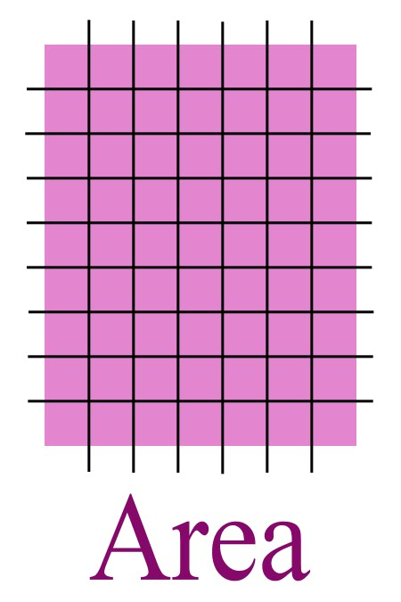
Recall What is area ????
The extent or measurement of a surface is called area .

Slide 3

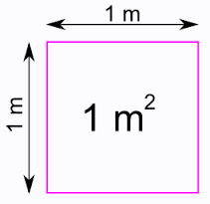
Recall what is it’s unit ????
unit² (square unit)

Slide 4

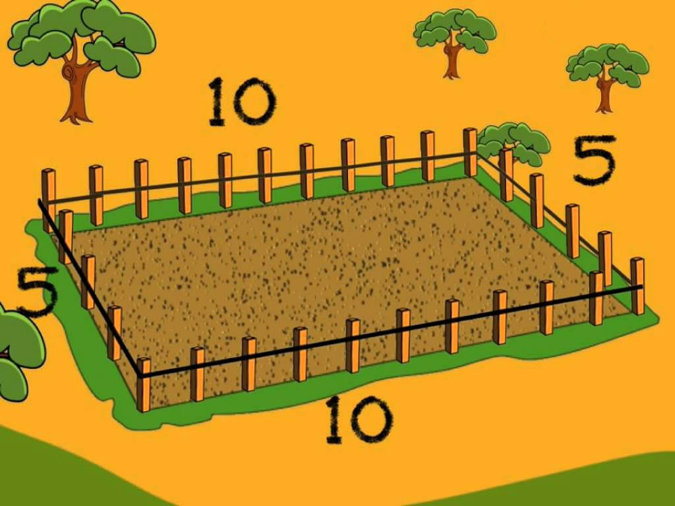
Correlate what do we need to calculate ……
While putting wire around the park

Slide 5

Length of wire = Perimeter of rectangular park
=2(l+b)
=2(5+10)
=2(15)
=30 units
Therefore, length of wire = 30 units

Slide 6
Correlate what do we need to calculate ……
While growing grass in the park

Slide 7
grass
Region where grass can be grown = Area of rectangular park
= l x b
= 10 x 5
= 50 sq. units
Therefore, grass can be grown in area of 50 sq. units

Slide 8

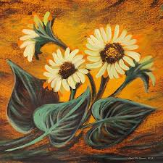
Now calculate the following for the
square painting
What would be length of frame required

Slide 9
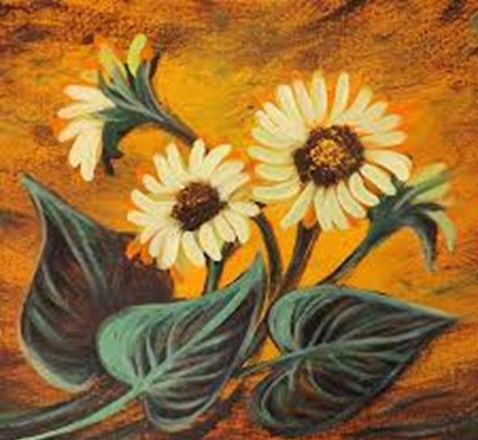

5 cm
Length of frame = perimeter
=4 x side
= 4 x 5
=20 cm
Therefore the length of frame will be 20 cm

Slide 10

Now calculate the following for the
square painting
What will be the glass required

Slide 11
5 cm
glass = area
=side²
= 5²
=25 sq.cm
Therefore the glass required will be 25 sq.cm

Slide 12


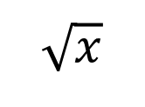

Express square root of $x$ in symbolic
form
$$\sqrt{x}$$
Find square root of:
$$\sqrt{4}=2$$
$$\sqrt{36}=6$$
$$\sqrt{44}=2\sqrt{11}$$
$$\sqrt{50}=5\sqrt{2}$$
$$\sqrt{80}=4\sqrt{5}$$

Slide 13

Types of Triangles
Equilateral
Isosceles
Scalene

Slide 14

What will be the area of the following triangle
A
7cm
B
C
15cm
Area = ½ x base x height
= ½ x 15 x 7
= 52.5 cm

Slide 15

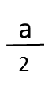
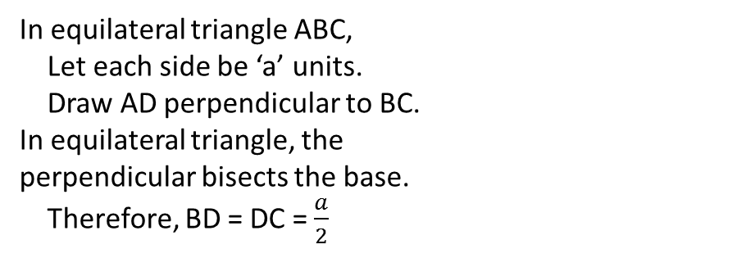
Calculate the area of an equilateral triangle with side ‘a’ units
A
In equilateral triangle ABC,
Let each side be ‘a’ units.
Draw AD perpendicular to BC.
In equilateral triangle, the
perpendicular bisects the base.
Therefore, BD = DC = $\frac{a}{2}$
a
a
h
B
D
C
a

Slide 16
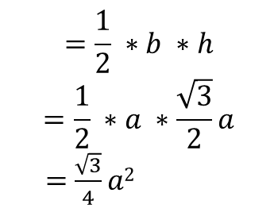
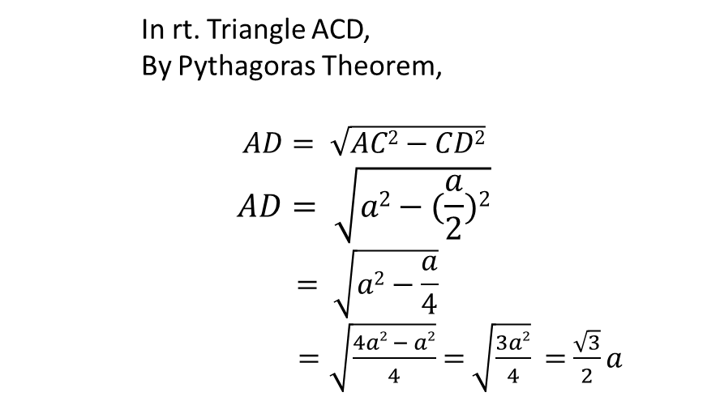
In rt. Triangle ACD,
By Pythagoras Theorem,
$$AD= \sqrt{AC2−CD2}$$
$$AD= \sqrt{a2−(\frac{a}{2})2}$$
$$= \sqrt{a2−\frac{a}{4}}$$
$=\sqrt{\frac{4a2 − a2}{4}}$$=$$\sqrt{\frac{3a2}{4}}$$=$$\frac{\sqrt{3}}{2}a$
Area,
$$=\frac{1}{2} ∗b ∗h$$
$$=\frac{1}{2} ∗a ∗\frac{\sqrt{3}}{2}a$$
$=$$\frac{\sqrt{3}}{4}a2$

Slide 17
Calculate the area of an isosceles triangle with equal sides of 13 units and 3rd side of length
24 units
A
13
13
h
5
12
D
12
B
C
24
In isosceles triangle ABC,
Draw AD perpendicular to BC.
In isosceles triangle, the
perpendicular bisects the base.
Therefore, BD = DC = 12 units.

Slide 18
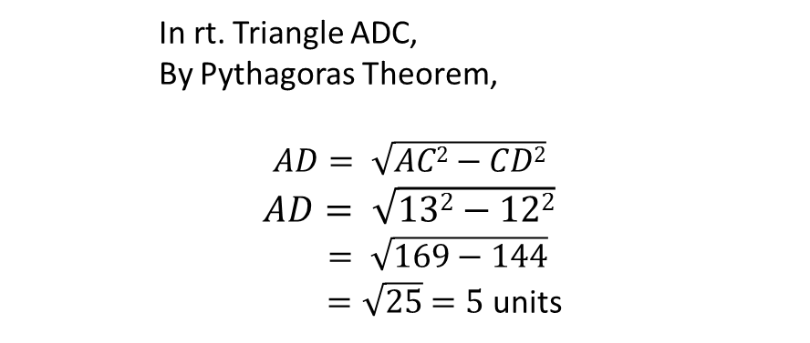
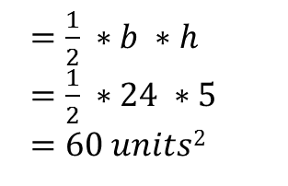
In rt. Triangle ADC,
By Pythagoras Theorem,
$$AD= \sqrt{AC2−CD2}$$
$$AD= \sqrt{132−122}$$
$= \sqrt{169−144}$
$=\sqrt{25}$$=5$ units
Now,
Area
$=\frac{1}{2} ∗b ∗h$
$=\frac{1}{2} ∗24 ∗5$
$=60 units$²

Slide 19
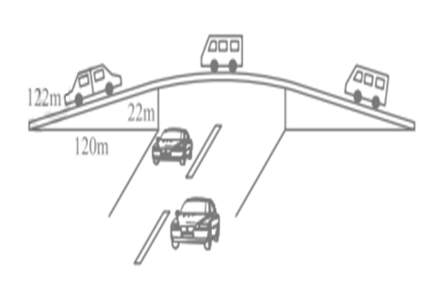
From the figure of flyover, find the area of the shaded region below the car A.
Car A
Flyover

Slide 20
When the height is unknown
and the sides are given,
we use a new formula
known as …
Heron’s formula

Slide 21
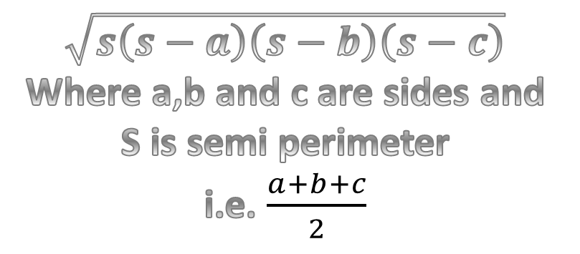
The formula is
$$\sqrt{s\left(s−a\right)\left(s−b\right)\left(s−c\right)}$$
Where a,b and c are sides and
S is semi perimeter
i.e. $\frac{a+b+c}{2}$
a
b
c

Slide 22
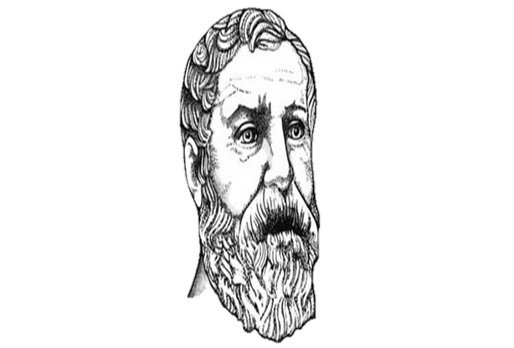
Heron was born in about 10AD possibly in Alexandria in Egypt. He worked in applied mathematics. His works on mathematical and physical subjects are so numerous and varied that he is considered to be an encyclopedic writer in these fields. Heron has derived the famous formula for the area of a triangle in terms of its
three sides.

Slide 23
INDEX TEMPLATE
Notes:
Please fill up the index template and embed it in the last slide of the presentation. Do not un-hide the slide.

