Slide 1
AIT | EXPLAINABLE DATA SCIENCE
Evaluating the Trustworthiness of Explanations for Student Dropout Risk
Comparing Black-Box and Interpretable Models
Aye Khin Khin Hpone (Yolanda Lim) | Nguyen Liem Son (Lucas) | Witchayda Theppithuk (Noey)
Han Htoo Zaw (Han) | Pyae Sone Han (Harry)
Locked model comparison | explanation audit | 50-person human study
AIT XDS | The Interpreters
1
Notes:
Timing: 0:40. Open with the decision problem, not the algorithm. State that the study asks whether a complex model and its explanations are justified.

Slide 2
MOTIVATION
The real decision is a capacity-limited contact list
20%
After S1
Support
Assumed share of a cohort that the support office can contact
Prediction point: after first-semester results are available
A flag offers a conversation; it never denies assistance
Score -> rank -> contact the top one in five
Student records
Risk ranking
Adviser review
AIT XDS | The Interpreters
2
Notes:
Timing: 1:20. Explain asymmetric errors: a missed student may receive no offer; an unnecessary flag uses a scarce meeting. Stress human review.

Slide 3
RESEARCH QUESTIONS
Three questions organise the study
RQ1
Predictive value
Does TabICL add value over conventional and interpretable baselines at the same 20% capacity?
RQ2
Explanation trustworthiness
Are the local explanations faithful, stable and appropriately constrained?
RQ3
Human usefulness
Do explanation charts help people anticipate the model's outreach flag?
AIT XDS | The Interpreters
3
Notes:
Timing: 1:00. State the three questions exactly and use them as signposts throughout the talk.

Slide 4
DATA DESIGN
One public cohort, one frozen split, one locked test
4,424
3,630
33
Original UCI records: Dropout, Enrolled and Graduate
Binary cohort after excluding 794 still-enrolled outcomes
Inputs after first semester; all second-semester fields removed
TRAIN
VALIDATION
LOCKED TEST
2,541
544
545
70%
15%
15%
Stratified once | seed 42 | every modelling choice fixed on validation
AIT XDS | The Interpreters
4
Notes:
Timing: 1:25. Explain why Enrolled was excluded and why that remains a deployment limitation. Mention the prediction window and frozen IDs.

Slide 5
FROZEN WORKFLOW
The test was protected from iterative model selection
1
Decision frame
2
Data design
3
Model development
6
Local explanations
5
One-time final test
4
Validation freeze
7
Post-hoc audit
8
Human study
9
Deliverables
Orange = added after the locked test without changing the model
AIT XDS | The Interpreters
5
Notes:
Timing: 1:20. Highlight the hash and lock file. The full explanation audit was post-hoc but used validation only and did not alter the model.

Slide 6
MODELS AND EVALUATION
Complexity was tested against strong, simpler baselines
Logistic regression
Depth-3 tree
XGBoost
Main-effects EBM
TabICL
Interpretable
Interpretable
Black box
Interpretable
Black box
Linear baseline
Small rule set
Tuned boosting
Shape functions, no interactions
Tabular foundation model
Same operating point for every model
Top 20% flagged by cohort rank
ROC-AUC and Brier score
Recall and precision at capacity
Paired bootstrap intervals: 2,000 resamples
AIT XDS | The Interpreters
6
Notes:
Timing: 1:15. Describe TabICL as the candidate, EBM as the key transparent comparator, and capacity metrics as the decision-relevant measures.

Slide 7
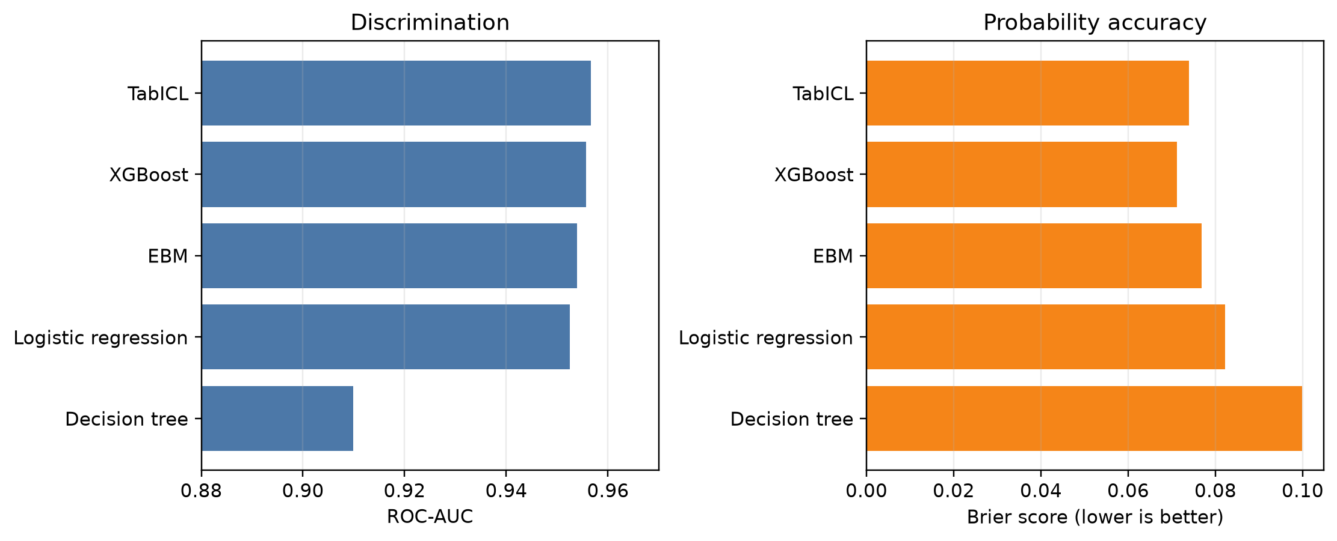
LOCKED FINAL TEST | n = 545
TabICL ranked well, but did not separate from EBM or XGBoost
0.957
TabICL ROC-AUC
0.954
EBM ROC-AUC
Delta = 0.003
95% CI -0.007 to 0.014
AIT XDS | The Interpreters
7
Notes:
Timing: 1:30. Avoid saying models are equal. Say the observed differences were small and the paired intervals included zero for TabICL versus EBM, XGBoost and logistic regression.

Slide 8
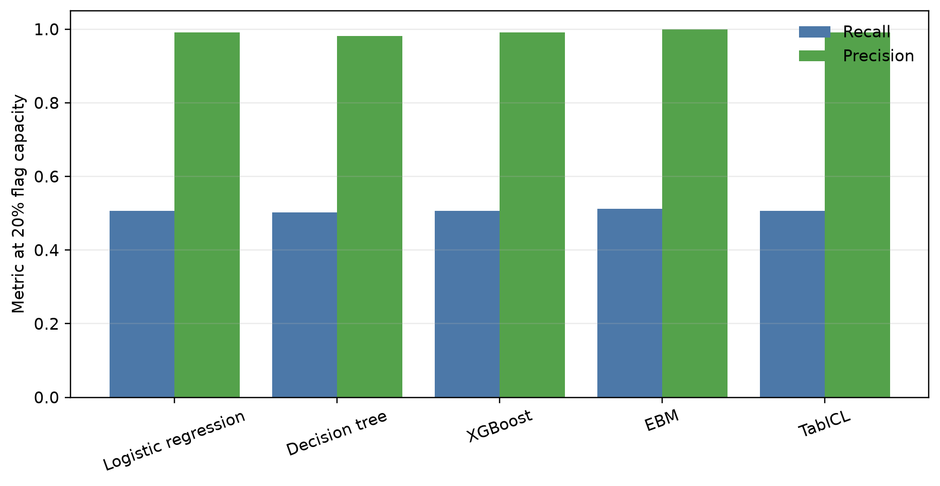
DECISION PERFORMANCE
Near-perfect precision coexists with missed dropouts
109
108
105
Students flagged in the locked test
Flagged students who later dropped out
Dropouts not flagged at 20% capacity
Precision 0.991
Recall 0.507
With 109 slots and 213 dropouts, recall cannot exceed about 0.51.
AIT XDS | The Interpreters
8
Notes:
Timing: 1:30. The high precision is real but does not imply comprehensive screening. Capacity mathematically limits recall.

Slide 9
PAIRED BOOTSTRAP: TabICL - BASELINE ROC-AUC
The added complexity is not supported by the uncertainty
Logistic regression
+0.004
-0.005 to +0.014
Decision tree
+0.047
+0.029 to +0.067
XGBoost
+0.001
-0.006 to +0.009
EBM
+0.003
-0.007 to +0.014
Only the small tree was clearly worse.
AIT XDS | The Interpreters
9
Notes:
Timing: 1:10. Explain the zero line. The decision-tree interval excludes zero; the other three do not.

Slide 10
WHO GETS FLAGGED? | VALIDATION
Most flags restate visible first-semester disengagement
108
78
93
Flagged validation students
Had passed no first-semester units
Unflagged dropouts had passed at least 1 unit
What the list adds
What remains difficult
Ordering of obvious high-risk records
Finding less-visible students who later leave
A simple transcript query could identify many of the clearest cases.
AIT XDS | The Interpreters
10
Notes:
Timing: 1:25. High precision partly comes from students who are already visibly disengaged; the important operational question is incremental benefit.

Slide 11
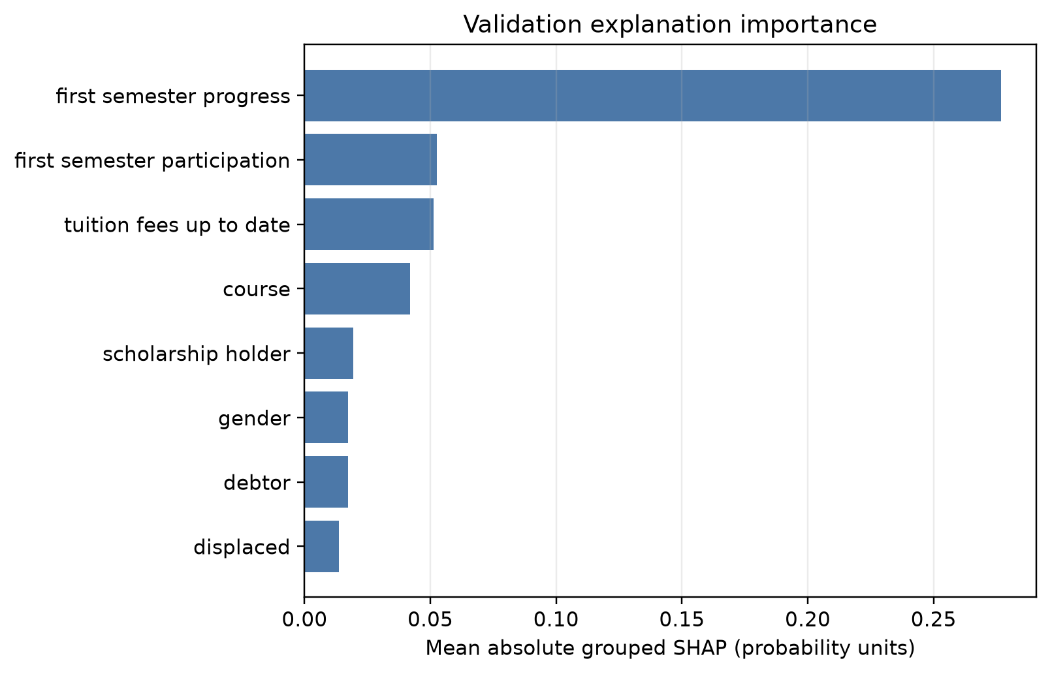
EXPLANATION AUDIT | 544 VALIDATION STUDENTS
Explanations are faithful - but dominated by one visible signal
536/544
Positive deletion-faithfulness cases
17/108
Flags with a fee/debt recourse candidate
Association is not cause
A score change is not an intervention effect.
AIT XDS | The Interpreters
11
Notes:
Timing: 1:30. Define deletion faithfulness. First-semester progress was the leading reason for every flagged student. Explain why fee recourse is model behaviour, not advice.

Slide 12
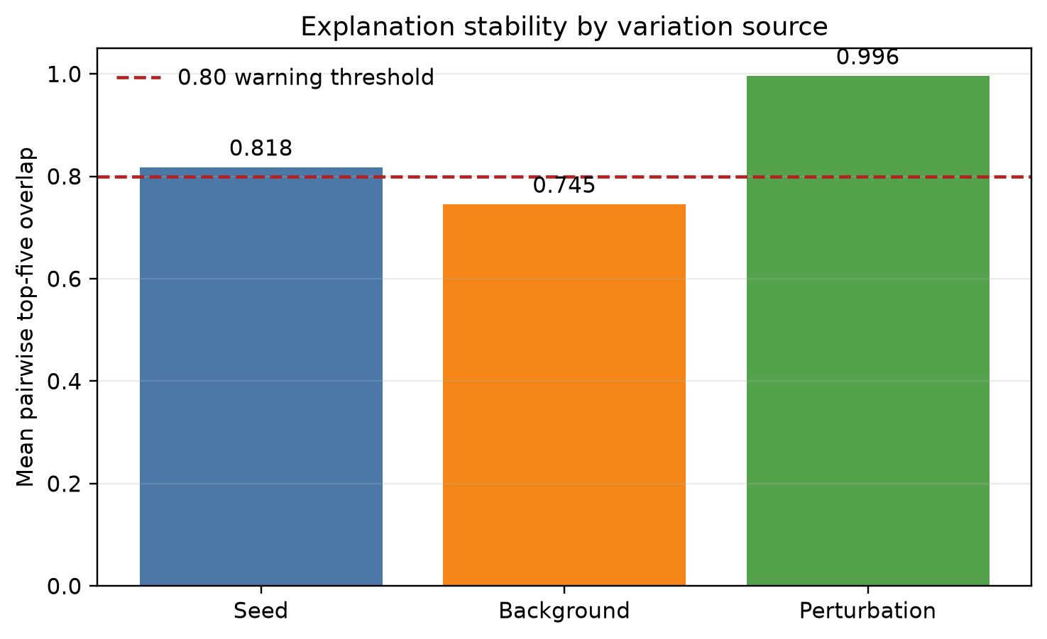
STABILITY
Top reasons depend on how the explanation is recomputed
411
Below 0.80 overlap when the comparison group changed
213
Below 0.80 overlap across random seeds
Minimal grade perturbations were stable in the tested setting.
AIT XDS | The Interpreters
12
Notes:
Timing: 1:25. Distinguish background and seed instability from the tested minimal-grade perturbation stability. Recommend showing uncertainty rather than a precise ranking.

Slide 13
HUMAN STUDY | n = 50
A two-group study tested whether charts help people predict the flag
25 participants
25 participants
Profiles only
Profile + chart
10 scored cases\n5 flagged | 5 unflagged
Student profile
Same student profile
Predict the hidden flag
+ five SHAP bars
Confidence + 3 written answers
Confidence + 3 written answers
Seeded assignment | two case orders | 500 scored responses | all participants retained
AIT XDS | The Interpreters
13
Notes:
Timing: 1:25. Clarify that this is forward simulation, not an intervention study and not a study with practising support officers.

Slide 14
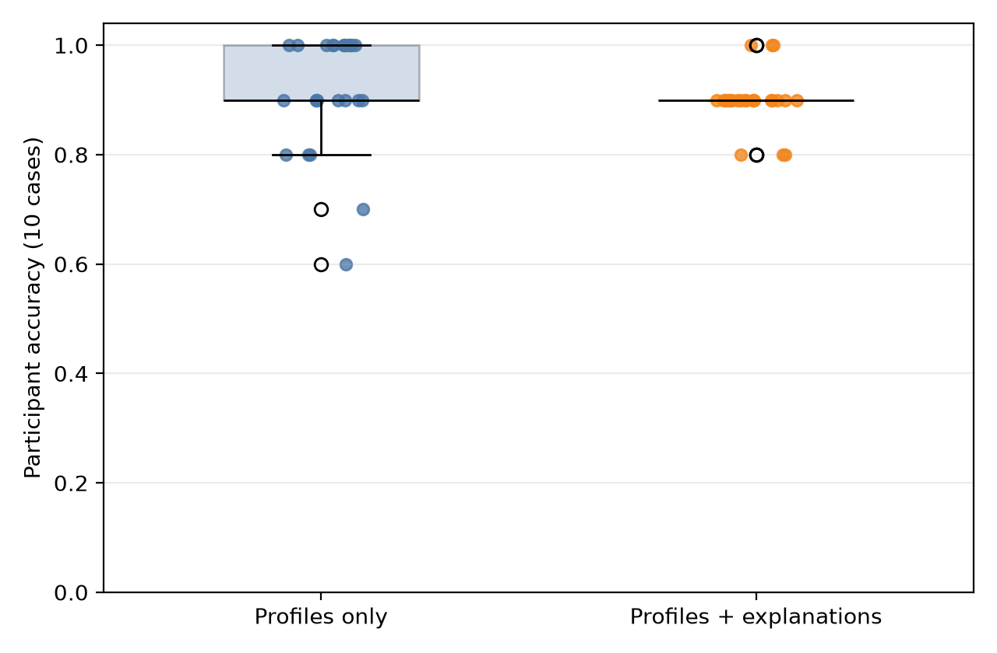
PARTICIPANT-LEVEL RESULTS
Charts increased confidence, not predictive accuracy
Metric | Profiles | + Charts | Difference [95% CI]
Accuracy | 0.916 | 0.900 | -0.016 [-0.060, 0.032]
Confidence | 4.14 | 4.35 | +0.21 [0.02, 0.42]
Minutes | 33.4 | 30.2 | -3.2 [-8.7, 2.0]
No evidence that the charts improved flag prediction.
Exploratory accuracy p = 0.61; Hedges' g = -0.19.
AIT XDS | The Interpreters
14
Notes:
Timing: 1:30. Lead with the confidence interval, not the p-value. Do not claim charts reduced accuracy generally; say the study found no evidence of an improvement.

Slide 15
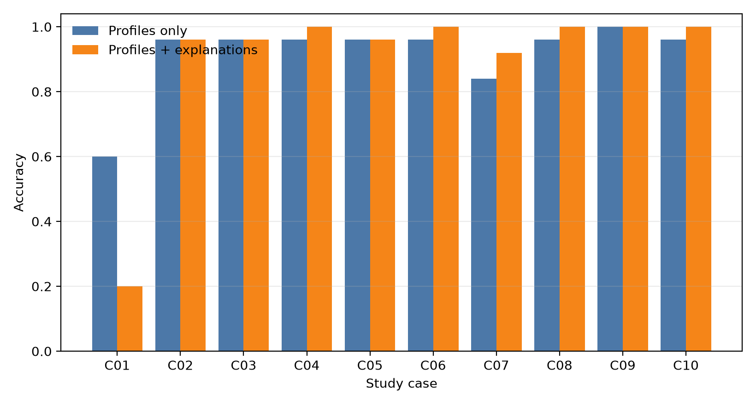
CASE C01
One unflagged case exposes a communication hazard
0.60 -> 0.20
Accuracy without versus with the chart on C01
Why?
Several bars pushed risk upward, but the chart did not show the cohort cut-off. More concern was easily read as flagged.
AIT XDS | The Interpreters
15
Notes:
Timing: 1:20. C01 drives the overall difference, but leave-one-case-out is post-hoc and does not prove benefit. The design lesson is to show the decision boundary.

Slide 16
QUALITATIVE RESULTS | 1,500 ANSWERS
Written answers reveal what people need beyond the model
40%
wanted academic engagement information
26%
wanted personal circumstances
attendance, current enrolment
work, family, caring responsibilities
76%
suggested a concrete next step
2.8%
asserted an unsupported cause
71% profiles; 82% charts
association was usually treated cautiously
Single coding pass; inter-coder agreement was not measured.
AIT XDS | The Interpreters
16
Notes:
Timing: 1:20. Focus on missing contextual information. Disclose the single coding pass and that comments were written, not spoken.

Slide 17
SENSITIVITY AND LIMITATIONS
The evidence supports further validation - not deployment
What the checks show
What the checks cannot establish
Admission-time ROC-AUC fell to 0.874
One Portuguese institution
One fixed split and one locked test
Removing protected attributes changed 5 of 108 flags
Human volunteers, not support officers
Gender recall gap narrowed from 0.19 to 0.10
No causal intervention or operational-benefit evidence
Enrolled-student sensitivity altered cohort rankings
Subgroup results are descriptive - not a fairness certificate
AIT XDS | The Interpreters
17
Notes:
Timing: 1:35. Be precise: protected-attribute analysis is descriptive. The system has not been externally, temporally, operationally or legally validated.

Slide 18
CONCLUSION
A transparent model is the better candidate for the next study
1
Predictive value
TabICL's advantage over EBM and XGBoost was within paired-bootstrap uncertainty.
2
Trustworthiness
SHAP was faithful, but the exact top reasons were often unstable and mostly restated progress.
3
Human evidence
The study found no evidence that charts improved predictions; one chart invited over-reading.
Next step: validate an EBM-based contact-list tool with current cohorts and practising support staff.
AIT XDS | Questions
18
Notes:
Timing: 1:10. Answer each RQ and end with the next validation step. Invite questions. Total planned speaking time: approximately 24-25 minutes.

Slide 19
Backup evidence
Detailed tables, sensitivity analyses, interface and reproducibility
APPENDIX
19

Slide 20
BACKUP
Locked final-test model metrics
Model | ROC-AUC | Brier | Bal. acc. | Macro F1 | Recall | Precision
Logistic regression | 0.953 | 0.082 | 0.752 | 0.766 | 0.507 | 0.991
Decision tree | 0.910 | 0.100 | 0.748 | 0.762 | 0.502 | 0.982
XGBoost | 0.956 | 0.071 | 0.752 | 0.766 | 0.507 | 0.991
EBM | 0.954 | 0.077 | 0.756 | 0.771 | 0.512 | 1.000
TabICL | 0.957 | 0.074 | 0.752 | 0.766 | 0.507 | 0.991
All models flag the top 20%; recall and precision refer to dropout at that capacity.
BACKUP | SOURCE: tables/final_test/metrics.csv
20

Slide 21
BACKUP | 2,000 BOOTSTRAP RESAMPLES
TabICL paired comparisons
Baseline | Delta ROC-AUC [95% CI] | Delta Brier [95% CI] | Interpretation
Logistic regression | 0.004 [-0.005, 0.014] | -0.008 [-0.017, 0.001] | Uncertain
Decision tree | 0.047 [0.029, 0.067] | -0.026 [-0.036, -0.016] | TabICL better
XGBoost | 0.001 [-0.006, 0.009] | 0.003 [-0.003, 0.009] | Uncertain
EBM | 0.003 [-0.007, 0.014] | -0.003 [-0.010, 0.004] | Uncertain
Differences are TabICL minus baseline; lower Brier is better.
BACKUP | SOURCE: tables/final_test/paired_comparisons.csv
21

Slide 22
BACKUP | n = 2,541
Training-split profile by outcome
Characteristic | Dropout | Graduate
Students | 995 | 1,546
First-semester units passed (mean) | 2.6 | 6.3
Passed no first-semester unit | 39.6% | 3.2%
Took no first-semester evaluation | 17.6% | 3.0%
Average grade (mean) | 7.3 | 12.7
Tuition fees up to date | 68.7% | 98.6%
Debtor | 21.5% | 5.0%
Scholarship holder | 9.8% | 39.1%
Age at enrolment (median) | 23 | 19
Female | 52.4% | 77.0%
BACKUP | TRAINING DATA ONLY
22

Slide 23
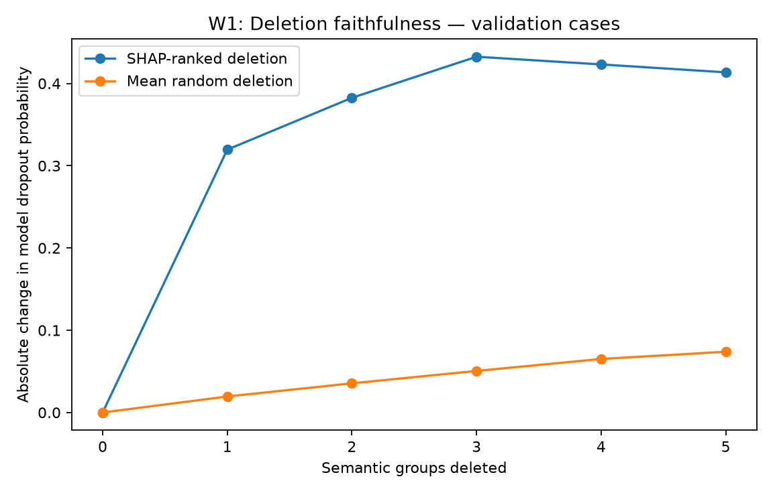
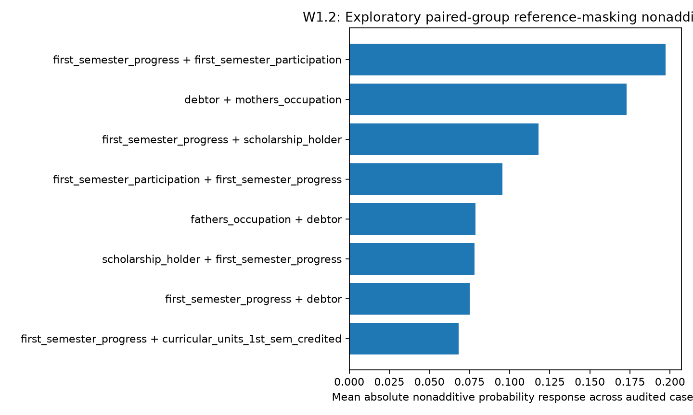
BACKUP | VALIDATION
Deletion faithfulness and pairwise effects
Deletion test: 536 of 544 cases had positive faithfulness area.
Progress x participation was the largest common non-additive pair.
BACKUP | EXPLANATION AUDIT
23

Slide 24
BACKUP | EXPLORATORY
Validation sensitivity analyses
Setting | ROC-AUC | Brier | Recall@20% | Precision@20%
Primary: after S1 | 0.952 | 0.071 | 0.507 | 1.000
Admission-time window | 0.874 | 0.135 | 0.469 | 0.926
Without protected attributes | 0.950 | 0.072 | 0.507 | 1.000
Enrolled added: frozen model | 0.924 | 0.111 | 0.587 | 0.947
Enrolled added: grouped refit | 0.929 | 0.085 | 0.606 | 0.977
At least 1 evaluation; re-ranked | 0.949 | -- | 0.559 | 1.000
Not used for model selection; Enrolled is treated as non-dropout only for this grouped sensitivity.
BACKUP | SENSITIVITY
24

Slide 25
BACKUP | NOT A FAIRNESS CERTIFICATE
Descriptive subgroup diagnostics
Attribute | Group | n | Dropout rate | Flag rate | Recall
Gender | Female | 335 | 0.299 | 0.122 | 0.410
Gender | Male | 210 | 0.538 | 0.324 | 0.593
Displaced | No | 229 | 0.476 | 0.288 | 0.596
Displaced | Yes | 316 | 0.329 | 0.136 | 0.414
Age at entry | <=20 | 318 | 0.283 | 0.116 | 0.411
Age at entry | 21-25 | 93 | 0.430 | 0.194 | 0.450
Age at entry | 26-35 | 83 | 0.663 | 0.434 | 0.655
Age at entry | 36+ | 51 | 0.549 | 0.353 | 0.607
BACKUP | LOCKED FINAL TEST
25

Slide 26
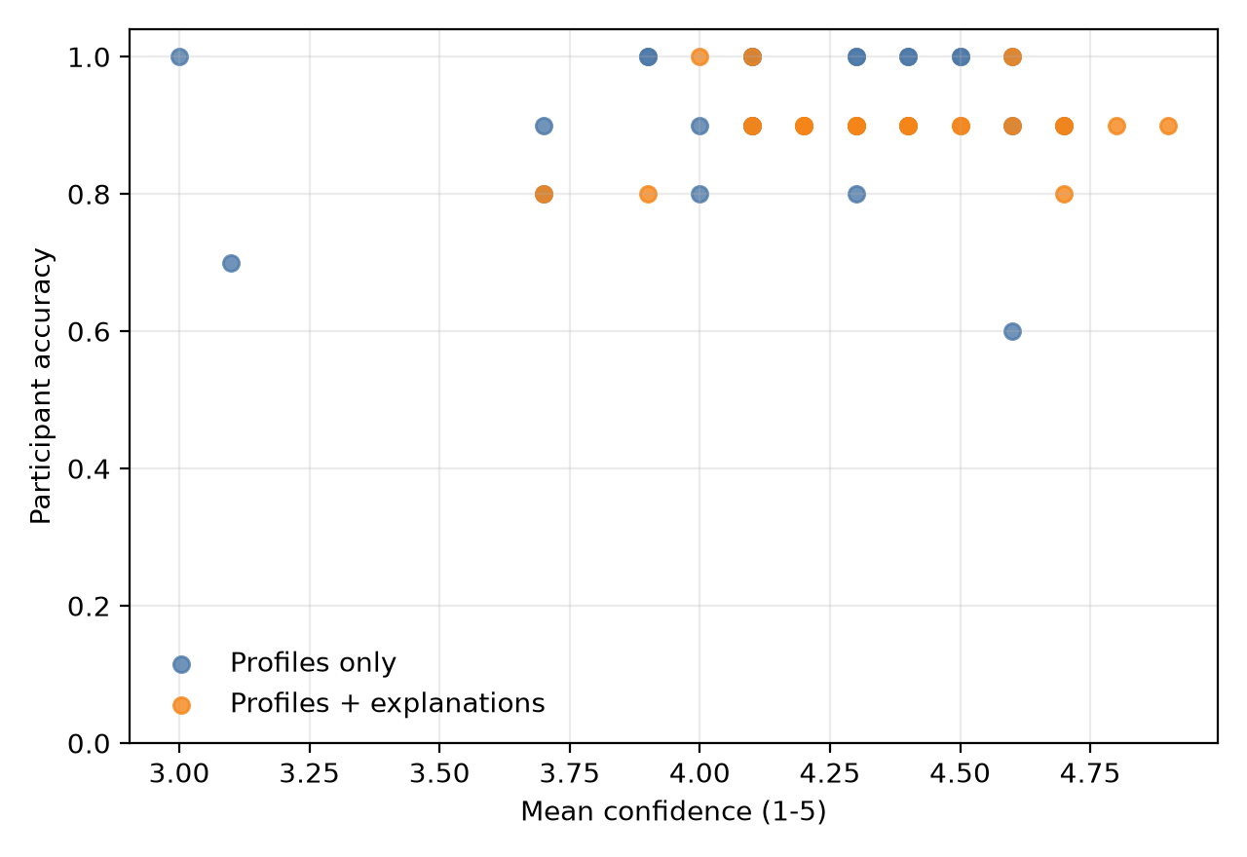
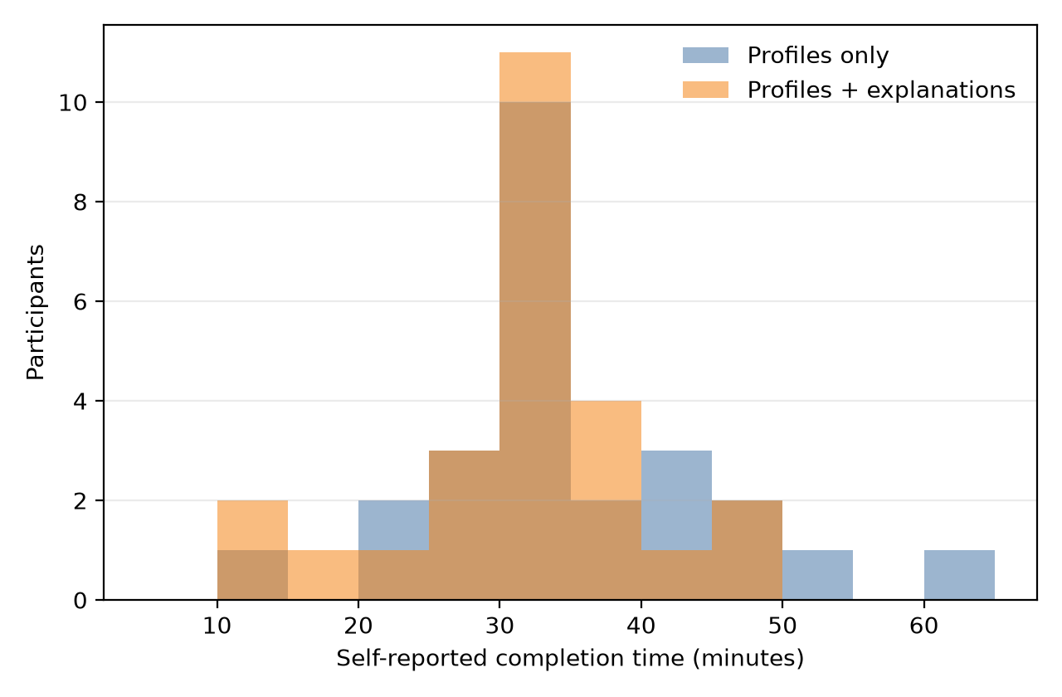
BACKUP
Human-study case and confidence detail
Chart group: higher mean confidence without higher accuracy.
Self-reported time difference: -3.2 min [-8.7, 2.0].
BACKUP | HUMAN STUDY
26

Slide 27
BACKUP | SINGLE CODING PASS
Primary qualitative themes
Question | Theme | Share
Why flagged | Explanation chart | 36.0%
Why flagged | Academic evidence | 31.0%
Why flagged | Several factors | 28.0%
Suggested support | Academic support | 29.8%
Suggested support | No action | 21.0%
Suggested support | Advising / monitoring | 16.0%
Suggested support | Financial / admin. support | 15.2%
Missing information | Academic engagement | 39.8%
Missing information | Personal circumstances | 25.8%
BACKUP | 1,500 WRITTEN ANSWERS
27

Slide 28
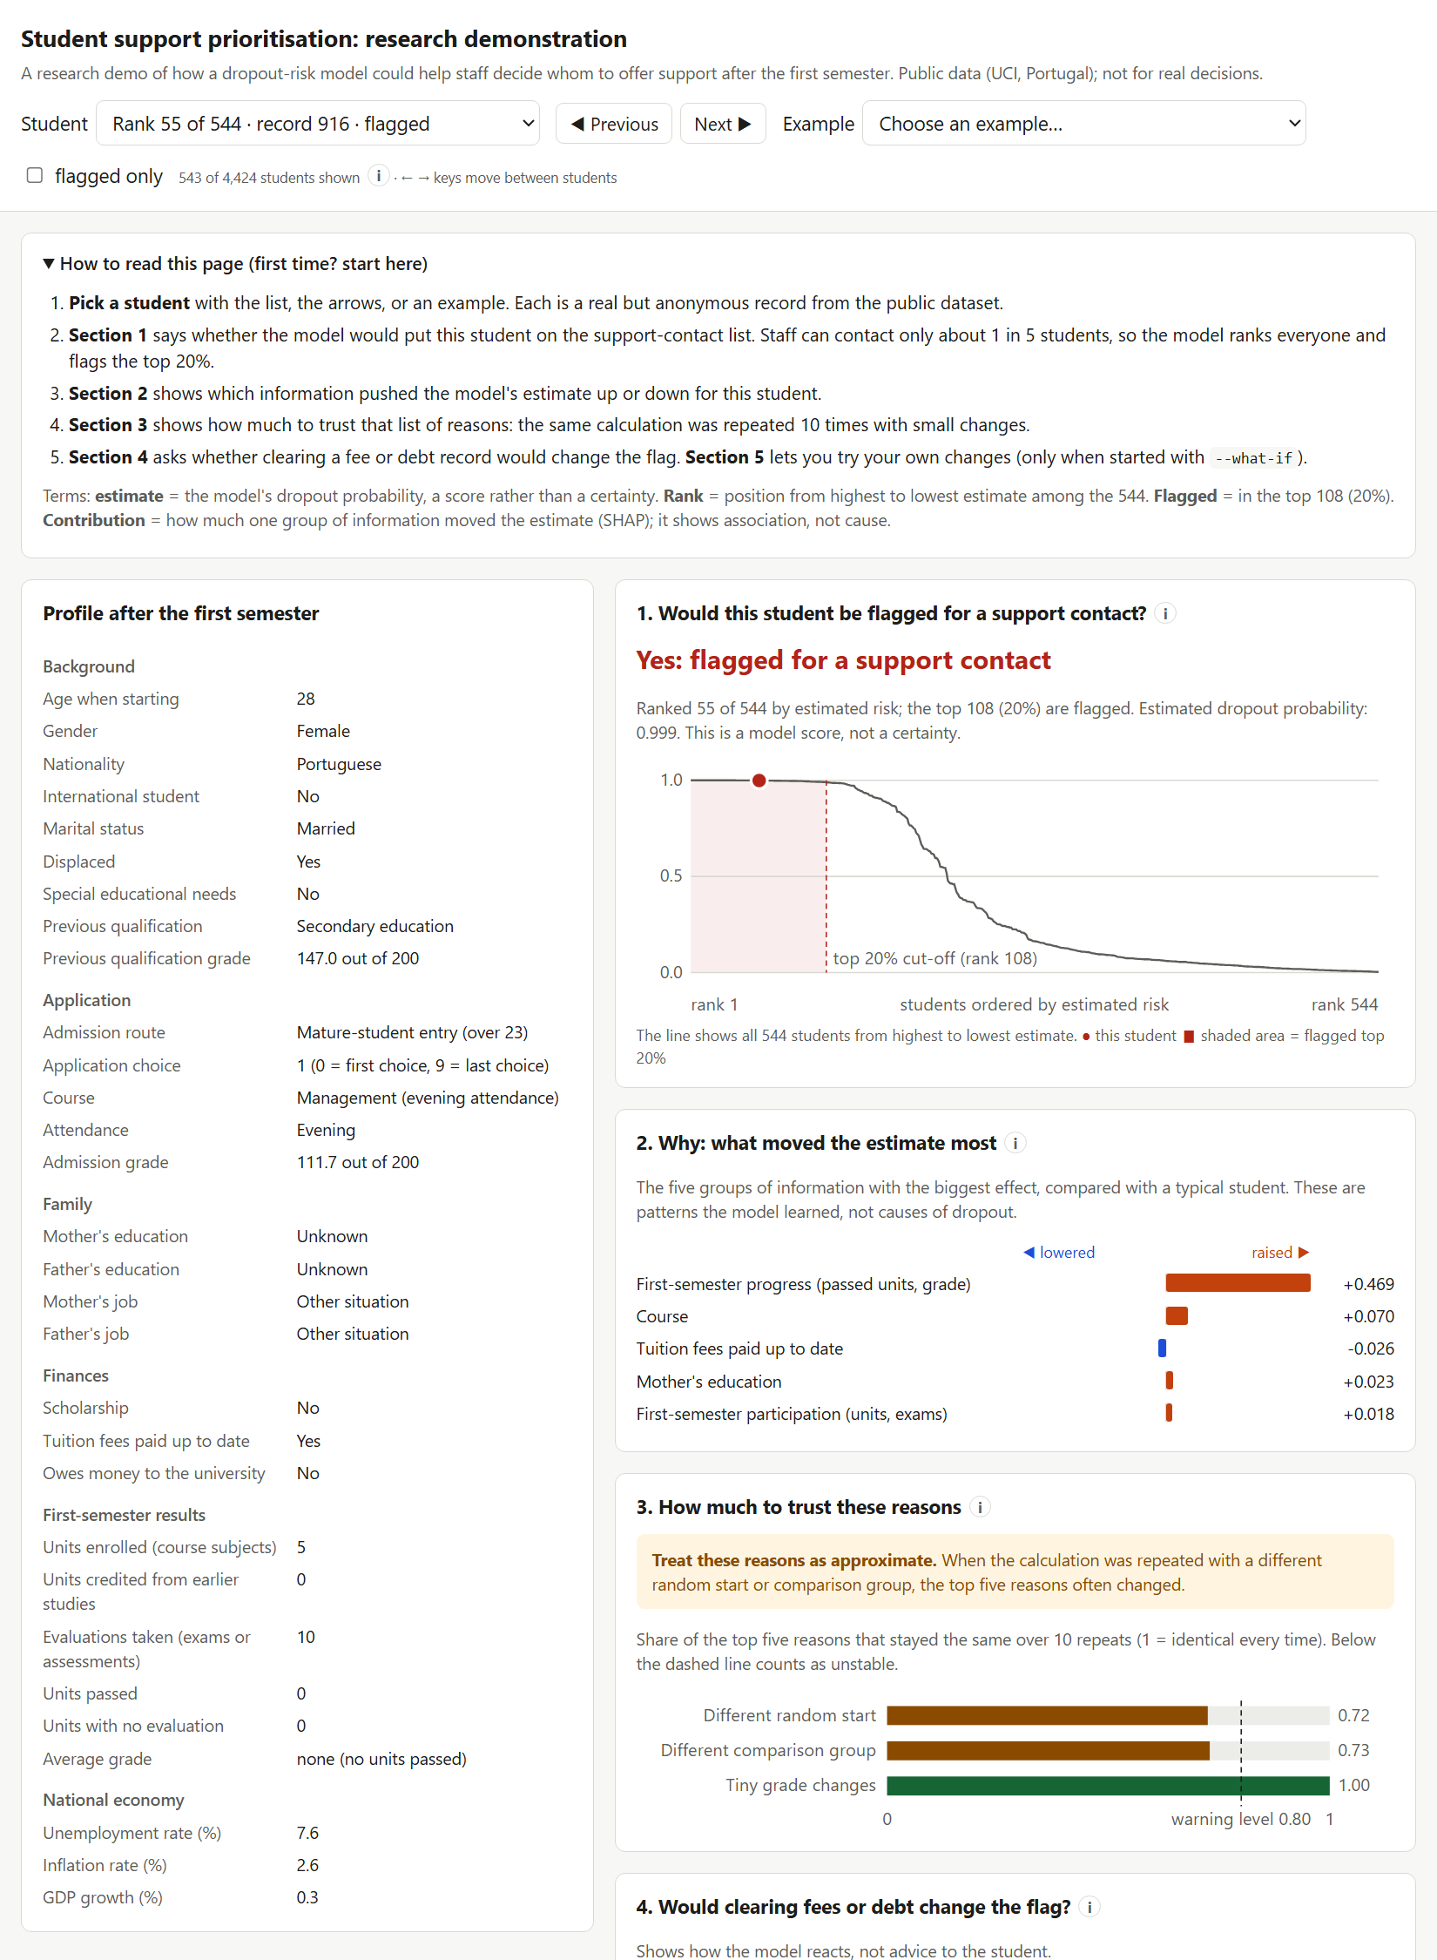
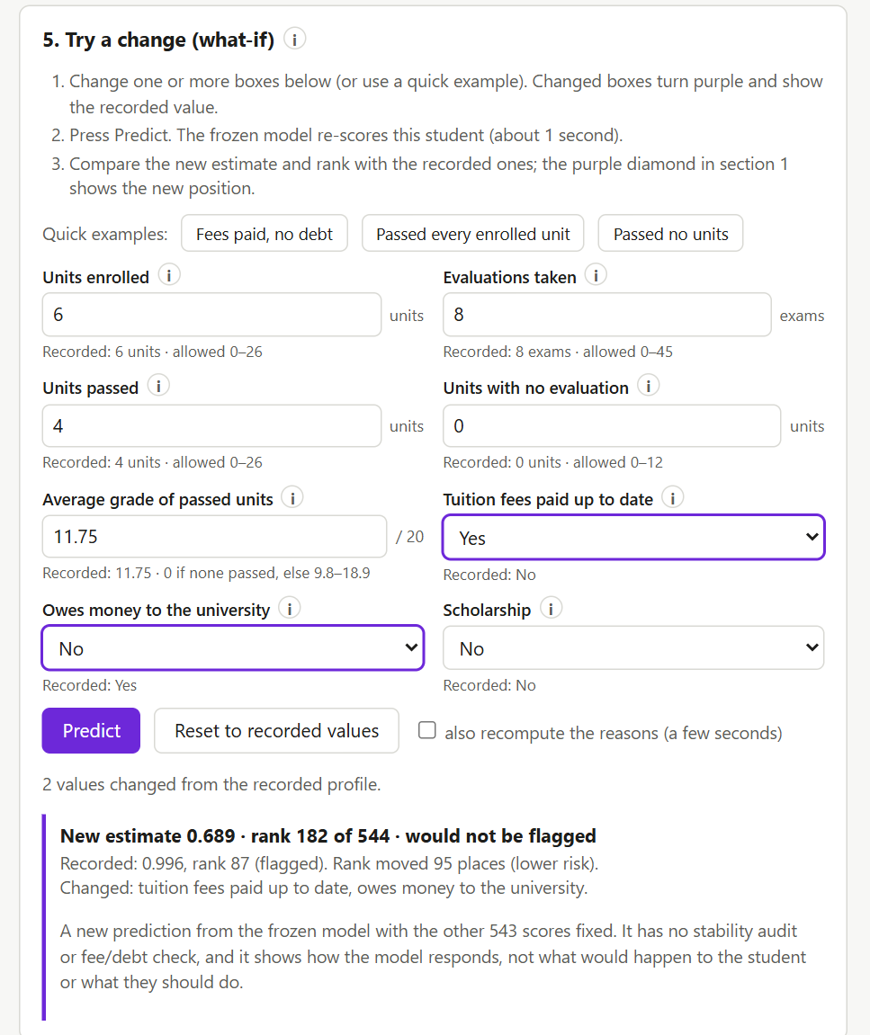
BACKUP | VALIDATION ONLY
Local research interface demonstration
Saved view: flag, rank, reasons and stability
What-if: model response, not causal advice
BACKUP | DEMONSTRATION, NOT USER-TESTED
28

Slide 29
BACKUP
Team contributions
Member | Main contribution
Yolanda Lim | Pipeline, frozen test, human analysis, sensitivity, interface, integration
Lucas Nguyen | Assignment generator, chart/profile renderer, tests and documentation
Noey Theppithuk | Data/model audits and full explanation audit
Han Zaw | Forms, case-pack contract, response transformation and export checks
Harry Han | Ethics materials, recruitment, pilot, send log and collection
All members | Recruitment, report and presentation
BACKUP | TEAM
29

Slide 30
BACKUP
Reproducibility and provenance
Once
98
Seed 42
Locked final-test execution on 2 November 2026
Automated unit tests in the release check
Frozen split and analysis seeds
Split IDs, protocol, code snapshot and fitted model were hashed
Report assets regenerate from saved aggregates without refitting
Raw participant responses are intentionally not shared
Release readiness verifies paths, numbers and documentation
BACKUP | REPRODUCIBILITY
30

