Slide 1
LS2102-MSD
Data, Code, Plots
Sharon
sk19ms015@iisekol.ac.in

Slide 2
File structure
Pollen
1 particle
X,Y coordinates
Over time
MemProt
1 particle
X,Y,Z coordinates
Over time
Pure water and Gluc water
Several particles
X,Y,Z coordinates
Over time

Slide 3
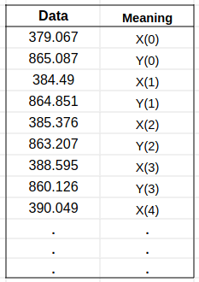
File structure: pollen
pollen_coords.dat

Slide 4
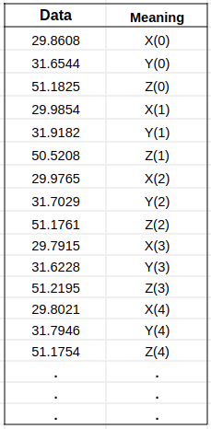
File structure: memprot
memprot_DPPC_295K.dat
memprot_DPPC_310K.dat
memprot_DPPC_325K.dat

Slide 5
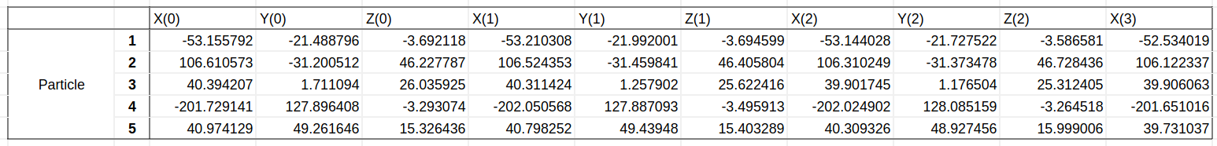
File structure: purewater and glucwater
pureWat_276K_30mols_800ps.dat
pureWat_310K_30mols_800ps.dat
pureWat_340K_30mols_800ps.dat
glc_276K_30mols_800ps.dat
glc_310K_30mols_800ps.dat
glc_340K_30mols_800ps.dat

Slide 6
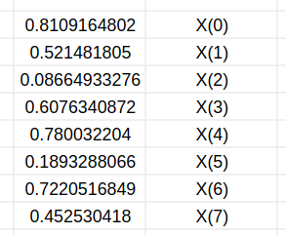
Calculation of MSD (1D)
for i in range(0,len(masterlist)):
xi=masterlist[i]
lastfrm = i+tcor
if (lastfrm < len(masterlist)):
for j in range(i,lastfrm):
xj=masterlist[j]
dt=int(j-i)
drSq=(xj-xi)**2
tcf[dt] += drSq
norm[dt] += 1
#normalize
for i in range(0,len(tcf)):
tcf[i] = tcf[i] / norm[i]
Your data:

Slide 7
Calculation of MSD (2D, 3D)
for i in range(0,len(masterlist),2):
xi=masterlist[i]
yi=masterlist[i+1]
lastfrm = i+2*tcor
if (lastfrm < len(masterlist)):
for j in range(i,lastfrm,2):
xj=masterlist[j]
yj=masterlist[j+1]
dt=int((j-i)/2)
drSq=(xj-xi)**2+(yj-yi)**2
tcf[dt] += drSq
norm[dt] += 1
#normalize
Your data:

Slide 8
Calculation of MSD (Multiple particles)
for m in range(0,n_select):
for i in range(0,len(masterlist),2):
xi=masterlist[i]
yi=masterlist[i+1]
lastfrm = i+2*tcor
if (lastfrm < len(masterlist)):
for j in range(i,lastfrm,2):
xj=masterlist[j]
yj=masterlist[j+1]
dt=int((j-i)/2)
drSq=(xj-xi)**2+(yj-yi)**2
tcf[dt] += drSq
norm[dt] += 1
#normalize

Slide 9
Running the code
Open these links
Pollen:
https://colab.research.google.com/drive/1kqCRbvdQnsgyyEVDzwjrO60k_FTOQ6J2?usp=sharing
MemProt:
https://colab.research.google.com/drive/1UeBrZEhm8sW_RbG9i6NVZ2Kjy8BFkO3F?usp=sharing
PureWater and GlucWater:
https://colab.research.google.com/drive/1tnbj_oDZHO7GpCw2fbFcHijKPwsuuElZ?usp=sharing

Slide 10
Running the code
Sign in using IISER-K gmail account

Slide 11
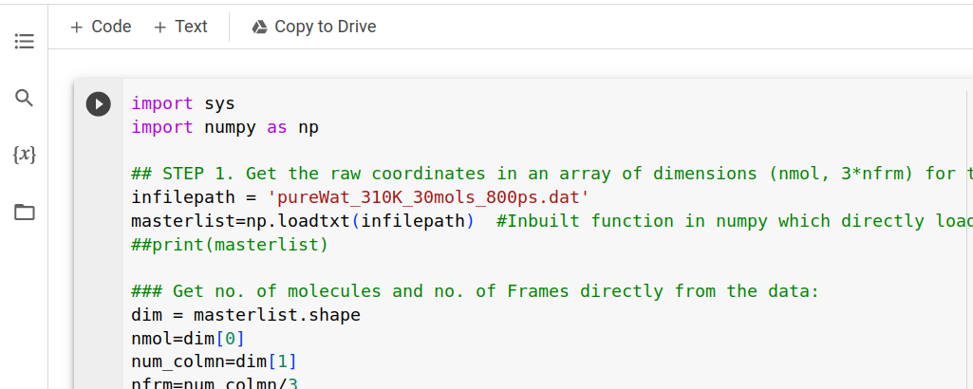
Running the code

Slide 12
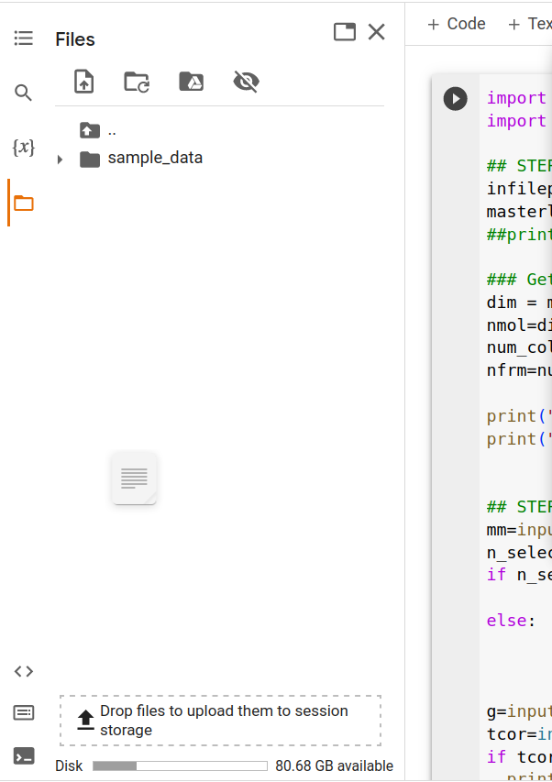
Running the code
Drag and drop file to analyze
Get the files here:
https://drive.google.com/drive/folders/1_jU2cKbSqItH_yP27OVggl7ZaRqbK3sz?usp=sharing

Slide 13
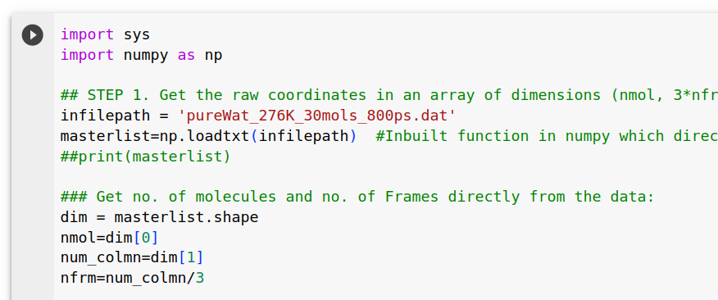
Running the code
Rename file in code
(don’t forget the extension: .dat)

Slide 14
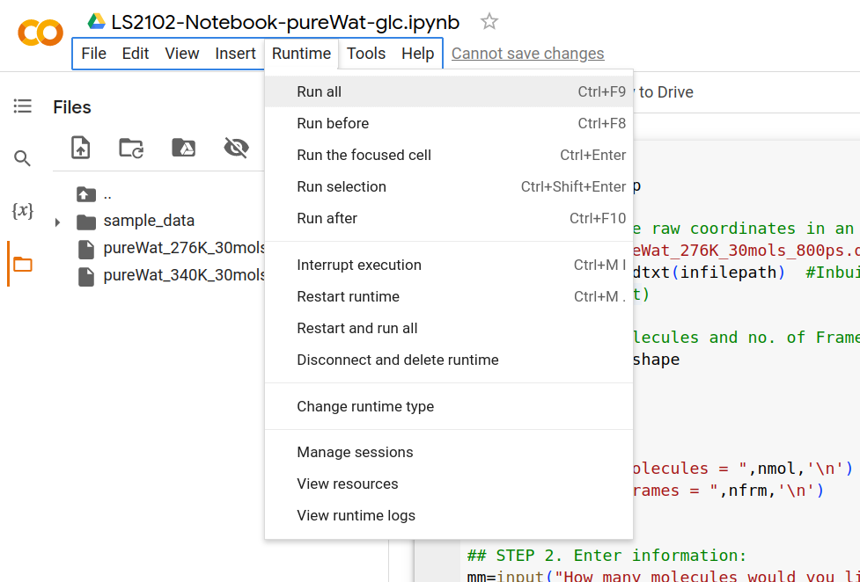
Running the code
Run the code
(Ignore the warning:
Press “run anyway”)

Slide 15
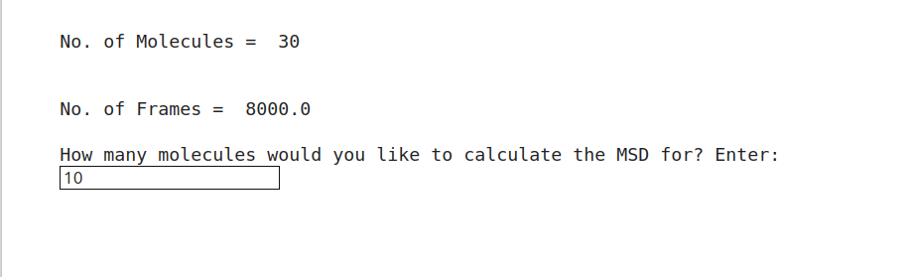
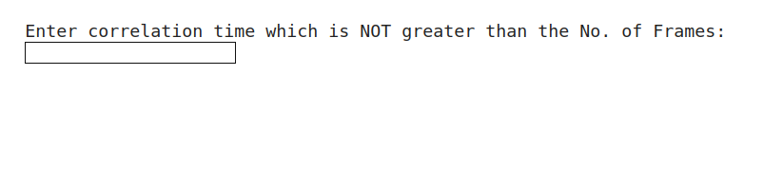
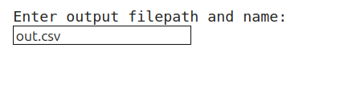
Running the code
Enter parameters

Slide 16
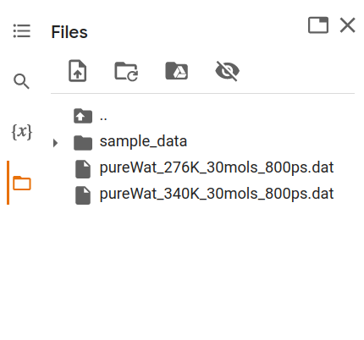
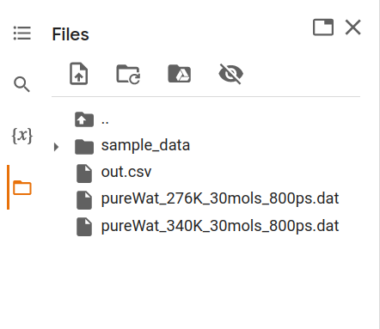
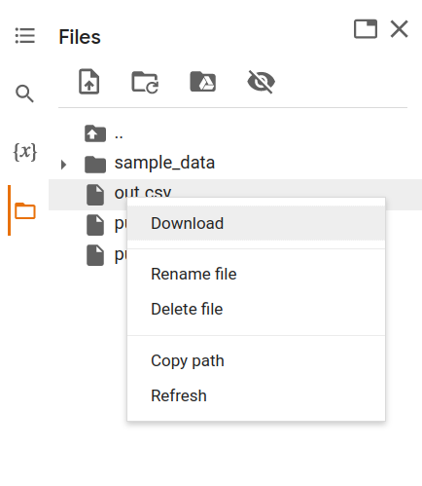
Download output file
Refresh the file browser; Download the file

Slide 17
Download output file
Use your tool of choice to plot and fit

Slide 18
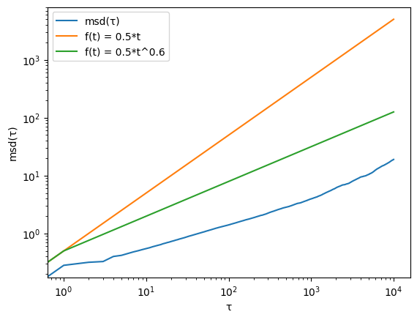
MSD(τ) of membrane protein

