Slide 1
DebtLess
TeamForward: Jason Du, Ryan D’Souza, Michael Han, Fidelia Hung

Slide 2





Existing
Very Convenient
Not Very
Personalized
Very
Personalized
Not Very Convenient

Slide 3
Similarities
1.) Setup your own budgets, arbitrary decisions?
2.) Requires you to do mental math ($200 left in food budget)
3.) Requires proactive effort from the user; self discipline

Slide 4
So what if … ?
We do the thinking for you Find out what you can reduce gradually based on your current spending habits and patterns
Make it reactionary for you We remind you where and when to save
Simplify your decisions to just Yes or No No mental math & you see the impact of your choices

Slide 5
DebtLess Challenge

Slide 6
Our app
DebtLess analyzes your transactions to find patterns in your spending. We then give you 3 tailored challenges per week to trim down on certain expenses to reduce your overall debt.

Slide 7
Categories
Coffee
Grocery
Meals out
Fast food
LCBO
Driving
Online Purchase (Amazon, eBay etc)
Pubs and Bars
Clothing / Luxury items
Memberships (recurring fee)
Telecommunications
Cable TV
Gadgets / Technology
And more ..

Slide 8
Why does this work?
It’s a gradual process that chips away your spending. We don’t aim to change your whole life, but instead give you 3 actionable challenges based on your timeline. We start out with a couple of easy challenges to get you familiar with the app and give you gratification, but our goal is to improve your spending habits in a realistic way.

Slide 9
Other Features

Slide 10
Rewards / Incentive program
Reward yourself for consecutive savings
Promoted to choose their own challenges

Slide 11
Pay off other loans
Prompt users when and how to pay off their credit card debt, as well as other types of loans.

Slide 12
Debt impacts
Graph shows what purchases are making large dents in your debt

Slide 13
DebtLess App
Introducing to you, the DebtLess app solution created in the ScotiaBank HackIt hackathon…

Slide 14
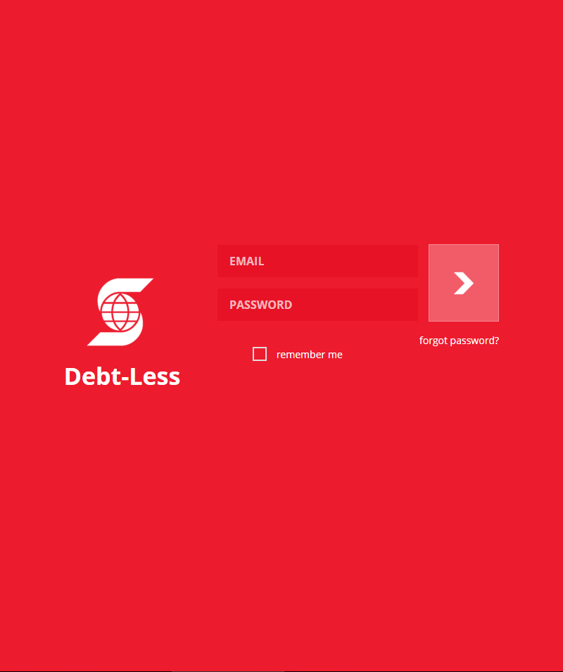
Login Page

Slide 15
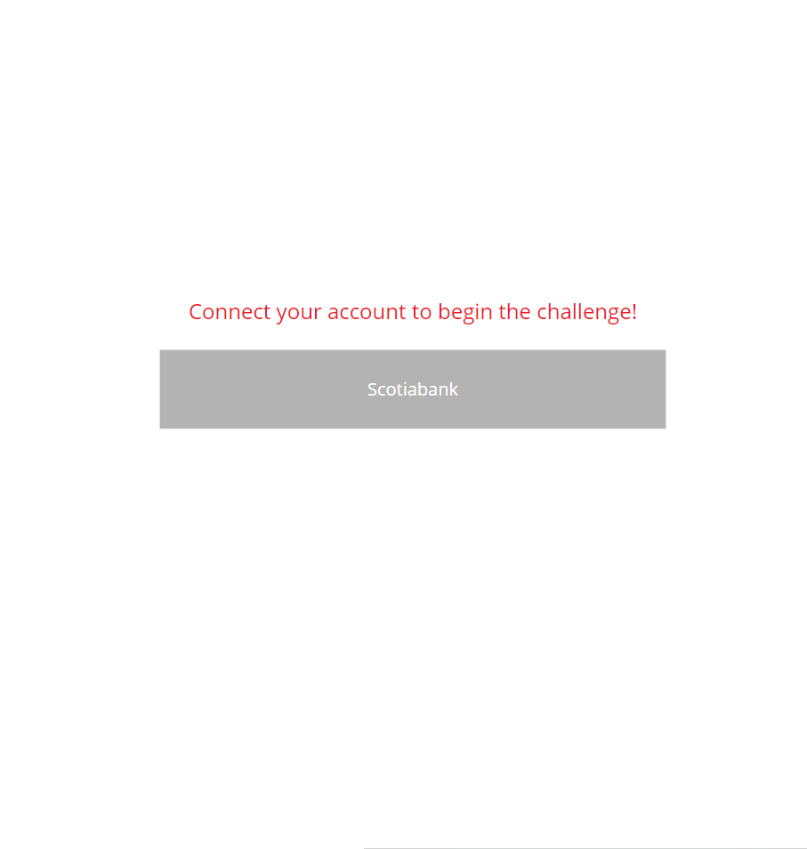
Bank Selection Screen

Slide 16
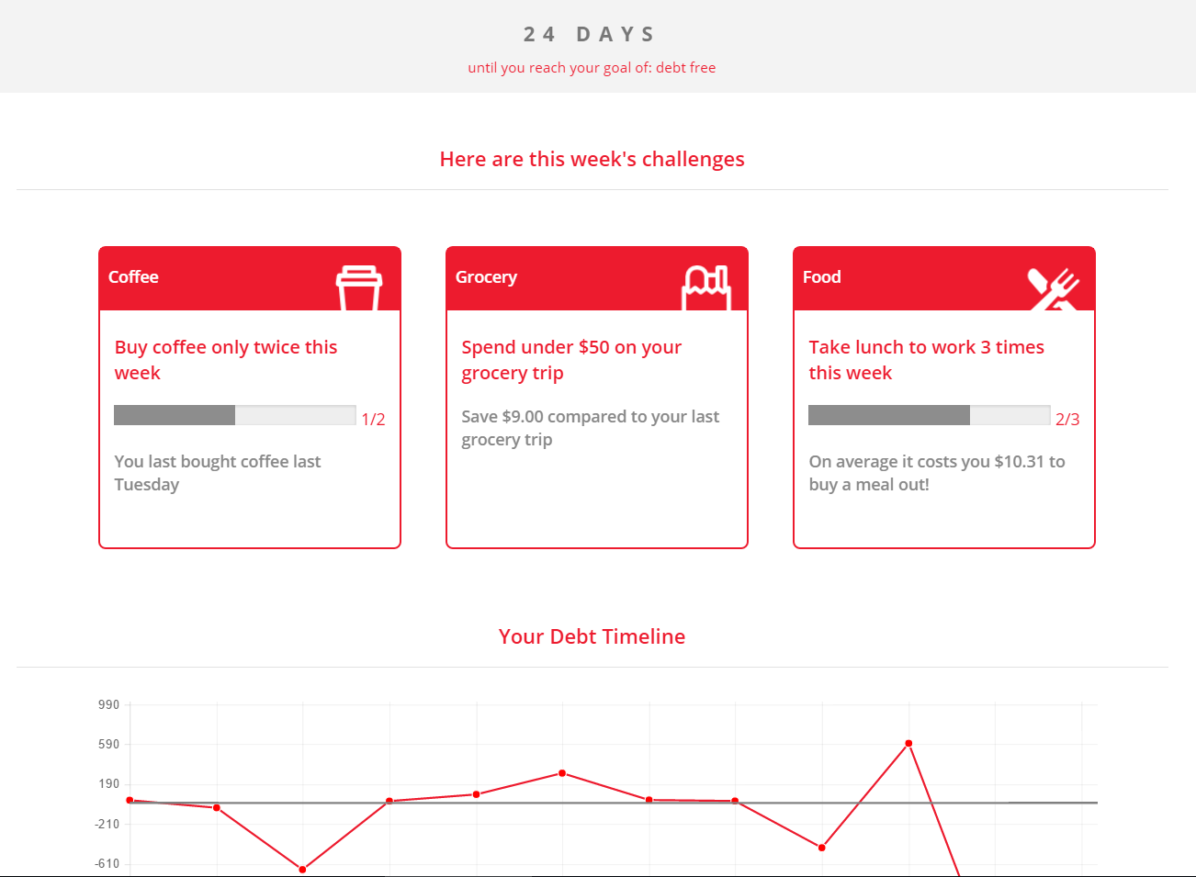
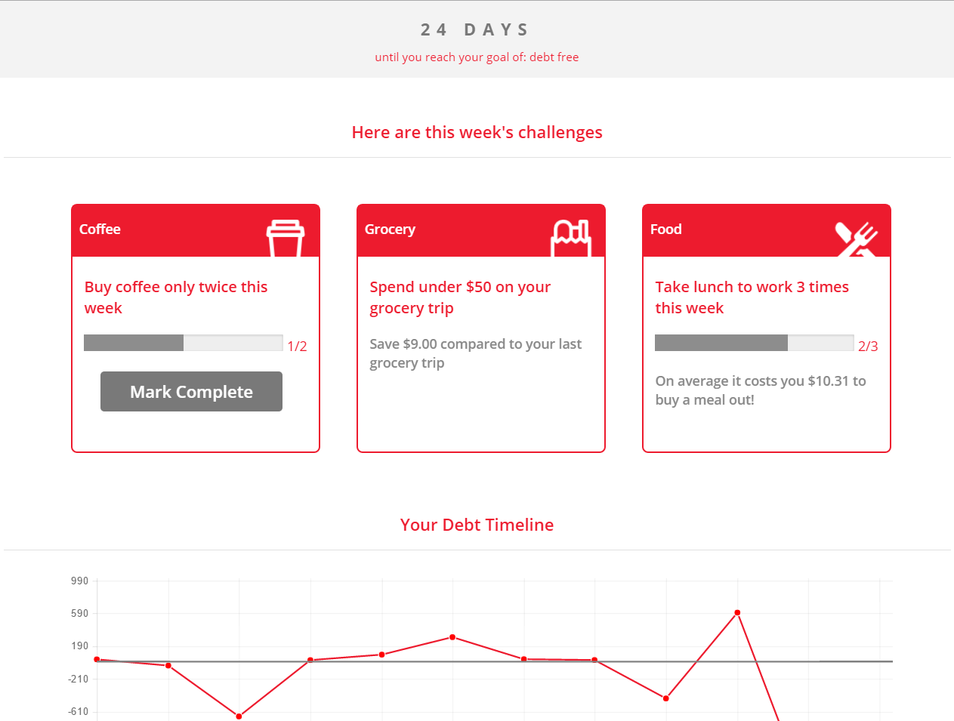
Dashboard

Slide 17
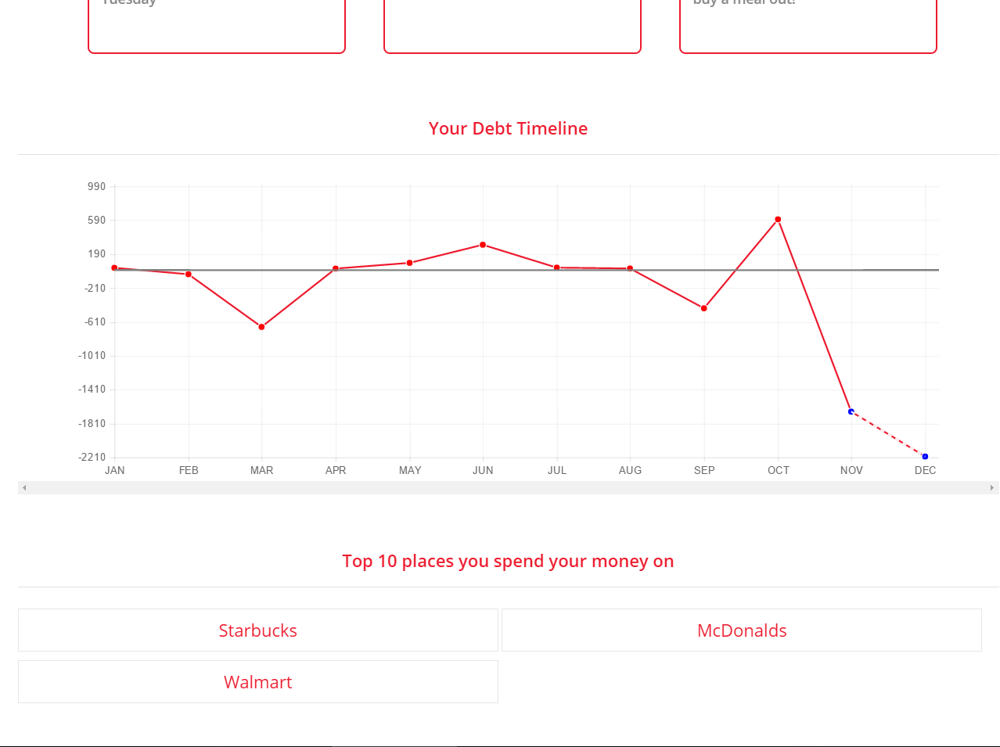
Debt Trend and Projection Graph

Slide 18
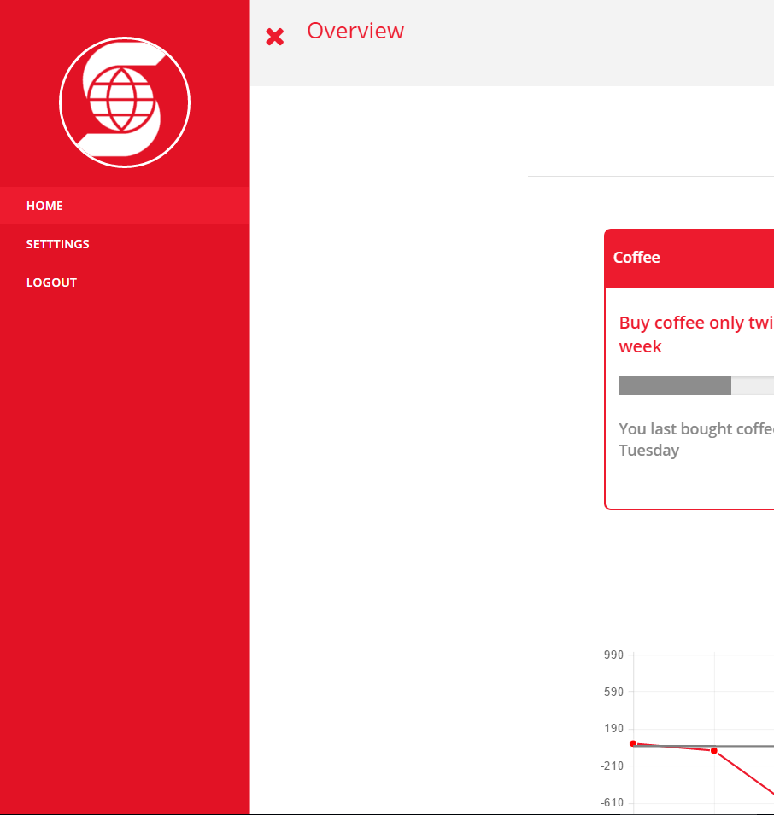
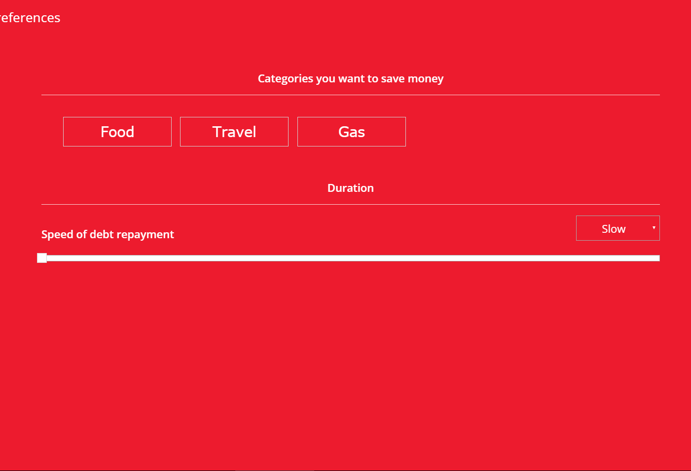
Side Panel and Settings

Slide 19
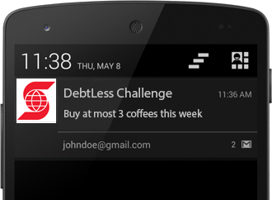
Geo-Fencing
If GPS is enabled, DebtLess can
automatically detect when you
walk into a store that’s currently
relevant to one of your challenges
and send you a notification to remind
you to follow the challenge.

Slide 20
Thank you!
TeamForward: Jason Du, Ryan D’Souza, Michael Han, Fidelia Hung
DebtLess

