Slide 1
Name De-Duplication
Approach
Ishank Saxena
Vellore Institute of Technology
Chennai

Slide 2
Approach
Entry-wise pairing
Detection of similar entries
Merging similar entries
Deletion of repeated entries

Slide 3
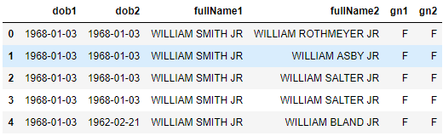
Entry – Wise Pairing
0
A cross record table is created in which each record is paired with the records that come after it. The resulting cross record table looks like this:
1
2
3
4

Slide 4
A simple Exploratory Data Analysis on the provided data reveals that:
463 out 463 pairs with same dates of birth have same first names.
423 out 463 pairs with same dates of birth have same first names.
Conclusion: Date of Birth, Gender and First Name can be used to uniquely identify people

Slide 5
Detection of similar entries
Same
DOB
Same
Gender
Same
Entry
Same
First
Name
If the Date of Birth, Gender and First Name was same for a pair then it was marked as same

Slide 6
Merging similar entries
Resultant Entry
Entry 1
First Name
First Name
Middle Name
Last Name
Middle Name
Middle Name
Entry 2
Last Name
Last Name
The priority is given to the first entry and its First, Middle and Last Names are assigned to the resultant entry. If the middle name or last name of second entry is not same as that of the first entry then they are merged into the middle name of the resultant.

Slide 7
Deletion of repeated entries
1
2
3
Once all similar pairs are marked, the second entry in the similar pair is assigned for deletion from the data frame. Thus, the changes after merging are accumulated in the first entry and the second entry is inserted into a deleted list. The entries in the deleted list are ignored when their comparisons are being evaluated.

Slide 8
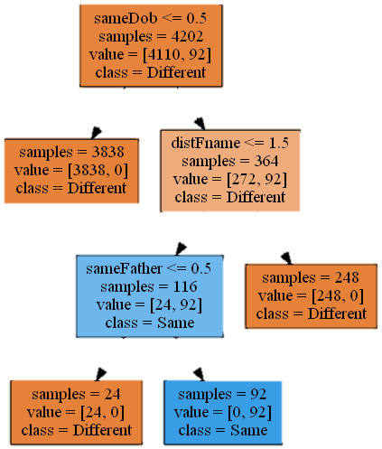
Miscellaneous
Another approach which gave priority to matching the Last Name was tried which now rests in peace in the Old Folder.
A decision tree classifier was also tried to be implemented. But it also was scrapped and now rests in the Old Folder. It also involved measuring edit distance between the last names which surprisingly was highly correlated with the output.
Intrigued by the word train in the problem statement, I went on to look for models that have been used by researchers for similar problems. The most common were:
  Clustering [1]
  Deep Neural Networks [2]
  But I didn’t feel that these were required in this problem since
  additional attributes (dob and gender) were also given where
  dob was a big disambiguating factor.
Actual Decision Tree that was Derrived

Slide 9
Thank You

