Slide 1
A Simple One-Pass Compiler to Generate Bytecode for the JVM
Chapter 2

Slide 2
Overview
This chapter contains introductory material to Chapters 3 to 8 of the Dragon book

Slide 3
Building a Simple Compiler
Building our compiler involves:
  Defining the syntax of a programming language
  Develop a source code parser: for our compiler we will use predictive parsing
  Implementing syntax directed translation to generate intermediate code: our target is the JVM abstract stack machine
  Generating Java bytecode for the JVM
  Optimize the Java bytecode (optional)

Slide 4
The Structure of our Compiler
Character
stream
Lexical analyzer
Syntax-directed
translator
Token
stream
Java
bytecode
Develop
parser and code
generator for translator
Syntax definition
(BNF grammar)
JVM specification

Slide 5
Syntax Definition
Context-free grammar is a 4-tuple with
  A set of tokens (terminal symbols)
  A set of nonterminals
  A set of productions
  A designated start symbol

Slide 6
Example Grammar
Context-free grammar for simple expressions:
G = <{list,digit}, {+,-,0,1,2,3,4,5,6,7,8,9}, P, list>
with productions P =
list → list + digit
list → list - digit
list → digit
digit → 0 | 1 | 2 | 3 | 4 | 5 | 6 | 7 | 8 | 9

Slide 7
Derivation
Given a CF grammar we can determine the set of all strings (sequences of tokens) generated by the grammar using derivation
  We begin with the start symbol
  In each step, we replace one nonterminal in the current sentential form with one of the right-hand sides of a production for that nonterminal

Slide 8
Derivation for the Example Grammar
list
⇒ list + digit
⇒ list - digit + digit
⇒ digit - digit + digit
⇒ 9 - digit + digit
⇒ 9 - 5 + digit
⇒ 9 - 5 + 2
This is an example leftmost derivation, because we replaced
the leftmost nonterminal (underlined) in each step.
Likewise, a rightmost derivation replaces the rightmost
nonterminal in each step

Slide 9
Parse Trees
The root of the tree is labeled by the start symbol
Each leaf of the tree is labeled by a terminal (=token) or ε
Each interior node is labeled by a nonterminal
If A → X₁ X₂ … X_{n} is a production, then node A has immediate children X₁, X₂, …, X_{n} where X_{i} is a (non)terminal or ε (ε denotes the empty string)

Slide 10
Parse Tree for the Example Grammar
Parse tree of the string 9-5+2 using grammar G
list
list
digit
list
digit
digit
The sequence of
leafs is called the
yield of the parse tree
9
-
5
+
2

Slide 11
Ambiguity
Consider the following context-free grammar:
G = <{string}, {+,-,0,1,2,3,4,5,6,7,8,9}, P, string>
with production P =
string → string + string | string - string | 0 | 1 | … | 9
This grammar is ambiguous, because more than one parse tree
represents the string 9-5+2

Slide 12
Ambiguity (cont’d)
string
string
string
string
string
string
string
string
string
string
9
-
5
+
2
9
-
5
+
2

Slide 13
Associativity of Operators
Left-associative operators have left-recursive productions
left → left + term | term
String a+b+c has the same meaning as (a+b)+c
Right-associative operators have right-recursive productions
right → term = right | term
String a=b=c has the same meaning as a=(b=c)

Slide 14
Precedence of Operators
Operators with higher precedence “bind more tightly”
expr → expr + term | term
term → term * factor | factor
factor → number | ( expr )
String 2+3*5 has the same meaning as 2+(3*5)
expr
expr
term
term
term
factor
factor
factor
number
number
number
2
+
3
*
5

Slide 15
Syntax of Statements
stmt → id := expr
| if expr then stmt
| if expr then stmt else stmt
| while expr do stmt
| begin opt_stmts end
opt_stmts → stmt ; opt_stmts
| ε

Slide 16
Syntax-Directed Translation
Uses a CF grammar to specify the syntactic structure of the language
AND associates a set of attributes with the terminals and nonterminals of the grammar
AND associates with each production a set of semantic rules to compute values of attributes
A parse tree is traversed and semantic rules applied: after the computations are completed the attributes contain the translated form of the input

Slide 17
Synthesized and Inherited Attributes
An attribute is said to be …
  synthesized if its value at a parse-tree node is determined from the attribute values at the children of the node
  inherited if its value at a parse-tree node is determined by the parent (by enforcing the parent’s semantic rules)

Slide 18
Example Attribute Grammar
String concat operator
Production
Semantic Rule
expr → expr₁ + term
expr → expr₁ - term
expr → term
term → 0
term → 1
…
term → 9
expr.t := expr₁.t // term.t // “+”
expr.t := expr₁.t // term.t // “-”
expr.t := term.t
term.t := “0”
term.t := “1”
…
term.t := “9”

Slide 19
Example Annotated Parse Tree
expr.t = “95-2+”
expr.t = “95-”
term.t = “2”
expr.t = “9”
term.t = “5”
term.t = “9”
9
-
5
+
2

Slide 20
Depth-First Traversals
procedure visit(n : node);
begin
for each child m of n, from left to right do
visit(m);
evaluate semantic rules at node n
end

Slide 21
Depth-First Traversals (Example)
expr.t = “95-2+”
expr.t = “95-”
term.t = “2”
expr.t = “9”
term.t = “5”
term.t = “9”
9
-
5
+
2
Note: all attributes are
of the synthesized type

Slide 22
Translation Schemes
A translation scheme is a CF grammar embedded with semantic actions
rest → + term { print(“+”) } rest
Embedded
semantic action
rest
+
term
{ print(“+”) }
rest

Slide 23
Example Translation Scheme
expr → expr + term
expr → expr - term
expr → term
term → 0
term → 1
…
term → 9
{ print(“+”) }
{ print(“-”) }
{ print(“0”) }
{ print(“1”) }
…
{ print(“9”) }

Slide 24
Example Translation Scheme (cont’d)
expr
{ print(“+”) }
expr
+
term
{ print(“2”) }
{ print(“-”) }
-
2
expr
term
{ print(“5”) }
term
5
{ print(“9”) }
9
Translates 9-5+2 into postfix 95-2+

Slide 25
Parsing
Parsing = process of determining if a string of tokens can be generated by a grammar
For any CF grammar there is a parser that takes at most O(n³) time to parse a string of n tokens
Linear algorithms suffice for parsing programming language source code
Top-down parsing “constructs” a parse tree from root to leaves
Bottom-up parsing “constructs” a parse tree from leaves to root

Slide 26
Predictive Parsing
Recursive descent parsing is a top-down parsing method
  Every nonterminal has one (recursive) procedure responsible for parsing the nonterminal’s syntactic category of input tokens
  When a nonterminal has multiple productions, each production is implemented in a branch of a selection statement based on input look-ahead information
Predictive parsing is a special form of recursive descent parsing where we use one lookahead token to unambiguously determine the parse operations

Slide 27
Example Predictive Parser (Grammar)
type → simple
| ^ id
| array [ simple ] of type
simple → integer
| char
| num dotdot num

Slide 28
Example Predictive Parser (Program Code)
procedure match(t : token);
begin
if lookahead = t then
lookahead := nexttoken()
else error()
end;
procedure type();
begin
if lookahead in { ‘integer’, ‘char’, ‘num’ } then
simple()
else if lookahead = ‘^’ then
match(‘^’); match(id)
else if lookahead = ‘array’ then
match(‘array’); match(‘[‘); simple();
match(‘]’); match(‘of’); type()
else error()
end;
procedure simple();
begin
if lookahead = ‘integer’ then
match(‘integer’)
else if lookahead = ‘char’ then
match(‘char’)
else if lookahead = ‘num’ then
match(‘num’);
match(‘dotdot’);
match(‘num’)
else error()
end;

Slide 29
Example Predictive Parser (Execution Step 1)
type()
Check lookahead
and call match
match(‘array’)
Input:
array
[
num
dotdot
num
]
of
integer
lookahead

Slide 30
Example Predictive Parser (Execution Step 2)
type()
match(‘array’)
match(‘[’)
Input:
array
[
num
dotdot
num
]
of
integer
lookahead

Slide 31
Example Predictive Parser (Execution Step 3)
type()
match(‘array’)
match(‘[’)
simple()
match(‘num’)
Input:
array
[
num
dotdot
num
]
of
integer
lookahead

Slide 32
Example Predictive Parser (Execution Step 4)
type()
match(‘array’)
match(‘[’)
simple()
match(‘num’)
match(‘dotdot’)
Input:
array
[
num
dotdot
num
]
of
integer
lookahead

Slide 33
Example Predictive Parser (Execution Step 5)
type()
match(‘array’)
match(‘[’)
simple()
match(‘num’)
match(‘dotdot’)
match(‘num’)
Input:
array
[
num
dotdot
num
]
of
integer
lookahead

Slide 34
Example Predictive Parser (Execution Step 6)
type()
match(‘array’)
match(‘[’)
simple()
match(‘]’)
match(‘num’)
match(‘dotdot’)
match(‘num’)
Input:
array
[
num
dotdot
num
]
of
integer
lookahead

Slide 35
Example Predictive Parser (Execution Step 7)
type()
match(‘array’)
match(‘[’)
simple()
match(‘]’)
match(‘of’)
match(‘num’)
match(‘dotdot’)
match(‘num’)
Input:
array
[
num
dotdot
num
]
of
integer
lookahead

Slide 36
Example Predictive Parser (Execution Step 8)
type()
match(‘array’)
match(‘[’)
simple()
match(‘]’)
match(‘of’)
type()
match(‘num’)
match(‘dotdot’)
match(‘num’)
simple()
match(‘integer’)
Input:
array
[
num
dotdot
num
]
of
integer
lookahead

Slide 37
FIRST
FIRST(α) is the set of terminals that appear as the
first symbols of one or more strings generated from α
type → simple
| ^ id
| array [ simple ] of type
simple → integer
| char
| num dotdot num
FIRST(simple) = { integer, char, num }
FIRST(^ id) = { ^ }
FIRST(type) = { integer, char, num, ^, array }

Slide 38
How to use FIRST
We use FIRST to write a predictive parser as follows
procedure rest();
begin
if lookahead in FIRST(+ term rest) then
match(‘+’); term(); rest()
else if lookahead in FIRST(- term rest) then
match(‘-’); term(); rest()
else return
end;
expr → term rest
rest → + term rest
| - term rest
| ε
When a nonterminal A has two (or more) productions as in
A → α
| β
Then FIRST (α) and FIRST(β) must be disjoint for
predictive parsing to work

Slide 39
Left Factoring
When more than one production for nonterminal A starts
with the same symbols, the FIRST sets are not disjoint
stmt → if expr then stmt
| if expr then stmt else stmt
We can use left factoring to fix the problem
stmt → if expr then stmt opt_else
opt_else → else stmt
| ε

Slide 40
Left Recursion
When a production for nonterminal A starts with a
self reference then a predictive parser loops forever
A → A α
| β
| γ
We can eliminate left recursive productions by systematically
rewriting the grammar using right recursive productions
A → β R
| γ R
R → α R
| ε

Slide 41
A Translator for Simple Expressions
expr → expr + term
expr → expr - term
expr → term
term → 0
term → 1
…
term → 9
{ print(“+”) }
{ print(“-”) }
{ print(“0”) }
{ print(“1”) }
…
{ print(“9”) }
After left recursion elimination:
expr → term rest
rest → + term { print(“+”) } rest | - term { print(“-”) } rest | ε
term → 0 { print(“0”) }
term → 1 { print(“1”) }
…
term → 9 { print(“9”) }

Slide 42
main()
{ lookahead = getchar();
expr();
}
expr()
{ term();
while (1) /* optimized by inlining rest()
and removing recursive calls */
{ if (lookahead == ‘+’)
{ match(‘+’); term(); putchar(‘+’);
}
else if (lookahead == ‘-’)
{ match(‘-’); term(); putchar(‘-’);
}
else break;
}
}
term()
{ if (isdigit(lookahead))
{ putchar(lookahead); match(lookahead);
}
else error();
}
match(int t)
{ if (lookahead == t)
lookahead = getchar();
else error();
}
error()
{ printf(“Syntax error\n”);
exit(1);
}
expr → term rest
rest → + term { print(“+”) } rest
| - term { print(“-”) } rest
| ε
term → 0 { print(“0”) }
term → 1 { print(“1”) }
…
term → 9 { print(“9”) }

Slide 43
Adding a Lexical Analyzer
Typical tasks of the lexical analyzer:
  Remove white space and comments
  Encode constants as tokens
  Recognize keywords
  Recognize identifiers and store identifier names in a global symbol table

Slide 44
The Lexical Analyzer
Lexical analyzer
lexan()
y := 31 + 28*x
<id, “y”> <assign, > <num, 31> <+, > <num, 28> <*, > <id, “x”>
token
tokenval
(token attribute)
Parser
parse()

Slide 45
Token Attributes
factor → ( expr )
| num { print(num.value) }
#define NUM 256 /* token returned by lexan */
factor()
{ if (lookahead == ‘(‘)
{ match(‘(‘); expr(); match(‘)’);
}
else if (lookahead == NUM)
{ printf(“ %d “, tokenval); match(NUM);
}
else error();
}

Slide 46
Symbol Table
The symbol table is globally accessible (to all phases of the compiler)
Each entry in the symbol table contains a string and a token value:
struct entry
{ char *lexptr; /* lexeme (string) */
int token;
};
struct entry symtable[];
insert(s, t): returns array index to new entry for string s token t
lookup(s): returns array index to entry for string s or 0
Possible implementations:
- simple C code (see textbook)
- hashtables

Slide 47
Identifiers
factor → ( expr )
| id { print(id.string) }
#define ID 259 /* token returned by lexan() */
factor()
{ if (lookahead == ‘(‘)
{ match(‘(‘); expr(); match(‘)’);
}
else if (lookahead == ID)
{ printf(“ %s “, symtable[tokenval].lexptr);
match(NUM);
}
else error();
}

Slide 48
Handling Reserved Keywords
/* global.h */
#define DIV 257 /* token */
#define MOD 258 /* token */
#define ID 259 /* token */
/* init.c */
insert(“div”, DIV);
insert(“mod”, MOD);
/* lexer.c */
int lexan()
{ …
tokenval = lookup(lexbuf);
if (tokenval == 0)
tokenval = insert(lexbuf, ID);
return symtable[p].token;
}
We simply initialize the global symbol table with the set of keywords

Slide 49
Handling Reserved Keywords (cont’d)
morefactors → div factor { print(‘DIV’) } morefactors
| mod factor { print(‘MOD’) } morefactors
| …
/* parser.c */
morefactors()
{ if (lookahead == DIV)
{ match(DIV); factor(); printf(“DIV”); morefactors();
}
else if (lookahead == MOD)
{ match(MOD); factor(); printf(“MOD”); morefactors();
}
else
…
}

Slide 50
Abstract Stack Machines
Instructions
Stack
Data
1
push 5
rvalue 2
+
rvalue 3
*
…
16
0
1
2
7
11
2
3
top
…
7
3
4
5
pc
…
4
6

Slide 51
Generic Instructions for Stack Manipulation
push v push constant value v onto the stack
rvalue l push contents of data location l
lvalue l push address of data location l
pop discard value on top of the stack
:= the r-value on top is placed in the l-value below it
and both are popped
copy push a copy of the top value on the stack
+ add value on top with value below it
pop both and push result
- subtract value on top from value below it
pop both and push result
*, /, … ditto for other arithmetic operations
<, &, … ditto for relational and logical operations

Slide 52
Generic Control Flow Instructions
label l label instruction with l
goto l jump to instruction labeled l
gofalse l pop the top value, if zero then jump to l
gotrue l pop the top value, if nonzero then jump to l
halt stop execution
jsr l jump to subroutine labeled l, push return address
return pop return address and return to caller

Slide 53
Syntax-Directed Translation of Expressions
expr → term rest { expr.t := term.t // rest.t }
rest → + term rest₁ { rest.t := term.t // ‘+’ // rest₁.t }
rest → - term rest₁ { rest.t := term.t // ‘-’ // rest₁.t }
rest → ε { rest.t := ‘’ }
term → num { term.t := ‘push ’ // num.value }
term → id { term.t := ‘rvalue ’ // id.lexeme }

Slide 54
Syntax-Directed Translation of Expressions (cont’d)
expr.t = ‘rvalue x’//‘push 3’//‘+’
term.t = ‘rvalue x’
rest.t = ‘push 3’//‘+’
term.t = ‘push 3’
rest.t = ‘’
x
+
3
ε

Slide 55
Translation Scheme to Generate Abstract Machine Code
expr → term moreterms
moreterms → + term { print(‘+’) } moreterms
moreterms → - term { print(‘-’) } moreterms
moreterms → ε
term → factor morefactors
morefactors → * factor { print(‘*’) } morefactors
morefactors → div factor { print(‘DIV’) } morefactors
morefactors → mod factor { print(‘MOD’) } morefactors
morefactors → ε
factor → ( expr )
factor → num { print(‘push ’ // num.value) }
factor → id { print(‘rvalue ’ // id.lexeme) }

Slide 56
Translation Scheme to Generate Abstract Machine Code (cont’d)
stmt → id := { print(‘lvalue ’ // id.lexeme) } expr { print(‘:=’) }
lvalue id.lexeme
code for expr
:=

Slide 57
Translation Scheme to Generate Abstract Machine Code (cont’d)
stmt → if expr { out := newlabel(); print(‘gofalse ’ // out) }
then stmt { print(‘label ’// out) }
code for expr
gofalse out
code for stmt
label out

Slide 58
Translation Scheme to Generate Abstract Machine Code (cont’d)
stmt → while { test := newlabel(); print(‘label ’ // test) }
expr { out := newlabel(); print(‘gofalse ’ // out) }
do stmt { print(‘goto ’ // test // ‘label ’ // out ) }
label test
code for expr
gofalse out
code for stmt
goto test
label out

Slide 59
Translation Scheme to Generate Abstract Machine Code (cont’d)
start → stmt { print(‘halt’) }
stmt → begin opt_stmts end
opt_stmts → stmt ; opt_stmts | ε

Slide 60
The JVM
Abstract stack machine architecture
  Emulated in software with JVM interpreter
  Just-In-Time (JIT) compilers
  Hardware implementations available
Java bytecode
  Platform independent
  Small
  Safe
The JavaTM Virtual Machine Specification, 2nd ed.
http://java.sun.com/docs/books/vmspec

Slide 61
Runtime Data Areas (§3.5)
method code
constant pool
frame
heap
local vars &
method args
pc
operand stack

Slide 62
Constant Pool (§3.5.5)
Serves a function similar to that of a symbol table
Contains several kinds of constants
Method and field references, strings, float constants, and integer constants larger than 16 bit cannot be used as operands of bytecode instructions and must be loaded on the operand stack from the constant pool
Java bytecode verification is a pre-execution process that checks the consistency of the bytecode instructions and constant pool

Slide 63
Frames (§3.6)
A new frame (also known as activation record) is created each time a method is invoked
A frame is destroyed when its method invocation completes
Each frame contains an array of variables known as its local variables indexed from 0
  Local variable 0 is “this” (unless the method is static)
  Followed by method parameters
  Followed by the local variables of blocks
Each frame contains an operand stack

Slide 64
Data Types (§3.2, §3.3, §3.4)
byte a 8-bit signed two’s complement integer
short a 16-bit signed two’s complement integer
int a 32-bit signed two’s complement integer
long a 64-bit signed two’s complement integer
char a 16-bit Unicode character
float a 32-bit IEEE 754 single-precision float value
double a 64-bit IEEE 754 double-precision float value
boolean a virtual type only, int is used to represent true (1) false (0)
returnAddress the location of the pc after method invocation
reference a 32-bit address reference to an object of class type,
array type, or interface type (value can be NULL)
Operand stack has 32-bit slots, thus long and double occupy two slots

Slide 65
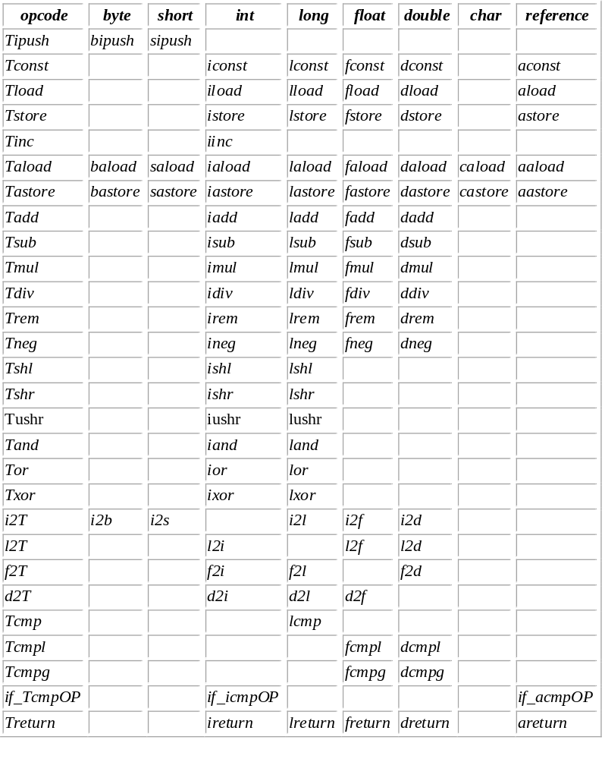
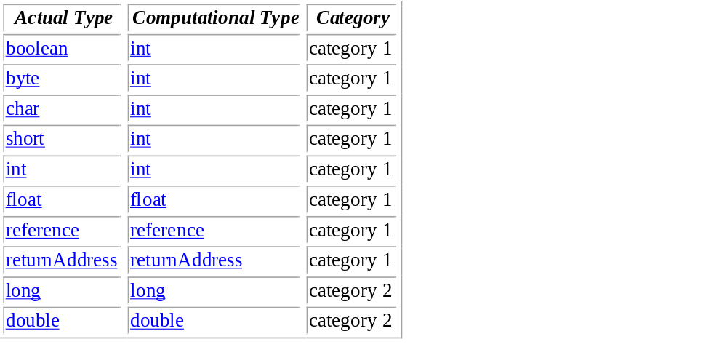
Instruction Set (§3.11, §6)

Slide 66
The Class File Format (§4)
A class file consists of a stream of 8-bit bytes
16-, 32-, and 64-bit quantities are stored in 2, 4, and 8 consecutive bytes in big-endian order
Contains several components, including:
  Magic number 0xCAFEBABE
  Version info
  Constant pool
  This and super class references (index into pool)
  Class fields
  Class methods

Slide 67
javac, javap, java
Hello.java
import java.lang.*;
public class Hello
{ public static void main(String[] arg)
{ System.out.println("Hello World!");
}
}
Compiler
javac Hello.java
Hello.class
Disassembler
javap -c Hello
JVM
java Hello

Slide 68
javap -c Hello
Local variable 0 =“this”
Index into constant pool
Method descriptor
Compiled from "Hello.java"
public class Hello extends java.lang.Object{
public Hello();
Code:
0: aload_0
1: invokespecial #1; //Method java/lang/Object."<init>":()V
4: return
public static void main(java.lang.String[]);
Code:
0: getstatic #2; //Field java/lang/System.out:Ljava/io/PrintStream;
3: ldc #3; //String Hello World!
5: invokevirtual #4; //Method java/io/PrintStream.println:(Ljava/lang/String;)V
8: return
}
String literal
Field descriptor

Slide 69
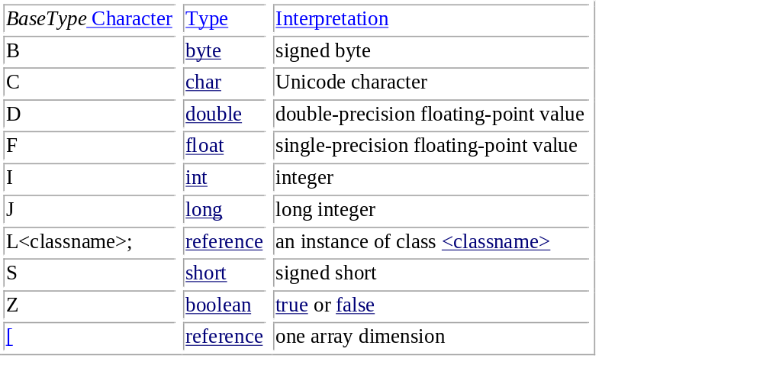
Field/Method Descriptors (§4.3)
FieldType:
MethodDescriptor:
( ParameterDescriptor* ) ReturnDescriptor
ParameterDescriptor:
FieldType
ReturnDescriptor:
FieldType
V

Slide 70
Generating Code for the JVM
expr → term moreterms
moreterms → + term { emit(iadd) } moreterms
moreterms → - term { emit(isub) } moreterms
moreterms → ε
term → factor morefactors
morefactors → * factor { emit(imul) } morefactors
morefactors → div factor { emit(idiv) } morefactors
morefactors → mod factor { emit(irem) } morefactors
morefactors → ε
factor → ( expr )
factor → int8 { emit2(bipush, int8.value) }
factor → int16 { emit3(sipush, int16.value) }
factor → int32 { idx := newpoolint(int32.value);
emit2(ldc, idx) }
factor → id { emit2(iload, id.index) }

Slide 71
Generating Code for the JVM (cont’d)
code for expr
stmt → id := expr { emit2(istore, id.index) }
istore id.index
stmt → if expr { emit(iconst_0); loc := pc;
emit3(if_icmpeq, 0) }
then stmt { backpatch(loc, pc-loc) }
code for expr
iconst_0
loc:
if_icmpeq off₁ off₂
code for stmt
pc:
backpatch() sets the offsets of the relative branch
when the target pc value is known

