Slide 1
Pure Data Synthesizer – Final Presentation
Jeffrey Lansford

Slide 2
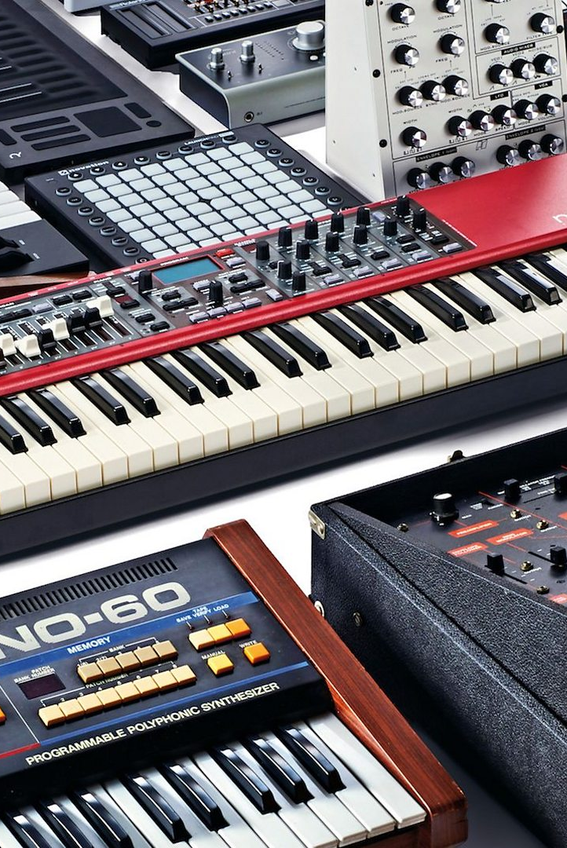
Envisioned System
Build a synthesizer that users can use to create music.
Take computer hardware and interfaces that normal people have and turn into a musical instrument that people can use to express themselves.
Model off traditional synthesizers to provide the same capabilities.
Allow users to customize the sounds like traditional synthesizers.
Synthesizer will also support a vocoder to allow more expression.

Slide 3
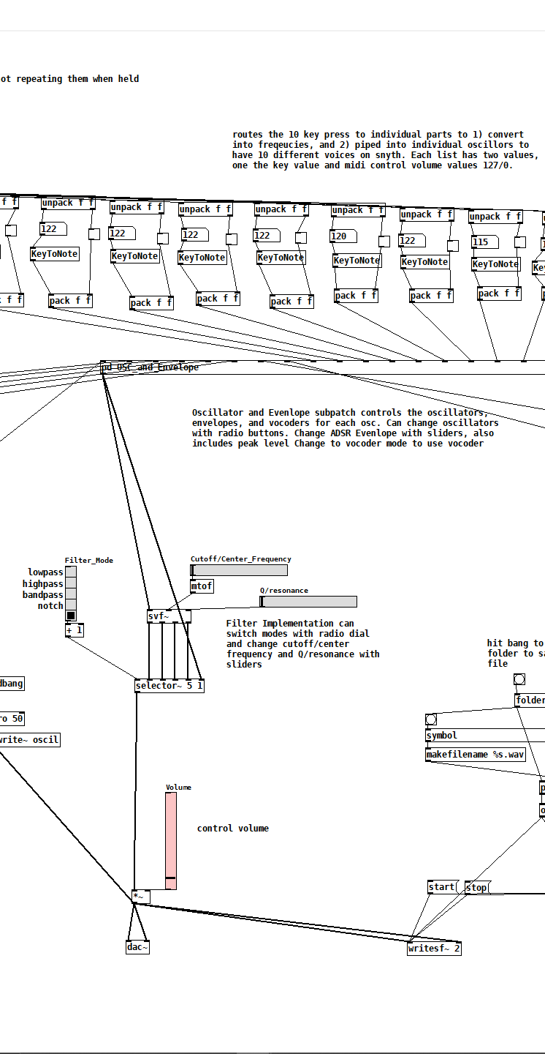
Implemented System
You can create sounds like a synthesizer on your computer.
Able to customize the output sound of the synth with oscillators, envelope settings, filter settings, and vocoder option.
Able to record outgoing audio into a .wav file in a directory of your choice
Use keyboard like a musical keyboard, with octave changing capacity.
Able to do polyphony up to 10 notes at once.

Slide 4
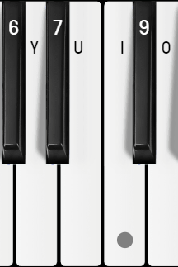
Interaction with System
Physical Interfaces
Keyboard
Keyboards is setup like a musical keyboard with White and Black Keys, even arrangement.
White Key Rows: [Q-P] & [Z-/]
Black Key Rows: [1-0] & [S-’]
Octave changes for keys is [-] & [=/+] corresponding to their symbol.
Virtual Interfaces
Oscillators
Able to select which oscillator user wants to use
Sine
Sawtooth
Triangle
Square
Custom
Users are able to create custom waves by drawing onto array patch called “Wave”
Envelope
User are able to use sliders to customize the ADSR Envelope.
Additional slider for peak level in case use does not want to lower volume.
Filter
Able to select which filter mode to use, including not using one, low pass, high pass, bandpass, band reject (notch), and customizing cutoff/center frequency and Q/resonance
Vocoder
Able to turn on vocoder and increase vocoder output to increase volume of vocoder.
Amplifier
Able to change volume
Recording
Able to select which directory and name of the recording file.

Slide 5
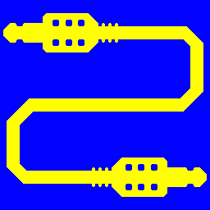
Problems/Successes
Problems
No direct way of creating an output device for synth to put sound through.
Would require building a Windows Sound Driver for the ground up and integrate that into the Pure Data Patch.
There is an alternative solution of using a outside program called Virtual Audio Device that creates virtual audio cables to route through.
Also added a way to record output sound in case if user does not want to download extra software.
No throughput of normal voice when not pressing keys in vocoder mode.
Since the vocoder has to be feed early into the parts of the synth, it would not be a neat and compact solution. With early problem, I decide to not deal with the problem and keep it out of scope.
Successes
Have keyboard be like a musical keyboard, with key presses being registered in the system correctly.
Have a great envelope and filter system that lets you change the sound.
Have create customization with the system, like oscillators, filters, and envelopes.
Being able to actually create music!

Slide 6
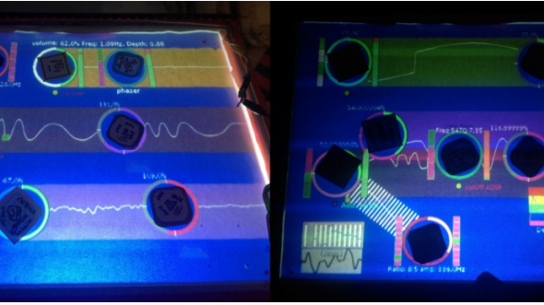
Literature
Reflecting on works in class and works I have seen, there is a next generation of implementing virtual instruments.
Tangible bits: Towards seamless interfaces between people, bits and atoms By Ishii, H., Ullmer, B.
Paper from class explaining TUIs and reaching for a Tangible bit world.
Potidis’ and Spyrou’s Spyractable.
An example of a TUI of interpreting a instrument.
My work only applies to traditional HCI interfaces while others are trying to push new bound of interacting with our computers to create unique sounds.
Whether TUIs or VR interfaces are the future, I can expand the system to create new interfaces for this interface that’s been around for thousands of years.

Slide 7
Demo

