Slide 1
Pure Data Synthesizer – Progress Check 2
Jeffrey Lansford

Slide 2
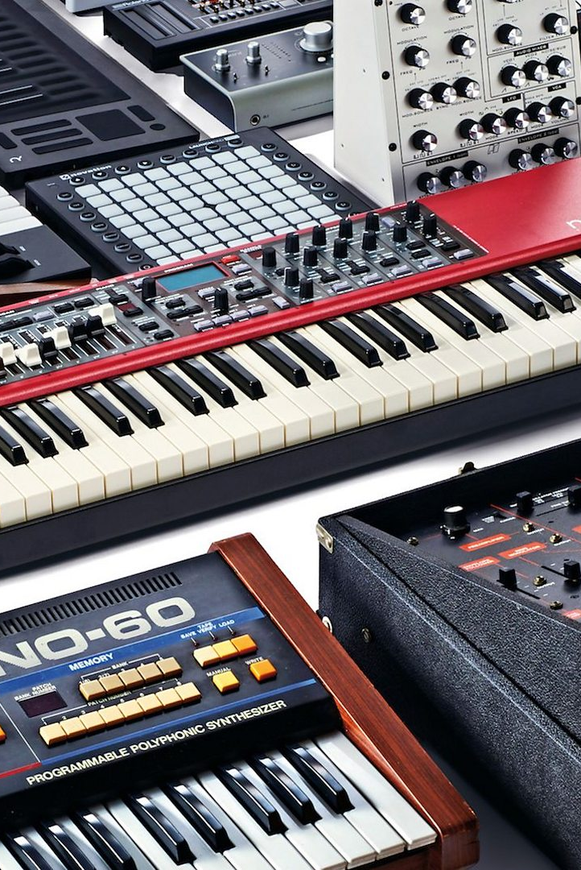
Concept Update
Reduced Scoped
Basic Synthesizer with (hopefully) vocoder support.
Synthesizer has 5 oscillators (Sin, Sawtooth, Triangle, Square, and Custom) with Octave changes.
Synthesizer has Filter support. (low pass, high pass, bandpass, band reject (notch)).
Synthesizer has Envelope support. (Attack, Decay, Sustain, and Release).
No longer doing Gate/triggers, Amplifier kind of implemented with volume control.
No more MIDI support.

Slide 3
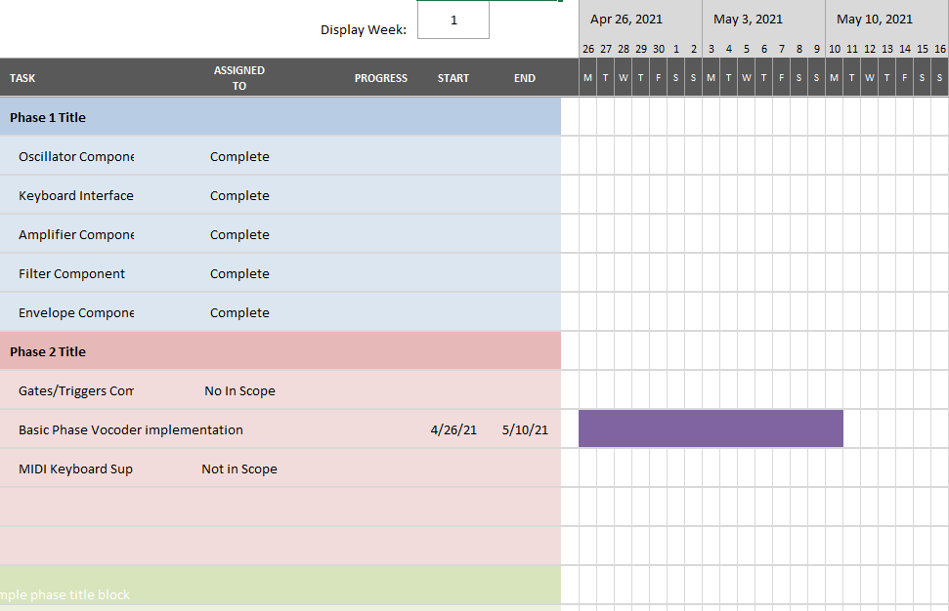
Completed/Upcoming Components
Completed
Keyboard Interface
Five Oscillator ( Sin, Sawtooth, Triangle, Square, Custom)
Filter and Envelope
Amplifier (volume)
Upcoming
Vocoder and External Audio support.

Slide 4
Demo

