Slide 1
Pure Data Synthesizer – Mid Progress Check
Jeffrey Lansford

Slide 2
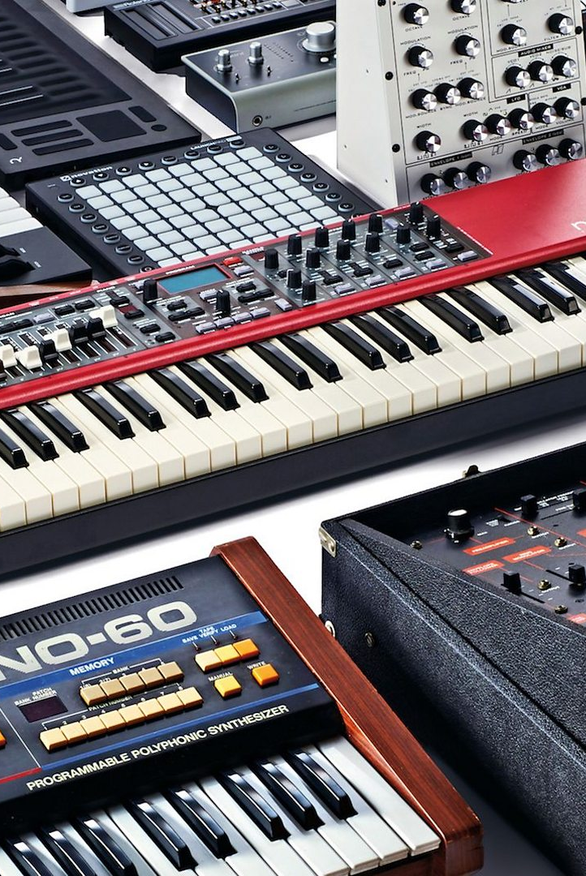
Concept Update
Build a synthesizer that users can use to create music.
Take computer hardware and interfaces that normal people have and turn into a musical instrument that people can use to express themselves.
Model off traditional synthesizers to provide the same capabilities.
Allow users to customize the sounds like traditional synthesizers.
Synthesizer will also support a vocoder to allow more expression.
Keyboard Synthesizer has limited voices, i.e. a limited amount of keys that can be pressed to produce sound. Currently, the Keyboard Synth has 10 voices, which means that you can press 10 keys at once and get each individual sound.
GUI Interface using Pure Data Patch Cord UI along with sliders.

Slide 3
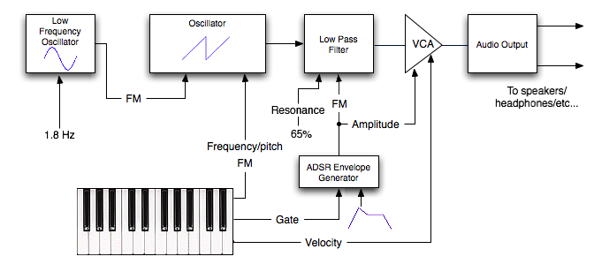
Literature Update
Article Detailing the Different Wave types that Synthesizers make
Riesterer, S. (2017, April 22). Synthesis essentials: All about oscillators. Retrieved March 31, 2021, from https://ask.audio/articles/synthesis-essentials-all-about-oscillators#:~:text=Sine%2C%20Triangle%2C%20Sawtooth%2C%20and,take%20place%20above%20the%20fundamental.
Online Publication detailing the basics of a Synthesizer going over basic components.
Sievers, B. (2006, November). A young person's guide to the principles of music synthesis. Retrieved March 31, 2021, from http://beausievers.com/synth/synthbasics/#conclusion

Slide 4
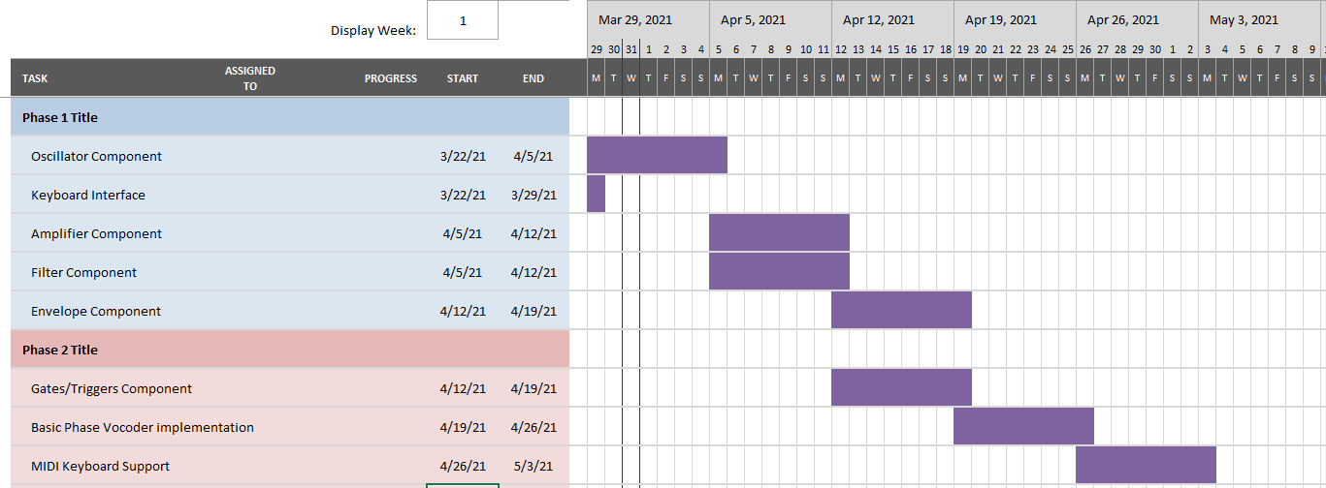
Completed/Upcoming Components
Completed
Keyboard Interface
Basic Oscillator (Sine)
Upcoming
(Next) Implement other types of Oscillator (Triangle, Sawtooth, Square)
Amplifier and Filter Components
Envelope and Gate/Triggers Components
Vocoder
MIDI Support

Slide 5
Demo

