Slide 1


15388 Final Project Analysis on CMU Faculty Course Evaluation
Qiyun Chen
J Young Kim

Slide 2
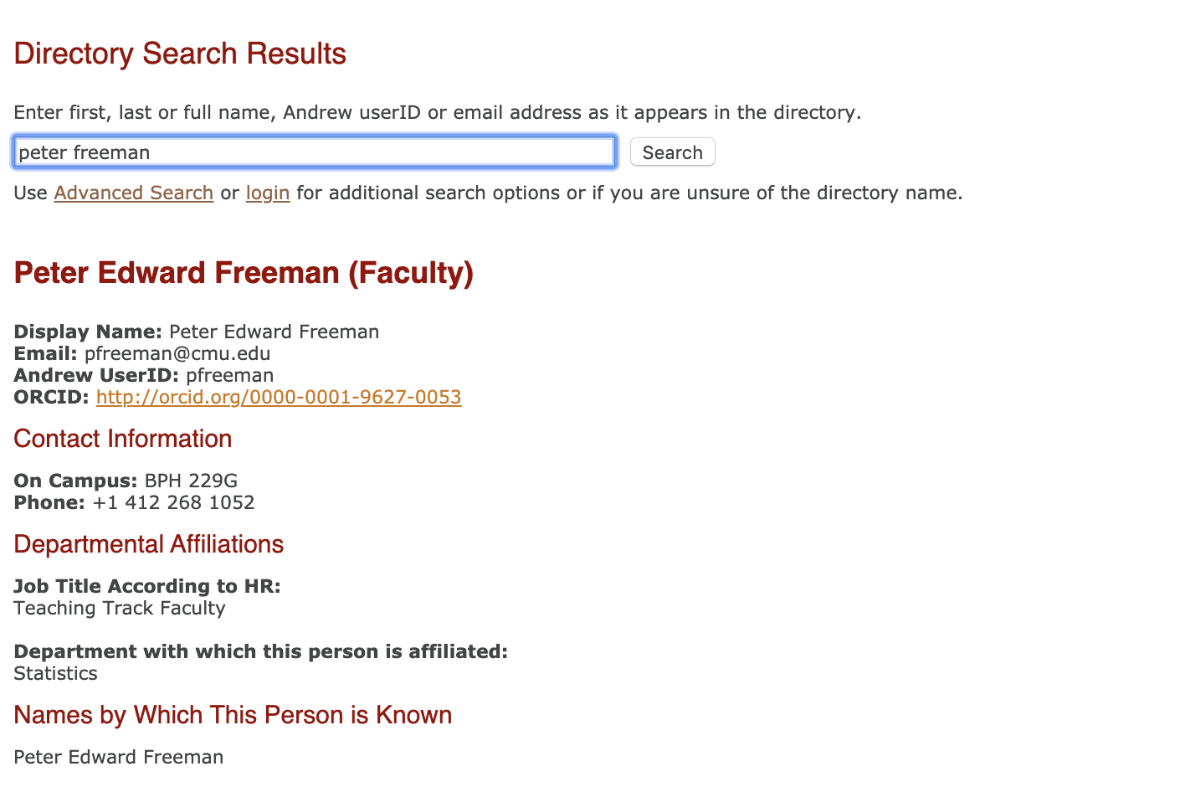
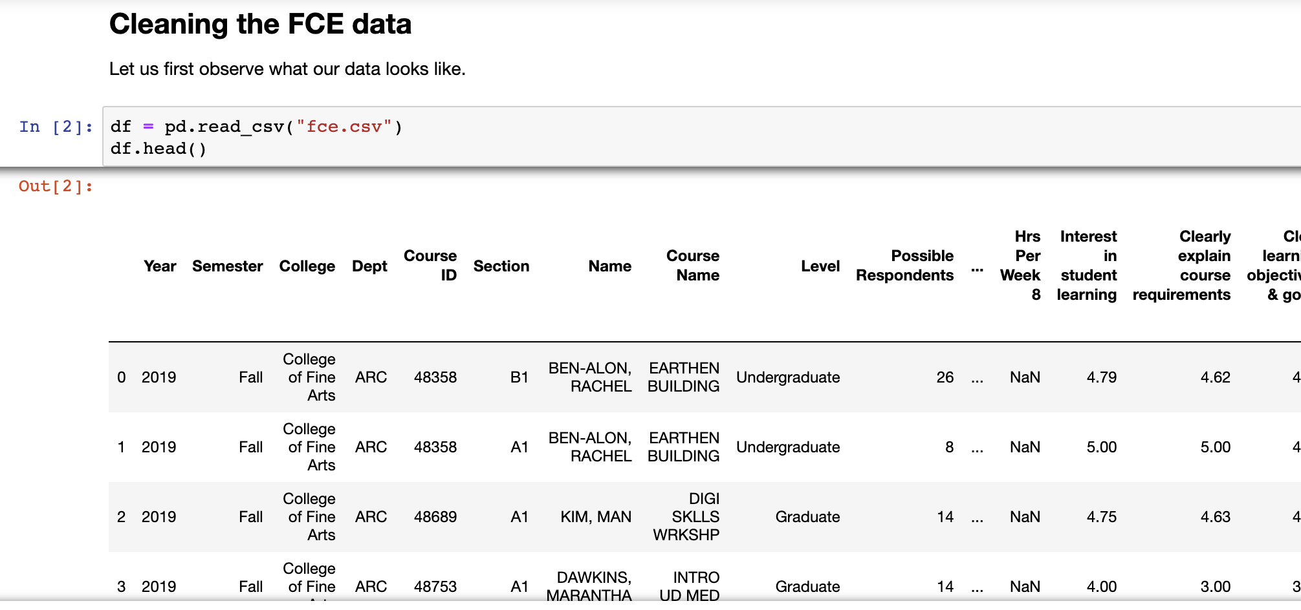
Data Collection
FCE Data => data cleaning
CMU Directory Data =>
data scraping & cleaning
Notes:
FCE Data => data cleaning
CMU Directory Data =>
data scraping & cleaning

Slide 3
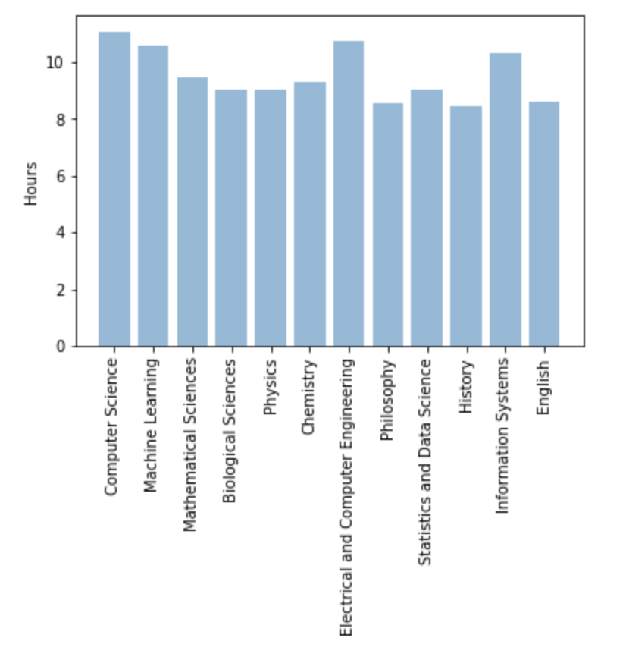
EDA Results
Hours per week by Department

Slide 4
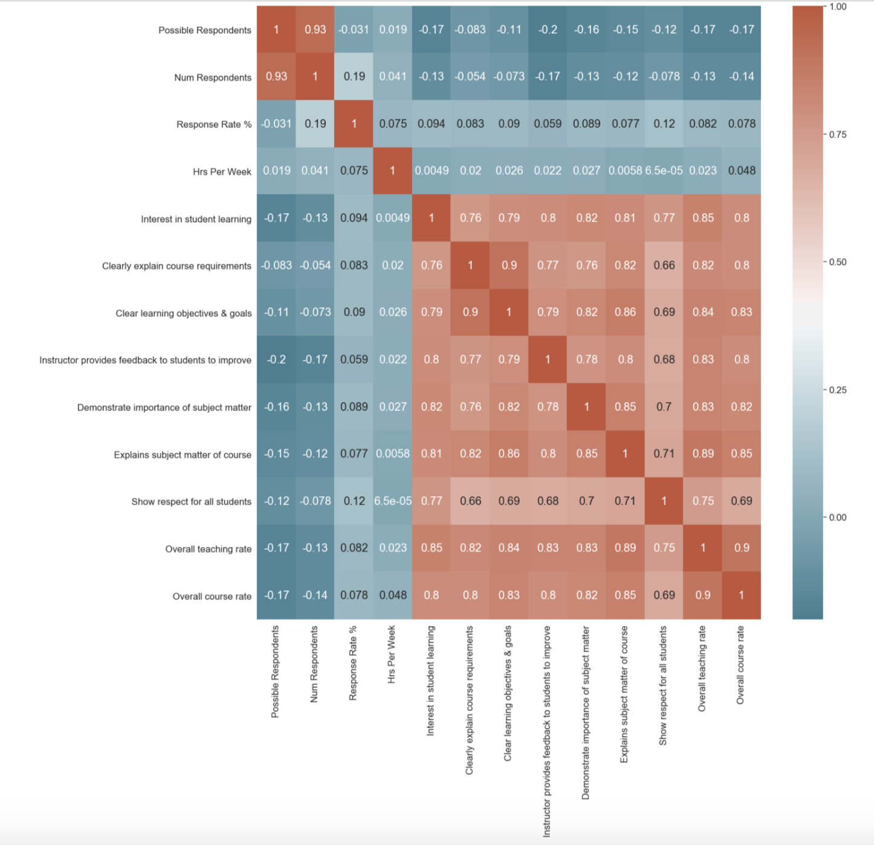
EDA Results
Overall course rate is highly correlated with
Overall teaching rate
Explains subject matter

Slide 5
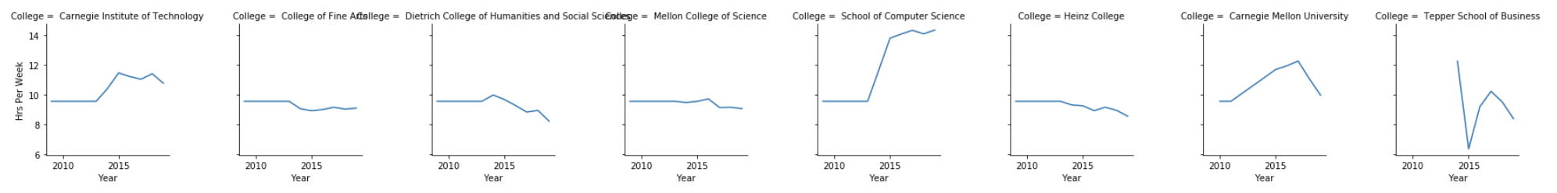
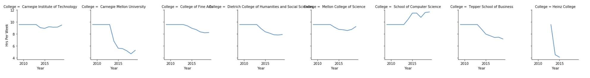
Trend of Hours Per Week by College over 2010-2019
Graduate Level Courses
Undergraduate Level Courses

Slide 6
Trend of Hours Per Week by College over 2010-2019
Graduate Level Courses
Undergraduate Level Courses

Slide 7
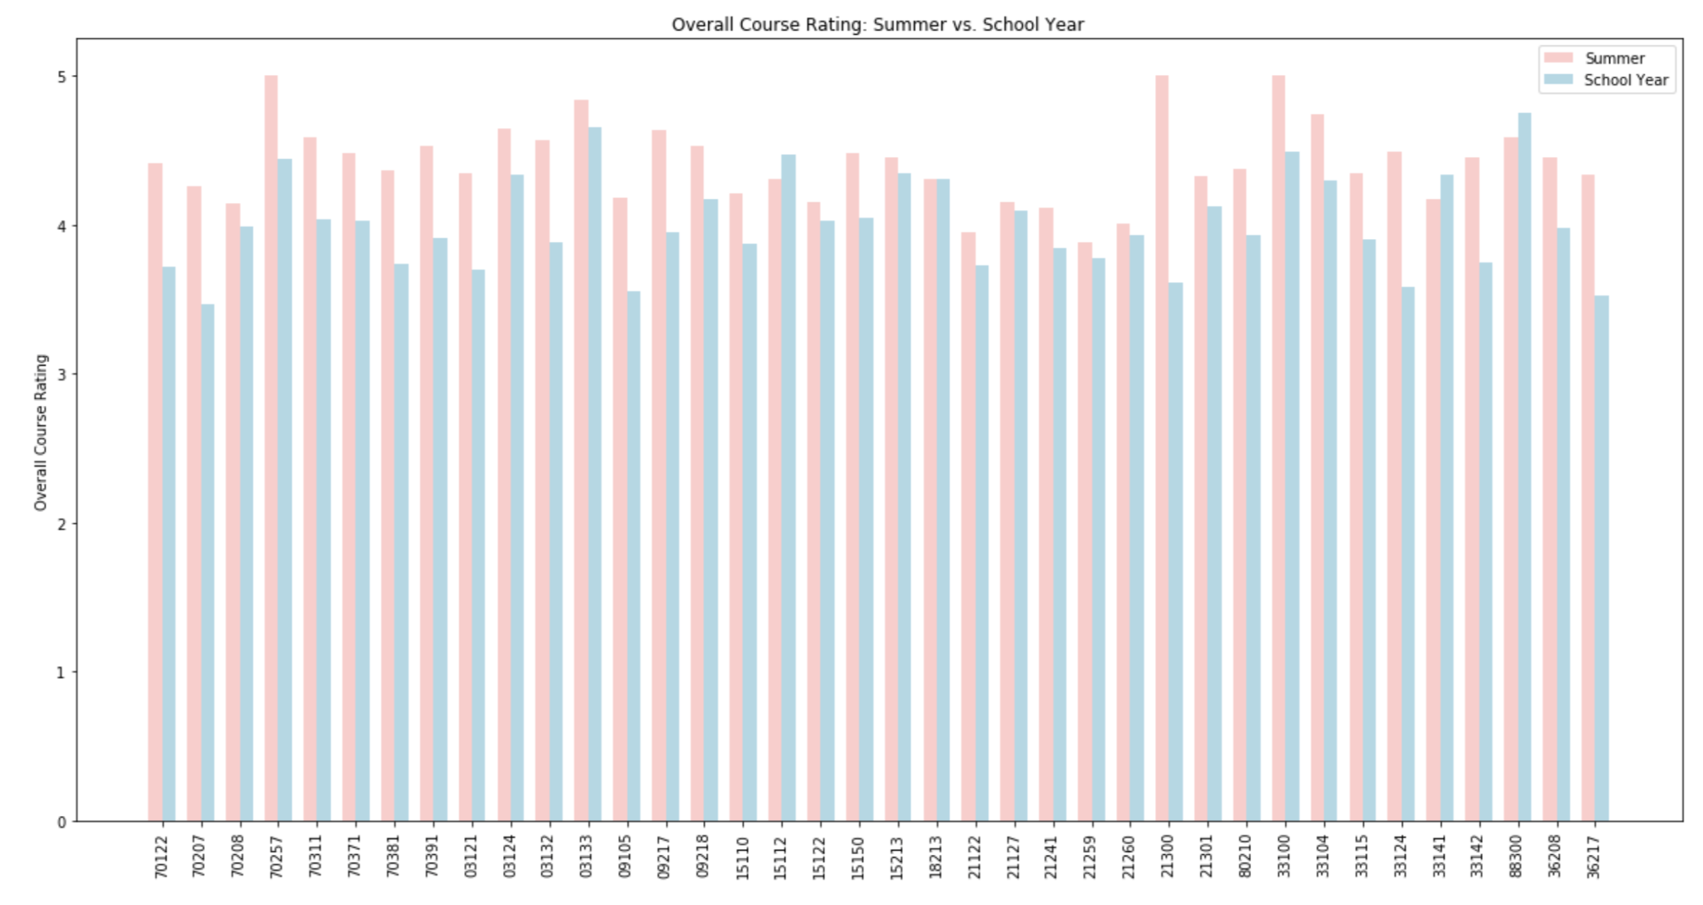
Summer courses have higher ratings than semester courses

Slide 8
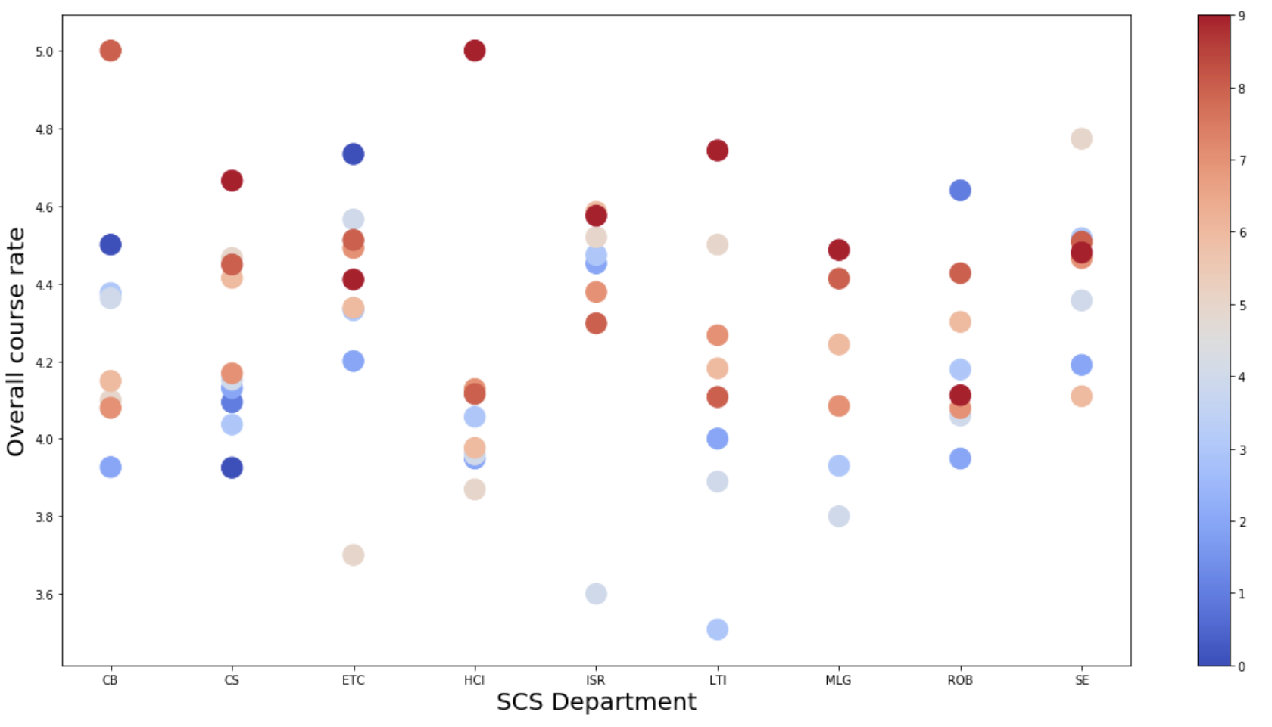
SCS overall course rate vs. Level of course
The overall correlation between the course Level and the overall course rate is about 0.33 with a significant p-value of 0.0035.

Slide 9
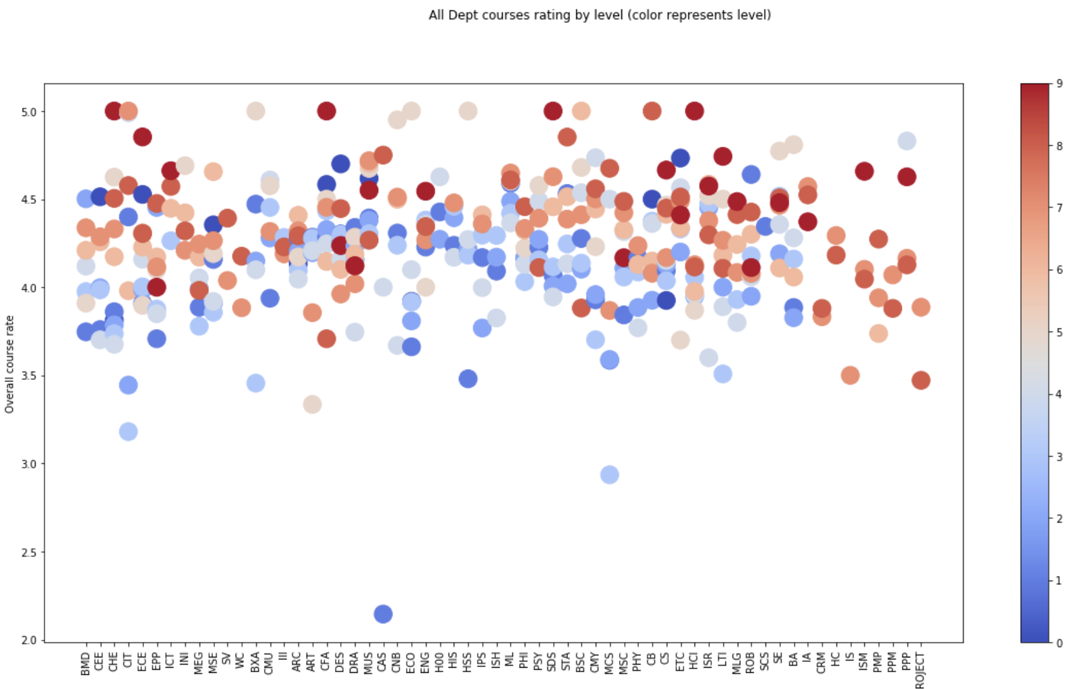
CMU overall course rate vs. Level of course
The overall correlation between the course Level and the overall course rate is about 0.29 with a significant p-value of 0.0030.

Slide 10
Tenure vs Teaching average overall teaching rate by College
College | Teaching Track | Tenure Track
MCS | 4.37 | 4.24
SCS | 4.31 | 4.19
Dietrich | 4.25 | 4.37
Heinz | 4.20 | 4.07

