Slide 1
Cloud Computing Resources, Grants, and Datasets
BD2K 2018 Workshop
Aditya Srikanth Kovuri
Sandeep Namburi

Slide 2
Outline
What is the cloud
Cloud in genomics and bioinformatics
Myths of the cloud
Galaxy Platform
Cloud computing resources, grants, and datasets
Research Computing Grants
Cloud as a Home for Collaborative Research

Slide 3
Cloud?
The National Institute of Standards and Technology describes cloud as “a model for enabling ubiquitous, convenient, on-demand network access to a shared pool of configurable computing resources (e.g., networks, servers, storage, applications and services) that can be rapidly provisioned and released with minimal management effort or service provider interaction.”

Slide 4
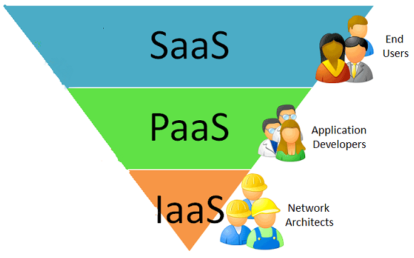
Service Models
Source: Samisa.org

Slide 5
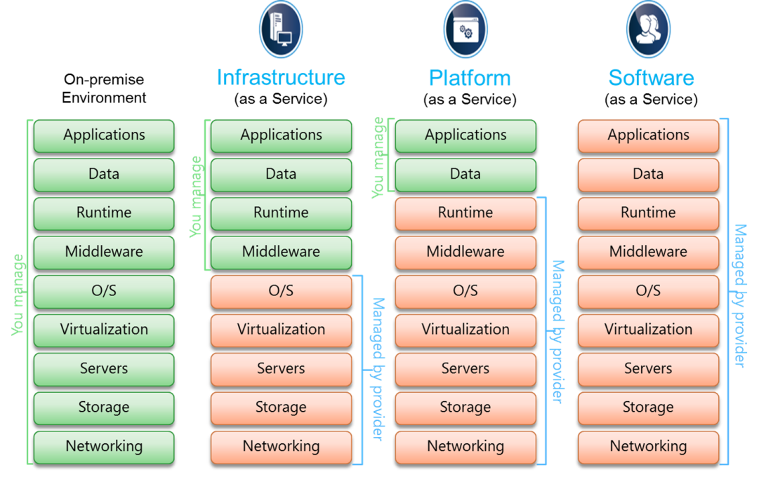
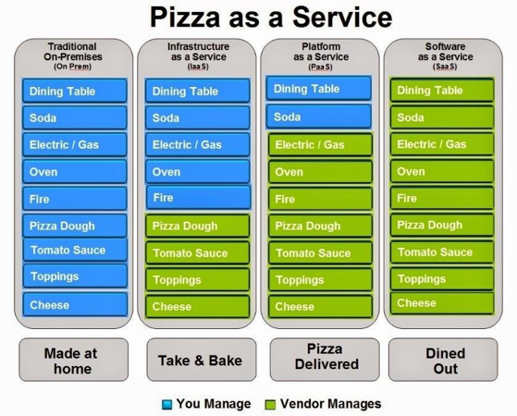
Service Models
Source:https://www.simple-talk.com/cloud/cloud-development/a-comprehensive-introduction-to-cloud-computing/

Slide 6
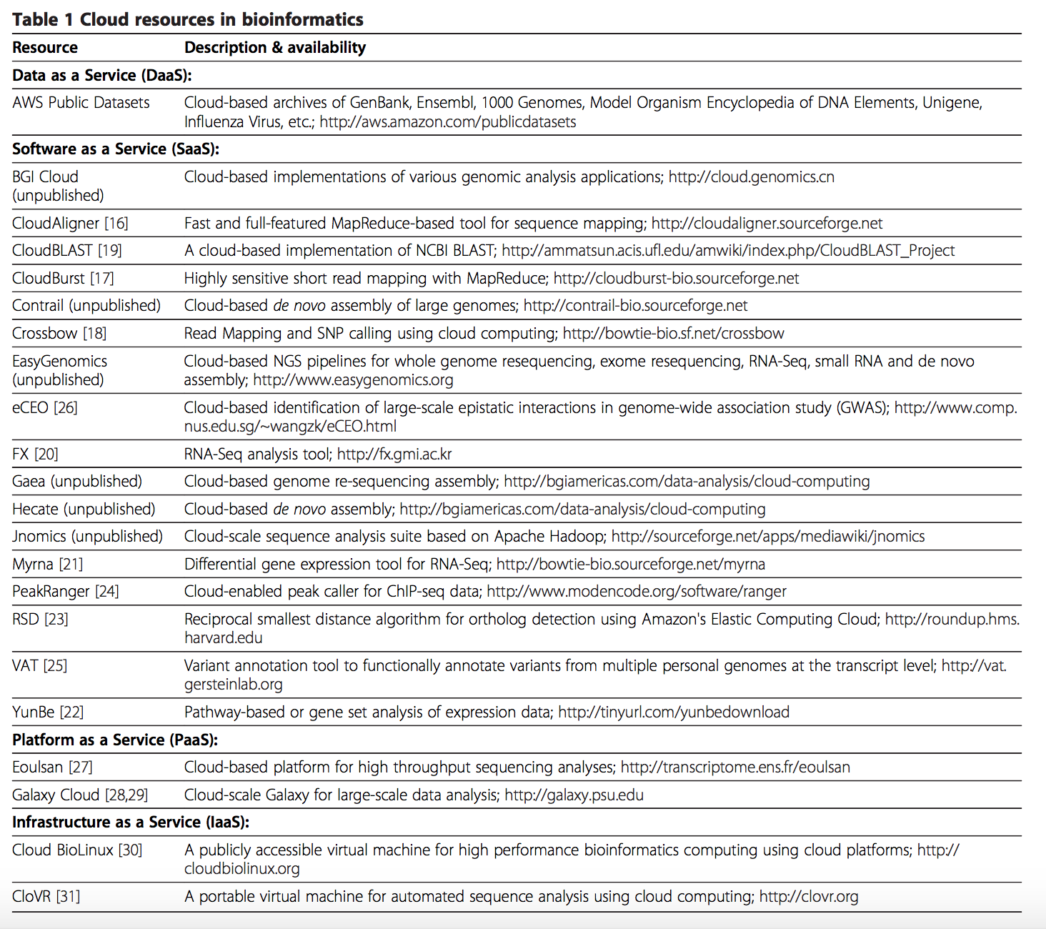
Cloud in Genomics and Bioinformatics
Source:Dai et al. Biology direct 2012

Slide 7
True or False

Slide 8
It is Only for Tech Companies
False

Slide 9
Cloud costs jobs
False

Slide 10
Big data is not a big deal
False

Slide 11
It is always cheaper to run in the cloud
False

Slide 12
Everything can be automated in the cloud, so there’s no need for support
False

Slide 13
Cloud technology is still in its infancy
False

Slide 14
Data is not as secure in the cloud
False

Slide 15
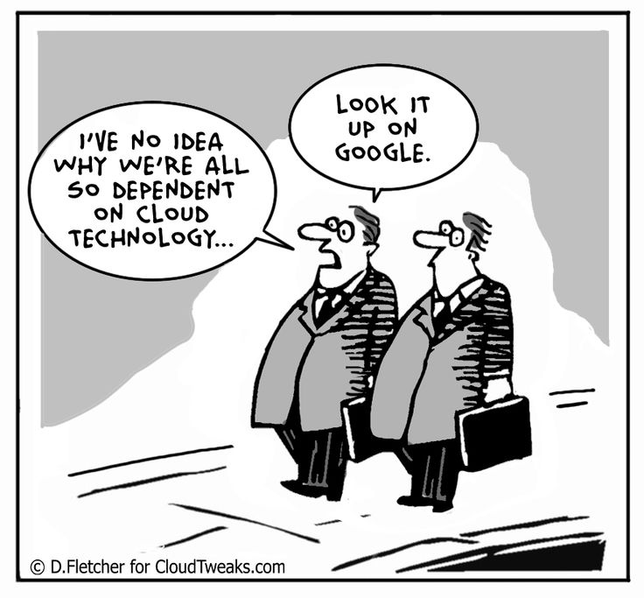
They are the myths of the cloud!!

Slide 16
What do I need to maintain my galaxy?

Slide 17
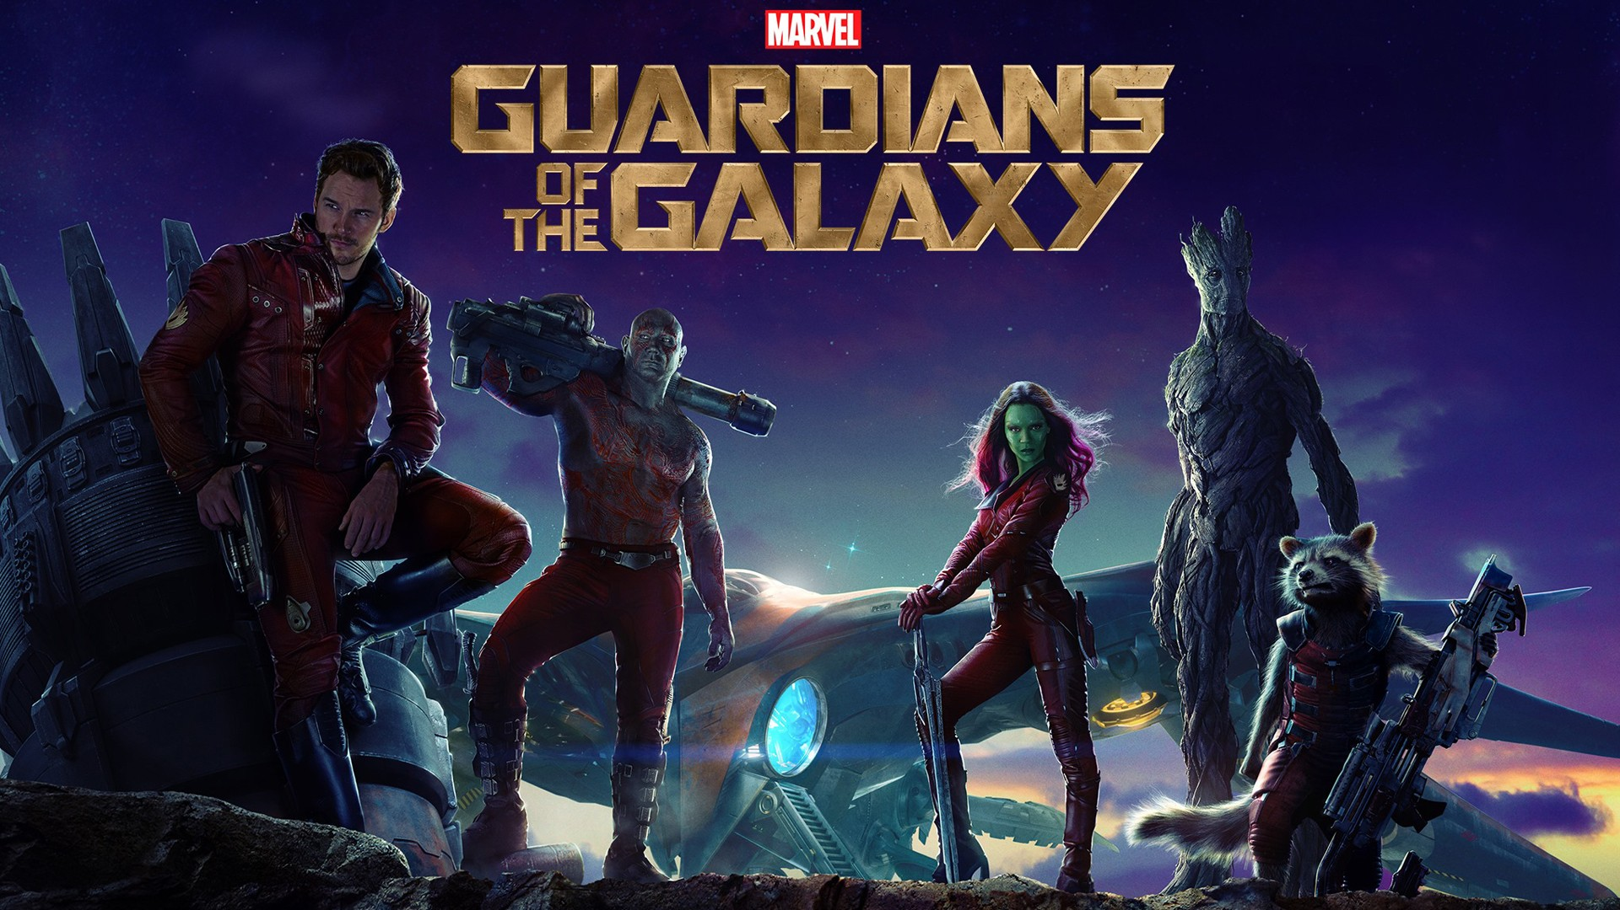
Source:https://www.comicbookmovie.com/guardians_of_the_galaxy/guardians-of-the-galaxy-ranks-as-deadliest-film-ever-a145699

Slide 18
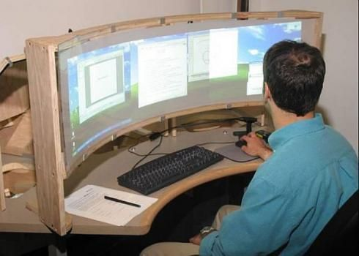
Source:http://izismile.com/2009/08/03/compilation_of_funny_pics_for_the_sysadmin_day_126_pics.html

Slide 19
Why Galaxy?
Bioinformatics course
Computationally focused course?
Biology focused course?

Slide 20
Versions Available
Standalone version
Docker version
Public Main Version
Cloudman Version

Slide 21
Best tools for your gaurdians
AWS price calculator
Instances chart
Usage Alarms

Slide 22
Grants
How?

