Slide 1
GW2 Introduction to web-based analysis with GeneWeaver2 geneweaver.org
This is a guided tour of beta.geneweaver.org designed
to highlight the use of major tools. Steps and explanations
are given to generate the results shown. Additional tools,
features, usage hints and approaches are marked “Tip”.

Slide 2
GeneWeaver Workshop
We will use http://geneweaver.org
Documentation: http://geneweaver.org/help
Sample dataset: http://geneweaver.org/help/do-chr6-qtl.txt

Slide 3
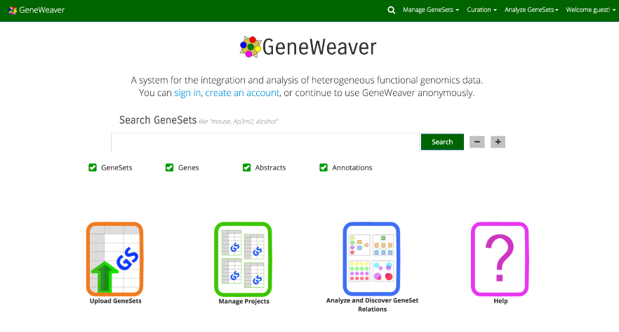
GeneWeaver is a web-based gene-centered database with integrated tools. It can combine diverse data sets from multiple species and experiment types, and allows simple and powerful data sharing publicly or across collaborative groups.
Point your browser to: geneweaver.org

Slide 4
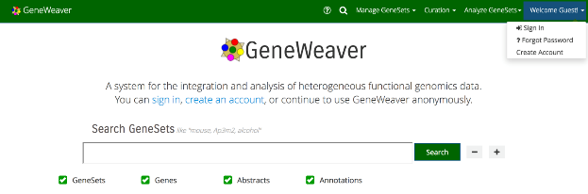
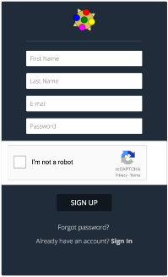
Many of the GeneWeaver tools can be used by guest users, however, for this tutorial we will create an account. If you already have an account, log into your existing account and proceed to the next slide.
Hover over the “Welcome Guest!” link at the top of the page and click “Create Account”.
On the account creation page, fill in the required fields
(first and last names, e-mail, and password) and click
”Sign Up”.
NOTE: If you perform an analysis without a user account,
all results and projects will be lost at the conclusion of a
session.

Slide 5

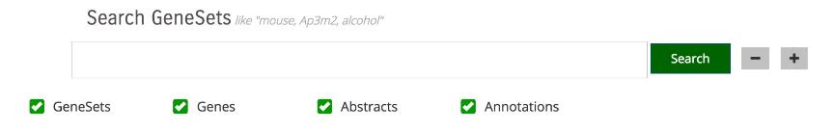
Data in GeneWeaver is organized into sets of genes, or GeneSets. These sets contain some simple metadata, such as a name, description, and publication info, along with the set of genes. All of this information can be searched to find a set of interest.
Searching GeneWeaver for data sets is possible through the Search Bar found on the front page or via the Search icon found in the menu.
Click on the search icon to view the search page.

Slide 6
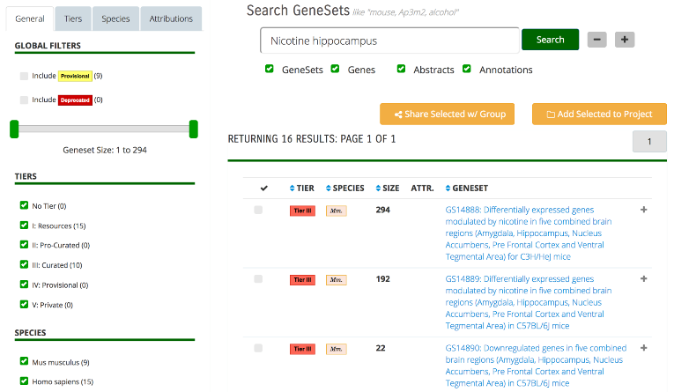
Search for “Nicotine hippocampus” to find all the public GeneSets relating to Nicotine studies in the Hippocampus that have already been upload to GeneWeaver.
Tip: From the search results page you can click on the plus sign to show a little more detail about the set, such as species and publication info. You can also click on the GeneSet name to see the full details and the list of genes included in the set on a separate page.

Slide 7
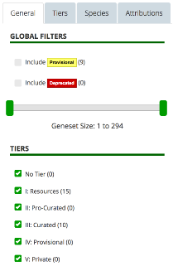
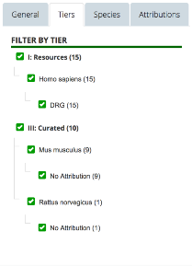
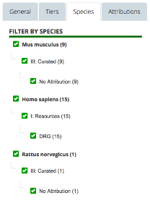
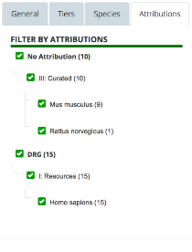
Tip: You can restrict your search to specific species, collaboration groups, or curation level (Tiers I – Tiers V). You can also narrow the search scope by searching only the GeneSets, the Genes, the Abstracts or the Ontologies.
Tip: Creating powerful queries with Boolean search is also possible using “AND”, “OR”, “NOT” and parentheses to craft a precise query.

Slide 8
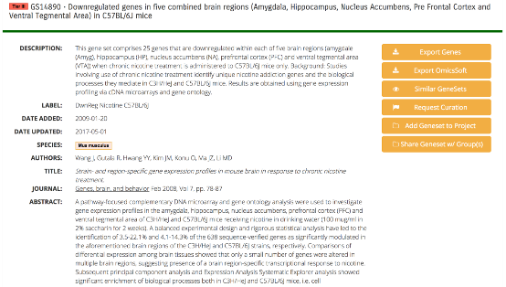
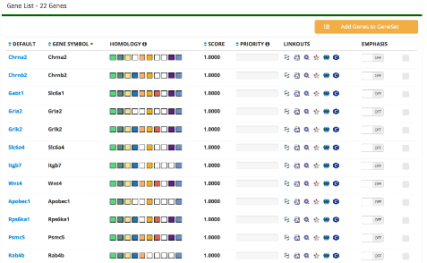
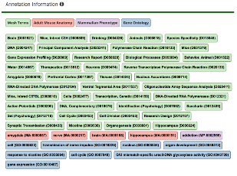
From the GeneSet details page, you can read more about the set, including a link to the provided publication in PubMed, if available, and ontology annotation information. On the second half of the page, you will find a list of the genes in the GeneSet, along with a set of linkouts to other sites, and the score associated with the gene (type of score value depends on the source), and homology assertions.
Tip: Using the “Gene Symbol” drop-down box, you can change the type of identifier used in the list. From this page you can also export the displayed genes to a tab-separated file for use in other software.
⬅Go back to search results now

Slide 9
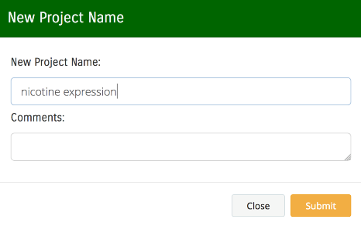
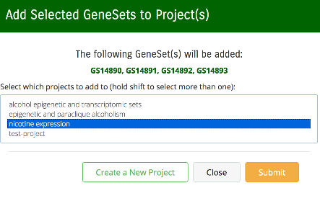
On the search results page, you can use the checkboxes and drop-down menu to add GeneSets to a new project. Projects allow you to run tools and analyze sets of GeneSets.
Click on the checkboxes next to the following nicotine GeneSets: GS14890, GS14891, GS14892, GS14893.
Use the orange button to “Add Selected to Project”, which adds the GeneSets to a new project.
In the pop-up window, click “Create New Project”, supply an informative name for the new project, and click the “Submit” button.
You should now see your new project in the pop-up window.
Select the name of your project, then click “Submit”.

Slide 10
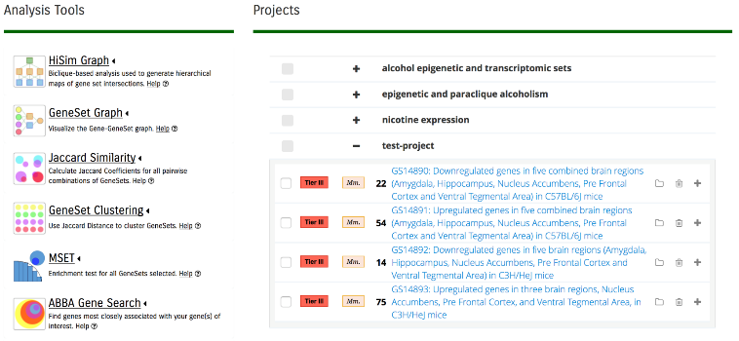
When a new Project is created, it will be available from the “Analyze GeneSets” page, where you can see the Project, its GeneSets, and the analysis tools available. Projects can be wholly or piecewise selected for analysis. The Analysis tools, listed on the left, provide a graphical depiction of the tools’ results to aid with selection.
Navigate to the “Analyze GeneSets” page by clicking the link in the menu.
Tip: GeneSets can be easily removed from a project by clicking the “trash” icon on the right side. Projects can be removed, shared, or marked as important from the ‘Manage Projects’ page.
Tip: Most of the analysis tools have options to tweak their output. These options are available by clicking the plus sign next to the tool.

Slide 11
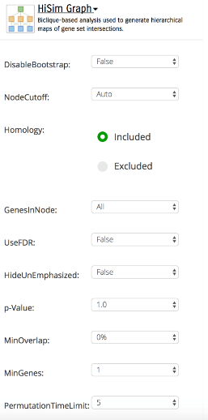
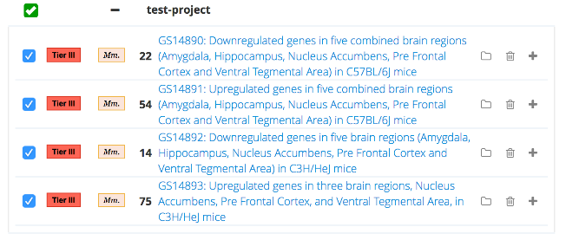
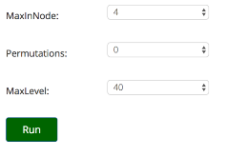
To run an analysis tool, simply select Projects and/or GeneSets and then click the button on the left representing the tool you wish to run.
Tip: Click the name of the analysis tool to expand the list of available options.
Tip: Projects are very useful for organizing similar studies. For example, by keeping experimental nicotine data in one project, and morphine data in another project, you can simply select both projects at once to run a comparative analysis, while keeping the collections distinct. Select your nicotine project and then run the “HiSim Graph” tool. You will be shown a status page while the tool is running (or waiting to run) which keeps you informed of the progress of the analysis.
Tip: The ‘Results’ page also keeps track of previous and on-going tool runs.

Slide 12
Expand your nicotine project and view its contents by clicking the plus (+) icon next to its name.
Select your nicotine project and then run the “HiSim Graph” tool. You will be shown a status page while the tool is running (or waiting to run) which keeps you informed of the progress of the analysis.
Tip: The ‘Results’ page also keeps track of previous and on-going tool runs.

Slide 13
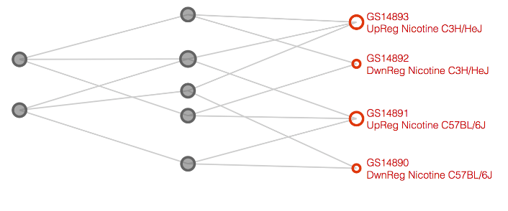
The HiSim Graph tool organizes multi-set intersections into a hierarchical directed acyclic graph (DAG). This organization infers an ontological relationship directly from the empirical data present in the original input sets. Genes in nodes at the top of the graph play a role in multiple phenotypes.
Hover over the leftmost node in the map to examine the genes it contains more closely.
Right click on a node to either view the GeneSet details or examine genes at the intersection of those sets.

Slide 14
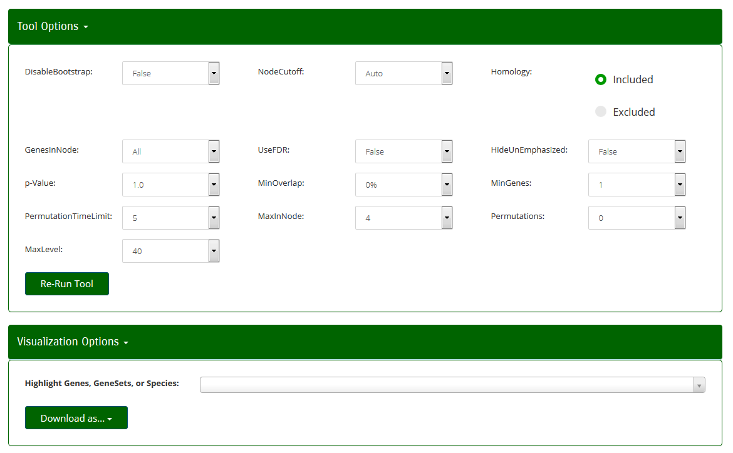
Many features of the HiSim Graph can be modified by clicking on ‘Tool options’ or ‘Visualization Options’.

Slide 15
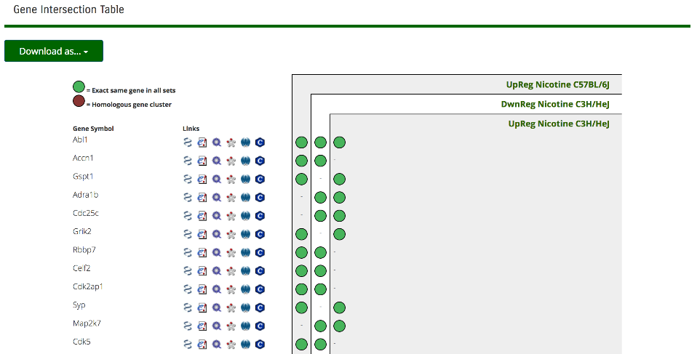
The GeneSet Intersection List shows all the sets in consideration, and a matrix of the genes associated with them. When a single species-specific gene is shown, a green circle is visible, but when multi-species data are compared, homology clusters are indicated with brown circles. In the example below, you could read it as “genes with homology to Kcnk1 are found in all 4 mouse and rat GeneSets.”
Tip: Linkouts for more information are also available (as with the geneset details page).
Tip: This page can also be exported to a TSV or CSV file (readable by Excel) for other uses by clicking the “Download as…” button.

Slide 16
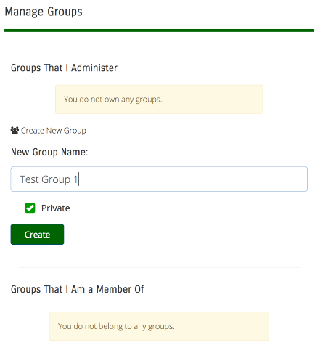
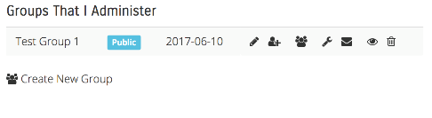
Let’s say we want to share our Nicotine project with a group of collaborators. First, we need to create or join a group. You can do this by clicking the “Account Settings” page in the top right corner.
Click “Create New Group”, type a group name in the “New Group Name” box, then click the “Create” button.
Tip: For other group functions, click on the icons.
Tip: Explore this page for other useful functions.

Slide 17
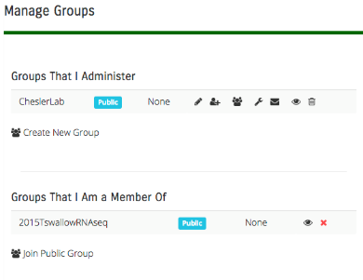
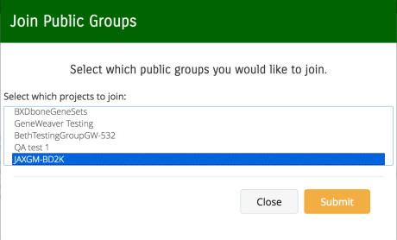
We’re also going to join a public group so we can analyze GeneSets that have been shared with us.
Click the “Join Public Group” button and search the list of public groups for “JAX Addiction Short Course 2018”.
Select the group and click “Submit”.

Slide 18
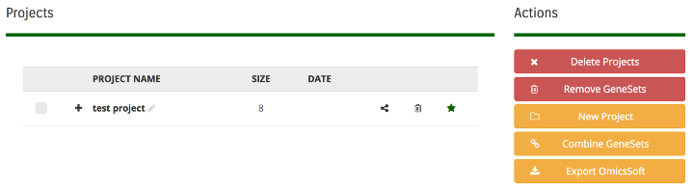
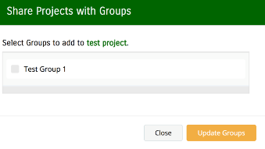
Let’s go to the “Manage Projects” page.
Hover your mouse over the “Manage GeneSets” link in the menu, then click the “Manage Projects” link.
Shared Projects provide a useful way to share analyses with collaboration groups. Any project you have can be shared by clicking the ‘share’ icon, then selecting the group from the pop-up window.
Share your project with the group you created.
Click the “share” icon, select your group name, the click the “Update Groups” button.

Slide 19
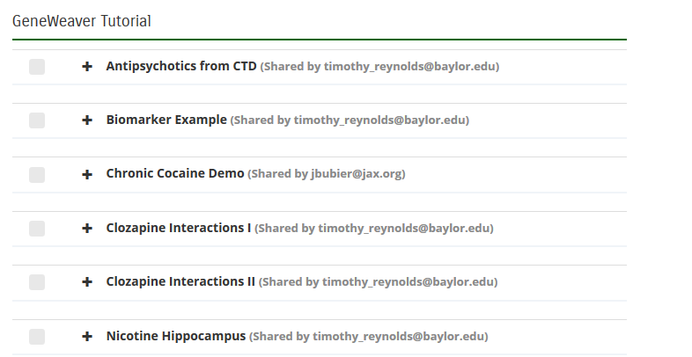
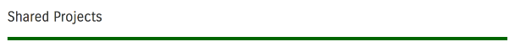
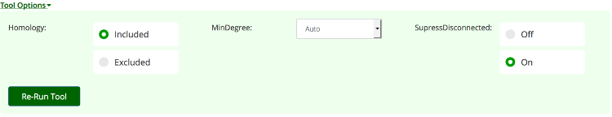
Let’s browse the genes in the “Nicotine Hippocampus” project.
Navigate back to the “Analyze GeneSets” page.
At the bottom the of page you should see projects that have been shared with you.
Select it and run the “GeneSet Graph” tool. This tool simply draws a node for every gene, and one for every GeneSet, and connects them with a line if they are associated. To aid comprehension, genes are arranged by connectedness (degree) from left to right (lower-higher).
You’ll notice that the resulting image is very tall and hard to read (and this was only 8 GeneSets!). This is an example of when it is good to change tool options. Options can be changed from the “Analyze GeneSets” page, or from the results page by clicking “Tool Options.” (shown below)
The image at left has a MinDegree of 3, let’s increase that to 4 and then rerun the tool.

Slide 20
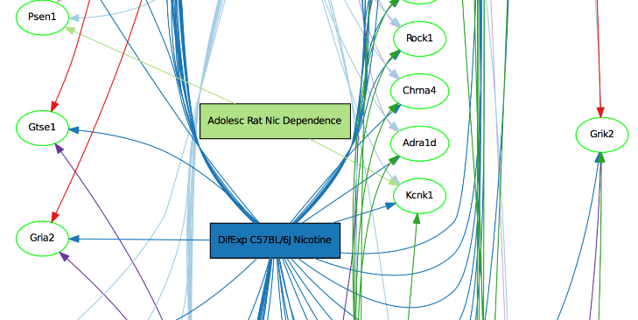
That’s better. From this result, we can see that Grik2 is connected to 6 GeneSets and might warrant further study. Some of the 5-way genes might be interesting as well.
Tip: You can click on any gene in this image to search GeneWeaver for other GeneSets that contain that gene.
Let’s try out one more tool before we move on. Navigate back to the ”Analyze GeneSets page” and using the same project, run the “Jaccard Similarity” tool.

Slide 21
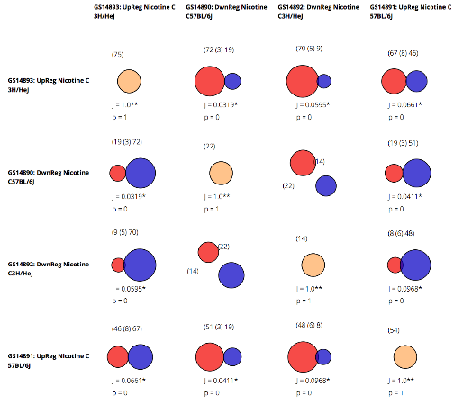
The Jaccard Similarity results give a large-scale, pairwise view of GeneSet overlaps. The Jaccard similarity coefficient is a positive match score for the similarity of set-set composition. Using this tool, you can quickly see when sets are highly overlapping or completely disjoint, and refine projects with more informative GeneSets.
Tip: Click on any intersection to bring up the GeneSet Intersection page discussed earlier in this tutorial.

Slide 22
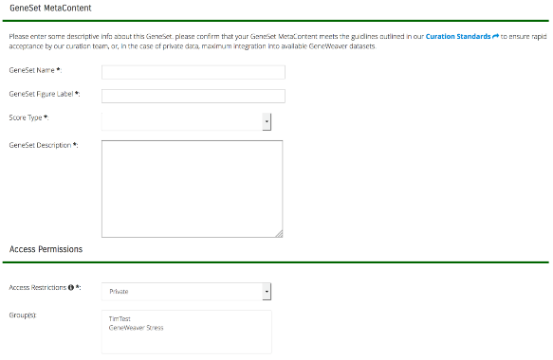
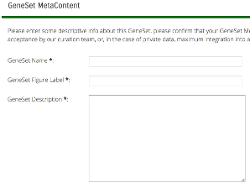
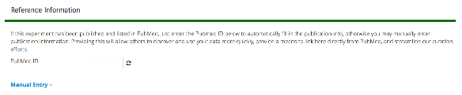
Uploading your own data to GeneWeaver is fast and easy! Let’s get started by going to: “Manage GeneSets” -> “Upload GeneSet”. This brings us to the upload page, where we need to provide a little bit of information:
Name – Shown in GeneSet Lists and Projects. Short but descriptive is best.
Label – Used to label nodes in results. Less than 24 characters recommended.
Score Type – Denotes the types of score used with the gene list (e.g. p-value, fold change, etc.)
Description – Used to describe the experiment and selection criteria for the set. Should probably be similar to the Table caption for published results.
Access Restrictions – Describes who can access this set, Everyone (Public), just you (Private), or groups of collaborators (Group).
Species - Select the species that the genes map to
Input File – You can either upload a plain text file, or copy and past a list by using the “copy/paste genes” button.

Slide 23
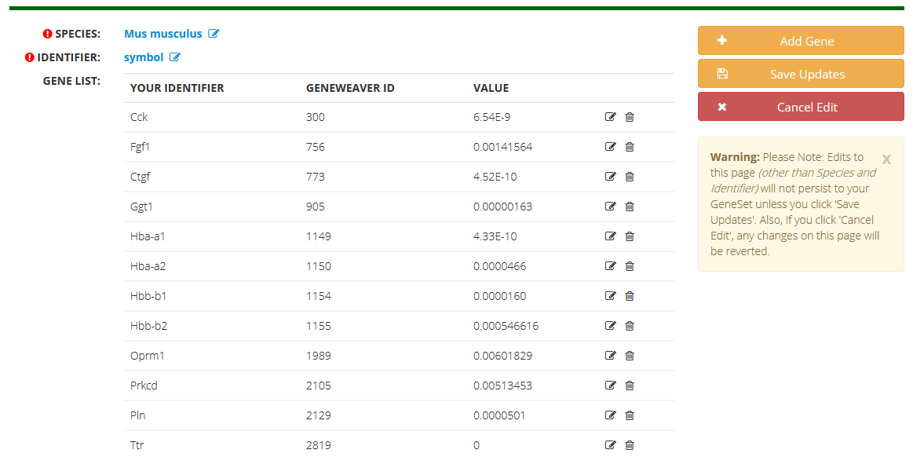
NOTE: You will be taken to a second page where you can verify genes associated with this data upload.
Click the “GeneSet Details” button to view your GeneSet.

Slide 24
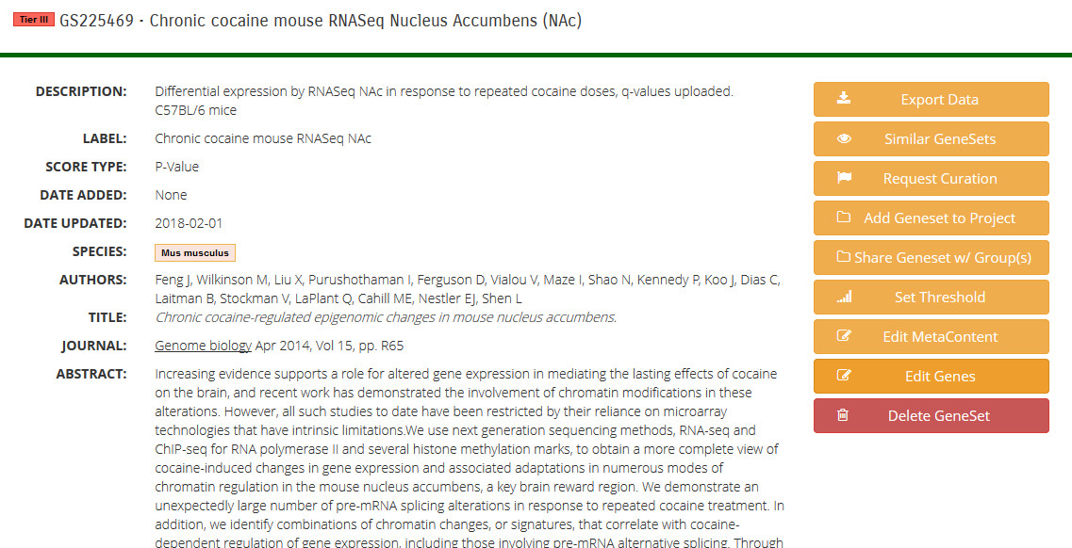
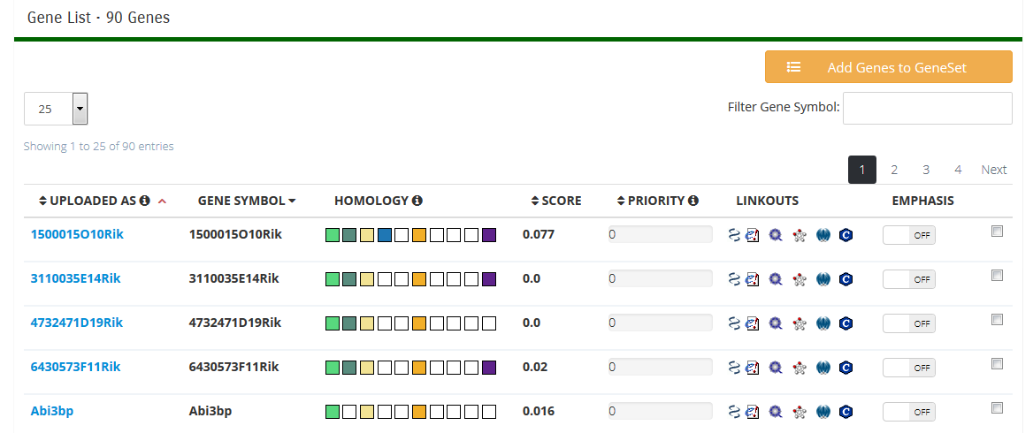
When upload completes, you will be taken to your new GeneSet details page. From here, you can add it to Projects and do further analysis.

Slide 25
This tutorial was intended to provide an introduction to practical approaches to the tools in GeneWeaver.
There are many tools and approaches that can be combined to create particular workflows to address a variety of genetics questions. Additional tutorials and documentation can be found on the website.
If you have any suggestions, comments, or questions please use the “Feedback” link located on every page.

Slide 26


Acknowledgements
Elissa Chesler – JAX
Erich J. Baker - Baylor University
Michael A. Langston - University of Tennessee
Jason Bubier – JAX
Charles Phillips – U. Tenn
Timothy Reynolds - Baylor/JAX
Jeremy Jay - U. Maine/JAX
Vivek Philip U. Tenn/JAX
Keith Sheppard – JAX
Dave Walton
Glenn Beane
Alex Berger
NIH R01 AA18776
Supported by NIH R01 AA18776 jointly funded by NIAAA and NIDA, and JAX Center for Precision Genetics NIH U54 OD 020351
26

