Slide 1
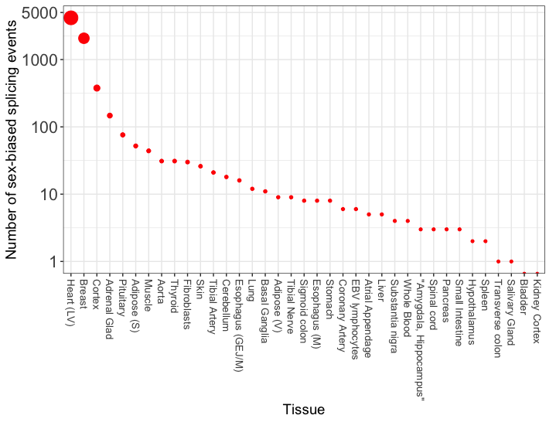
Figure 1 – Number of sex-biased in GTEX tissues.
Comments:
Sex biased splicing seems to be restricted to selected tissues. This is vey striking.
Tissues can be split into three categories:
4 tissues with more than > 100 events
12 tissues with 10 ≤ events ≥ 100
21 tissues with < 10 events

Slide 2
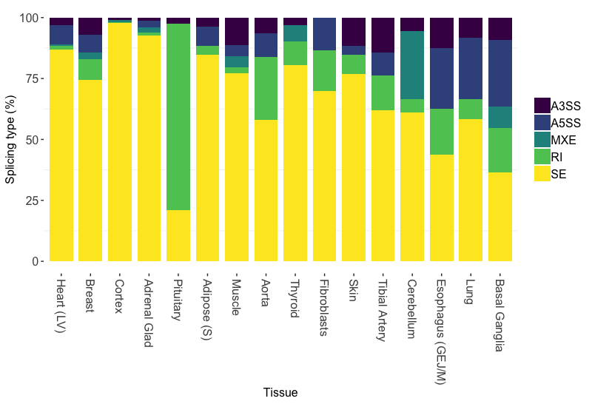
Figure 2 – Distribution of alternative splicing events between males and females in GTEX tissues (tissues with > 10 events).
Comments:
Most common is exon skipping, except for pituitary with highest proportion of intron retention.
Esophagus, Lung, Basal with higher proportion of A3SS and A5SS.
Cerebellum (brain) with high frequency of mutually exclusive exons.

Slide 3
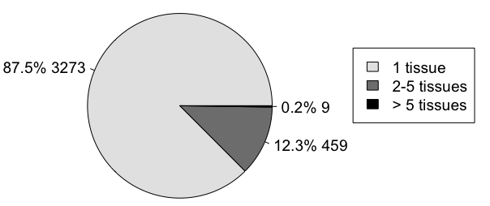
Figure 3 – Frequency of gene splicing across tissues.
Comments:
In total, 3,741 genes have sex-biased ASEs
These genes can be classified into:
Tissue specific splicing (1 tissue)
Group enriched (2 to 5 tissues)
Recurrent > 5 tissues

Slide 4
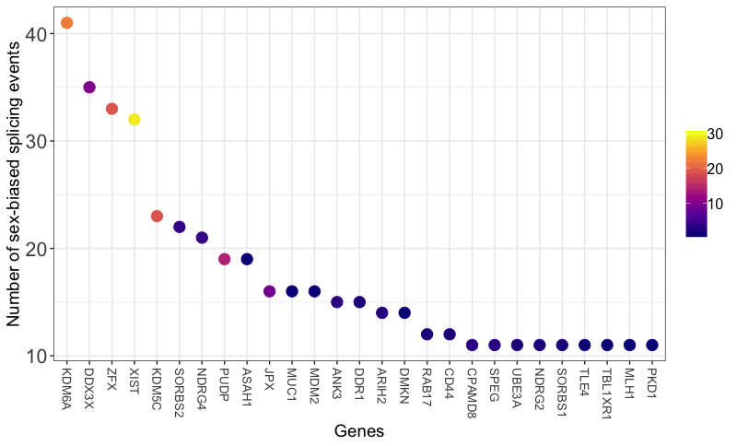
Figure 4 – Most frequently spliced genes between males and females, and their recurrence across tissues.
Tissues
Comments:
Shown are genes with > 10 splicing events (n = 27).
Color encodes the number of tissues where gene is spliced to show recurrent splicing across tissues.
KDM6A, DDX3X, ZFX, XIST and KDMC5C are both frequently spliced AND recurrently spliced across tissues.
e.g. XIST has 32 ASEs, in 29 tissues
KDM5C has 23 ASEs, in 19 tissues
On the other hand, CD44 has 12 ASEs in 2 tissues.
3,741 unique genes
Mean splicing frequency = 1.93
Range (min, max) = 0 to 41

Slide 5
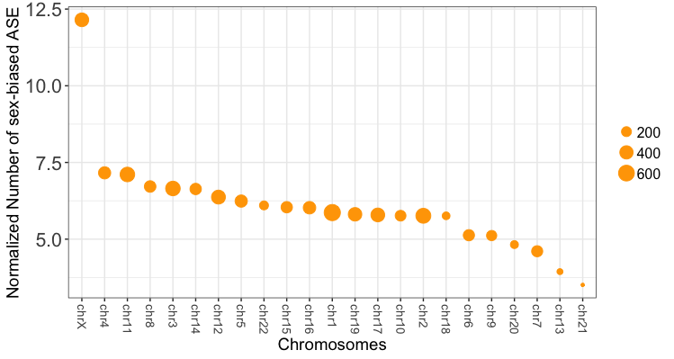
Figure 5 – Most frequently spliced chromosomes between males and females, normalized by the number of exons in chromosomes.
Comments:
Chromosomes are ranked by the normalized splicing index, which is the number of splicing events per 1000 exons in the chromosome
Y axis = normalized splicing index = (#ASE over the #exons in the chromosome) * 1000
Color encodes the absolute number of ASE in the chromosome.
chrX is the most frequently spliced chromosome due to sex
chrX has 429 ASEs, 35309 total exons, index = 12.15
chr1 has 639 ASEs, 108417 total exons, index = 5.86

