Slide 1
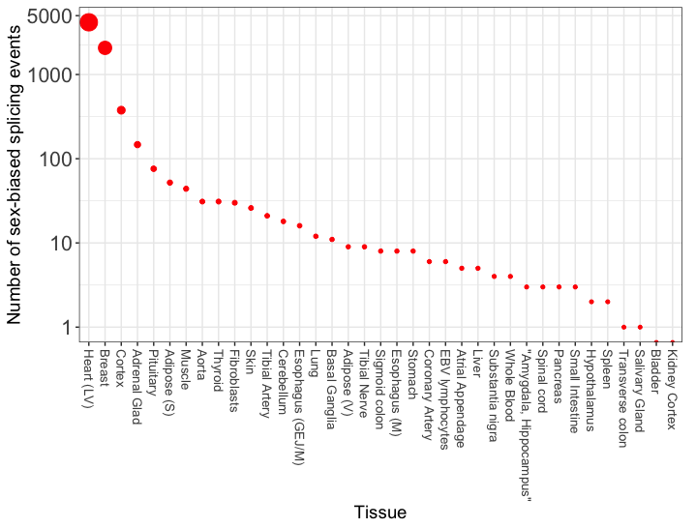
Figure 1 – Number of sex-biased in GTEX tissues.
Comments:
Sex biased splicing seems to be restricted to selected tissues. This is vey striking.
Tissues can be split into three categories:
4 tissues with more than > 100 events
12 tissues with 10 ≤ events ≥ 100
21 tissues with < 10 events

Slide 2
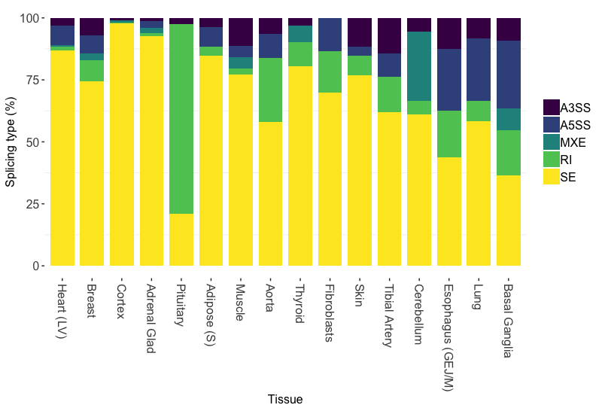
Figure 2 – Splicing types in GTEX tissues (tissues with > 10 events).
Comments:
Most common is exon skipping, except for pituitary with highest proportion of intron retention.
Esophagus, Lung, Basal with higher proportion of A3SS and A5SS.
Cerebellum (brain) with high frequency of mutually exclusive exons.

Slide 3
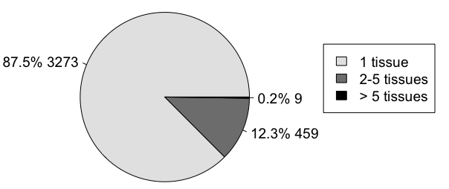
Figure 3 – Recurrence of splicing across tissues.
Comments:
In total, 3,741 genes have sex-biased ASEs
These genes can be classified into:
Tissue specific splicing
Group enriched (2 to 5 tissues)
Recurrent > 5 tissues

Slide 4
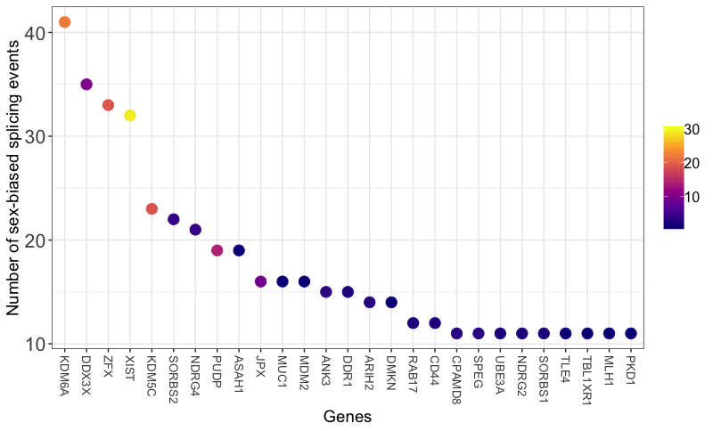
Figure 4 – Most frequently sex-biased spliced genes.
Tissues
Comments:
Shown are genes with > 10 splicing events (n = 27).
Color encodes the number of tissues where gene is spliced to show recurrent splicing across tissues.
KDM6A, DDX3X, ZFX, XIST and KDMC5C are both frequently spliced AND recurrently spliced across tissues.
e.g. XIST has 32 ASEs, in 29 tissues
KDM5C has 23 ASEs, in 19 tissues
On the other hand, CD44 has 12 ASEs in 2 tissues.
3,741 unique genes
Mean splicing frequency = 1.93
Range (min, max) = 0 to 41

