Slide 1

Speech Recognition
Jessica Ritchie
Jade Fjestad

Slide 2
Problem
Classify audio recordings as known or unknown to the database using a Gaussian Mixture Model (GMM)

Slide 3
Approach
Select Dataset
3 000 recordings from 6 users (https://www.kaggle.com/datasets/alanchn31/free-spoken-digits)
Feature Extraction
Mel Frequency Cepstral Coefficients
Templates contain array of pitches
Split Data
Training data = 490 recordings of Nicolas
Testing data = 10 recordings of Nicolas
Probe data = 50 recordings (10 each from 5 remaining users)
Train GMM
500 Gaussian components

Slide 4
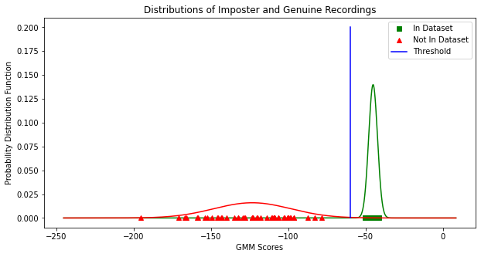
Results
Distinct distributions
Select threshold = -60

Slide 5
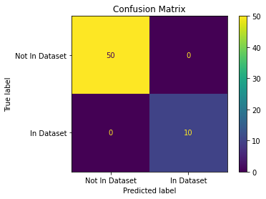
Results
Identified every sample correctly!
Performance Metric | Value
TRR | 83.3%
FAR | 0.0%
FRR | 0.0%
TAR | 16.7%

Slide 6
Slide about Mel Frequency Cepstral Coefficients?
Reduces the dimensions of audio to focus on important charecteristics and improve model performance
Robust to external noise by applying smoothing filters
Uses mel-scale filter bank that makes the audio more “human” like (emphasizes lower frequencies, de-emphasizes higher)

Slide 7
Q & A

