Slide 1

Speech Recognition
Jessica Ritchie
Jade Fjestad

Slide 2
Problem
Classify audio recordings as known or unknown to the database using a Gaussian Mixture Model (GMM)

Slide 3
Approach
Select Dataset
3 000 recordings from 6 users
Feature Extraction
Mel Frequency Cepstral Coefficients
Templates contain array of pitches
Split Data
Training data = 490 recordings of Nicolas
Testing data = 10 recordings of Nicolas
Probe data = 50 recordings (10 each from 5 remaining users)
Train GMM
500 Gaussian components

Slide 4
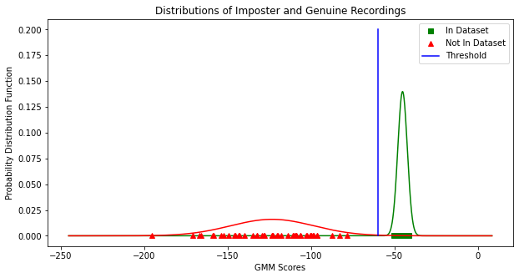
Results
Distinct distributions
Select threshold = -60

Slide 5
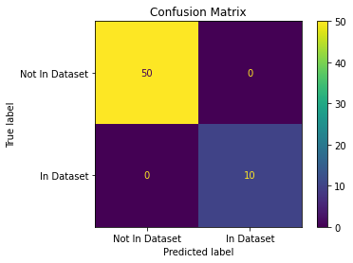
Results
Identified every sample correctly!
Performance Metric | Value
TRR | 83.3%
FAR | 0.0%
FRR | 0.0%
TAR | 16.7%

Slide 6
Q & A

