Slide 1
Voice Activated
Classroom Assistant
By James Hodge, Bria Lowe, Christina Noe

Slide 2
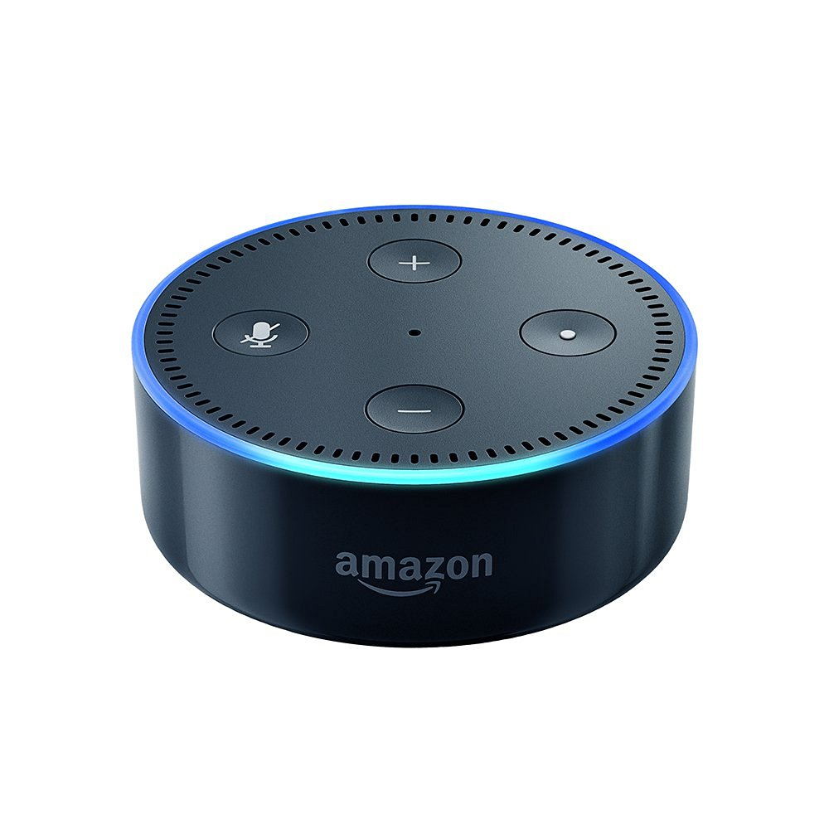
Project Summary
Motivation
This project focuses on adapting Intelligent Personal Assistant technology from a home setting to a classroom setting.
We aim to give teachers the tools to automate repetitive tasks, and provide a hands free way of managing classroom records.
Goals
Creating new voice commands for the Intelligent Personal Assistant that can be used in a classroom
Connect the software to Learning Management Systems to provide easy control over classroom records

Slide 3
Key Definitions
Learning Management Systems (LMS) - A digital administration and record keeping service for use in education.
Intelligent Personal Assistant (IPA) - Software that can perform assistant tasks such as schedule management or question answering.
Amazon Web Services (AWS) - A suite of cloud-computing services offered by Amazon. Amazon suggests using AWS to host services for Echo projects.
Alexa Skills Kit - Offered by Amazon, a collection of APIs, documentation, and code samples for developing Alexa skills.
Amazon Echo Dot - A smaller version of the Amazon Echo IPA.The Dot has a smaller speaker that the standard Echo, but it’s less expensive, lighter, and comes with bluetooth capability.

Slide 4
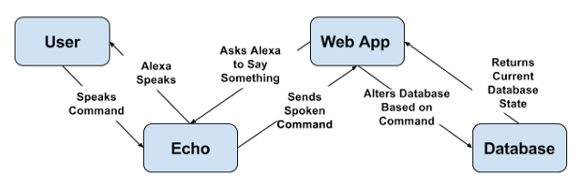
System Architecture
Echo Dot Device - The interface through which users give Alexa spoken commands.
Web Application - The interface that receives and processes Alexa commands, through which users can display student attendance information. Users will be able to edit student information manually. Will also handle the business logic of accessing and editing the student database.
Database: Learning Management System or SQL - The mechanism for storing student information. Users can link to an external online LMS or create an internal LMS.

Slide 5
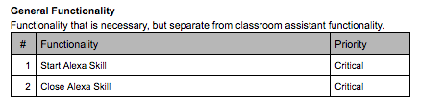
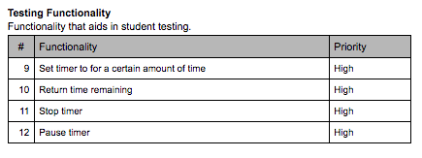
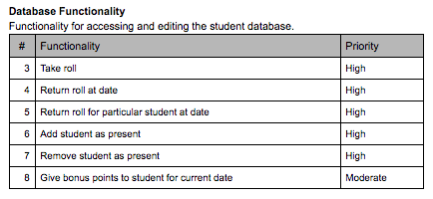
Functional Requirements

Slide 6
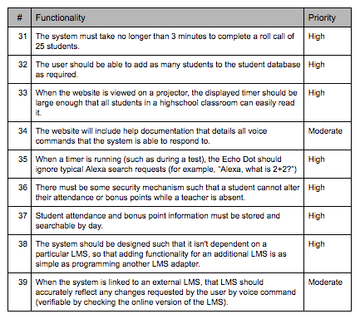
Non-Functional Requirements

Slide 7
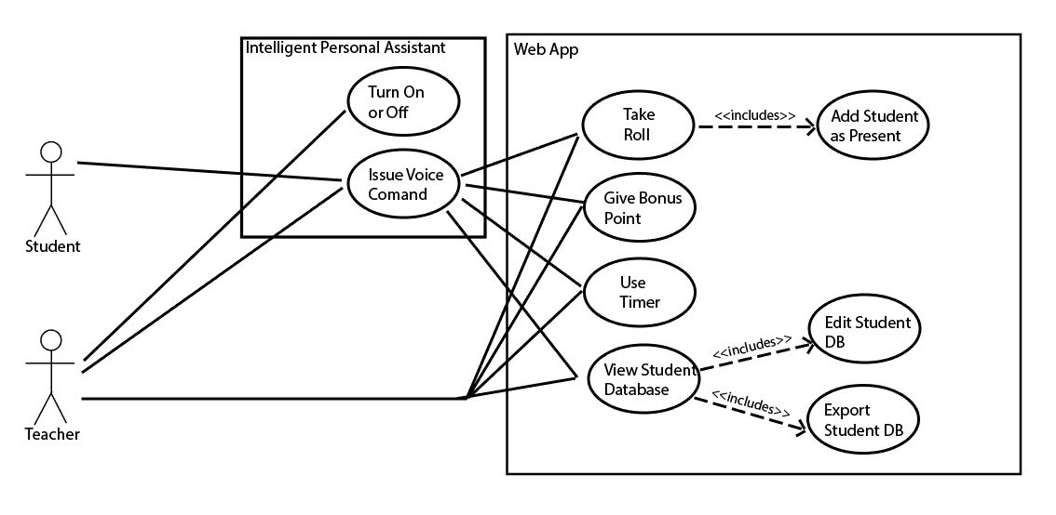
Use Cases

Slide 8
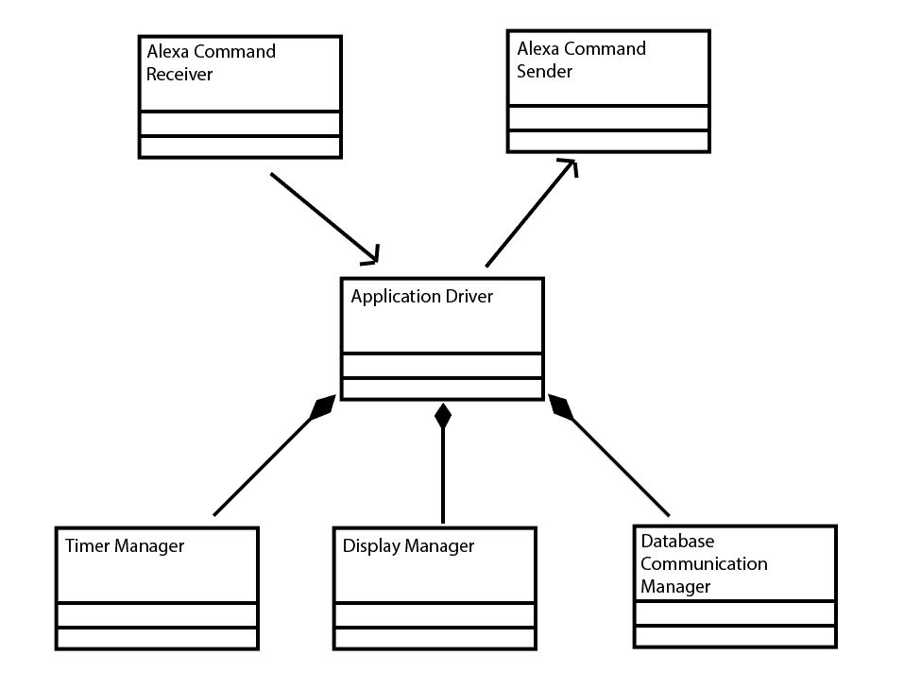
Class Diagrams

Slide 9
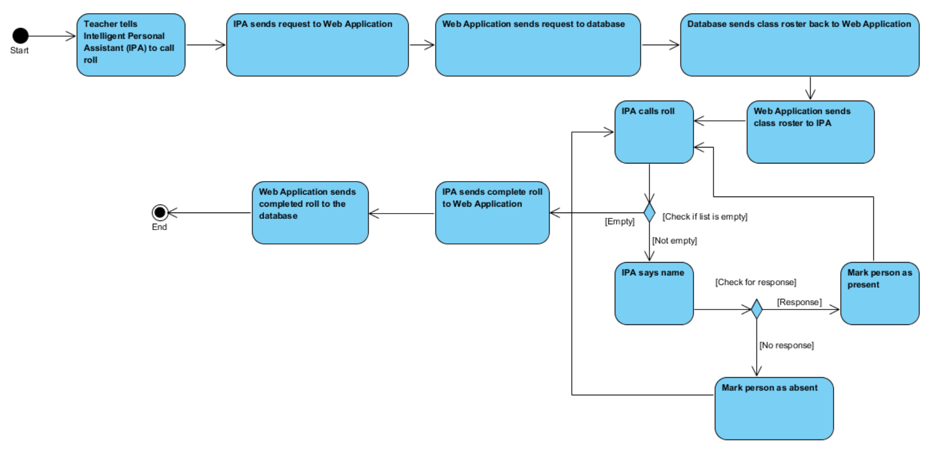
Activity Diagrams

Slide 10
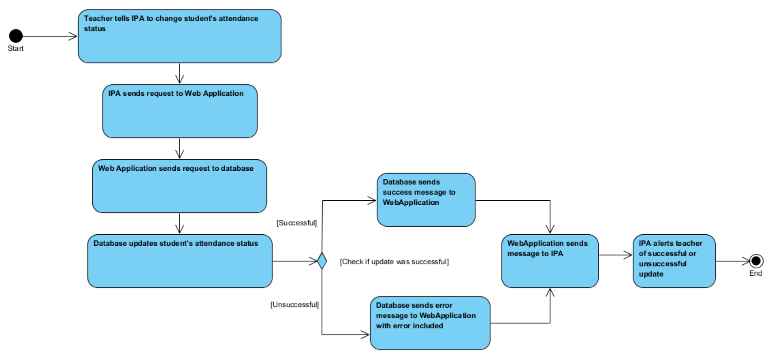
Activity Diagrams

Slide 11
Potential Risks
Unauthorized student control
Not recognizing voice commands
Accessing more than one class database for a single LMS account
Conflicts when connecting to LMS

Slide 12
Questions?

