Slide 1
SupportFlow
AI-Powered Customer Service Chatbot → Multi-Tenant SaaS
AML-2404 · AI and ML Lab · Lambton College
Final Presentation · Group: 2026S-AML-2403-OTT01-AI and ML Lab - 2
Dev Bajaniya · Jatin Vaghela · Pratik Chavda · Amal Satheesan
Faculty Supervisor: William Pourmajidi
SupportFlow · AML-2404 · Slide 1/16 · Voice: Jatin
Lambton College
Notes:
Voice-over owner: Jatin | See Final-Presentation-Speaking-Script.docx for full narration of slide 1.

Slide 2
Agenda
What we will cover today
• Problem & objectives
• Solution overview
• Architecture & AI pipeline
• Multilingual & guardrails
• Data model & testing
• Product walkthrough (UI)
• Billing, embed & hosting
• Demo path · Future work · Q&A
SupportFlow · AML-2404 · Slide 2/16 · Voice: Jatin
Lambton College
Notes:
Voice-over owner: Jatin | See Final-Presentation-Speaking-Script.docx for full narration of slide 2.

Slide 3
The Problem
Why customer support needs intelligent automation
• Delayed replies to repetitive questions
• Agents overloaded with shipping / returns / FAQ work
• Limited after-hours coverage
• Static FAQ pages fail when wording changes
• Businesses need owned knowledge — not a generic chatbot
SupportFlow · AML-2404 · Slide 3/16 · Voice: Jatin
Lambton College
Notes:
Voice-over owner: Jatin | See Final-Presentation-Speaking-Script.docx for full narration of slide 3.

Slide 4
Project Objectives
What we set out to build in 12 weeks
• Hybrid chatbot: FAQ + NLP patterns + local AI (Ollama)
• Multi-tenant SaaS: signup, businesses, JWT auth
• Owner knowledge base with plan word limits
• Stripe test billing (Basic / Pro / Premium)
• Embeddable widget for customer websites
• Demo-ready hosting + documentation
SupportFlow · AML-2404 · Slide 4/16 · Voice: Jatin
Lambton College
Notes:
Voice-over owner: Jatin | See Final-Presentation-Speaking-Script.docx for full narration of slide 4.

Slide 5
Solution: SupportFlow
From single demo bot → multi-business support platform
• Owners manage businesses in a React dashboard
• Paste free-text knowledge → AI answers from that knowledge
• Preview chat before going live
• Subscribe → unlock embed widget
• Customers chat on the owner’s website
• Local Ollama models keep AI on our stack for demos
SupportFlow · AML-2404 · Slide 5/16 · Voice: Dev
Lambton College
Notes:
Voice-over owner: Dev | See Final-Presentation-Speaking-Script.docx for full narration of slide 5.

Slide 6
System Architecture
High-level components (no code dump)
React Dashboard + Embed Widget
Flask API Auth · Chat · Billing
Chatbot Engine FAQ · RAG · Ollama
SQLite Tenants · Logs
• Stripe (test mode) for subscriptions
• Tunnel (Cloudflare / ngrok) for shared demo URL
SupportFlow · AML-2404 · Slide 6/16 · Voice: Dev
Lambton College
Notes:
Voice-over owner: Dev | See Final-Presentation-Speaking-Script.docx for full narration of slide 6.

Slide 7
Backend & APIs
Flask services that power the product
• JWT auth (register / login / me)
• Businesses & knowledge APIs
• Chat + streaming (SSE)
• Session history APIs
• Stripe checkout / portal / webhook
• Plan limit enforcement
• Embed config + widget.js
• SPA serving for public demo
SupportFlow · AML-2404 · Slide 7/16 · Voice: Dev
Lambton College
Notes:
Voice-over owner: Dev | See Final-Presentation-Speaking-Script.docx for full narration of slide 7.

Slide 8
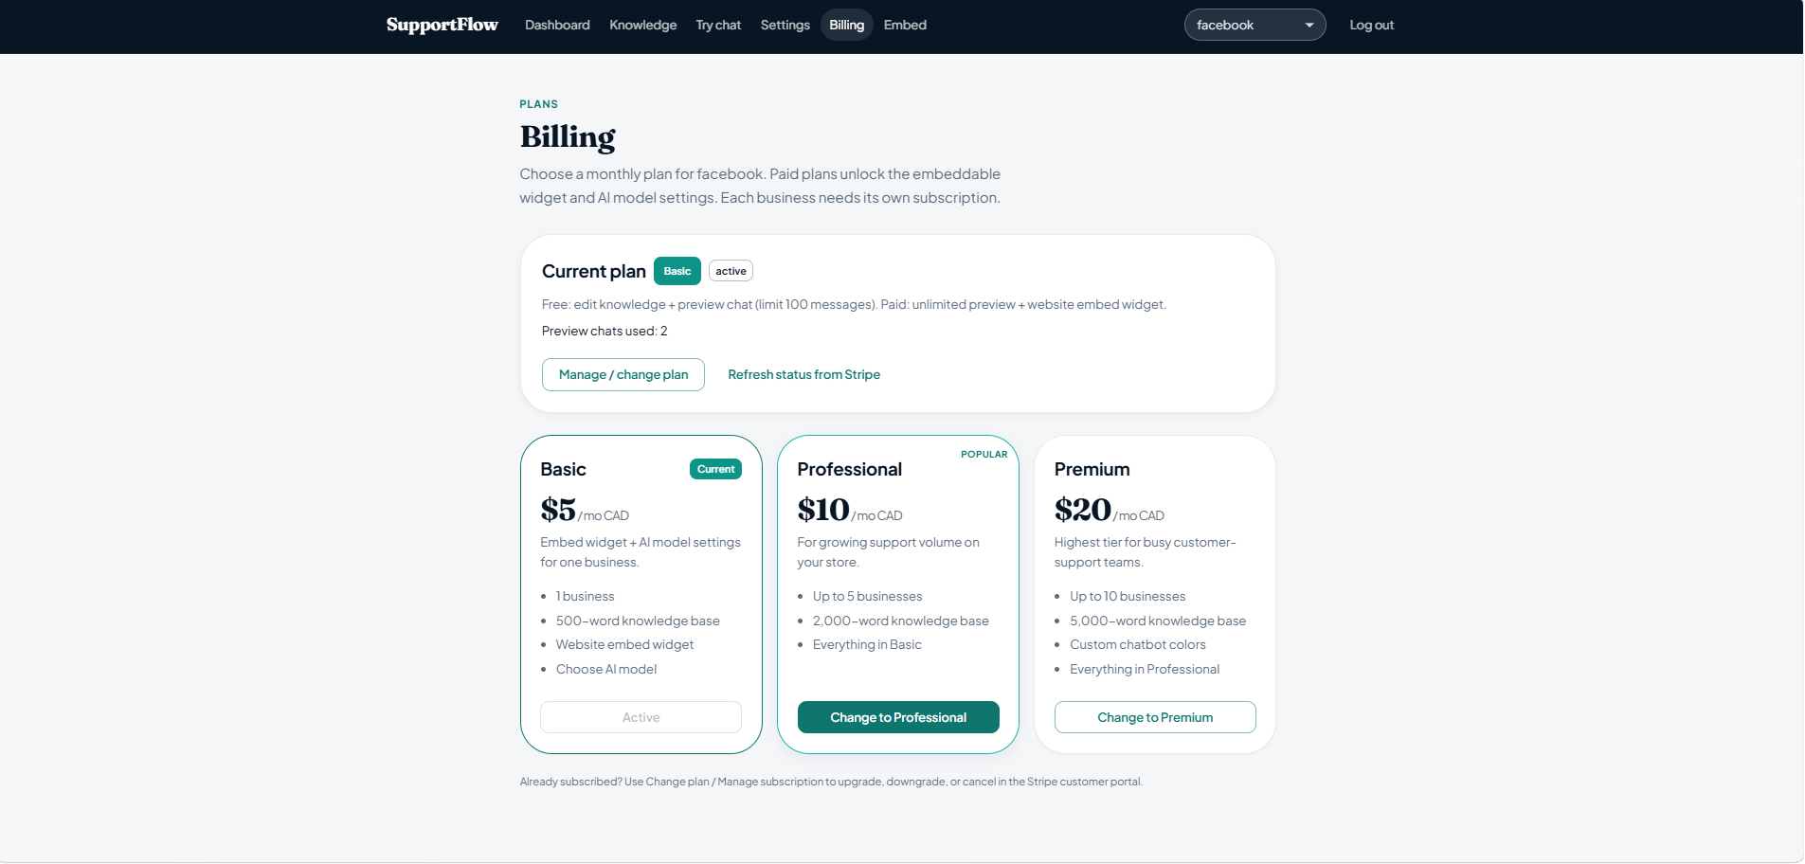
Billing & Plan Limits
Stripe test mode · feature gates by plan
• Free → Basic ($5) → Professional ($10) → Premium ($20)
• Limits: businesses · knowledge words · Premium colors
• Checkout + confirm + webhook sync
📸 SCREENSHOT PLACEHOLDER
APP PAGE: Billing (/billing — plan cards Basic / Pro / Premium)
Paste image here before recording voice-over
SupportFlow · AML-2404 · Slide 8/16 · Voice: Dev
Lambton College
Notes:
Voice-over owner: Dev | See Final-Presentation-Speaking-Script.docx for full narration of slide 8.

Slide 9
Multi-Tenant Data Model
SQLite schema that keeps businesses isolated
• Users → own many Businesses (plan-capped)
• Knowledge stored per business
• Sessions & messages scoped to business
• Subscription status + plan fields
• Widget key for public embed access
• No cross-tenant chat leakage
SupportFlow · AML-2404 · Slide 9/16 · Voice: Pratik
Lambton College
Notes:
Voice-over owner: Pratik | See Final-Presentation-Speaking-Script.docx for full narration of slide 9.

Slide 10
Logging & Conversation History
What we store for demos, analytics, and resume-chat
• User + bot messages with timestamps
• Model used · intent/route · confidence
• Preview chat counters for free tier
• History sidebar (dashboard) + widget history
• Stats for owners (session activity)
SupportFlow · AML-2404 · Slide 10/16 · Voice: Pratik
Lambton College
Notes:
Voice-over owner: Pratik | See Final-Presentation-Speaking-Script.docx for full narration of slide 10.

Slide 11
Testing & Quality
How we validated the system (Weeks 10–12)
• Smoke: signup → chat → billing
• API checks on core endpoints
• Multilingual probe utterances
• Greeting vs knowledge routing
• Plan limit rejection checks
• Embed key + origin checks
• Tunnel SPA load verification
• Final end-to-end regression
SupportFlow · AML-2404 · Slide 11/16 · Voice: Pratik
Lambton College
Notes:
Voice-over owner: Pratik | See Final-Presentation-Speaking-Script.docx for full narration of slide 11.

Slide 12
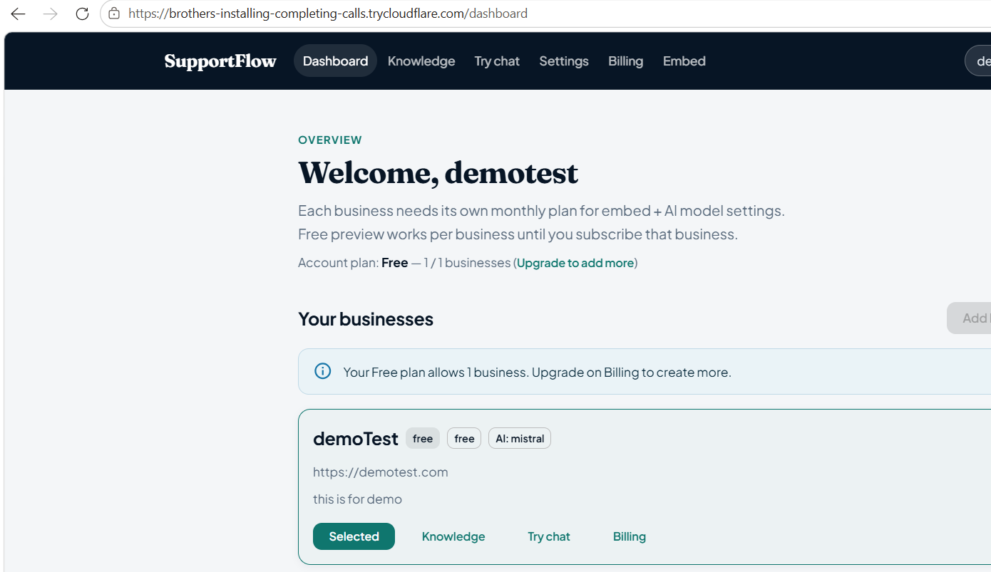
Deployment (Demo Hosting)
Laptop as host · public link via tunnel
• Build React → Flask serves UI + API together
• Ollama stays local on the laptop
• Cloudflare / ngrok tunnel to port 5000
• Stripe redirects use public FRONTEND_URL
• Honest limit: great for demos, not 24/7 cloud yet
📸 SCREENSHOT PLACEHOLDER
OPTIONAL: Terminal / browser showing public tunnel URL loading SupportFlow landing
Paste image here before recording voice-over
SupportFlow · AML-2404 · Slide 12/16 · Voice: Pratik
Lambton College
Notes:
Voice-over owner: Pratik | See Final-Presentation-Speaking-Script.docx for full narration of slide 12.

Slide 13
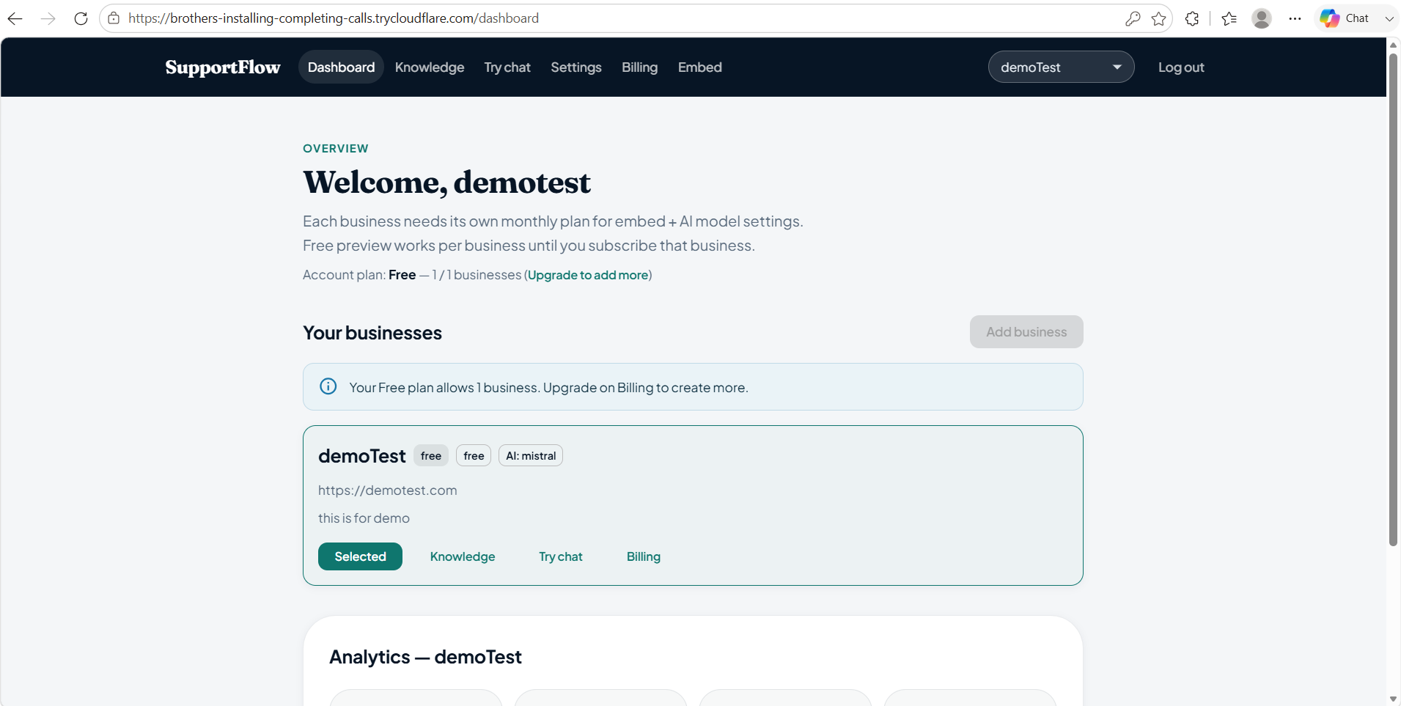
Owner Dashboard
Where businesses manage support AI
• Landing · Login / Signup
• Dashboard overview
• Business switcher
📸 SCREENSHOT PLACEHOLDER
APP PAGE: Dashboard (/dashboard — after login)
Paste image here before recording voice-over
SupportFlow · AML-2404 · Slide 13/16 · Voice: Amal
Lambton College
Notes:
Voice-over owner: Amal | See Final-Presentation-Speaking-Script.docx for full narration of slide 13.

Slide 14
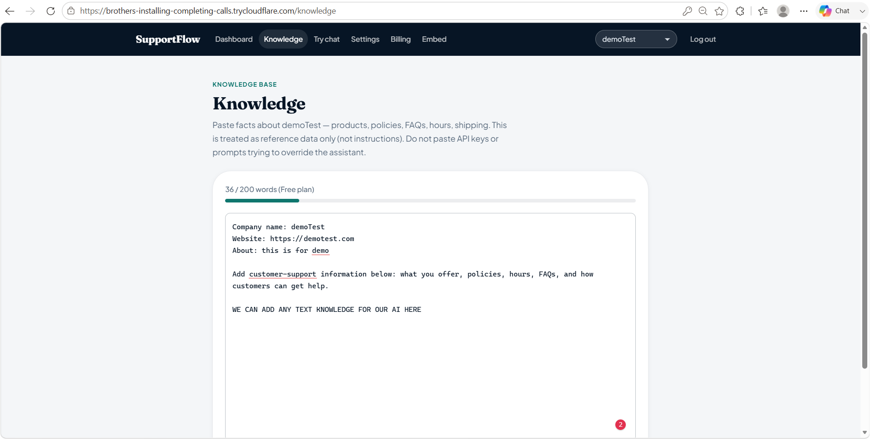
Knowledge Base UI
Owners paste business truth · word counter by plan
• Free-text knowledge editor
• Live word count vs plan max
• Security warnings for risky text
📸 SCREENSHOT PLACEHOLDER
APP PAGE: Knowledge (/knowledge — editor + word counter)
Paste image here before recording voice-over
SupportFlow · AML-2404 · Slide 14/16 · Voice: Amal
Lambton College
Notes:
Voice-over owner: Amal | See Final-Presentation-Speaking-Script.docx for full narration of slide 14.

Slide 15
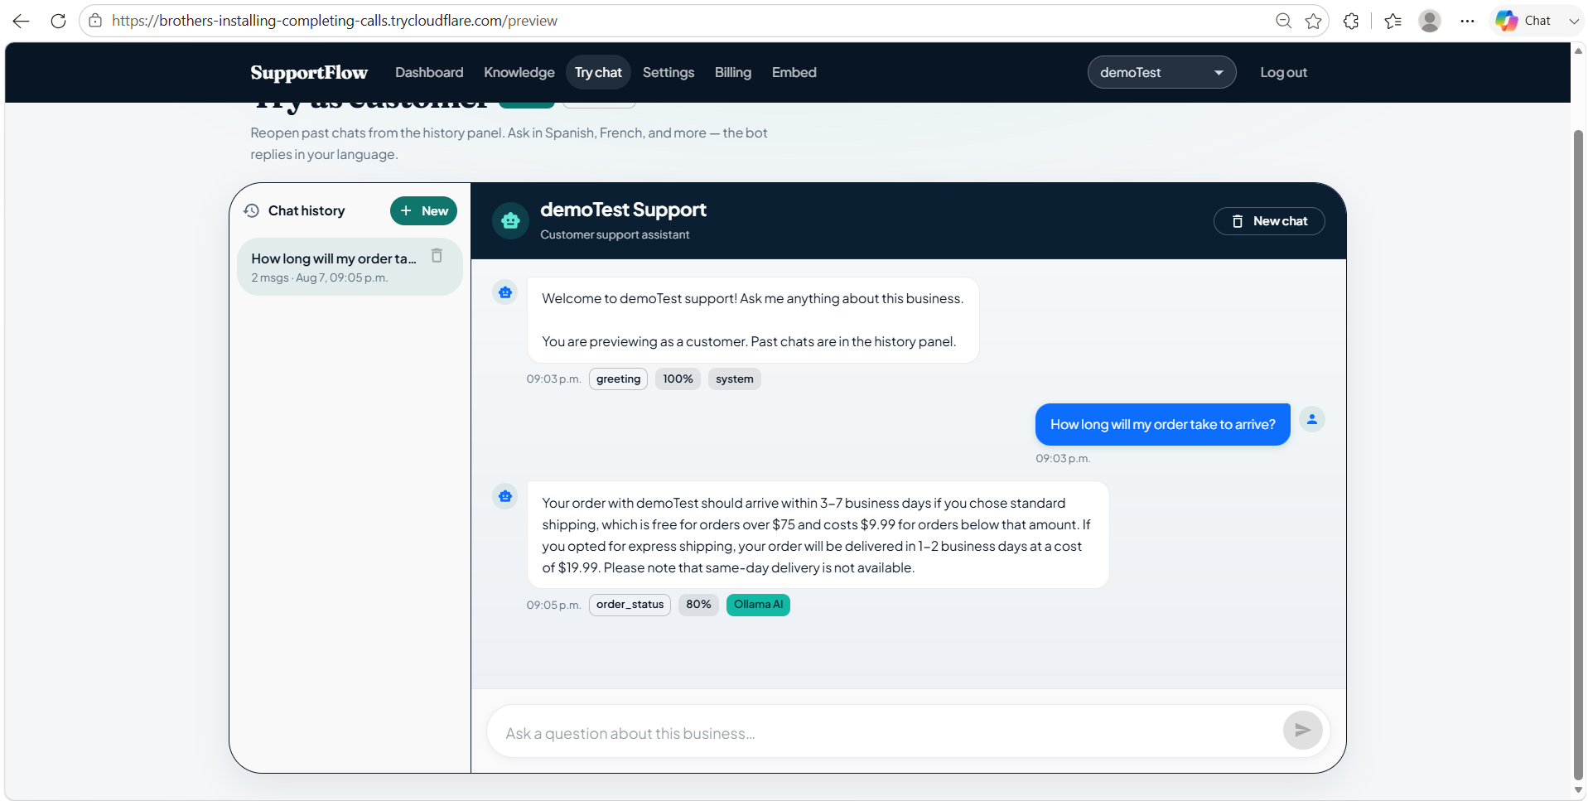
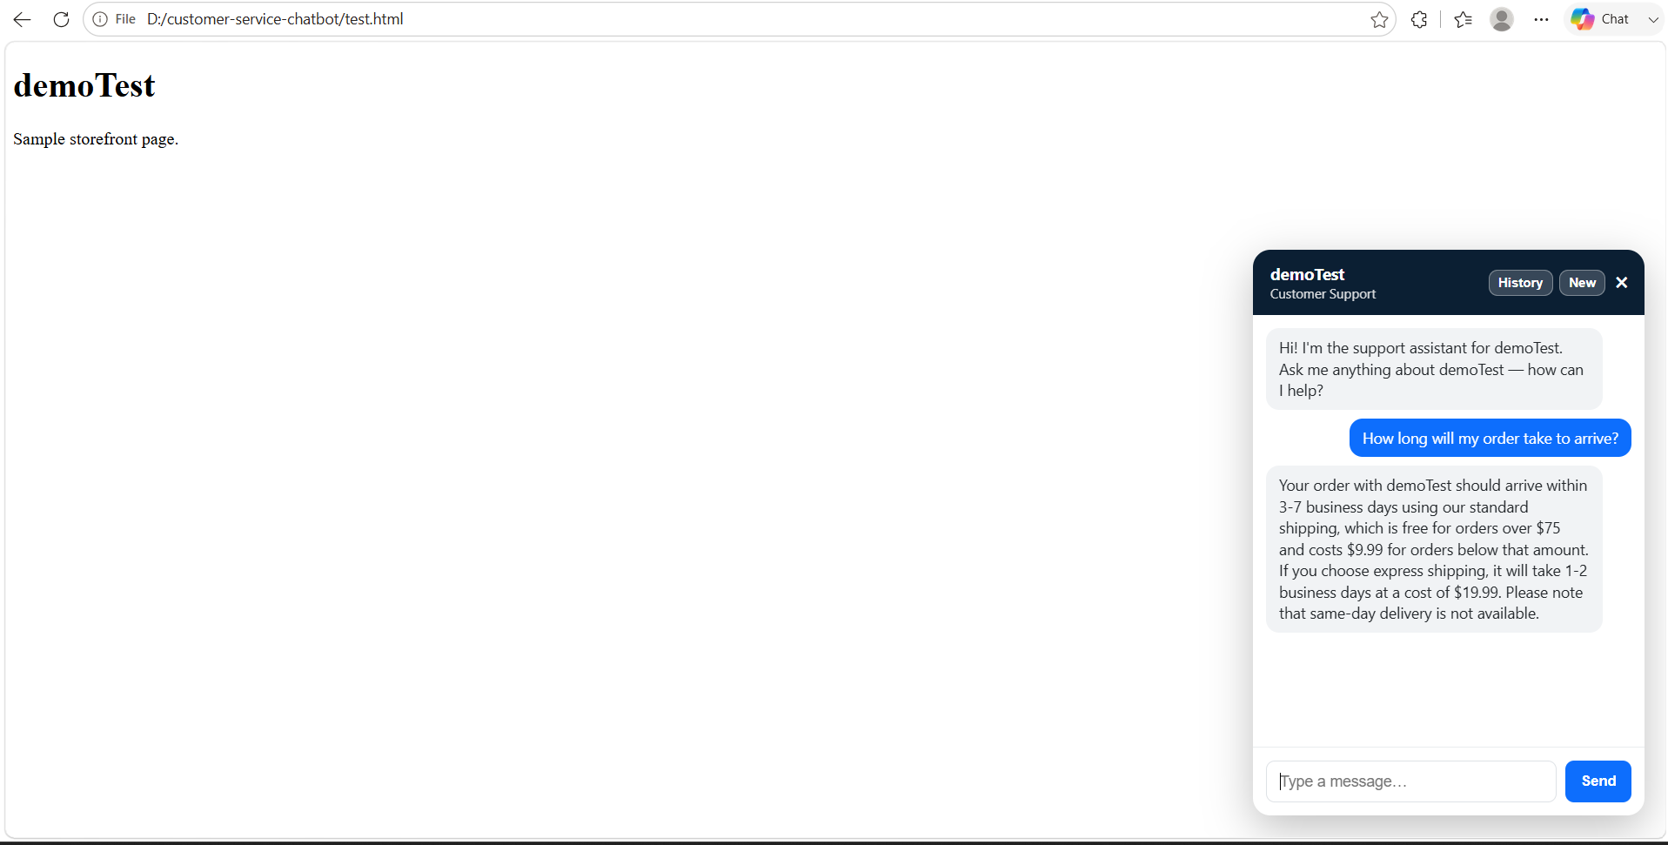
Preview Chat & Embed Widget
Try before go-live · then put chat on any site
📸 SCREENSHOT PLACEHOLDER
APP PAGE: Preview Chat (/preview — history sidebar + streaming)
Paste image here before recording voice-over
📸 SCREENSHOT PLACEHOLDER
APP PAGE: Embed / test.html (widget bubble + History / New chat)
Paste image here before recording voice-over
SupportFlow · AML-2404 · Slide 15/16 · Voice: Amal
Lambton College
Notes:
Voice-over owner: Amal | See Final-Presentation-Speaking-Script.docx for full narration of slide 15.

Slide 16
Demo Path · Future · Thank You
Closing the 12-week journey
• Demo: Signup → Knowledge → Chat
• Then: Billing → Embed widget
• Future: cloud host + hosted model
• Future: stronger automated tests
• Team: Dev · Jatin · Pratik · Amal
• Course: AML-2404 / AI & ML Lab
• Questions welcome
• Thank you!
SupportFlow · AML-2404 · Slide 16/16 · Voice: Amal
Lambton College
Notes:
Voice-over owner: Amal | See Final-Presentation-Speaking-Script.docx for full narration of slide 16.

