Slide 1
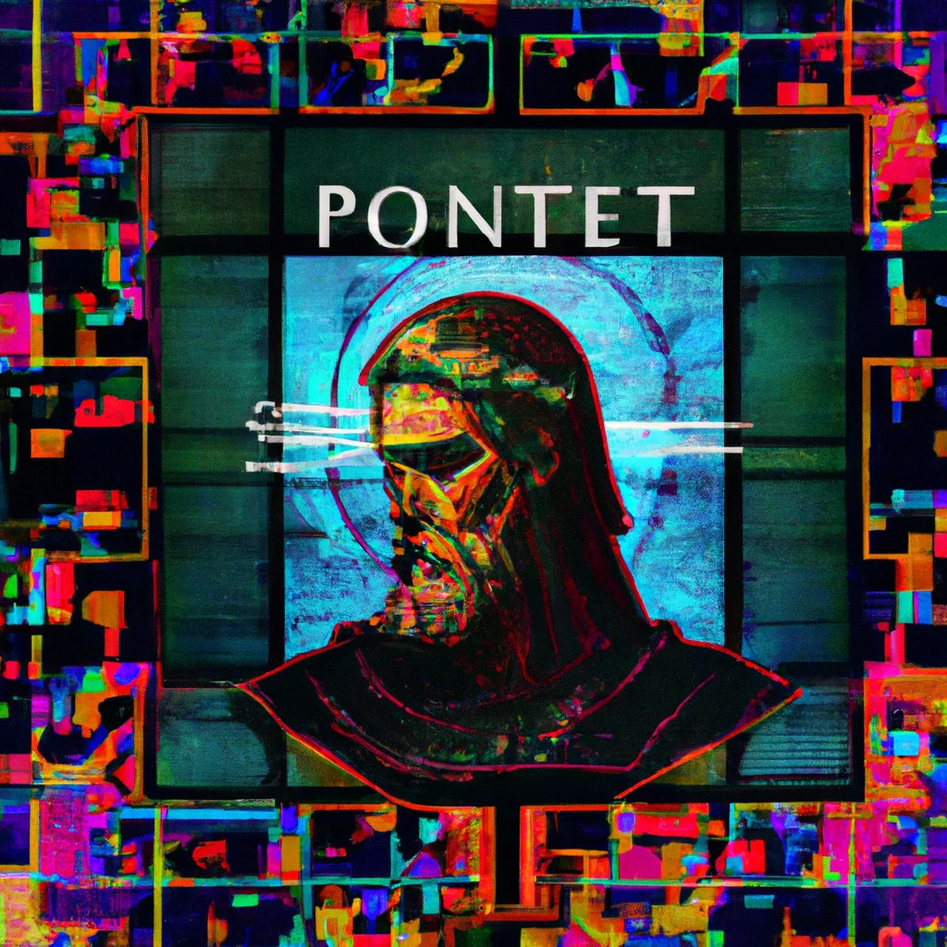

Scripture Quotation Identifier
Kai
Kobe
Michael
Stephen

Slide 2
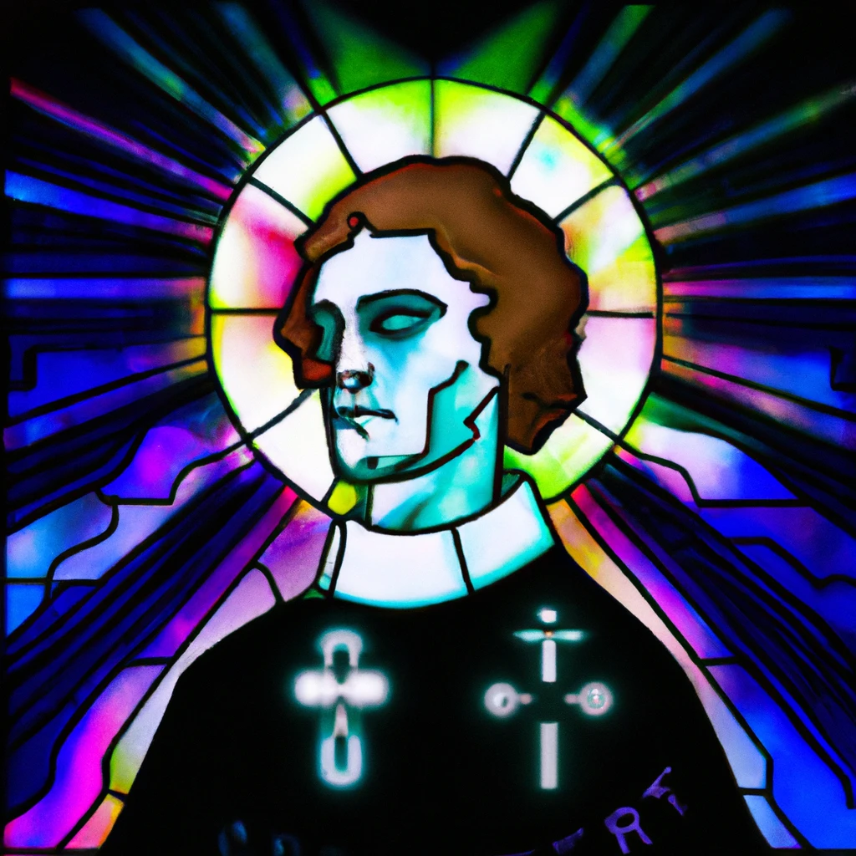
Purpose: Find quotes or allusions to Koine Greek in the writings of Church Fathers
Challenge: Quotes may not be exact
John 9:5 As long as I am in the world, I am the light of the world
6 Matches
Church Father: I am the light of the world as long as I am in it

Slide 3

How it works
1. Split text up by clause (separated by ‘.’, ‘;’, or ‘?’)
Church Father: I am the way, the life, and the truth.
When Jesus said this…

Slide 4
How it works
1. Split text up by clause (separated by ‘.’, ‘;’, or ‘?’)
2. Remove Definite Articles and “And”
Church Father: I am the way, the life, and the truth.

Slide 5
How it works
1. Split text up by clause (separated by ‘.’, ‘;’, or ‘?’)
2. Remove Definite Articles and “And”
3. Compare with Biblical text
John 9:5 – 3 matches
John 14:6 – 6 matches
John 11:35 – 0 matches
Church Father: I am the way, the life, and the truth.

Slide 6
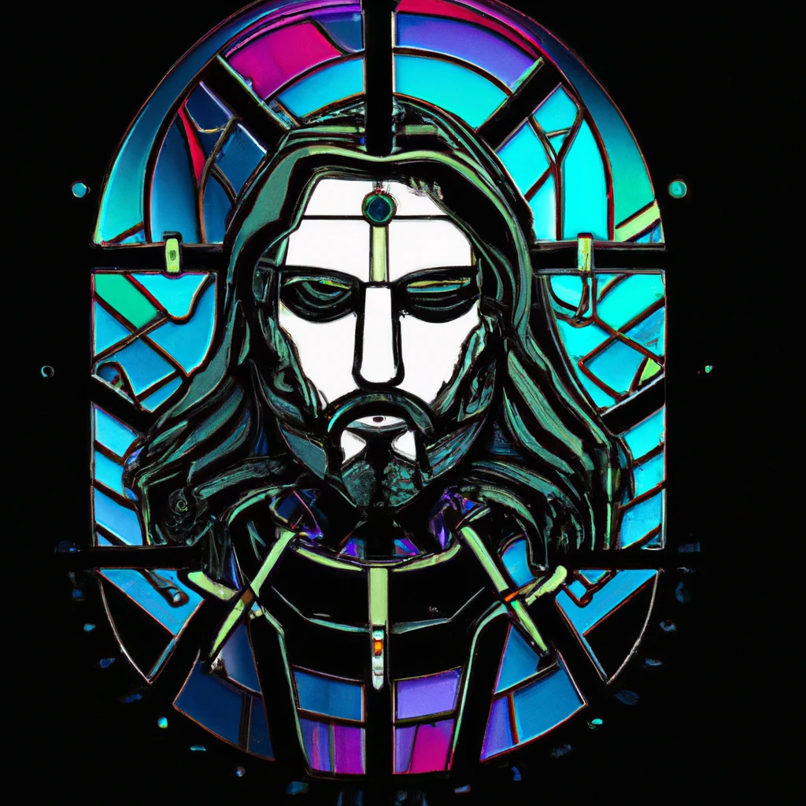
Analysis
The Whole new Testament is used and compared to every line of the Church father’s writings
1 Match
2 Matches
John 9:5
John 14:6
John 11:35
 | Sentence 1 | Sentence 2 | Sentence 3
3 Matches
6 Matches
0 Matches
3 Matches
0 Matches
1 Match
0 Matches

Slide 7
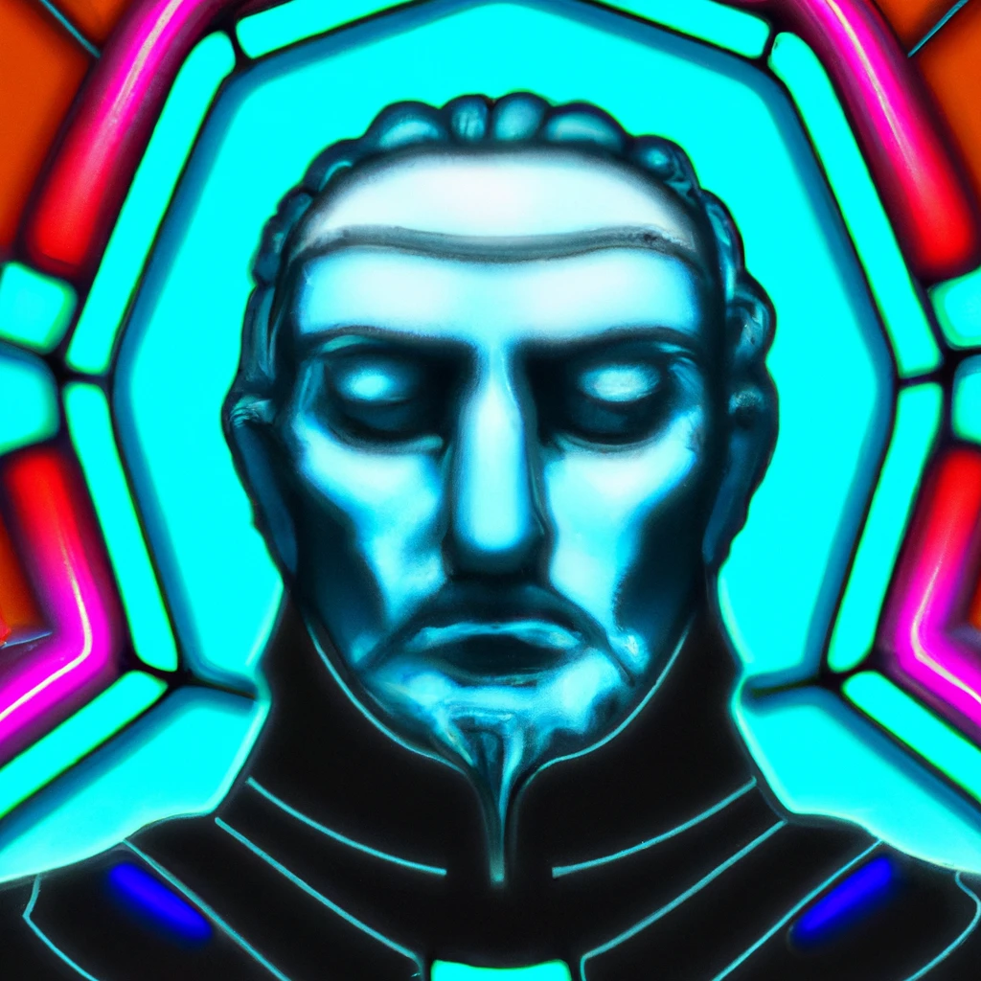
Drawbacks
Worse at detecting references to short verses
Currently only works with the Greek new testament
Processing intensive
Large-sized output
Still requires a scholar to validate if the line is a quote of a selected verse

Slide 8
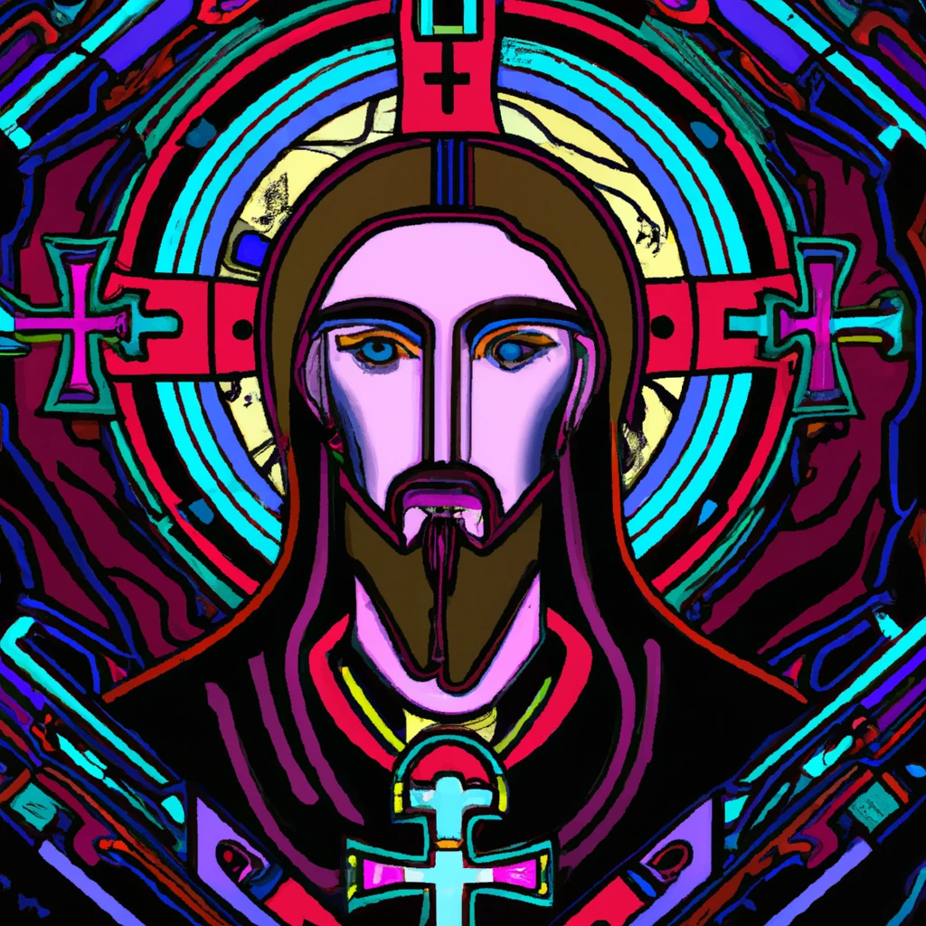
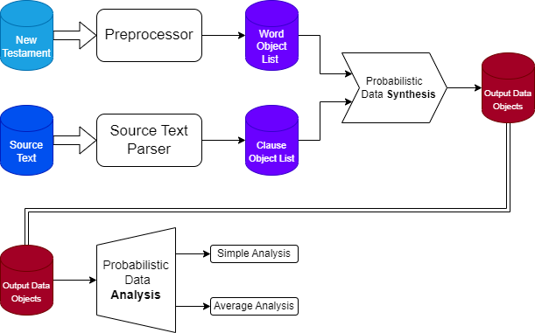
Summary Diagram

Slide 9
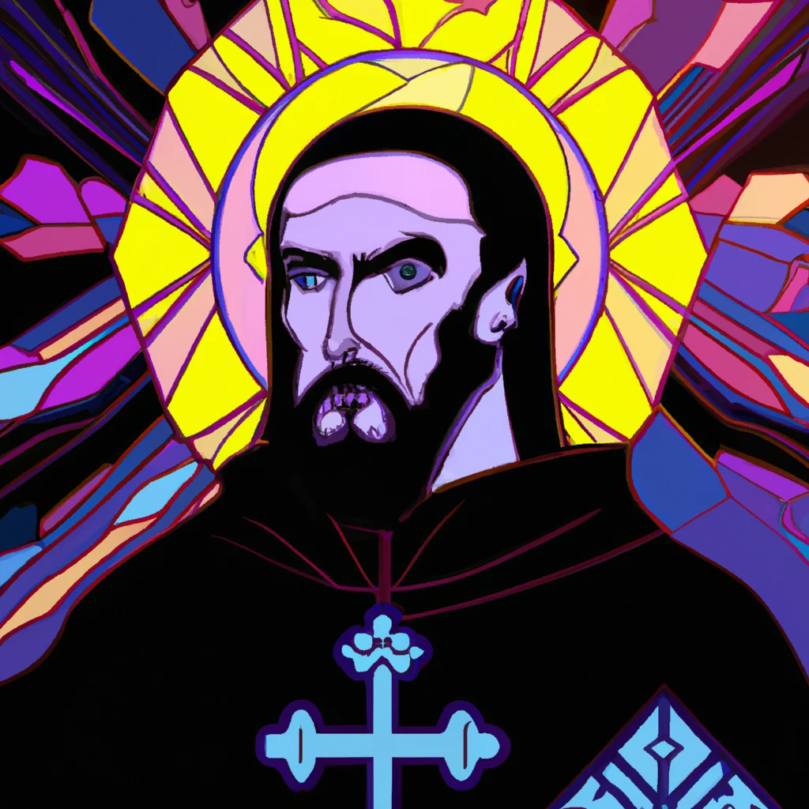
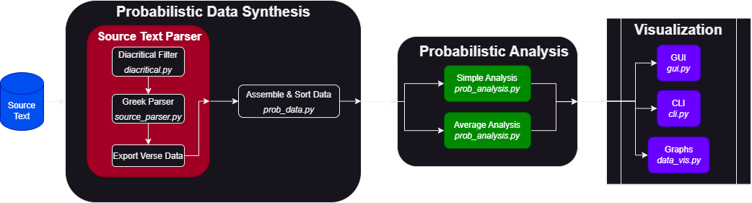
Tool Set

Slide 10
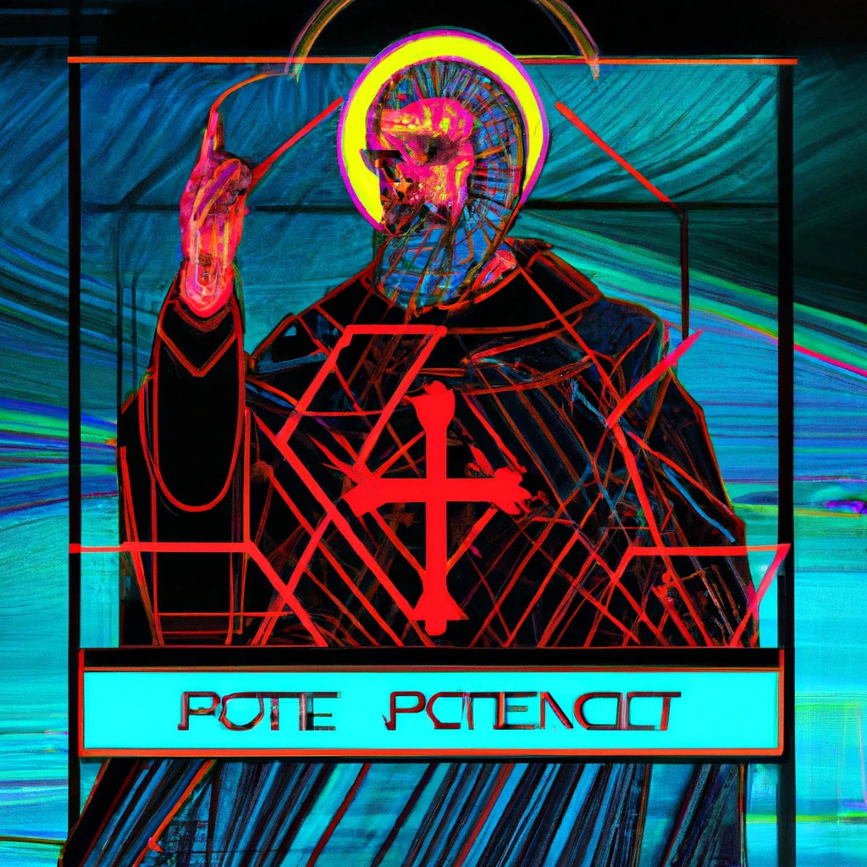
DEMO TIME

Slide 11
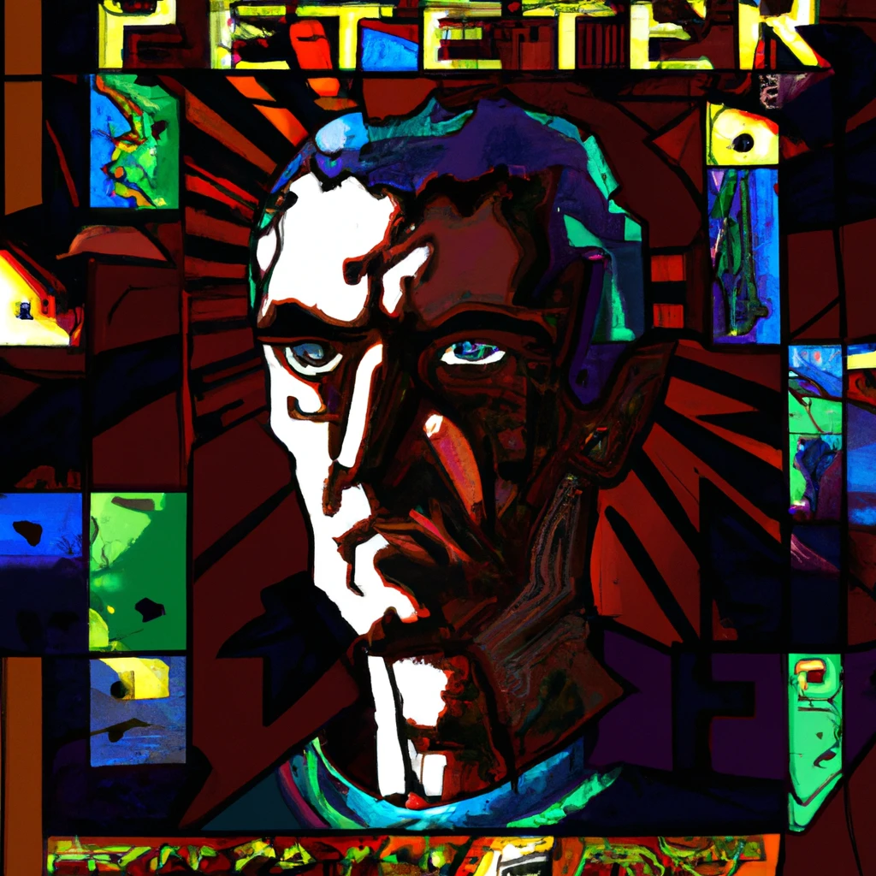
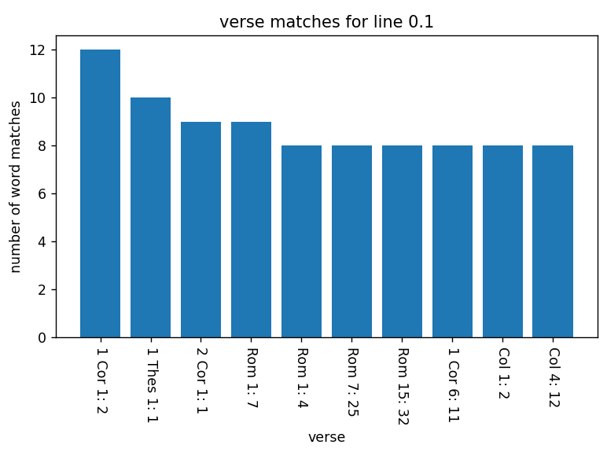
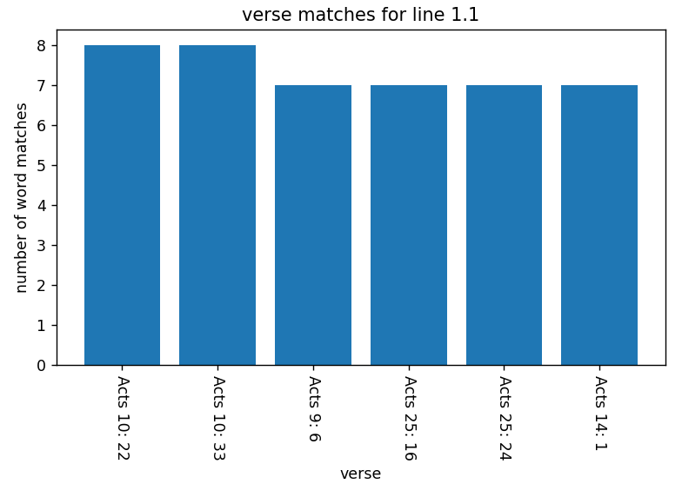
Bar Graphs generated

Slide 12
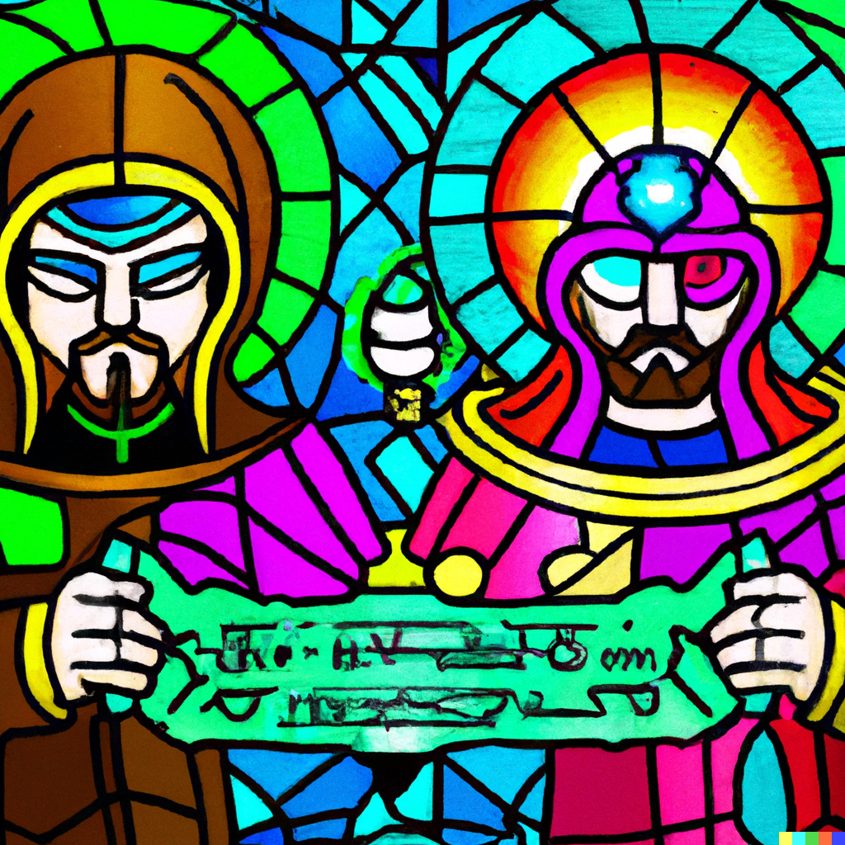
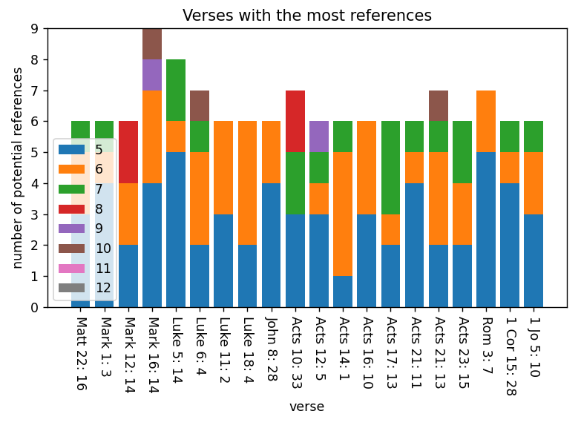
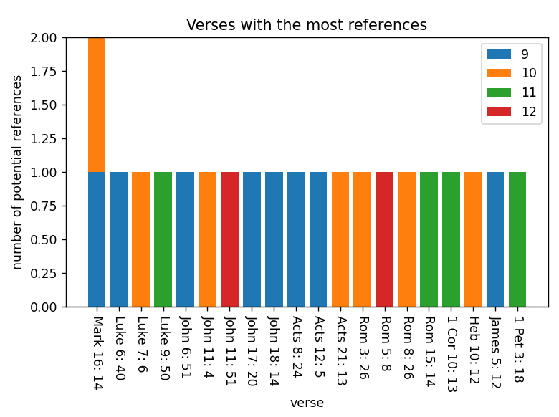
Stacked-Bar Graphs

