Slide 1


SproutHub Startup Weekend
Sunday, September 16th 2012

Slide 2
Problem
Local Farmers markets have limited reach to potential consumers
# of Markets open on Saturday
11
2
1
8-11
11-1
1+
Farmers markets operating hours are not always convenient
Locations of markets is sparse & fragmented across Louisville
Limited awareness of product availability, locations & time
Reasons for not shopping at Markets
11
8
7
Other
Location
Time

Slide 3
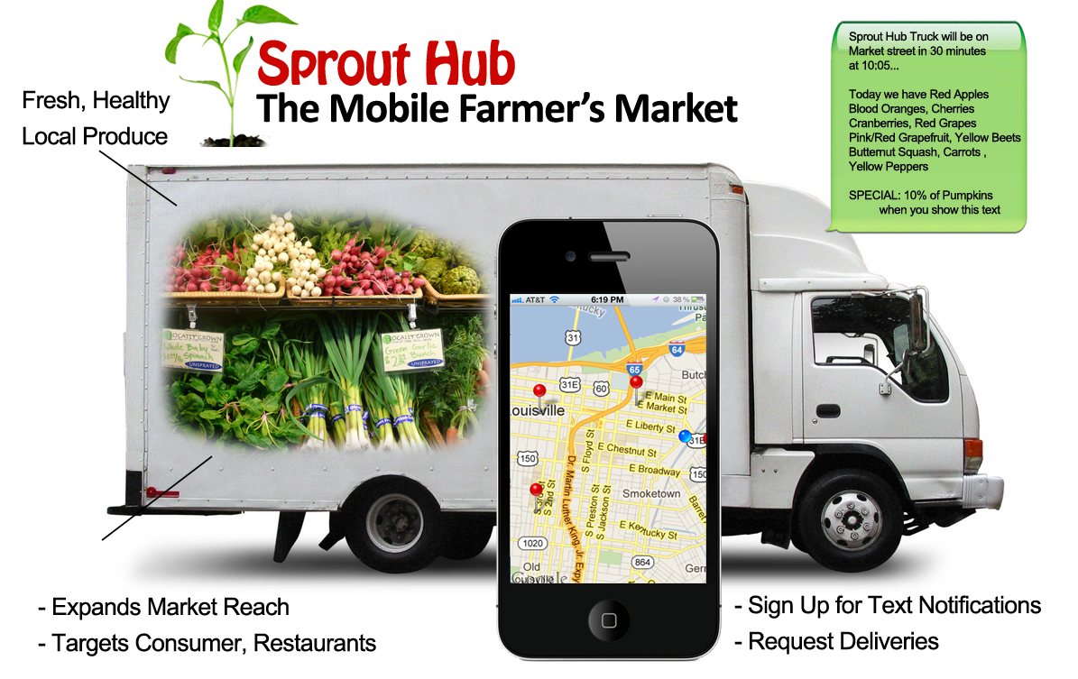
“…Genius, amazing, hilarious #SWLOU” @ZacharyCohn

Slide 4
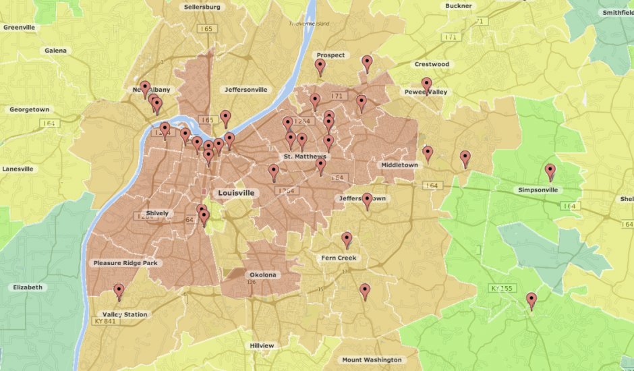
Market Overview
National Market
Where to find customers?
$/Units CAGR%
# of markets 5,274 8%
Market Revenues $1.2B 8%
CSA offering farms 1,400 15%
Marketing Strategy
Direct to consumer model for farming showing steady growth over last 10 yrs
Initially, leveraging traditional, mobile & social platforms
Community Supported Agriculture (CSA’s) growing double-digit per year
Marketing via traditional media once business is expanding & scalable

Slide 5
Financial Overview
$’s in millions
Segment / Data
Unit Economics
1.7
~50%
CAGR
Sale / Unit $3.50
Cost / Unit $1.50
Lab & OH / Unit $0.40
Gross Profit % 54%
Rev
0.5
0.4
0.2
EBITDA
Strategy / Assumptions
‘13
‘15
Pilot starting in Louisville, KY … expansion to 3 nearby cities by ‘15
Margin %
36
21
Total initial investment 10k … ~75-100K incremental needed per expansion
ROI
~20x
~9x
Investigating low-cost methods to acquire customers … leveraging new & old technologies

Slide 6
SproutHub Team
Jeremy Gray – Sprout Master
Finance & IT Management
Brandon Kobel – Chief Fertilizer
.Software Engineer
Daniel VanderMeer – Master Gardener
Software Architecture & Design
Harry Talamini – Compost Officer
Business Development
Mark Mintman – Cool Cucumber
Finance and Investor Relations

