Slide 1
Screen Time vs. Shut-eye A Data Analysis Experiment
By: James Simonson

Slide 2
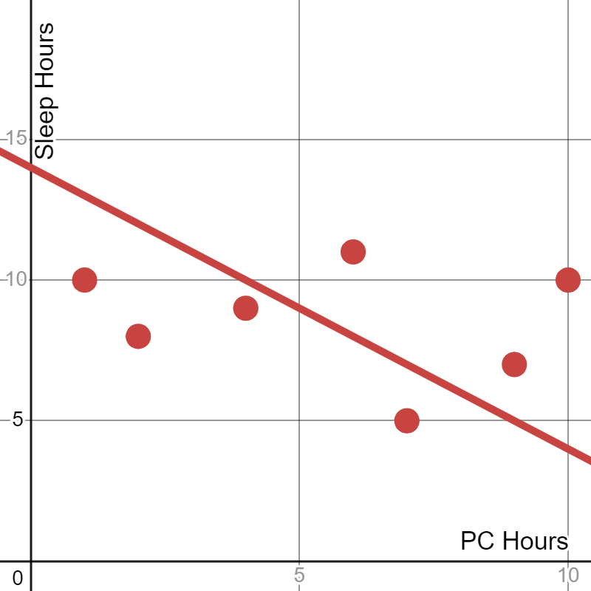
Sleep Hours vs. Computer Hours
Main Question:
"Does the amount of time spent on computer affect the hours of sleep individuals get?"
Example:

Slide 3
Hypothesis
Null Hypothesis (H0):
There is no significant relationship between hours of PC screen time and hours of sleep.
This suggest no significant correlation between PC screen time and hours of sleep.
Alternative Hypothesis (Ha):
There is a significant negative relationship between hours of PC screen time and hours of sleep.
This suggests that increased screen time leads to decreased sleep duration.

Slide 4
The Data
Primary Variables - (Mean) (Collection Method)
Hours of Sleep (Mean of 7.8 Hours) (Self-reported Android App - Sleepmeter)
Hours of PC Time (Mean of 8.05 Hours) (Auto-collection via PC App – Workrave)
Confounding Variables
Homework Due / Class that day (PC time)
Unmeasurable events
Caring for sick pets/children (Sleep)
Social events (Sleep and PC time)

Slide 5

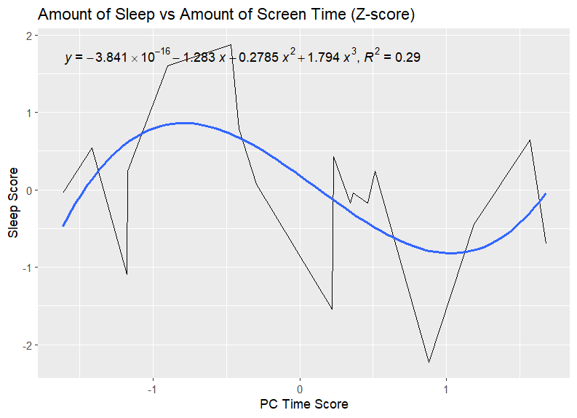
Standardizing Data
Method:
Scale function in R
Visualization:
Sinusoidal relationship between z=score
Displays negative correlation
(Less PC time → More Sleep & Vice versa)
Low Fitment to Data (R^2)=0.29

Slide 6
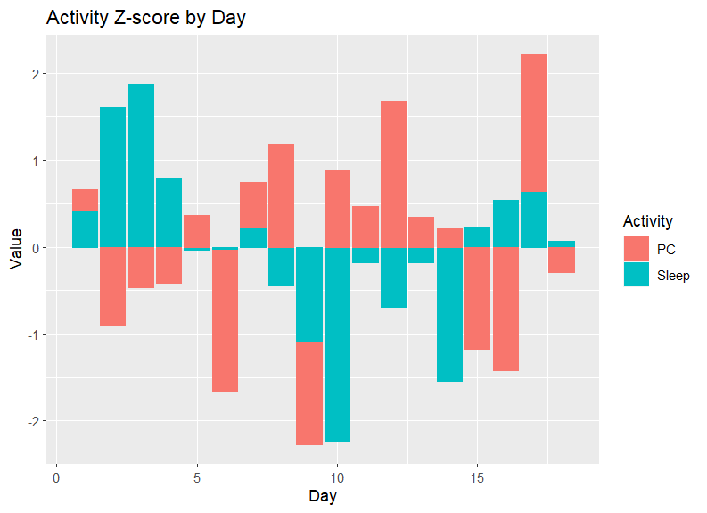
Visualization Cont.
Evaluation:
The inverse relationship between PC time and Sleep time
Days 6,8,17 do not follow the relationship

Slide 7
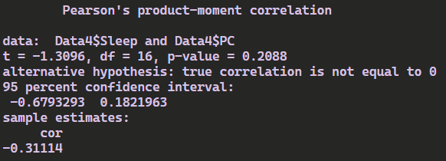
Statistical Analysis
Correlation Testing: ( Sleep Hours ~ PC Hours)
Utilized Pearson’s Correlation Coef. to determine correlation
Results:
Coefficient of -0.31 (Indicates moderate negative correlation)
P-value of 0.2088 (Indicates insignificant results)

Slide 8
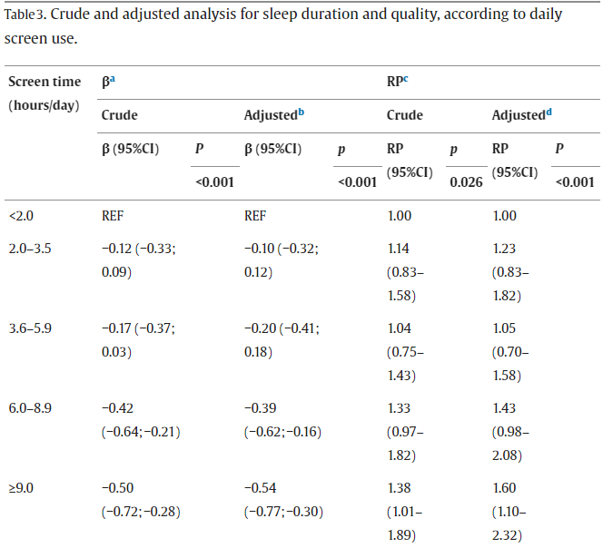
Comparison to External Sources:
Science Direct
Analysis of over 1800 individuals
Comparing Screen time, Sleep Duration, and Sleep Quality
Results
“The adolescents with 9 h or more of screen time per day slept an average of 30 min less over 24 h than those who used screens for fewer than 2 h a day, who were taken as the reference category.”
ß = Linear Regression, RP = Poisson Regression
https://www.sciencedirect.com/science/article/pii/S2590142723000137#tbl3fnc

Slide 9
Hypothesis Conclusions:
Significance:
Given a P-value above 0.05 significance we do not have enough evidence to reject the null hypothesis. (There is no significant correlation between sleep hours and PC hours.
Main Question:
The data does not indicate that the amount of time spent on computer affects the hours of sleep individuals get.
Comparison to External:
Given that we visualize a similar trend as expressed in the external source, this may be indicative of a type 2 error in which we have a false-negative.
Therefore, more data may be needed to adequately assess this hypothesis.

Slide 10
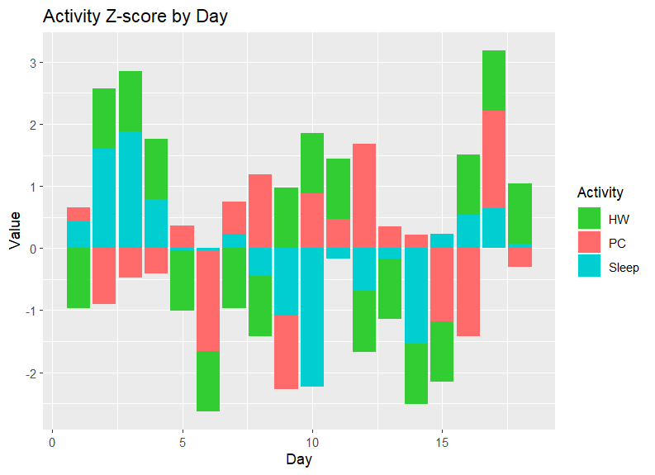
Things to Note: (Applicable Confounding Variables)
Throughout this process I experienced a medical emergency with my pet. This may have led to inconsistent sleep hours.
Throughout this process I experienced 2 separate Final exams which required additional PC time.
Generally inflated PC time due to PC gaming being my main hobby.
Visualizing Inconsistencies:

Slide 11
Thank you for your time.
Digress to Q&A portion of presentation.
GitHub Link

