Slide 1
VGP244
K-D Trees

Slide 2
K-D Tree
Introduction
  Multiple dimensional data
    Range queries in databases of multiple keys:
    Ex. find persons with
    34 ≤ age ≤ 49 and $100k ≤ annual income ≤ $150k
    GIS (geographic information system)
    Computer graphics
  Extending BST from one dimensional to k-dimensional
    It is a binary tree
    Organized by levels (root is at level 0, its children level 1, etc.)
    Tree branching at level 0 according to the first key, at level 1 according to the second key, etc.
KdNode
  Each node has a vector of keys, in addition to the pointers to its subtrees.
8/3/2007
KDTrees

Slide 3
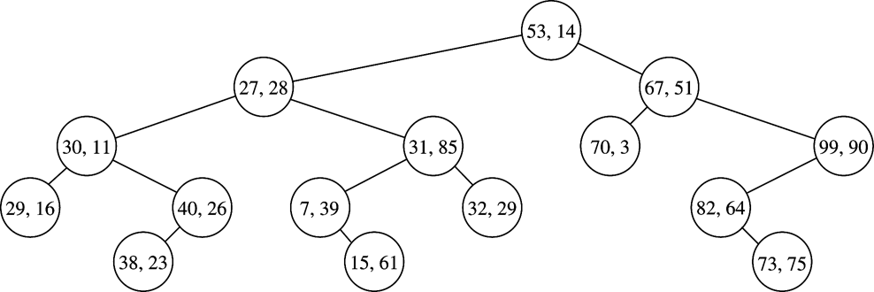
K-D Tree
A 2-D tree example
8/3/2007
KDTrees

Slide 4
2-D Tree Operations
Insert
  A 2-D item (vector of size 2 for the two keys) is inserted
  New node is inserted as a leaf
  Different keys are compared at different levels
Find/print with an orthogonal (rectangular) range
  exact match: insert (low[level] = high[level] for all levels)
  partial match: (query ranges are given to only some of the k keys, other keys can be thought in range ± ∞)
high[1]
key[1]
low[1]
key[0]
low[0]
high[0]
8/3/2007
KDTrees

Slide 5
2-D Tree Insertion
public void insert(Vector <T> x)
{
root = insert( x, root, 0);
}
// this code is specific for 2-D trees
private KdNode<T> insert(Vector <T> x, KdNode<T> t, int level)
{
if (t == null)
t = new KdNode(x);
int compareResult = x.get(level).compareTo(t.data.get(level));
if (compareResult < 0)
t.left = insert(x, t.left, 1 - level);
else if( compareResult > 0)
t.right = insert(x, t.right, 1 - level);
else
; // do nothing if equal
return t;
}
8/3/2007
KDTrees

Slide 6
Insert (55, 62) into the following 2-D tree
55 > 53, move right
53, 14
62 > 51, move right
27, 28
65, 51
30, 11
31, 85
70, 3
99, 90
55 < 99, move left
29, 16
40, 26
7, 39
32, 29
82, 64
38, 23
55,62
73, 75
15, 61
62 < 64, move left
Null pointer, attach
8/3/2007
KDTrees

Slide 7
2-D Tree: printRange
/**
* Print items satisfying
* lowRange.get(0) <= x.get(0) <= highRange.get(0)
* and
* lowRange.get(1) <= x.get(1) <= highRange.get(1)
*/
public void printRange(Vector <T> lowRange,
Vector <T>highRange)
{
printRange(lowRange, highRange, root, 0);
}
8/3/2007
KDTrees

Slide 8
2-D Tree: printRange (cont.)
private void
printRange(Vector <T> low,Vector <T> high,
KdNode<T> t, int level)
{
if (t != null)
{
if ((low.get(0).compareTo(t.data.get(0)) <= 0 &&
t.data.get(0).compareTo(high.get(0)) <=0)
&&(low.get(1).compareTo(t.data.get(1)) <= 0 && t.data.get(1).compareTo(high.get(1)) <= 0))
System.out.println("(" + t.data.get(0) + "," +
t.data.get(1) + ")");
if (low.get(level).compareTo(t.data.get(level)) <= 0)
printRange(low, high, t.left, 1 - level);
if (high.get(level).compareTo(t.data.get(level)) >= 0)
printRange(low, high, t.right, 1 - level);
}
}
8/3/2007
KDTrees

Slide 9
printRange in a 2-D Tree
In range? If so, print cell
low[level]<=data[level]->search t.left
high[level] >= data[level]-> search t.right
53, 14
27, 28
65, 51
30, 11
31, 85
70, 3
99, 90
29, 16
40, 26
7, 39
32, 29
82, 64
38, 23
73, 75
15, 61
low[0] = 35, high[0] = 40;
This sub-tree is never searched.
low[1] = 23, high[1] = 30;
Searching is “preorder”. Efficiency is obtained by “pruning” subtrees from the search.
8/3/2007
KDTrees

Slide 10
3-D Tree example
X < 20
20,12,30
X > 20
15,18,27
40,12,39
Y < 18
Y > 18
Y < 12
Y > 12
17,16,22
19,19,37
22,10,33
25,24,10
Z < 22
Z < 33
Z > 33
16,15,20
24,9,30
50,11,40
X < 16
X > 16
12,14,20
18,16,18
A
B
C
D
What property (or properties) do the nodes in the subtrees labeled A, B, C, and D have?
8/3/2007
KDTrees

Slide 11
K-D Operations
Modify the 2-D insert code so that it works for K-D trees.
Modify the 2-D printRange code so that it works for K-D trees.
8/3/2007
KDTrees

Slide 12
K-D Tree Performance
Insert
  Average and balanced trees: O(lg N)
  Worst case: O(N)
Print/search with a square range query
  Exact match: same as insert (low[level] = high[level] for all levels)
  Range query: for M matches
    Perfectly balanced tree:
    K-D trees: O(M + kN ^{(1-1/k)} )
    2-D trees: O(M + √N)
    Partial match
    in a random tree: O(M + N^{α}) where α = (-3 + √17) / 2
8/3/2007
KDTrees

Slide 13
K-D Tree Performance
More on range query in a perfectly balanced 2-D tree:
  Consider one boundary of the square (say, low[0])
  Let T(N) be the number of nodes to be looked at with respect to low[0]. For the current node, we may need to look at
    One of the two children (e.g., node (27, 28), and
    Two of the four grand children (e.g., nodes (30, 11) and (31, 85).
  Write T(N) = 2 T(N/4) + c, where N/4 is the size of subtrees 2 levels down (we are dealing with a perfectly balanced tree here), and c = 3.
  Solving this recurrence equation:
  T(N) = 2T(N/4) + c = 2(2T(N/16) + c) + c
  …
  = c(1 + 2 + ⋅⋅⋅ + 2^(log₄ N) = 2^(1+ log₄ N) – 1
  = 2*2^(log₄ N) – 1 = 2^ ((log₂ N)/2) – 1 = O(√N)
8/3/2007
KDTrees

Slide 14
K-D Tree Remarks
Remove
  No good remove algorithm beyond lazy deletion
  (mark the node as removed)
Balancing K-D Tree
  No known strategy to guarantee a balanced 2-D tree
  Periodic re-balance
Extending 2-D tree algorithms to k-D
  Cycle through the keys at each level
8/3/2007
KDTrees

