Slide 1
NoSQL Databases
Intro
Class of databases/storage systems that are not based on relational model (RDBMS)
Named after the fact that most NoSQL databases didn’t support any SQL language
This is not true anymore, but the naming was already widely used by the market
The term “NoSQL = Not Only SQL” is gaining traction
Exists for many decades, but were not so widely adopted until mid 2000’s
Web 2.0, social networks, etc

Slide 2
NoSQL Databases
Intro
Use cases
Web 2.0, Big Data, real-time, social networks..
Main characteristics (vs relational databases)
Schemaless
Simpler to design
Simpler to maintain
Simpler to scale

Slide 3




NoSQL Databases
Types
Key-value
Associative array (map/dictionary)
Key => value
Graph database
Key => graphs
graphs are data-structures based on 1..N connections amongst each other
Document-oriented
Key => XML, YAML, JSON, BSON documents
Column family
Columns containing key-value pairs

Slide 4
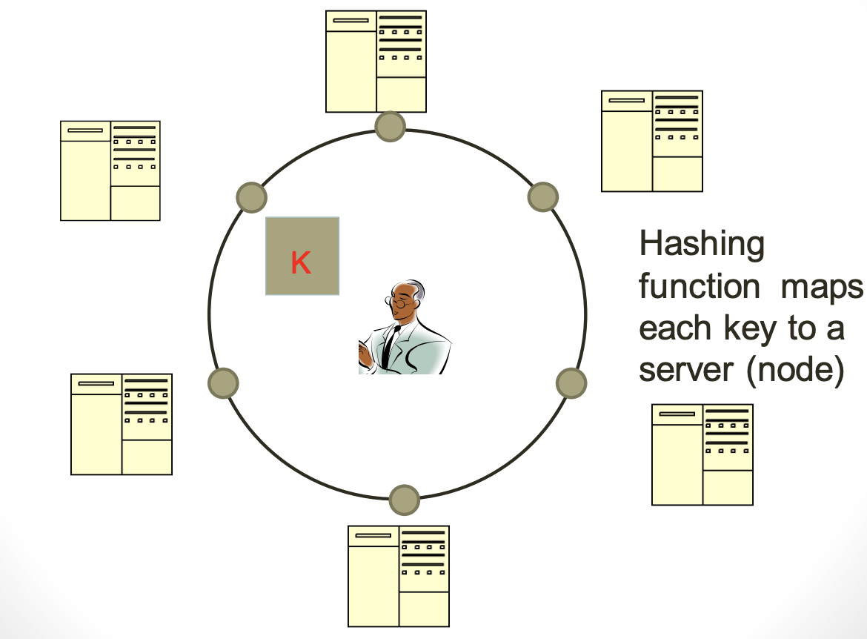
NoSQL Databases
Typical NoSQL architecture

Slide 5
NoSQL Databases
CAP theorem
(Eric) Brewer’s theorem
It is impossible for a distributed data store to simultaneously provide more than two out of the following three guarantees:
Consistency: Every read receives the most recent write or an error
Availability: Every request receives a (non-error) response, without the guarantee that it contains the most recent write
Partition tolerance: The system continues to operate despite an arbitrary number of messages being dropped (or delayed) by the network between nodes
You must always give something up: consistency, availability or tolerance to failure and reconfiguration

Slide 6
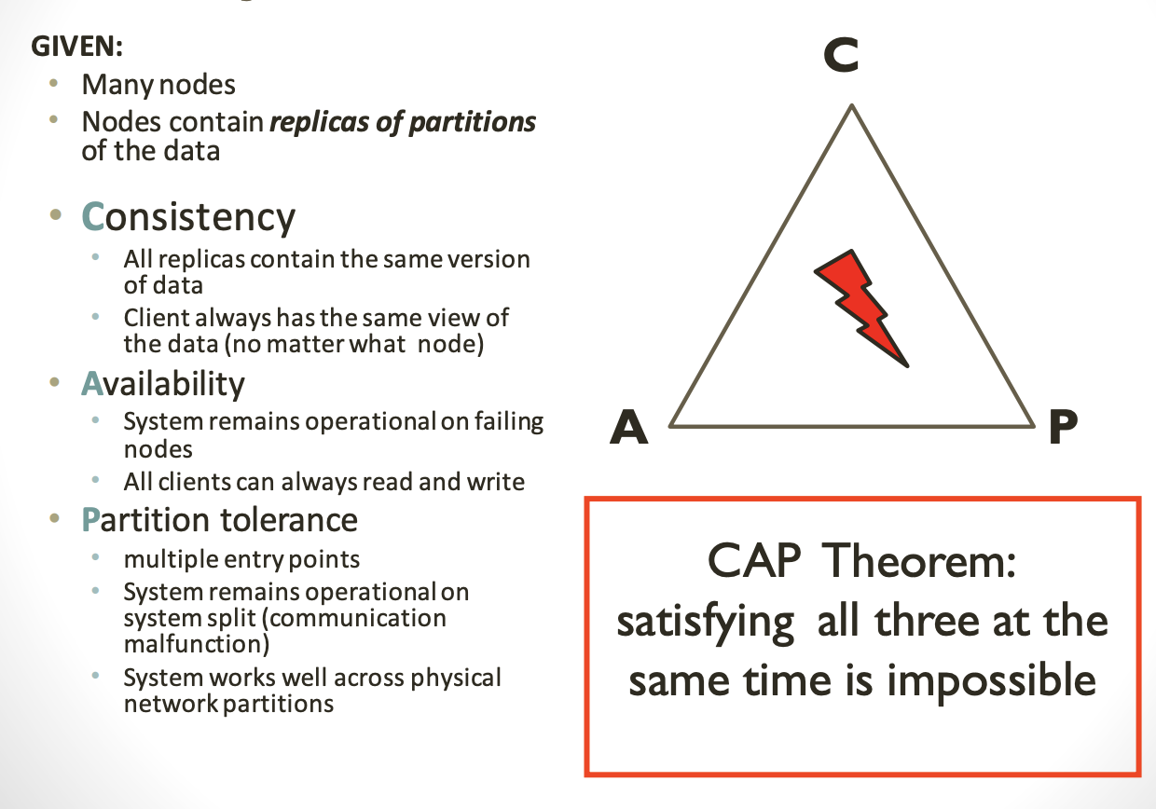
NoSQL Databases
CAP theorem

Slide 7
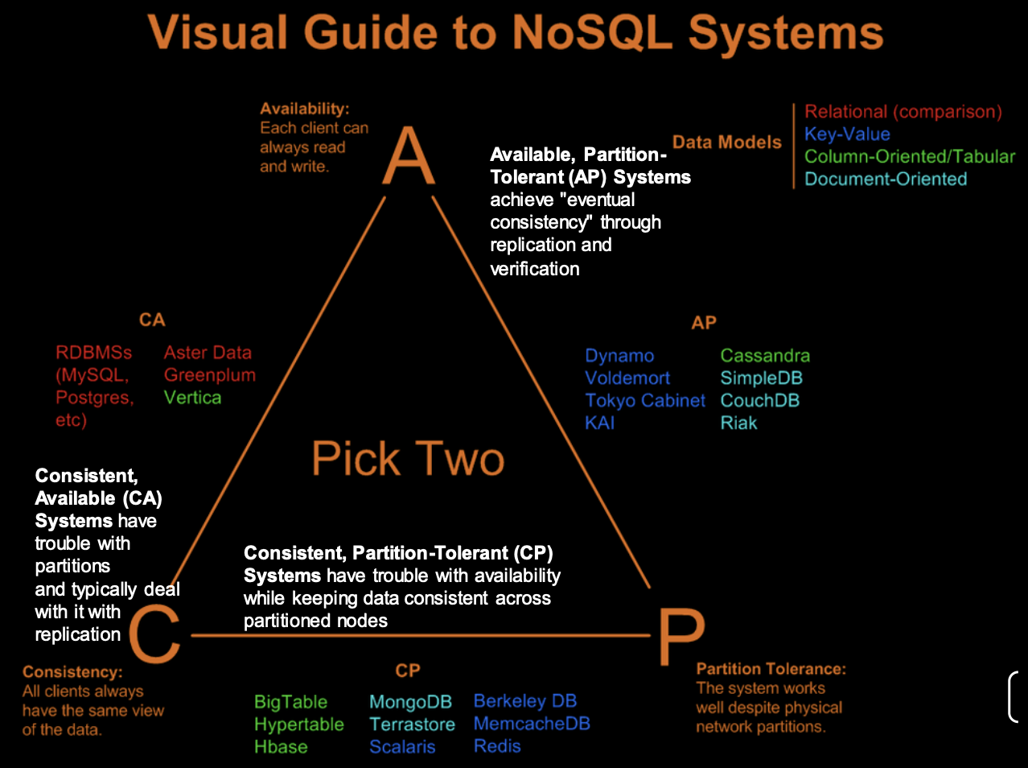

Slide 8
NoSQL Databases
Benefits of NoSQL
Elastic Scaling
RDBMS scale up – bigger load, bigger server (adding more nodes is possible, but more complex)
NO SQL scale out – distribute data across multiple hosts seamlessly
DBA Specialists
RDMS require highly trained expert to monitor DB
NoSQL require less management, automatic repair and simpler data models
Big Data
Huge increase in data RDMS: capacity and constraints of data volumes at its limits
NoSQL designed for big data

Slide 9
NoSQL Databases
Benefits of NoSQL
Flexible data models
Change management to schema for RDMS have to be carefully managed
NoSQL databases more relaxed in structure of data
Database schema changes do not have to be managed as one complicated change unit
Application already written to address an amorphous schema
Economics
RDMS rely on expensive proprietary server
No SQL: clusters of cheap commodity servers to manage the data and transaction volumes
Cost per gigabyte or transaction/second for NoSQL can be lower than the cost for a RDBMS to manage data

Slide 10
NoSQL Databases
Drawbacks of NoSQL
Support
RDBMS vendors provide a high level of support to clients
NoSQL – are open source projects with startups supporting them
Maturity
RDMS is a mature product: more stable and dependable
NoSQL are still implementing their basic feature set

Slide 11
NoSQL Databases
Drawbacks of NoSQL
Administration
RDMS administrator well defined role
No SQL’s goal: no administrator necessary however NO SQL still requires effort to maintain
Lack of Expertise
Whole workforce of trained and seasoned RDMS developers
Still recruiting developers to the NoSQL camp
Analytics and Business Intelligence
RDMS designed to address this niche
NoSQL designed to meet the needs of Web 2.0 application - not designed for ad hoc query of the data

Slide 12
NoSQL Databases
Sharding
Distributes a single logical database system across a cluster of machines
Uses range-based partitioning to distribute documents based on a specific shard key
Automatically balances the data associated with each shard
Can be turned on and off per collection (table)

Slide 13
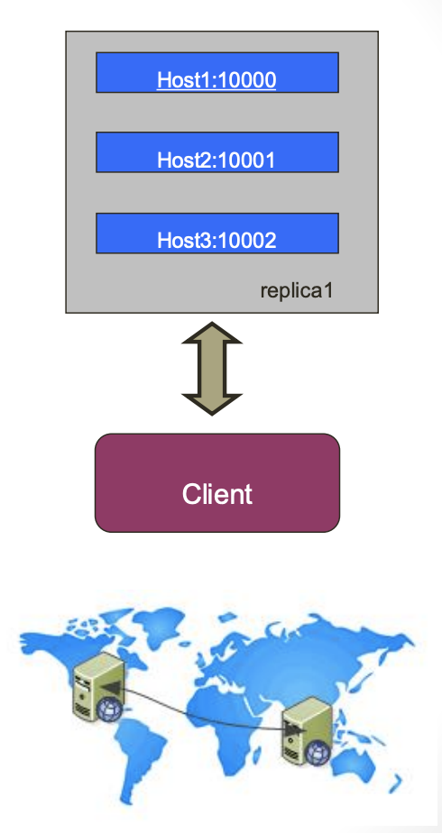
NoSQL Databases
Replica sets
Redundancy and failover
Zero downtime for upgrades and maintenance
Master-slave replication
Strong Consistency
Delayed Consistency
Geospatial features

Slide 14
NoSQL Databases
Major differences to RDBMS
Looser schema definition
Applications written to deal with specific documents/ data
Applications aware of the schema definition as opposed to the data
Designed to handle distributed, large databases
Trade offs:
No strong support for ad hoc queries but designed for speed and growth of database
Query language through the API
Relaxation of the ACID properties

Slide 15
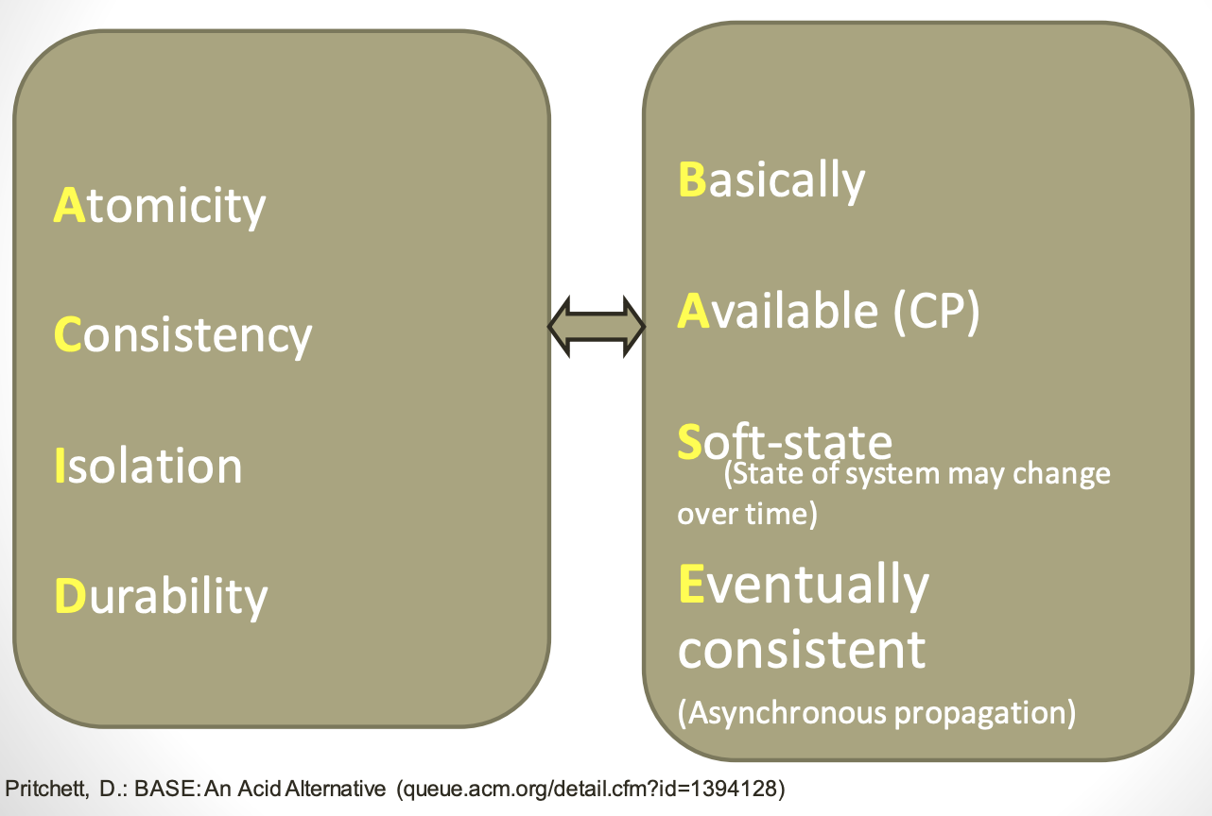
NoSQL Databases
ACID vs BASE
principles

Slide 16
Session 4
NoSQL Databases
MongoDB

Slide 17
NoSQL Databases: MongoDB
Introduction
Developed by 10gen
Founded in 2007
A document-oriented, NoSQL database
Hash-based, schema-less database
No Data Definition Language
In practice, this means you can store hashes with any keys and values that you choose
Keys are a basic data type but in reality stored as strings
Document Identifiers (_id) will be created for each document, field name reserved by
Application tracks the schema and mapping
Uses BSON format
Based on JSON – B stands for Binary
Written in C++
Supports APIs (drivers) in many computer languages
JavaScript, Python, Ruby, Perl, Java, Java Scala, C#, C++, Haskell, Erlang

Slide 18
NoSQL Databases: MongoDB
Introduction
Dynamic schema
No DDL
Document-based database
Secondary indexes
Query language via an API
Atomic writes and fully-consistent reads
If system configured that way
Master-slave replication with automated failover (replica sets)
Built-in horizontal scaling via automated range-based partitioning of data (sharding)
No joins nor transactions

Slide 19
NoSQL Databases: MongoDB
Introduction
Simple queries
Functionality provided applicable to most web applications
Easy and fast integration of data
No ERD diagram
Not well suited for heavy and complex transactions systems

Slide 20
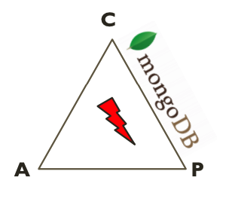
NoSQL Databases: MongoDB
CAP Approach
Consistency
all replicas contain the same version of the data
Availability
system remains operational on failing nodes
Partition tolerance
multiple entry points
system remains operational on system split

Slide 21
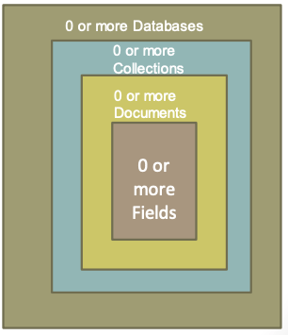
NoSQL Databases: MongoDB
Hierarchical Objects
A MongoDB instance may have zero or more ‘databases’
A database may have zero or more ‘collections’
A collection may have zero or more ‘documents’
A document may have one or more ‘fields’
MongoDB ‘Indexes’ function much like their RDBMS counterparts.

Slide 22
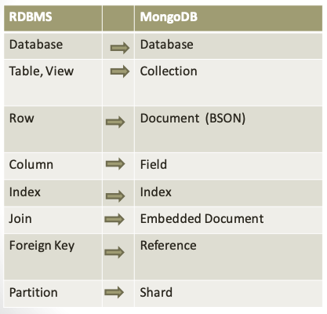
NoSQL Databases: MongoDB
Relational concepts -> NoSQL

Slide 23
NoSQL Databases: MongoDB
Components
Mongod – Database instance
Mongos - Sharding processes
Analogous to a database router
Processes all requests
Decides how many and which mongods should receive the query
Mongos collates the results, and sends it back to the client
Mongo – an interactive shell ( a client)
Fully functional JavaScript environment for use with a MongoDB
You can have one mongos for the whole system no matter how many mongods you have
OR you can have one local mongos for every client if you wanted to minimize network latency.

Slide 24
NoSQL Databases: MongoDB
Features
Scale horizontally over commodity hardware
Lots of relatively inexpensive servers
Keep the functionality that works well in RDBMSs
Ad hoc queries
Fully featured indexes
Secondary indexes
What doesn’t distribute well in RDB?
Long running multi-row transactions
Joins

Slide 25
NoSQL Databases: MongoDB
Data replication
Ensures redundancy, backup, and automatic failover
Replication occurs through groups of servers known as replica sets
Primary set – set of servers that client tasks direct updates to
Secondary set – set of servers used for duplication of data
At the most can have 12 replica sets
Many different properties can be associated with a secondary set i.e. secondary-only, hidden delayed, arbiters, non-voting
If the primary set fails, the secondary sets ‘vote’ to elect the new primary set

Slide 26
NoSQL Databases: MongoDB
Data consistency
All read operations issued to the primary of a replica set are consistent with the last write operation
Reads to a primary have strict consistency
Reads reflect the latest changes to the data
Reads to a secondary have eventual consistency
Updates propagate gradually
If clients permit reads from secondary sets – then client may read a previous state of the database
What if failure occurs before the secondary nodes are updated?
System identifies when a rollback needs to occur
Users are responsible for manually applying rollback changes!

Slide 27
NoSQL Databases: MongoDB
Indexes
B+ tree indexes
An index is automatically created on the _id field (the primary key)
Users can create other indexes to improve query performance or to enforce Unique values for a particular field
Supports single field index as well as Compound index
Like SQL: the order of the fields in a compound index matters
If you index a field that holds an array value, MongoDB creates separate index entries for every element of the array
Support text and geospatial indexes
Text search and geospatial queries

Slide 28
NoSQL Databases: MongoDB
Indexes
Sparse property of an index ensures that the index only contain entries for documents that have the indexed field
ignore records that do not have the field defined
If an index is both unique and sparse: the system will reject records that have a duplicate key value but allow records that do not have the indexed field defined
Typically used for frequently used queries
Necessary when the total size of the documents exceeds the amount of available RAM
Defined on the collection level
Can be defined on 1 or more fields
Composite index (SQL) -> Compound index (MongoDB)
Only 1 index can be used by the query optimizer when retrieving data

Slide 29
NoSQL Databases: MongoDB
JSON Format
Data is in name / value pairs
A name/value pair consists of a field name followed by a colon, followed by a value:
Example: “name”: “R2-D2”
Data is separated by commas
Example: “name”: “R2-D2”, race : “Droid”
Curly brackets hold objects
Example: {“name”: “R2-D2”, race : “Droid”, affiliation: “rebels”}
Square brackets hold arrays []
Example [ {“name”: “R2-D2”, race : “Droid”, affiliation: “rebels”}, {“name”: “Yoda”, affiliation: “rebels”} ]

Slide 30
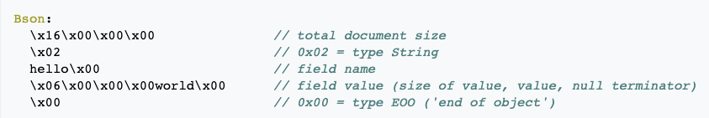
NoSQL Databases: MongoDB
BSON format
Binary-encoded serialization of JSON-like documents
Zero or more key/value pairs are stored as a single entity
Each entry consists of a field name, a data type, and a value
Large elements in a BSON document are prefixed with a length field to facilitate scanning

Slide 31
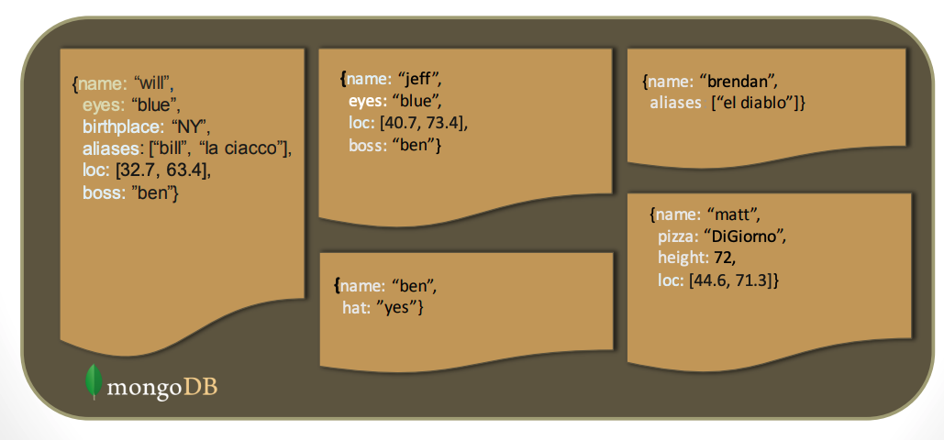
NoSQL Databases: MongoDB
Schema Free
MongoDB does not need any pre-defined data schema
Every document in a collection could have different data
Addresses NULL data fields

Slide 32
NoSQL Databases: MongoDB
CRUD Operations
Create (SQL: INSERT INTO…)
db.collection.insert(<document> )
db.collection.save( <document> )
db.collection.update(<query>, <update>, { upsert: true } )
Read (SQL: SELECT a, b FROM…)
db.collection.find(<query>, <projection> )
db.collection.findOne(<query>, <projection> )
Update (SQL: UPDATE.. WHERE…)
db.collection.update(<query>, <update>, <options> )
Delete (SQL: DELETE FROM…)
db.collection.remove( <query>, <justOne> )

Slide 33
NoSQL Databases: MongoDB
Create Operations
db.collection_name specifies the collection or the ‘table’ to store the document
db.collection_name.insert( <document>)
Omit the _id field to have MongoDB generate a unique key
Example:
db.parts.insert( {{type: “screwdriver”, quantity: 15 } )
db.parts.insert({_id: 10, type: “hammer”, quantity: 1 })
db.collection_name.update( <query>, <update>, { upsert: true } )
Will update 1 or more records in a collection satisfying query
db.collection_name.save(<document>)
Updates an existing record or creates a new record

Slide 34
NoSQL Databases: MongoDB
Read Operations
db.collection_name.find(<query> , <projection> ).cursor modified
Provides functionality similar to the SELECT command
<query> where condition , fields in result set
Example: var PartsCursor = db.parts.find({parts: “hammer”}).limit(5)
Has cursors to handle a result set
Can modify the query to impose limits, skips, and sort orders
Can specify to return the ‘top’ number of records from the result set
db.collection_name.findOne(<query> , <projection> )

Slide 35
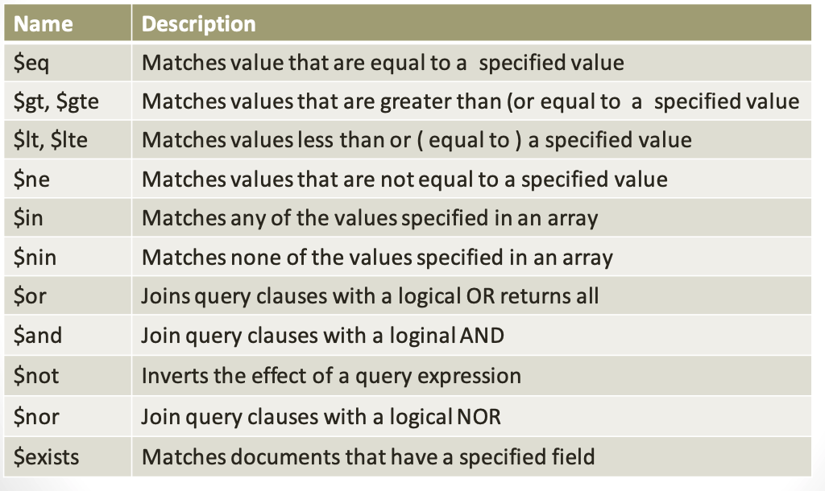
NoSQL Databases: MongoDB
Query Operators

Slide 36
NoSQL Databases: MongoDB
Update Operations
db.collection_name.save(<document> )
Updates an existing record or creates a new record
db.collection_name.update(<query>, <update>, { upsert: true } )
Will update 1 or more records in a collection satisfying query
db.collection_name.findAndModify((<query>, <sort>, <update>, <new>, <fields>, <upsert>)
Modify existing record(s) – retrieve old or new version of the record

Slide 37
NoSQL Databases: MongoDB
Delete Operations
db.collection_name.remove(<query> , <justone> )
Delete all records from a collection or matching a criterion
<justone> - specifies to delete only 1 record matching the criterion
Example:
db.parts.remove(type: /^h/ } ) - remove all parts starting with h
db.parts.remove({}) – delete all documents in the parts collections

Slide 38
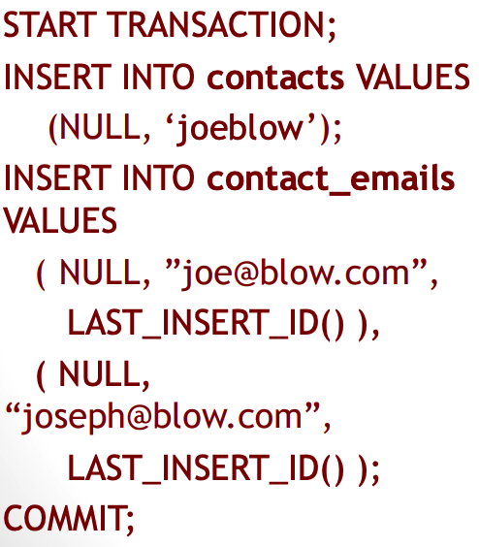
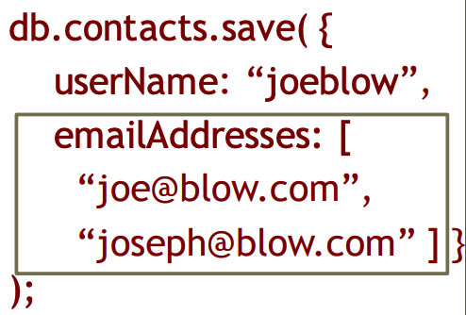
NoSQL Databases: MongoDB
SQL Relations (with transaction)
NoSQL Entities

Slide 39
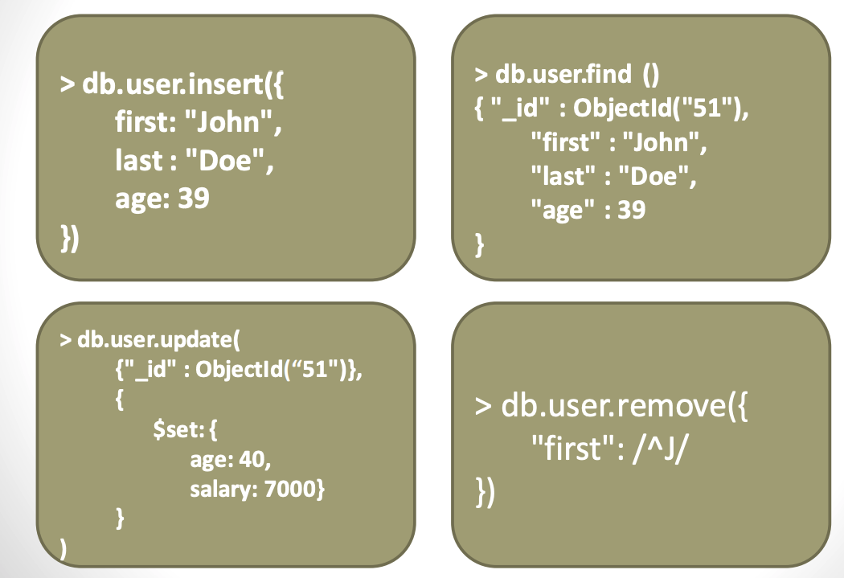
NoSQL Databases: MongoDB
CRUD Examples

Slide 40
NoSQL Databases: MongoDB
Exercise - setup
Download restaurants.zip
mongoimport --db test --collection restaurants <restaurants.json
open mongodb console
show dbs
use test
show collections

Slide 41
NoSQL Databases: MongoDB
Exercise
Display all the documents in the collection restaurants
db.restaurants.find();
Display the fields restaurant_id, name, borough and cuisine for all the documents in the collection restaurant
db.restaurants.find({},{"restaurant_id" : 1,"name":1,"borough":1,"cuisine" :1});

Slide 42
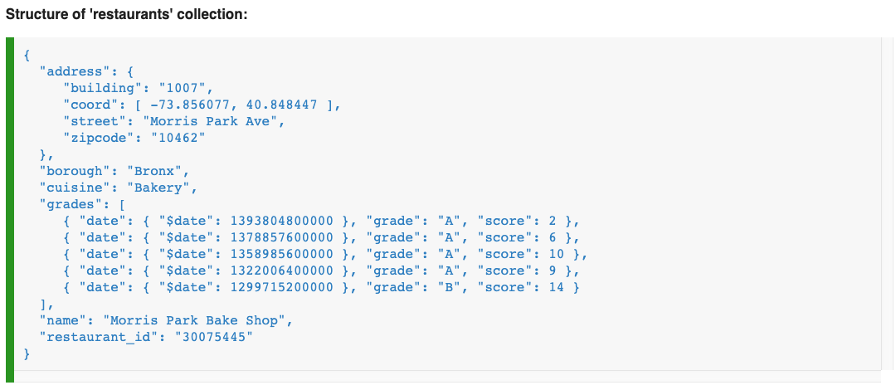
NoSQL Databases: MongoDB
Exercise
https://www.w3resource.com/mongodb-exercises/

