Slide 1
Graphs
Some material taken from website of Dale Winter

Slide 2
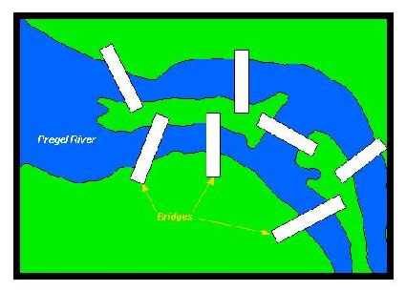
Seven Bridges of Königsberg
Leonhard Euler – 1736
Find a starting point so that you can walk around the city, crossing each bridge exactly once, and end up at your starting point

Slide 3
Four Color Problem
What is the smallest number of colors needed to color any planar map (drawn so that no edges cross)so that any two neighboring regions have different colors?
Over the last 150 years, some big shots in the world of mathematics have been involved with this problem. Around 1850, Francis Guthrie showed how to color a map of all the counties in England using only four colors. He became interested in the general problem, and talked about it with his brother, Frederick. Frederick talked about it with his math teacher, Augustus DeMorgan , who sent the problem to William Hamilton Hamilton was evidently too interested in other and it lay dormant for about 25 years. In 1878, Arthur Cayley made the scientific community aware of the problem again, and shortly thereafter, British mathematician Sir Alfred Kempe devised a 'proof' that was unquestioned for over ten years. However, in 1890 Percy John Heawood, found a mistake in Kempe's work. The problem remained unsolved until 1976, when Kenneth Appel and Wolfgang Haken produced a proof involving an intricate computer analysis of 1936 different configurations.

Slide 4
Graphs
Unlabeled graph
Nodes (vertex) and links (edges), without notations on nodes
Labeled graph
Nodes contain a label
Weighted graph
Links have an associated value or “weight” label
Vertex is adjacent to another if an edge connects it
The vertices are called “neighbors”
Path
Sequence of edges, to get from one vertex to another
A vertex is “reachable” if there is a path between the two nodes
Length if path: number of edges on the path
Connected graph
A path exists from each node to every other node
Complete graph
Path from each vertex to every other vertex

Slide 5
Graphs
Degree of a vertex
Number of edges connected to it
In a complete graph, it number of vertices minus 1
Simple path
Does not pass through a vertex more than once
Cycle
Path begins / ends at the same vertex
Undirected
Edges do not indicate a direction
Directed
Explicit direction in an edge between two nodes
“digraph” (directed graph)
Directed edges
Source and destination vertices
Incident edges
Edges emanating from a source vertex

Slide 6
Graphs
How is a graph different from a tree?
A node can have many parents in a graph
Links can have values or weights assigned to them

Slide 7
Directed Graphs
Directed Acyclic Graph (DAG)
Contains no cycles
Lists and trees
Special cases of directed graphs
List
Nodes are predecessors and successors
Tree
Nodes are parents and children

Slide 8
Graphs
Dense and sparse graphs
Based of number of edges in the graph
Limiting cases
Complete directed graph with N vertices
N * (N-1)
Complete undirected graph with N vertices
N * (N-1) / 2

Slide 9
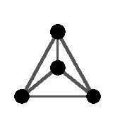
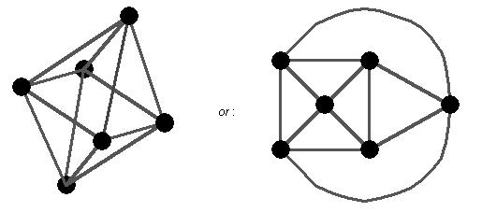
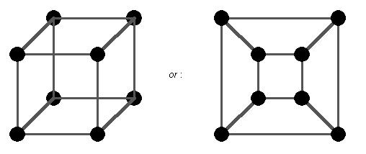
Graphs
Tetrahedral
Octahedral
Cube

Slide 10
Definitions
Definition :
A graph G consists of a set of vertices and a set of edges, where each edge joins an unordered pair of vertices. The set of vertices of G is denoted by V(G) and the set of edges is denoted by E(G).
Definition:
A loop is an edge that joins a vertex to itself. A multiple edge occurs when there is more than one edge joining a pair of vertices.
Definition:
A simple graph is a pair (V(G), E(G)) where V(G) is a non-empty finite set of elements, and E(G) is a finite set of unordered pairs of distinct elements of V(G).

Slide 11
Examples of usage
Directed graph to describe the sequence of courses (with prerequisites)
Roadmap
Airline routes
Adventure game layout
Network schematic
Web page links
Relationship between students and courses
Flow capacities in a communications or a transportation network
Neurons

Slide 12
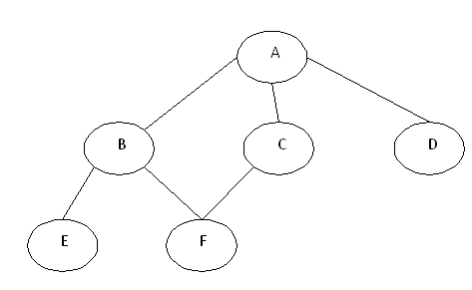
Representation of Graphs
How can I represent the edges in a graph?
Adjacency matrix
Adjacency list

Slide 13
Adjacency matrix
Adjacency matrix
Using Boolean flags, we construct an n by n matrix
Each node/vertex is a row/column in the matrix
The flag indicates a link between the two nodes
Advantages
Easy to put into practice..a 2D array
Adding/deleting links easy.. Just update the Boolean flags
Disadvantages
Memory usage as the node count increases
Information redundancy

Slide 14
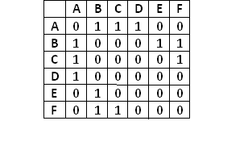
Adjacency matrix

Slide 15
Adjacency Matrix (undirected)
 | Destination Nodes
Source Nodes |  | A | B | C | D
 | A | 0 | 1 | 0 | 0
 | B | 1 | 0 | 1 | 1
 | C | 0 | 1 | 0 | 1
 | D | 0 | 1 | 1 | 0
A
D
B
C
Directed graph
4 bidirectional links
Adjacency matrix

Slide 16
Adjacency Matrix (directed)
 | Destination Nodes
Source Nodes |  | A | B | C | D
 | A | 0 | 0 | 0 | 0
 | B | 1 | 0 | 0 | 1
 | C | 0 | 1 | 0 | 0
 | D | 0 | 0 | 1 | 0
A
D
B
C
Directed graph
4 directed links
Adjacency matrix
4 links
Weight can occupy cell

Slide 17
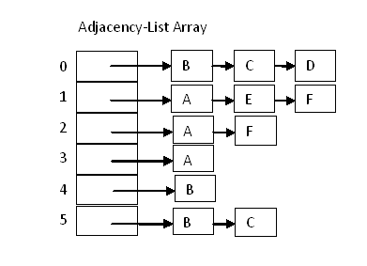
Adjacency list
Array of Linked List nodes
List whose elements are a linked list

Slide 18
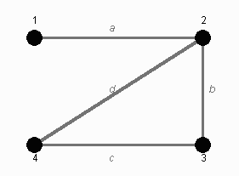
Incidence Matrix
Graph information stored in a matrix or grid
Grid “G”
We note if a vertex is “incident” to a particular edge
 | Side 'a' | Side 'b' | Side 'c' | Side 'd'
Vertex 1 | 1 | 0 | 0 | 0
Vertex 2 | 1 | 1 | 0 | 1
Vertex 3 | 0 | 1 | 1 | 0
Vertex 4 | 0 | 0 | 1 | 1

Slide 19
Adjacency List (directed)
A
B |  | D | A
C
D |  | C
A
D
B
C
Directed graph
4 directed links
Weighting can also be assigned, next to the destination node

Slide 20
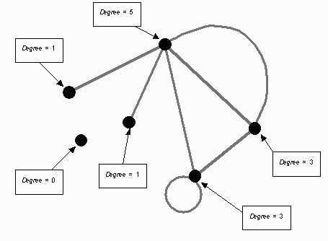
Degree or Valency
The number of edges incident with a vertex

Slide 21
Representations can be used to…
Determine if edge exists between two vertices
Find all adjacent vertices for a given vertex
Consider the computational advantages in using one over the other

Slide 22
Graph Traversals
Two algorithms to traverse and search for a node
Determine if a node is reachable from a given node
BFS
Breadth First Search
DFS
Depth First Search

Slide 23
DFS algorithm
See how far you can go
Use a STACK
Result is A B E F C D
Push starting node
Loop until the stack is empty
Peek the node in the stack
If node has unvisited adjacent nodes, mark as traversed and push it on stack
If node does not have unvisited adjacent nodes, pop the node from the stack

Slide 24
DFS algorithm
public void dfs()
{ //DFS uses Stack data structure
Stack s=new Stack();
s.push(this.rootNode);
rootNode.visited=true;
printNode(rootNode);
while(!s.isEmpty())
{ Node n=(Node)s.peek();
Node child=getUnvisitedChildNode(n);
if (child!=null)
{
child.visited=true;
printNode(child);
s.push(child);
}
else
{
s.pop();
}
}
//Clear visited property of nodes
clearNodes();}

Slide 25
BFS algorithm
Stay close to root
Visit “level” by “level”
Use a QUEUE
Result is A B C D E F
Push start node into the queue
Loop until the queue is empty
Remove the node from the queue
If removed node has unvisited child nodes, mark as traversed and insert unvisited children into queue

Slide 26
BFS algorithm
public void bfs()
{ //BFS uses Queue data structure
Queue q=new LinkedList();
q.add(this.rootNode);
printNode(this.rootNode);
rootNode.visited=true;
while(!q.isEmpty())
{
Node n=(Node)q.remove();
Node child=null;
while ((child=getUnvisitedChildNode(n))!=null)
{
child.visited=true;
printNode(child);
q.add(child);
}
}
//Clear visited property of nodes
clearNodes();}

Slide 27
Graph Traversals
Follow a sequence of links
Operations
Insert/delete items in the graph
Find the shortest path to a given item in a graph
Find all items to which a given item is connected in a graph
Traverse all of the items in a graph

Slide 28
Generic Traversal Algorithm
Starting with an arbitrary vertex
TraverseFromVertex(graph, startVertex)
Mark all vertices as unvisited
Insert startVertex into empty collection
While (collection not empty)
Remove a vertex from the collection
If vertex hasn’t been visited
Mark it as visited
Process the vertex
Insert all adjacent unvisited vertices into the collection

Slide 29
Generic Traversal Algorithm
All vertices reachable from startVertex are processed exactly once
Determining adjacent vertices is straightforward
Matrix used:
Iterate across the vertex’s row
List used:
Traverse the vertex’s linked list

Slide 30
Traversal
Depth-first
Uses a stack as a collection
Goes deeply before backtracking to another path
Can be implemented recursively
Breadth-first
Queue is the collection
Visit every adjacent vertex before proceeding deeper
Similar to a level order traversal of a tree

Slide 31
Graph Components
Graph can be partitioned into disjoint components
Each component stored in a set
Sets are stored in a list

Slide 32
Trees within graphs
Spanning Tree
Fewest number of edges possible
While keeping connection between all vertices in the component
N – 1 edges in the tree for “N” vertices
Traversing all the vertices of an undirected graph (not just a single component)
Generates a spanning forest

Slide 33
Minimum Spanning Tree
Weighted edges
Sum all edges
Minimize the sum
Minimum spanning forest
Applies to the entire graph
Algorithms
1957: Prim’s algorithm
1956: Kurskal’s algorithm
Prim’s algorithm (We are assuming a connected graph)
Mark all vertices and edges as unvisited
Mark vertex “v” as visited
For all vertices
Find the least weight edge from a visited vertex to an unvisited vertex
Mark the edge and vertex as unvisited
At the end, the edges are the tree’s branches in the minimum spanning tree

Slide 34
Topological Sort
DAG
Topological order assigns a rank to each vertex
Edges go from lower to higher ranked vertices
Sort based on graph traversal
Either depth or breadth based
Vertices are returned in a stack in ascending order

Slide 35
Shortest Path Problem
Single source shortest path problem
Shortest path from a single vertex to all other vertices
Dijkstra’s algorithm
Assumes all weights are positive
All-pairs shortest path problem
Set of all shortest paths I a graph

Slide 36
Dijkstra’s algorithm
Computes distances of the shortest paths for a source vertex to all other vertices in the graph
Output is a 2D grid (called “results”)
N rows
First column in each row is a vertex
Second column is the distance from source to this vertex
Third column holds the immediate parent vertex on this path
Temporary list, called “included” produced
Contains N Booleans
Tracks if a vertex has been included in the set of vertices for which we’ve already determined the shortest path

Slide 37
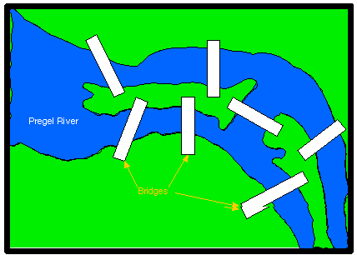
Back to the Seven Bridges

Slide 38
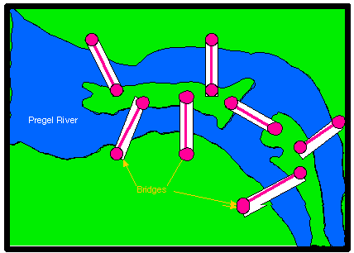
Seven Bridges
The bridges are “pairs” of vertices joined by edges

Slide 39
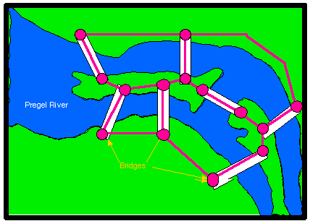
Seven Bridges
Complete the graph
Draw in the joining streets

Slide 40
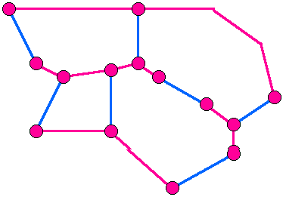
Seven Bridges
“Bridge” edges are in blue
Do we have a sequence of edges so that:
Consecutive edges e_{j}… and e_{j+1} are incident to a common vertex AND
Each of the blue edges belongs to the sequence AND
Each of the blue edges occurs exactly one in the sequence
Referred to as a “walk”

Slide 41
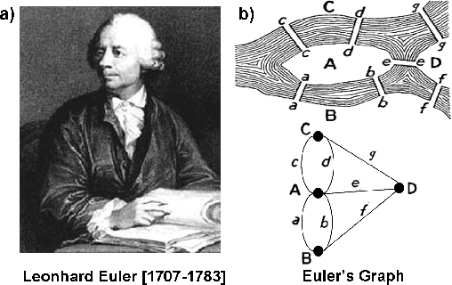
Seven Bridges
Bridges of Königsberg

Slide 42
Walking
Walk
Finite sequence of edges, e₁ , . . . , e_{m}
edge, e_{j} , incident to vertices v_{j - 1} and v_{j} such that any two consecutive edges e_{j} and e_{j + 1} are incident to a common vertex v_{j}
vertex v₀ is called the initial vertex and the vertex v_{m} is called the final vertex
number of edges in the walk is called the length of the walk

Slide 43
Path
In a walk, no requirement that edges in walk are different from each other
possible to have a walk that consists of same edge repeated over and over
Like walking up and down the same street over and over
Assumption that all edges in the walk are distinct
Definition of a PATH
Closed walk
Walk from a vertex to itself
Simple path
All vertices are distinct
Circuit
Simple path which is closed

