Slide 1
Introduction To Spring
Presentation by James Paris
Notes:
We designed this template so that each member of the project team has a set of slides with its own theme. Members, here’s how you add a new slide to just your set:
Mark where you want to add the slide: Select an existing one in the Thumbnails pane, click the New Slide button, then choose a layout. The new slide gets the same theme as the other slides in your set.
Careful! Don’t annoy your fellow presenters by accidentally changing their themes. That can happen if you choose a different theme from the Design tab, which changes all of the slides in the presentation to that look.

Slide 2
Preview of KT
Why use Spring?
What can Spring do?
Sample of web-app: Project Introduction
Getting Started
  Dependency management / Creating a Spring Project (Spring Initialzr)
  Opening project in Eclipse
Quick/brief walkthrough on how my web application is built
Showcase the web-application
Q/A

Slide 3
Why use Spring?
Spring makes programming Java quicker, easier, and safer for everybody. Spring is optimized for speed, simplicity, and productivity.
Spring is Fast
  Create a project in seconds
  Fast startup, fast shutdown, and optimized execution
Spring is Flexible
  Provides a foundation for a wide range of features and functions.
  Spring has tools to help with a large varieties of projects
Spring is Secure
  Security professionals work to patch all security vulnerabilities reported
Spring is Supportive
  The Spring community is enormous and rapidly growing.
  Many guides and tutorials are available to help learn
Spring is Productive
  Loaded with out-of-the-box production-ready features
    Tracing, Metrics, and health status

Slide 4


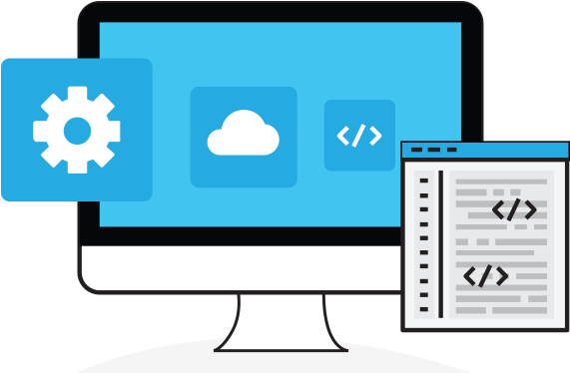




What can Spring do?
Microservices
Reactive
Cloud
Web App’s Batch
Serverless
Event Driven
Other POI: Data Flow, GraphQL, Session (api), CredHub, Apache Kafka, Statemachine, Web Services (SOAP)
https://spring.io/projects/

Slide 5
Example of Web-App : Task Manager
In this project, we will create a task manager web application using Spring boot and Spring Data JPA
Project Details
The application will have a UI in JSP
3 JSP Pages: Create task, display task(s), and update task
Would look better with a login/registration page
  2 additional JSP’s: Register and Login

Slide 6
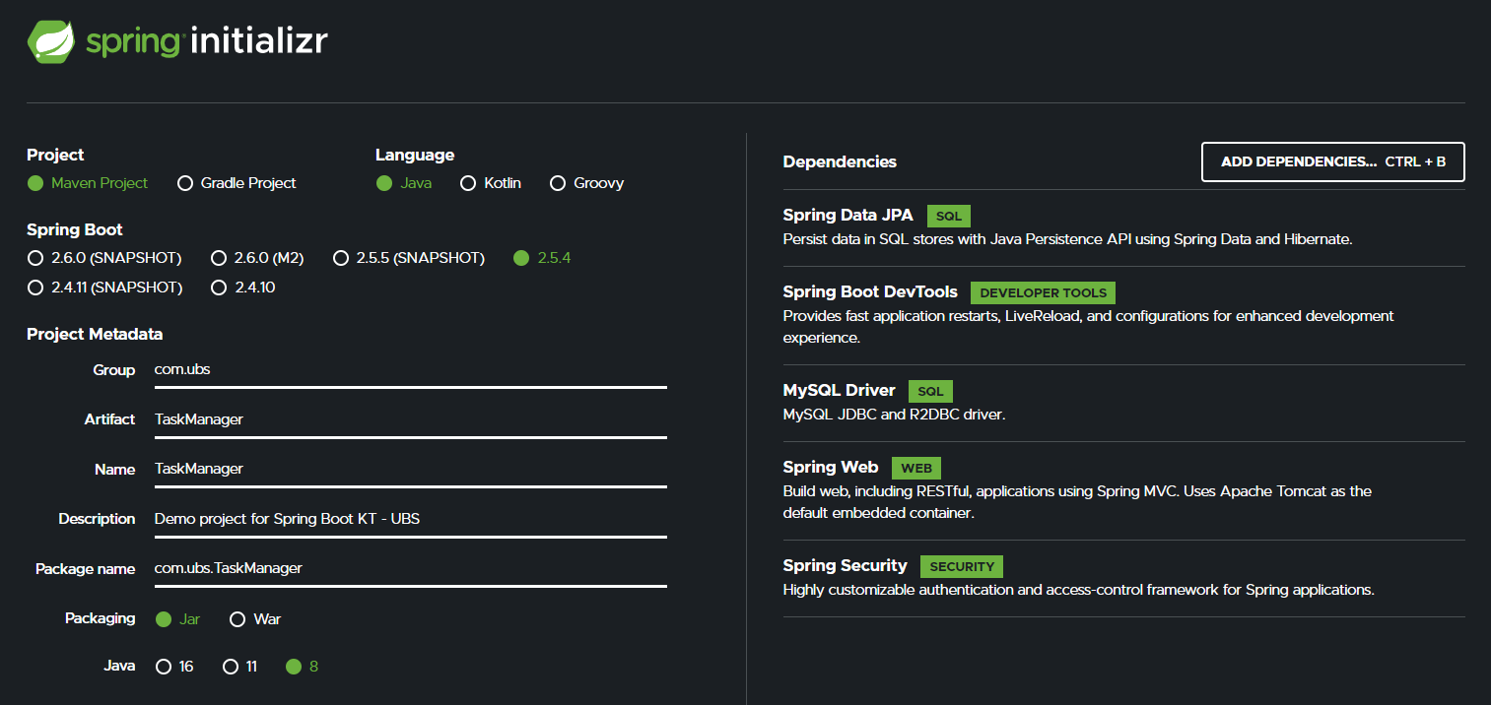
Getting Started
Start.spring.io – Automatically generates our Project/Pom.xml

Slide 7
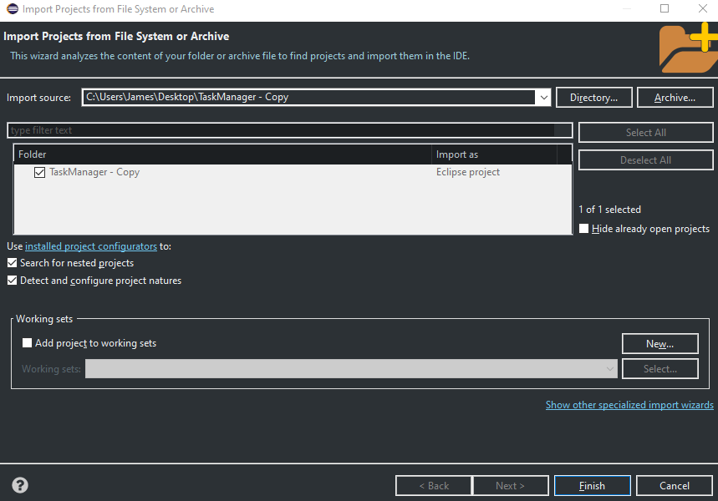
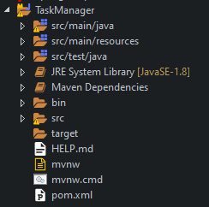
Opening the Project In Eclipse IDE
File > Open Projects from File System… > Select directory of your unzipped folder from Spring Initialzr. Once your project is selected, click finish. Refer to Fig 1-1 for your eclipse screen should look.
Import the generated project into eclipse. Fig 1-2 is how your project directory should look once that is done.
Figure 1-1
Figure 1-2

Slide 8
Working on the Code - Backend
My next step was to start with the backend of my system. In order to accomplish this task manager I will to create a few packages with classes
  com.ubs.TaskManager.config
    WebSecurityConfig.java – Configures who is permitted to visit what page. Also encrypts critical user information for security purposes
  com.ubs.TaskManager.controller
    LoginController.java – Maps login page
    RegisterController.java – Maps register page, and how it functions on the backend
    TaskController.java – Maps task action pages, and how they function on the backend
  com.ubs.TaskManager.model
    Task.java – Entity creation - Task
    User.java - Entity creation - User
    UserPrincipal.java – How backend interacts with user on backend; (Login)
  com.ubs.TaskManager.repository
    TaskRepsitory.java – Creates repo for tasks
    UserRepository.java – Creates repo for tasks, and allows a search for a specific user (Login)
  com.ubs.TaskManager.service
    TaskService.java – Methods for interacting with task repository
    UserService.java – Methods for interacting with user repository

Slide 9
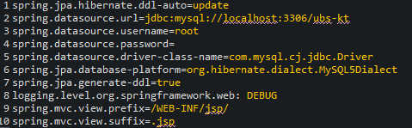
Backend (Cont)
The final backend step is to tie in our data sources. To do this, edit your “applications.properties”.
(Location: src>main>resources>application.properties)
This is the contents of my ‘application.properties’ file

Slide 10
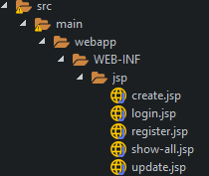
Working on the Code - Frontend
Start by creating the directories/files. This is how mine looks
Use whatever front end you prefer. I used Bootstrap in this project

Slide 11
Showcase Project - Show code – Q/A

Slide 12
Thank You!
I hope you all enjoyed this KT!
If you would like src code to this web-app, please email:
James-za.paris@ubs.com

