Slide 1

PROJECT EVE

Slide 2
PROJECT MANAGEMENT STYLE
15 minute standups on Monday
Redistribute tasks
Everyone knows where everyone else is at
Kanban
Laissez Faire supervised by project manager
Group coding sessions
We’ve divided the project into the core requirements and 3 groups of optional requirements
No deliverables every 2 weeks
But the specifications will change as we progress (to include more optional requirements we can get done)

Slide 3
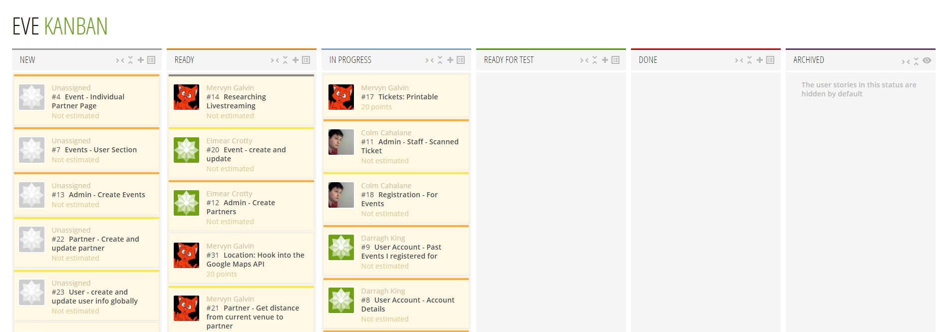
TAIGA (PM SOFTWARE)
Taiga is a project management tool that’s used primarily with Kanban
Ability to tag tasks and assign them to team members
Also allows us to keep track of what’s being worked on at the moment and what’s left to do
Very user-friendly and pretty
Little to no training required for use

Slide 4

PROJECT ROLES
1 Project Manager - Evan
Chair weekly standup
Helps assign roles, check up on progress and give direction
Organises group coding, meetings and supervises overall progress
Everyone shares the roles of:
Coder
Documenter
Tester
The Project Manager assigns necessary tasks
Majority of tasks are assigned by the member themselves

Slide 5
REQUIREMENTS ANALYSIS - Milestone 1
Public view for promotion of events.
Event registration, with confirmation by email.
Necessitates a user management and authentication system.
We need to allow for a printable confirmation. (QR Code ticket)
Integration with iCal/Google Calendar; for events user has a ticket.
Reception desk/staff interface that allows for:
verification and scanning of user tickets
printing of name badges.
Admin interface for:
initial setup
event creation and management
partner management
Electronic information packs for visitors…
In the user’s own language (using Laravel Localisation and Google Translate)
With details on partner companies associated with the event.
Access to recordings of talks / results of events / competitions.
Permit website visitors to contact organisers.

Slide 6
REQUIREMENTS ANALYSIS (OPTIONAL)
Milestone 2 - Payment Handling & Stripe
Payment for events handled externally by Stripe.
Milestone 3 - Partners V2 with Integrations
Integration with external services such as the Google Places API to generate information packs on sponsors and nearby services for each event.
Allow users to contact partner companies directly, or integrate with services like Airbnb for same-page booking once tickets are sorted.
Milestone 4 - Social Media Integration
Login/Register/Authenticate with Facebook when registering for an event
“Friends of yours attending this event” - allowing users to see relevant attendance list
Share details on events with friends

Slide 7
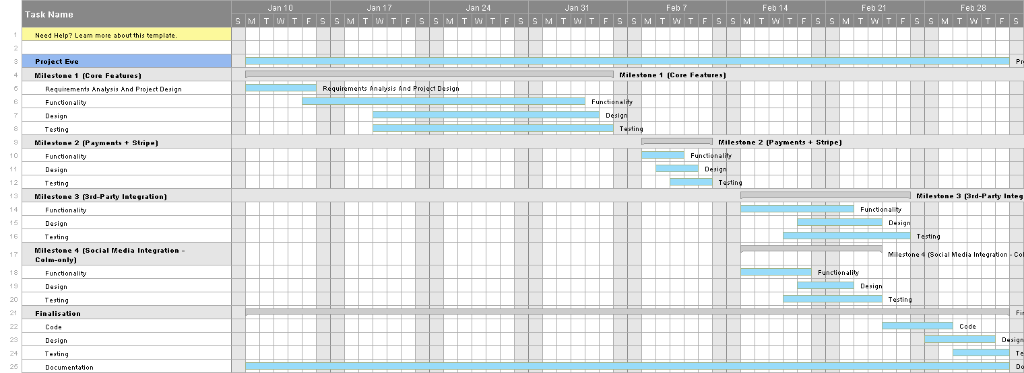
PROJECTED TIMELINE
(it’s zoomable)
Notes:
[insert gantt chart - Evan]
Design, Requirements Analysis, Dev environment, models + migrations (Week 1)
Dummy data, admin skeleton, homepage design, overall design, installation, model relationships (Week 2)
Week 3 -
Week 4 - Milestone 1 Completed (Core reqs)
Week 5 - Milestone 2 Completed (Stripe integration + payments)
Week 5.5 - Milestone 4 Beginning (Colm-solo)
Week 6 -
Week 7 - Milestone 3 + Milestone 4
Week 8 - Finalised testing and bug fixing

Slide 8
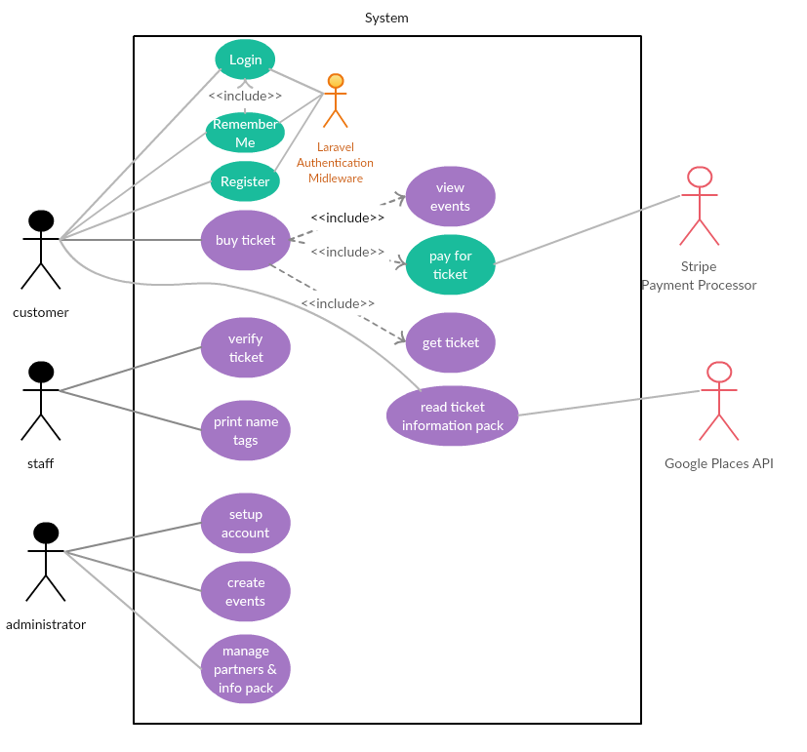
USE CASE DIAGRAM
Three levels of user access: Customer, Staff, Administrator.
Customers must be able to read information, buy tickets, view events, pay for ticket, and retrieve/print tickets they own.
Staff must be able to verify (scan) customers’ tickets, and print name tags for customers.
Administrators need to be able to complete initial setup, create and manage events, and manage partners and information packs for events.

Slide 9
LANGUAGE & FRAMEWORK
PHP
We’re all familiar with PHP
Recent versions add strict typing, secure hashing and improved encryption
Composer as a Dependency Manager gives us access to thousands of useful libraries and packages
Laravel
MVC
Database Migrations
Protection from Cross-Site Request Forgery, SQL Injection
Prebuilt user authentication and easy payments addons
Command-line management tools
Running & reverting migrations and creating new models, controllers, etc.
Easy request routing
Notes:
Composer packages we’re using:
QRCode generation
Image Intervention (image manipulation - cropping, color overlays)

Slide 10
WHY LARAVEL AND NOT
DJANGO OR RAILS?
Quick development
Very large user base
RESTful routing
Really easy and beautiful templating
Built on top of a properly maintained and proven foundation of composer packages
Separated file structure for models, views and controllers
Notes:
RESTful routing = Resource Controllers

Slide 11
DEV ENVIRONMENT
Single Dev Environment
We use vagrant to manage the same base VM for each member
Version Control
Github allows us to collaborate and keep track of the code
Allows us to easily deploy the code to any system
Staging Server
Used for presenting a stable version of the product
Only project lead can manage staging server
Notes:
Vagrant
Git + Github
Staging Server

Slide 12
DEV TOOLS
Gulp
Automatically processes LESS and minifies Javascript
LESS
CSS Variables
Nested CSS classes makes code prettier
Editor Config
Single, unified coding standards regardless of personal IDE or code editor
Notes:
The editor config works for nearly all modern IDEs/Code Editors - Sublime, Eclipse, JetBrains’ software

Slide 13
DATABASE SCHEMA
Notes:
Here we have our Database schema
Tables = Models
relations and foreign-keys have been implemented using Laravel’s migrations which are versioned.
The relations used are 1-to-many, many-to-many and one-to-one

Slide 14
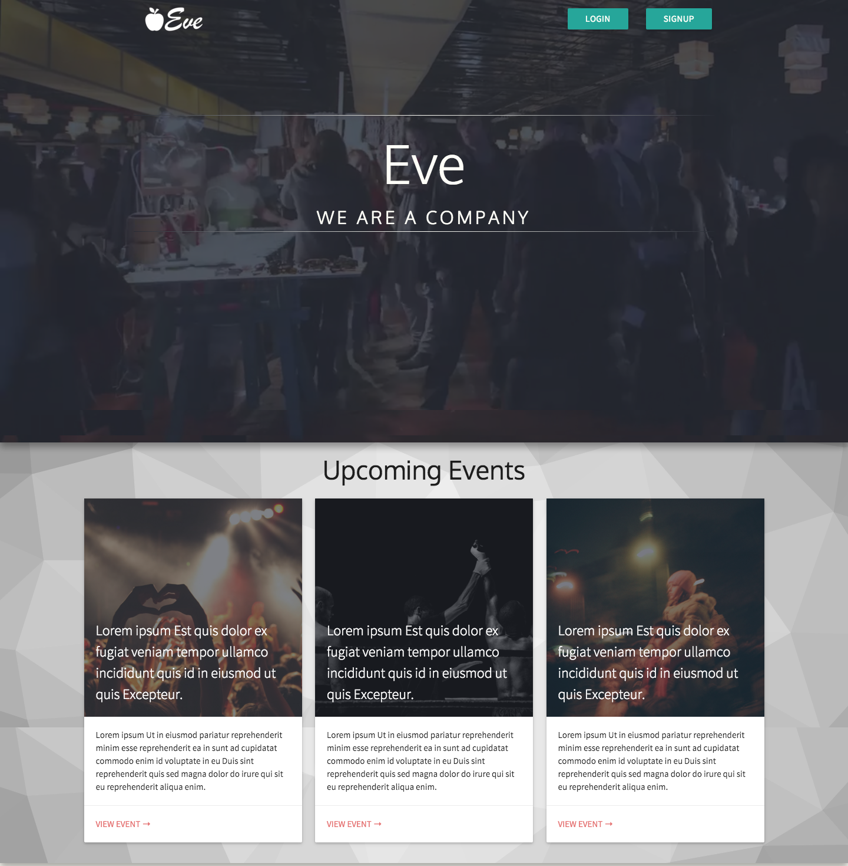
WHAT DO WE HAVE ALREADY
Homepage - Layout & design, dummy data
Admin - Manage data & users, permissions
Initial install & setup
Events - create, view, register for tickets
Event partner companies
Media associated with events
Ticket verification (QR Codes)
Login & user accounts
A user’s events (that they’re registered for)
Notes:
So what’ve we done since starting the project?
We have a landing page for advertising the event,
-> Initial set-up of the web application by the admin
-> User management and permissions
-> the ability to create and view events, and register for tickets
-> additionally, QR codes for tickets, to be scanned by staff, is ready and implemented
An advantage of Laravel is that it came with user login and verification pre-implemented
Finally, users can see all the events they’re registered for

Slide 15
DESIGN
MaterializeCSS: A design framework based on the principles of Google’s Material Design
Material Design is a design philosophy that is focused on a consistent user experiences across devices, using bold colours, and the clever use of animation and motion,
Extending upon this by writing in CSS pre-processor language LESS
Clean, content-focused, designed for mobile first
Notes:
In our design, we want to include a lot of the concepts of Google’s Material Design philosophy as well as make our lives easier. For that, we’re using the MaterializeCSS framework which implements Material Design as well as gving us a responsive grid system and a UI compatible with touch. On top of that, we’ll be writing custom CSS using the LESS pre-processor which makes editing and maintaining our styling easier.

Slide 16
FEATURE ESTIMATES
(M1) Core Features - 4 Weeks (Already in progress)
(M2) Payments and Stripe Integration - 1 Week
(M3) Google Places API + Partner Contact - 1 Week, 5 Days
(M4) Social Media Integration - 2 Weeks Total
Register/Login with social accounts - 4 Days
Show other friends attending this event - 1 Week
(M5) Optimisation - ~ 3 Weeks (Outside of project time limit)
Optimise location based on
Expected attendance vs Venue Capacity - 3 Days
Local Hotel Capacities - 1 Week
Travel Costs (price of petrol, average petrol consumption, distance) - 1 Week
Notes:
In terms of features estimates, we’ve shown you our project timeline and that we’ve grouped the requirements into different milestones. The core features will take about 4 weeks to complete and adding Stripe payments will take a week. Integrating our system with the Google Places API and setting up contact with partners would take one and a half weeks but we’ve allocated two weeks to be safe. Similarly for Social Media integration, we’re rounding up to two weeks to ensure we have a small buffer.
Unfortunately, due to the time limit, we don’t foresee us being able to complete Milestone 5 by the deadline but, because our methodology allows us to adapt to change, if we end up with more time within the project, we could easily explore implementing parts of, if not all of, Milestone 5.

Slide 17
BRIEF REVIEW
We are:
Using Laravel, written in PHP
Employing a Kanban methodology
Using Taiga.IO’s Kanban board for management
Employing Material Design to make our UX pretty and responsive
Already making progress on the backend and design of the site
Notes:
Just as a brief overview, we’re using a PHP framework called Laravel to develop our application, we’re using Kanban boards from Taiga.IO as management, we’re using Material Design concepts in our user interface and experience and we’ve already begun development in the last couple weeks. Any questions?

