Slide 1
Hill Cipher

Slide 2
A brief history
Who created it?
When Was it created?
Why was it created?

Slide 3
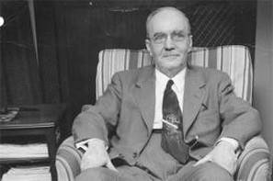
Who Created it?
Lester S. Hill (1891–1961)
He was an American mathematician and educator who specialized in communications. He received a Bachelor's degree from Columbia College and a Ph.D. from Yale University. He taught all over, including the University of Montana, Princeton University, the University of Maine, Yale University, and Hunter College. On top of creating the Hill cipher, he also developed methods for detecting errors in telegraphed code numbers.

Slide 4
When it was created?
In 1929, it was the first polygraphic cipher in which it was practical to operate on more than three symbols at once

Slide 5
Why it was created?
The Hill Cipher uses Linear Algebra, and in it requires the user to have at least a basic understanding of matrices. It also make use of Modulo Arithmetic. Hill cipher has a significantly more mathematical nature than many other basic ciphers. Because of this, it allows it to act easily on larger blocks of letters.

Slide 6




Basic principal

Slide 7
Encrypting
To encrypt a message using the Hill Cipher we must first turn our keyword into a key matrix. We also turn the plaintext into digraphs and each of these into a column vector. We then perform matrix multiplication modulo the length of the alphabet on each vector. These vectors are then converted back into letters to produce the ciphertext.

Slide 8
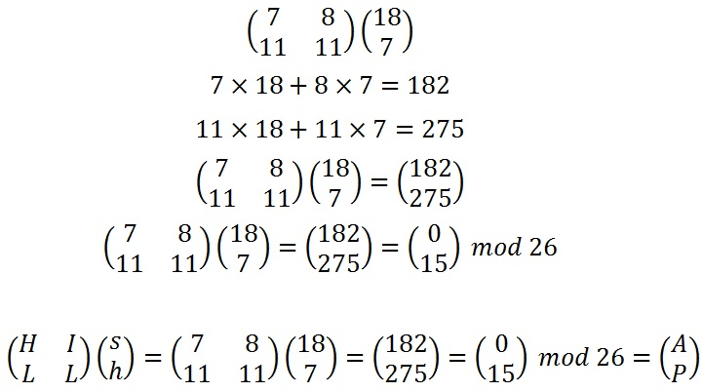
Encryption example

Slide 9
decrypting
To decrypt a ciphertext encoded using the Hill Cipher, we must find the inverse matrix. Once we have the inverse matrix, the process is the same as encrypting. alphabet, and finally convert the numbers back to letters.
The majority of the process is the same as encryption, aside from finding the inverse matrix.

Slide 10

Inverse matrix
Function to calculate the inverse key matrix.

Slide 11


Finding the inverse matrix
Function to calculate the determinant of a 2 x 2 matrix.

Slide 12



Finding the inverse matrix
If d is the determinant, then we are looking for the inverse of d.
The multiplicative inverse is the number we multiply 15 by to get 1 modulo 26.
This calculation gives us an answer of 1 modulo 26.

Slide 13


Finding the inverse matrix
The adjugate matrix of a 2 x 2 matrix.
Again, once we have these values we will need to take each of them modulo 26 (in particular, we need to add 26 to the negative values to get a number between 0 and 25. For our example we get the matrix below.
The adjugate matrix of the key matrix.

Slide 14


Finding the inverse matrix
Multiplying the multiplicative inverse of the determinant by the adjugate to get the inverse key matrix

Slide 15
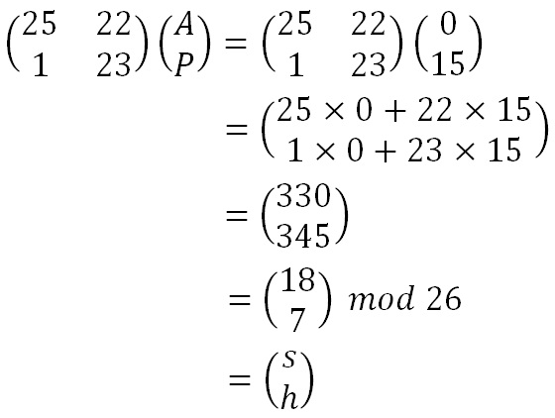
Decryption example

Slide 16
Demonstration

Slide 17
Pros:
More complicated than shift ciphers like Caesar
Can easily be combined with non-linear operations for added security
Ability to calculate by hand
Cons:
Fairly simple to crack with known-plaintext attack due to linearity
Becomes increasingly difficult to cipher by hand with increased key matrix size

Slide 18
Questions?

