Slide 1
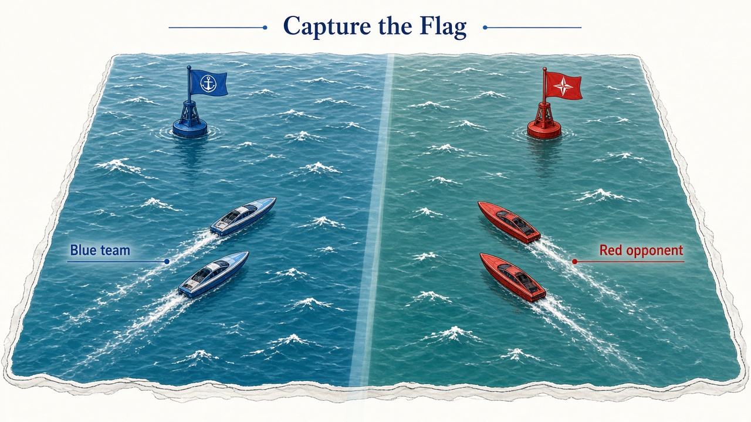
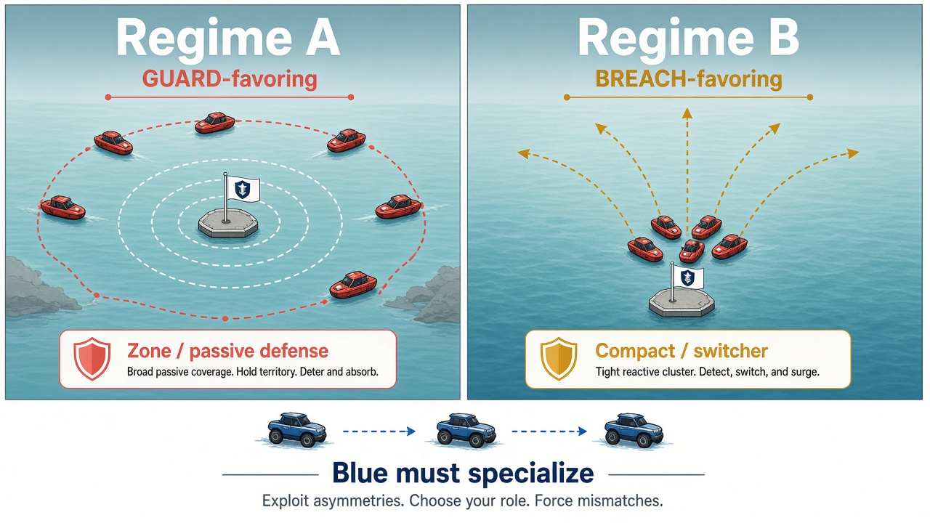
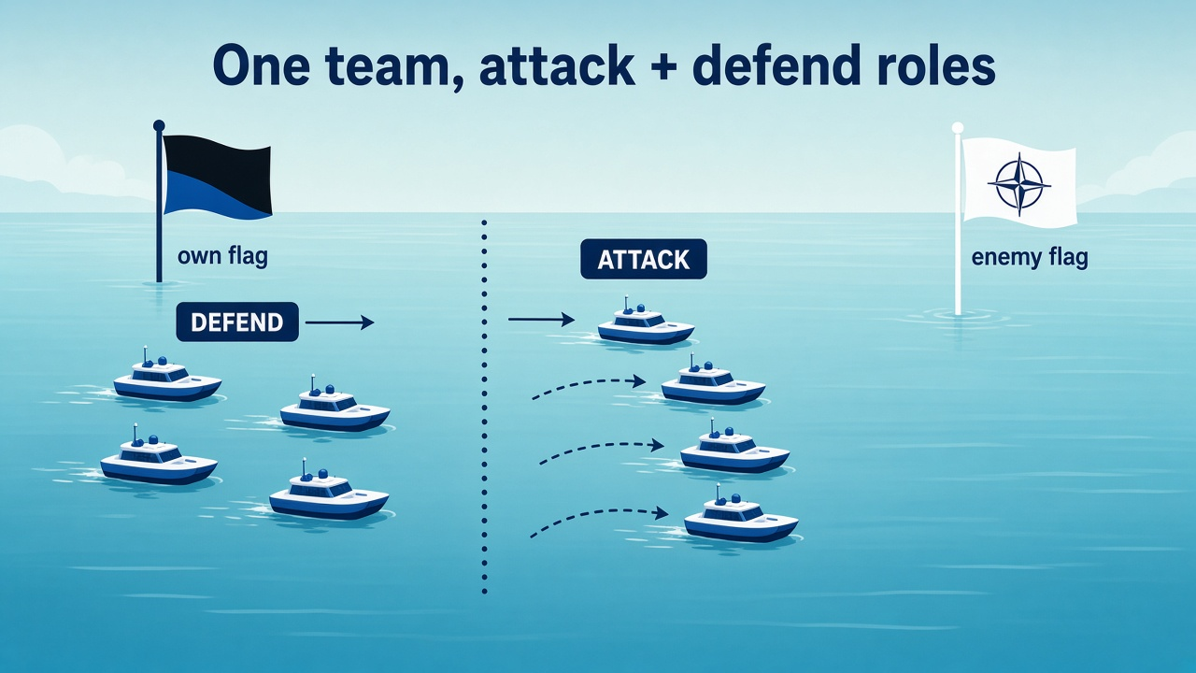
Maritime Capture-the-Flag: scenario and objectives
One Blue team of ASVs · two Red opponent regimes · specialize strategy without duplicating the whole policy
Task: Blue ASVs must capture Red's flag and return home under partial observability.
Objectives
Regime A (broad / passive zone defense) favors a GUARD-style Blue response.
Regime B (compact / reactive defense) favors a BREACH-style Blue response.
Learn complementary strategies, then compress them into one shared student π(a | o, z, r) so the correct strategy wins on each pole.
Assets: scenario_maritime_ctf_overview.jpg · scenario_regime_ab_boats.jpg · scenario_roles_atk_def.jpg

