Slide 1

Brand Style Guide
10 September 2026

Slide 2
Viopatch Brand Value Ladder & Thematic Matrix
Mapping foundational pharmaceutical rigor to life-changing emotional outcomes across three strategic benefit pillars
TIER 3
Life-Changing Emotional
Transformative Human Outcomes
SAFETY & VITALITY
Zero Pill Anxiety & Organ Peace
Freedom from chronic NSAID dread; complete confidence in gentle, sustained, non-damaging long-term relief.
ACTIVE MOBILITY
Spontaneous Mobility & Freedom
Restores daily movement — unrestricted walking, stairs, family playtime, and active living without pain dread.
DIGNITY & REST
8+ Hours Restorative Sleep
Eliminates 3 AM throbbing wake-ups. Wearable discretion under clothes without awkward balm smell or stains.
TIER 2
Functional Clinical Promise
Pharmacological Performance
BIOLOGICAL SAFETY
Zero GI Toxicity (100% Bypass)
Direct localized absorption completely bypasses digestive tract; eliminates gastric ulcers and liver/renal strain.
CONTINUOUS DELIVERY
12-Hour Sustained Zero-Order Release
Constant localized transdermal flux straight into inflamed knee, neck, and back joints without dosage spikes.
OVERNIGHT FLUX
Tropical Dermal Adhesion
Hypoallergenic micro-porous matrix engineered for high-humidity sweat resistance; adheres securely overnight.
TIER 1
Physical Attributes
Formulation & Engineering
STANDARDIZED PHYTO-ACTIVES
100% Herbal Active Transdermal Matrix
Standardized actives: Gandhpura Oil (natural methyl salicylate), Menthol, Camphor, Eucalyptus, and Clove Oil infused in transdermal polymer.
WEARABLE CONVENIENCE
Ultra-Thin, Non-Greasy & Odor-Locked Patch
Clean peel-and-stick application. Flexible breathable weave stretches with joints. Leaves zero balm stains on clothes or bedsheets.
FOUNDATION
50+ Years Manufacturing Rigor
Unexo Life Sciences (Est. 1972)
PHARMACEUTICAL HERITAGE & INFRASTRUCTURE
Pioneering Transdermal Technology Backed by Vaccine-Grade Cleanroom Rigor
Manufactured under US-FDA CFR 21 compliance guidelines, cGMP standards, and ISO Class 8 cleanroom environments. Half a century of sterile pharmaceutical infrastructure backing topical consumer analgesics.

Slide 3
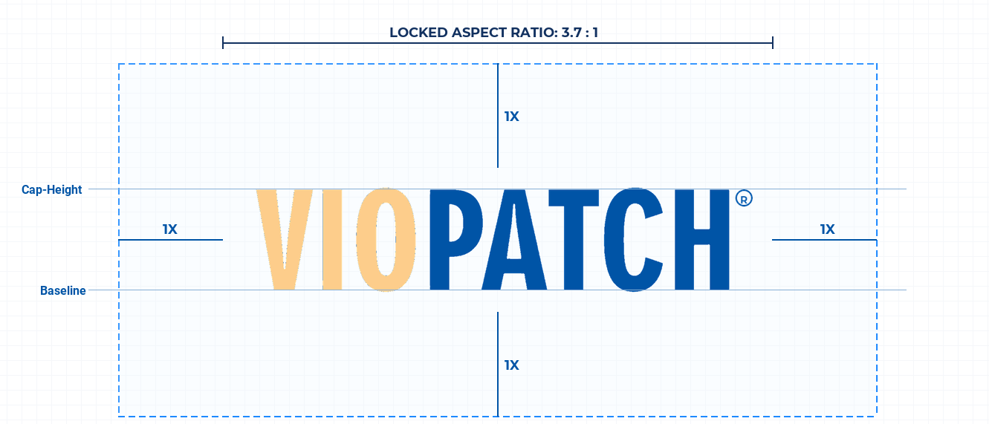
Standardized logo across communication channels
1X CLEAR SPACE
Height of logo (H) exclusion boundary on all 4 sides. No typography, icons, or container borders may intrude.
LOCKED GEOMETRY
Inviolable 3.7 : 1 aspect ratio. Agency redrawing, horizontal stretching, or vertical squashing is strictly prohibited.
STATUTORY TRADEMARK (®)
Registered glyph locked at cap-height beside 'H'. Mandatory across all commercial packaging and digital assets.
MINIMUM REPRODUCTION
Print: 25 mm width | Digital: 120 px width. Minimum reproduction threshold to preserve statutory legal legibility.

Slide 4

Use only approved logo from authorized source; agency redrawing is prohibited
Dark Background Variant
Light Background Variant
📦 Master Vector Package (.SVG / .EPS / .AI)
Resolution-independent vector assets for commercial packaging converters, offset printers, foil stamping, and environmental signage
📦 High-Res Raster Package (.PNG / .JPG - 300 DPI)
300 DPI transparent RGBA masters calibrated for e-commerce marketplaces (Amazon, Flipkart), corporate web CMS, partner portals, and mobile UI

Slide 5








Incorrect usage of Viopatch brand
✕
✕
✕
✕
1. Do Not Distort
Never stretch or squash. The 3.7:1 aspect ratio must remain permanently locked across all media.
2. Do Not Recolor
Never alter brand hues. 'VIO' is strictly Skin (#FDCD8B) and 'PATCH' is strictly Blue (#0054A6) on light backgrounds, or White (#FFFFFF) on dark backgrounds.
3. Do Not Outline
Never stroke or outline letterforms (IBM Rule). Letterforms must always be solid vector fills.
4. Do Not Add Shadows
Never apply drop shadows, glows, bevels, or 3D extrusions (Uber Rule). Wordmark must remain crisp & flat.
✕
✕
✕
✕
5. Do Not Omit ®
Never omit or relocate statutory trademark (®). The glyph is legally mandatory at cap-height beside 'H'.
6. Do Not Rotate or Tilt
Never rotate or place the logotype on an angle or diagonal layout (Uber Rule). Always align horizontally.
7. Do Not Violate Spacing
Never crowd inside tight borders or containers (IBM Rule). Maintain the inviolable 1X clear space boundary.
8. Do Not Use Low Contrast
Never place the blue wordmark on dark navy or busy backgrounds (Uber Rule). Use the white-text variant on dark.

Slide 6
Use only approved brand color palette across communication channels
Non-exhaustive: corporate communication, letterheads, emails, e-commerce platforms, offset printing, physical packaging
Color Name | Swatch | HEX | RGB | CMYK / Pantone | Suggested Usage
Viopatch Cool Blue |  | #0054A6 | 0, 84, 166 | 100, 65, 0, 5 PMS 2145 C | Primary Brand Standard. Wordmark 'PATCH', primary packaging headers, CTA buttons, authoritative badges, and commercial print ink.
Viopatch Dermal Yellow |  | #FDCD8B | 253, 205, 139 | 0, 22, 50, 0 PMS 1345 C | Secondary Brand Identity. Wordmark 'VIO', physical transdermal patch fabric shade, breathable dermal warmth, and patient touchpoints.
Viopatch Herbal Green |  | #379131 | 55, 145, 49 | 75, 0, 100, 0 PMS 361 C | Botanical Reassurance. 100% Herbal leaf badge, active Ayurvedic ingredient claims (Gandhpura, Clove), therapeutic wellness accents.
Viopatch Thermal Orange |  | #F26B43 | 242, 107, 67 | 0, 70, 75, 0 PMS 1655 C | Therapeutic Pain Zone. Anatomical heat gradients, localized pain epicenter illustrations, active delivery burst, and thermal callouts.
Viopatch Menthol Frost |  | #0284C7 | 2, 132, 199 | 85, 35, 0, 0 PMS 2995 C | Cryo-Relief & Soothing. Menthol & Camphor cooling sensation, hydrogel matrix technology callouts, and transdermal penetration diagrams.
Viopatch Clinical Slate |  | #475569 | 71, 85, 105 | 70, 50, 35, 20 PMS 7545 C | Structural Neutral & Headings. Clinical architecture, data tables, structural dividers, technical borders, secondary captions, and subtitles.
Viopatch Statutory Charcoal |  | #2A2A28 | 42, 42, 40 | 65, 55, 60, 45 Neutral Dark | Canonical Body Copy. High-density drug facts, composition formulas, statutory packaging legal panels, and technical specifications.
Viopatch Hospital Calm Grey |  | #F2F2F7 | 242, 242, 247 | 2, 2, 0, 3 Neutral Light | Interface & Surface. Hospital-grade card backings, alternating table row shading, modern callout containers, and clean sterile backdrops.

Slide 7
Typography: Industrial Print Packaging
Non-exhaustive: physical packaging, tooling, folding carton lithography, and statutory drug facts regulatory standards
Font Family | Visual Specimen | Packaging Role & Hierarchy | Foundry & Licensing | Technical Specifications
Futura Bold Condensed | VIOPATCH KNEE PAIN RELIEF • 12-HOUR RELIEF | Primary SKU Headlines & Product Variant Identification | Commercial Foundry License (Linotype / Monotype) | All Caps • Condensed Proportions Maximum Retail Shelf Impact
Century Gothic Bold | Herbal Formula • Ayurvedic Topical Pain Treatment Non-Messy • Non-Greasy • Breathable Micro-Porous Fabric | Sub-Brand Descriptors & Core Therapeutic Claims | Commercial Foundry License (Monotype) | Title Case • Geometric Sans High Contrast Shelf Legibility
Arial Narrow | COMPOSITION: Gandhpura Taila 10% w/w, Menthol 5% w/w, Camphor 3% w/w Mfg Lic. No. DL-1972-AYUR • Store below 25°C • Keep out of reach of children | Statutory Regulatory Panel, Drug Facts & Legal Declarations | System Pre-Installed (Universal Packaging Standard) | High Information Density Compliant Statutory Clarity
OCR-B 10 Pitch BT | 8 906020 150012 | BATCH: VP-2026-09 | EXP: 08/2029 GS1 standard optical characters calibrated for automated packaging scanners. | Machine-Readable Barcodes, Batch Numbers & Expiry Stamps | GS1 Standard Optical Font (Pre-Calibrated Packaging Lines) | Monospace Optical Characters 100% Automated Scanning Accuracy

Slide 8
Typography: Digital, Web & Marketing
Non-exhaustive: corporate presentations, pitch decks, web portals, e-commerce listings, and digital advertising
Font Family | Visual Specimen | Digital Hierarchy & Role | Approved Weights | Google Fonts Download URL
Barlow Condensed | TARGETED DEEP TISSUE TRANSDERMAL RELIEF ABCDEFGHIJKLMNOPQRSTUVWXYZ • 0123456789 | Digital Display H1, Hero Banners, E-Commerce Headers & Campaign Ads | Bold (700) SemiBold (600) | fonts.google.com/specimen/Barlow+Condensed
Montserrat | Executive Presentations & Section Design Architecture Geometric clarity optimized for pitch decks and digital collateral | Corporate Pitch Decks, Section Titles, Card Sub-heads & Identity Emblems | Bold (700) Medium (500) | fonts.google.com/specimen/Montserrat
Roboto | Continuous transdermal drug delivery matrix designed for active mobility and restorative sleep. The quick brown fox jumps over the lazy dog • 0123456789 • !@#$%^&*() | Canonical Web & E-Commerce Body Copy, Interface UI, Technical Specifications & Claims | Regular (400) Medium (500) Bold (700) | fonts.google.com/specimen/Roboto

Slide 9
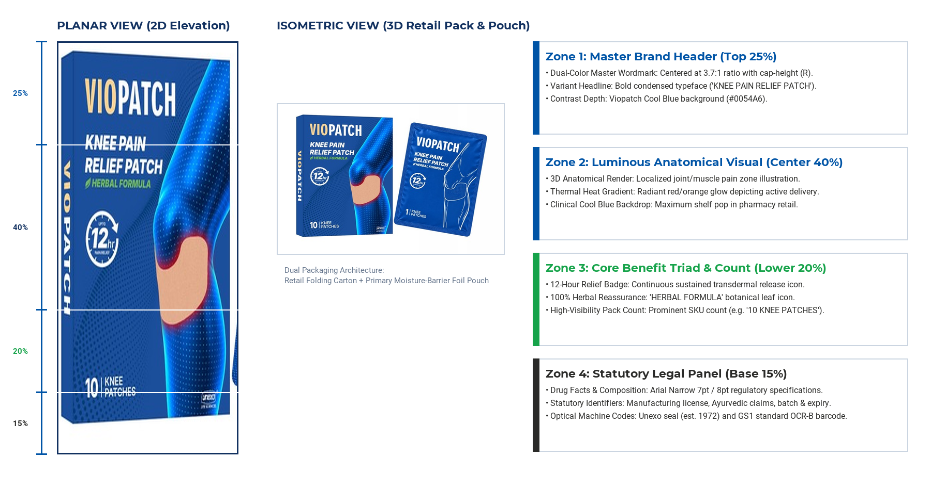
2026 Packaging Refresh: TBD

Slide 10
Contact for all brand queries
info@unexo.in

