Slide 1
American motors
Group 4

Slide 2
Predicting the Fuel Efficiency
Fuel efficiency = f(Cylinder, Displacement, Horsepower, Accel, Weight)
Use domain knowledge
Relationship between predictors
Assumed model
NA removal
Regression diagnostics
MILPGAL = ß0 + ß1 CYLINDER + ß2 DISPLACE + ß3 HORSPWR + ß4 ACCL + ß5 Weight + error

Slide 3
Regression diagnostics
Diagnostics steps
Remove multi-collinearity
VIF < 4 for predictors
Remove influential observations
Cook’s distance <1
Standardized residuals (r_{i})
|r_{i}| < 2
All assumptions hold as it is from previous sessions
To identify
Outliers
High leverage
Influential observation

Slide 4
Step 1: Multi collinearity :: VIF < 4
MILPGAL = ß0 + ß1 CYLINDER + ß2 DISPLACE + ß3 HORSPWR + ß4 ACCL + ß5 Weight + error
CYLINDER | DISPLACE | HORSPWR | ACCEL | WEIGHT
7.967440 | 16.199925 | 7.550373 | 2.710441 | 11.632114
DROP DISPLACE
MILPGAL = ß0 + ß1 CYLINDER + ß2 HORSPWR + ß3 ACCL + ß4 Weight + error
CYLINDER | HORSPWR | ACCEL | WEIGHT
3.617 | 7.500 | 2.548 | 7.168263
DROP HORSPWR

Slide 5
Step 1: Multi collinearity :: VIF < 4
MILPGAL = ß0 + ß1 CYLINDER + ß2 ACCL + ß3 Weight + error
CYLINDER | ACCEL | WEIGHT
3.546 | 1.105747 | 3.397882
All the predictor variables are within acceptable VIF range

Slide 6
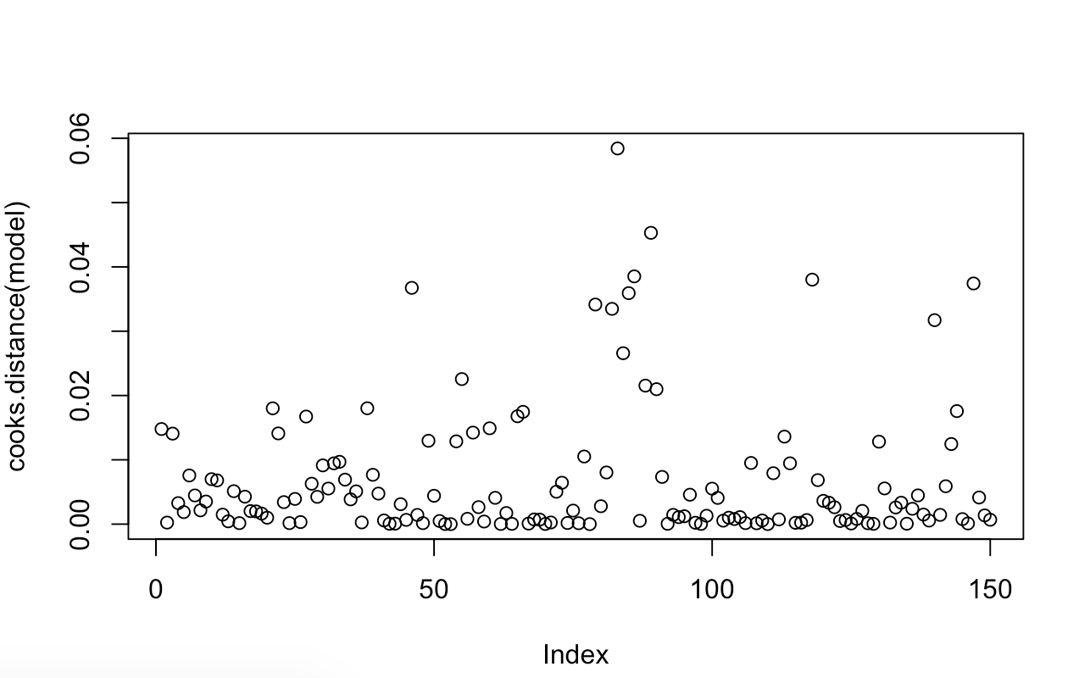
Step 2: Influential observations :: Cooks’ D < 1
All observations are within acceptable cook’s distance range

Slide 7
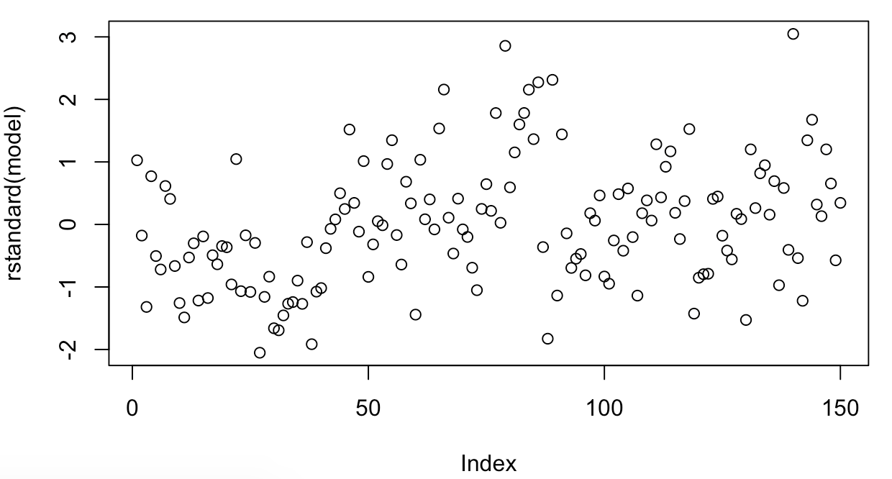
Step 3: Standardized residuals :: |r_{i}| < 2
Remove values outside r-standard(-2,2) one by one

Slide 8
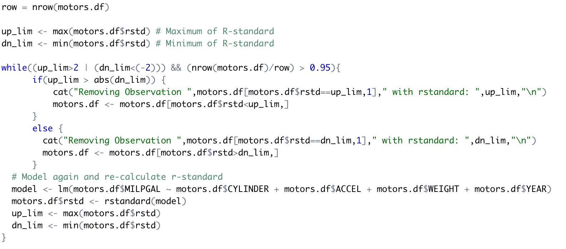
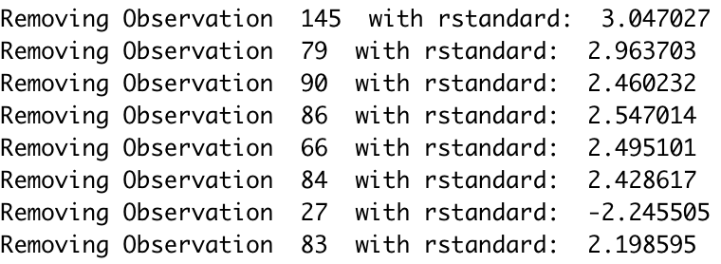
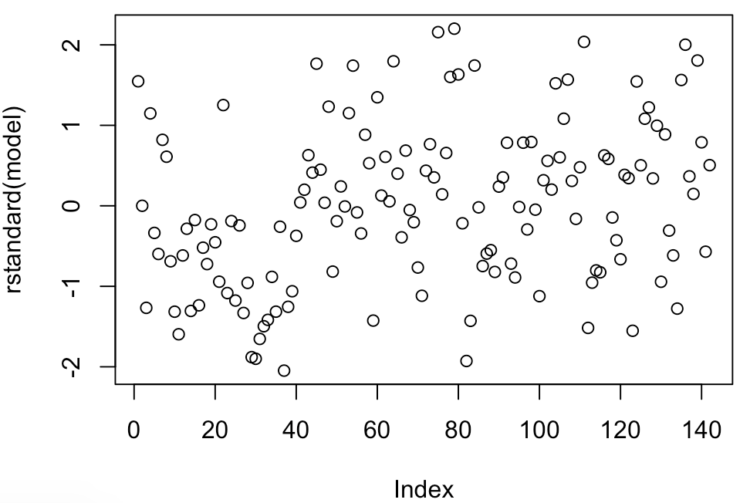
Step 3: Standardized residuals :: |r_{i}| < 2
5% threshold set for removal of observation
Absolute maximum r-standard observation is removed
Loop exited after removing eight observations

Slide 9
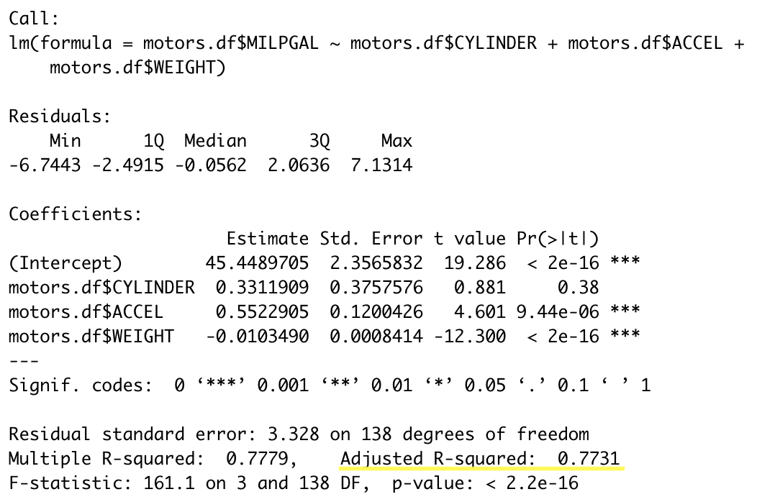
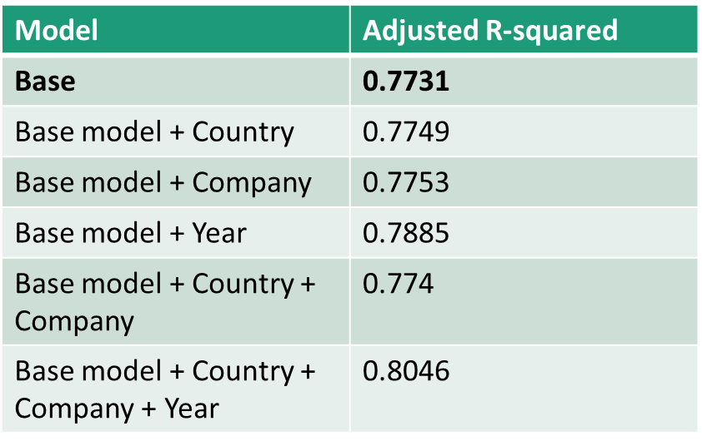
Model summary
MILPGAL = ß0 + ß1 CYLINDER + ß2 ACCL + ß3 Weight + error
How does the model performs with other variables like year, country and company?

Slide 10
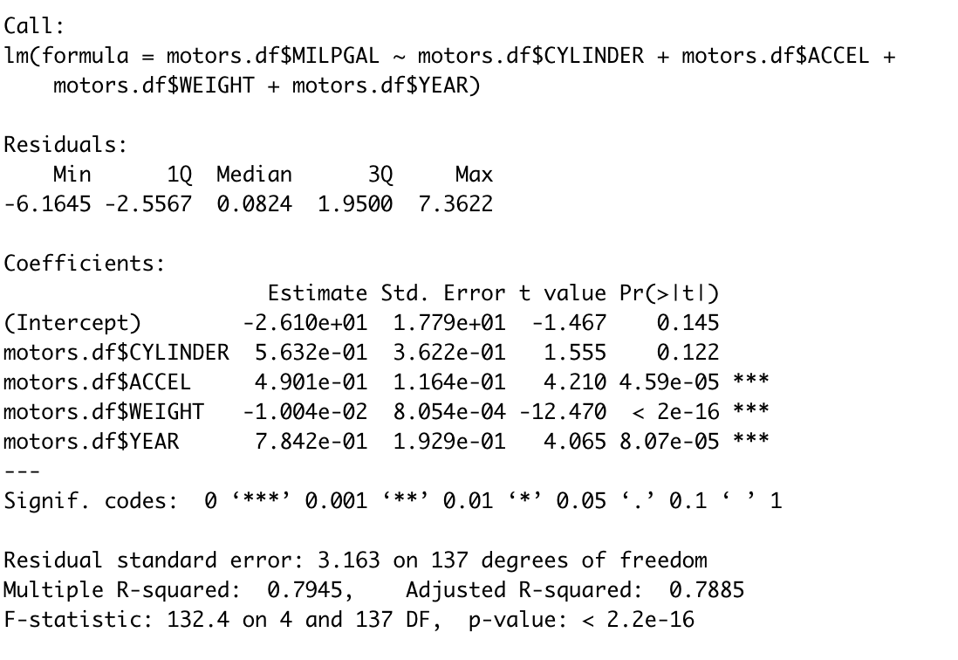
Model summary
Company and country does not add much value to the model individually.
Adding both country and company can lead to overfitting
Year is added to the base model to capture technical innovation trends in market.
Final Model
MILPGAL = ß0 + ß1 CYLINDER + ß2 ACCL + ß3 Weight + ß4 Year + error

Slide 11
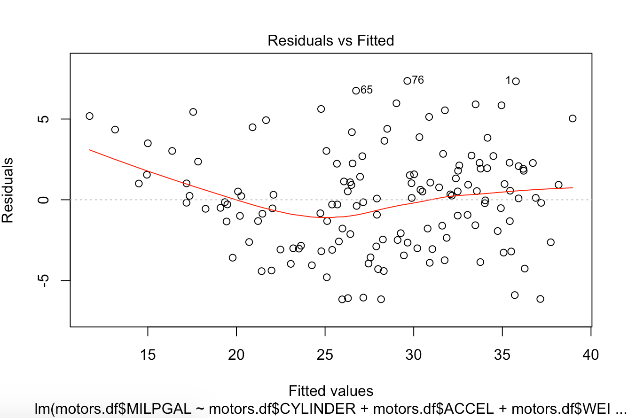
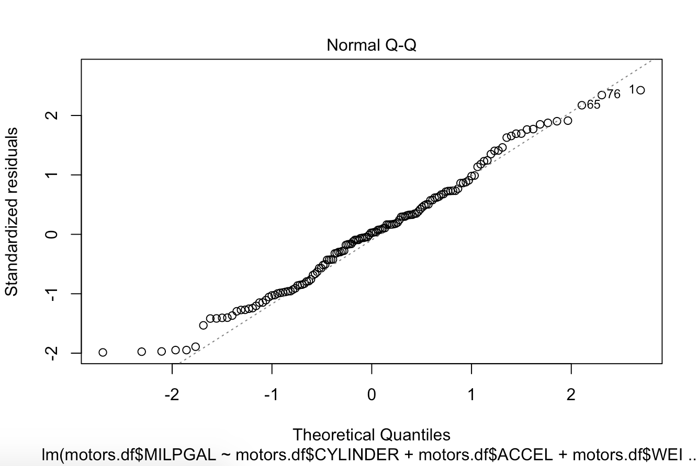
Model SUMMARY

Slide 12
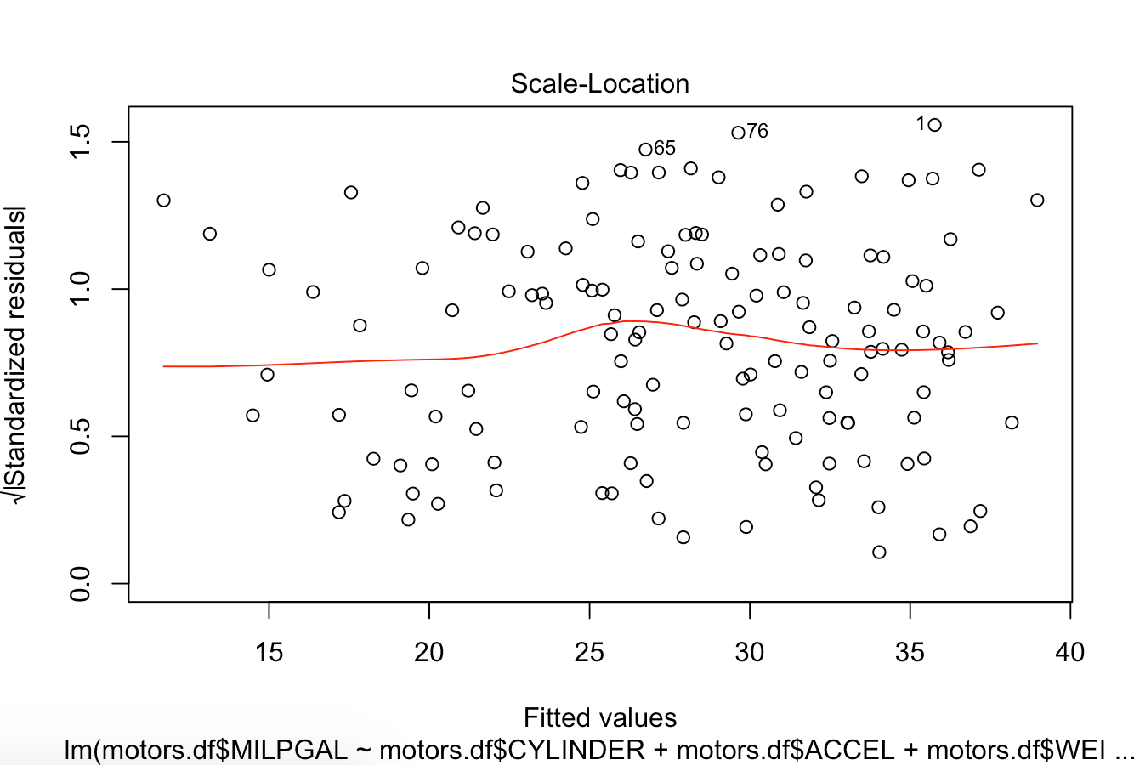
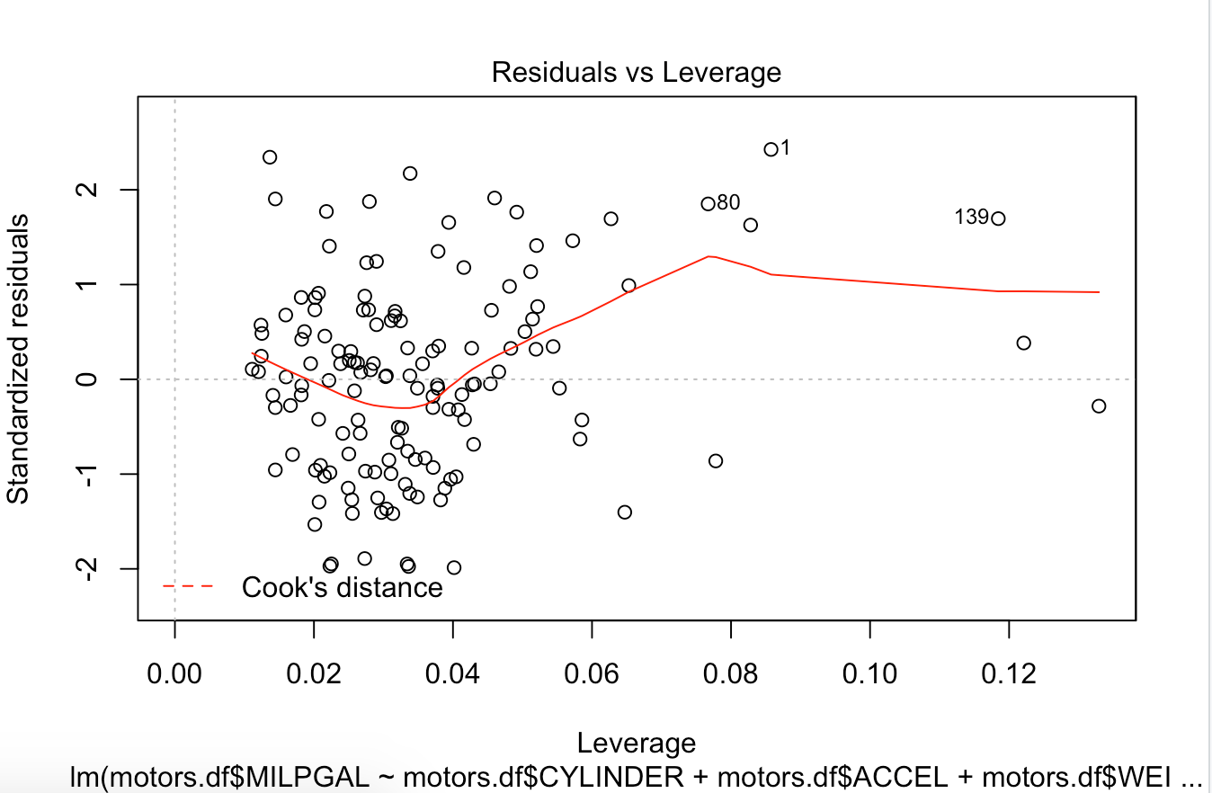
Model SUMMARY

Slide 13
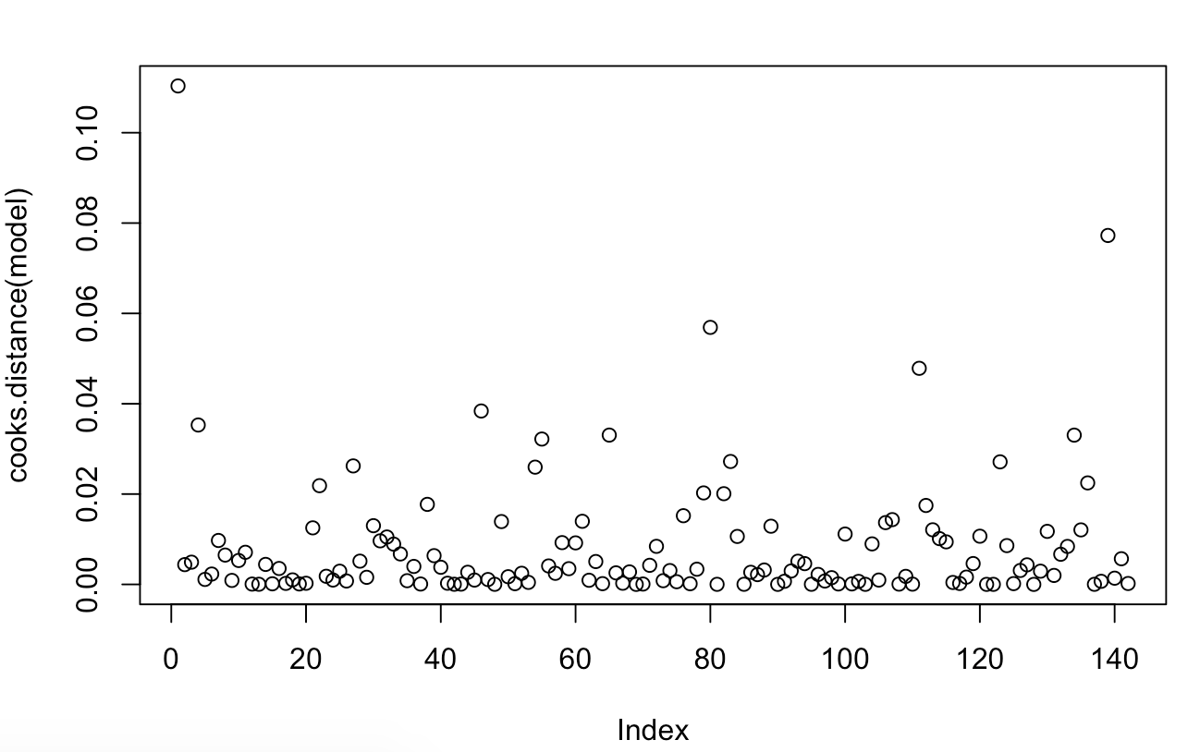
Model SUMMARY

Slide 14
Business questions
1. Factors that significantly predict fuel economy?
Cylinder (+)
Accel (+)
Weight (-)
Year (+)
2. Determine whether American motors is significantly above or below the market in terms of fuel efficiency:
Predictor estimate | ß0 | Cylinder (ß1) | Accel (ß2) | Weight (ß3) | Year (ß4)
All data | -0.261 | 0.5632 | 0.4901 | -0.1004 | 0.7842
American motors alone | -38.183 | 0.460591 | 0.338817 | -0.0074 | 0.862711
All data without American motors | -0.3298 | 0.7003 | 0.7084 | -0.1066 | 0.8330

Slide 15
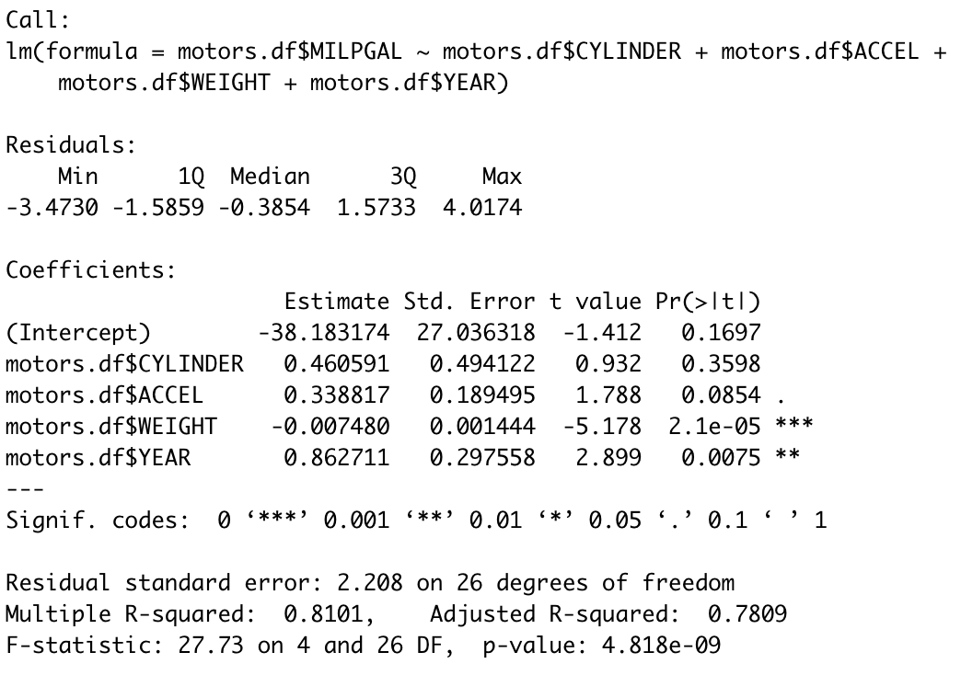
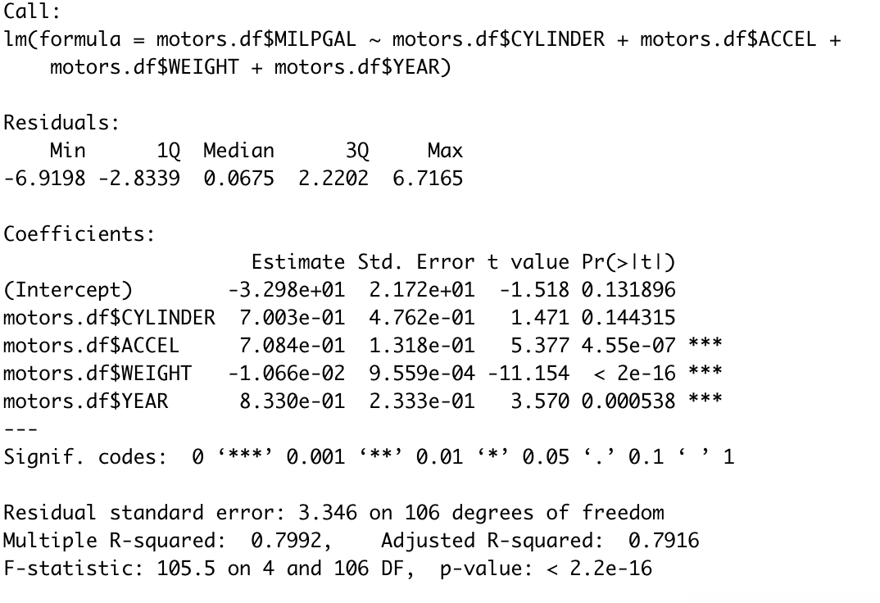
Summary
Summary of regression w/ American Motors only
Summary of regression w/ all data except American Motors

Slide 16
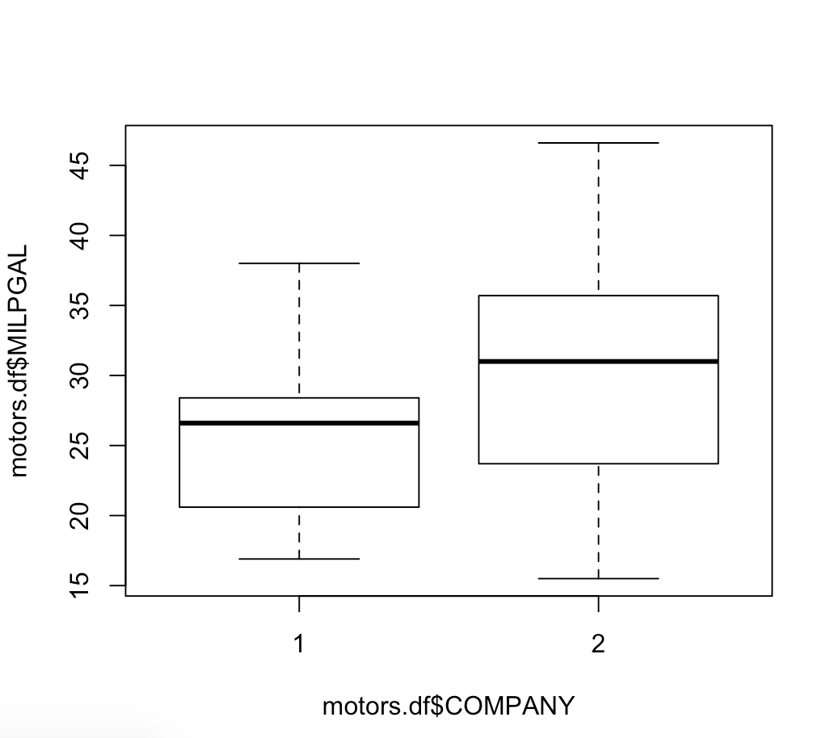
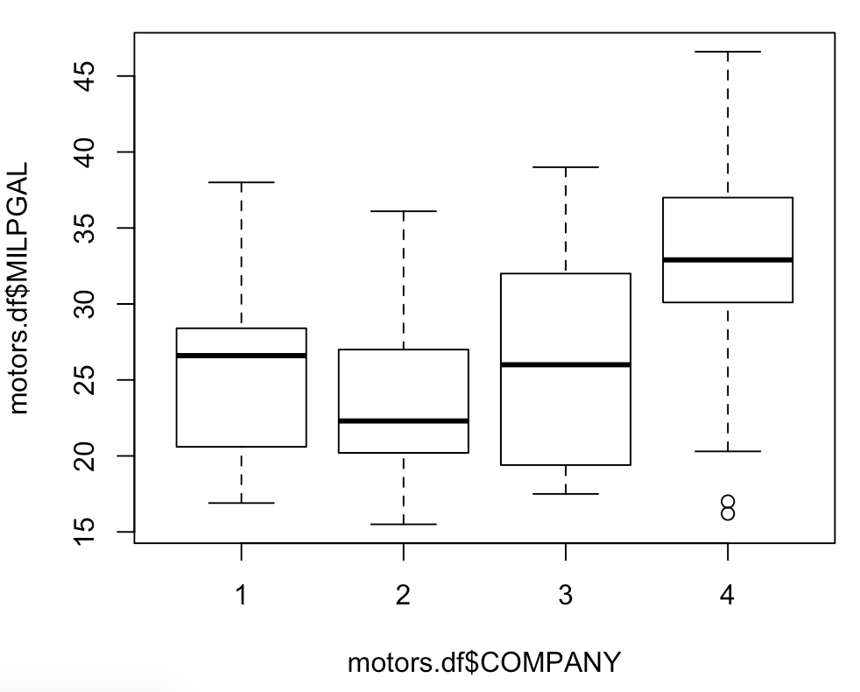
Box plot
1 – American Motors
2 – Apex motors
3 – Smith motors
4 - Others
1 – American Motors 2- Others

Slide 17
Predicting the Price of Vehicles
Table1: Average price for different manufactures and country Fig1: Price variation with Model Years
Price (Y) = f (Cylinder, Displace, Horspwr, Accel, Weight, Year, country, Company)
MODEL 1:
Simplified assumption of linear relation between the predictors and response variable.
As seen in Table1, We need 4 indicator variables to represent 5 different groups.
“Milpgal” (Fuel Efficiency) can be predicted by the remaining variables. So not including Milpgal in this model.
Price ~ Cylinder + Displace + Horspwr + Accel + Weight + Year + Cat11 + Cat12 + Cat13 + Cat 24
Where Cat(xy) refers to the Indicator variable of Country-X and Company-Y
 | US (1) | Europe (2) | Japan (3)
American Motors (1) | 18100
Apex Motors (2) | 14909.09091
Smith Motors (3) | 14353.33333
Others (4) |  | 22365.38 | 17459.09
Industry Average | 17455.48387

Slide 18
Predicting the Price of Vehicles
Assumptions:
Multicollinearity: VIF < 4 for all predictor variables
Linearity and Homoscedasticity: Residual plot is random with constant variance
Normal Random Errors: Q-Q plot is linear
No Influential Observations
Test of Multicollinearity:-
We drop Displace
Cylinder | Displace | Horspwr | Accel | Weight | Year | Cat11 | Cat12 | Cat13 | Cat24
9.16468 | 19.83245 | 8.426788 | 3.049305 | 12.76366 | 1.214237 | 1.874477 | 1.594437 | 1.87549 | 1.52

Slide 19
Model 2 for Predicting the Price of Vehicles
MODEL 2:
Price ~ Cylinder + Horspwr + Accel + Weight + Year + Cat11 + Cat12 + Cat13 + Cat 24
Test of Multicollinearity:-
We drop Weight
Cylinder | Horspwr | Accel | Weight | Year | Cat11 | Cat12 | Cat13 | Cat24
3.78847 | 8.421737 | 2.994064 | 8.692252 | 1.211707 | 1.809221 | 1.531423 | 1.741727 | 1.472019

Slide 20
Model 3 for Predicting the Price of Vehicles
MODEL 3:
Price ~ Cylinder + Horspwr + Accel + Year + Cat11 + Cat12 + Cat13 + Cat 24
Test of Multicollinearity:-
Cylinder | Horspwr | Accel | Year | Cat11 | Cat12 | Cat13 | Cat24
2.98922 | 3.804655 | 1.659543 | 1.21092 | 1.755428 | 1.425566 | 1.455589 | 1.42085
All the predictor variables are within acceptable VIF range

Slide 21
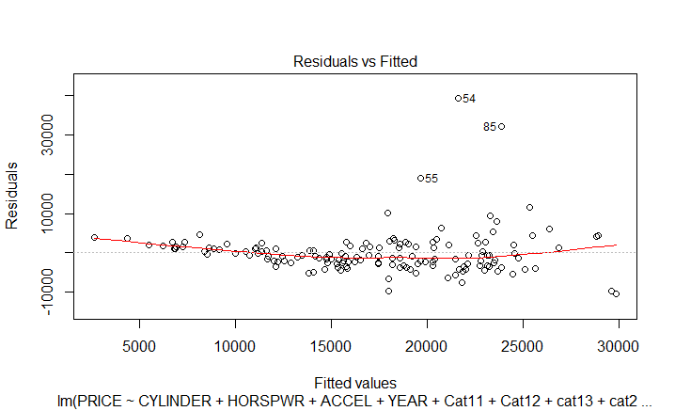
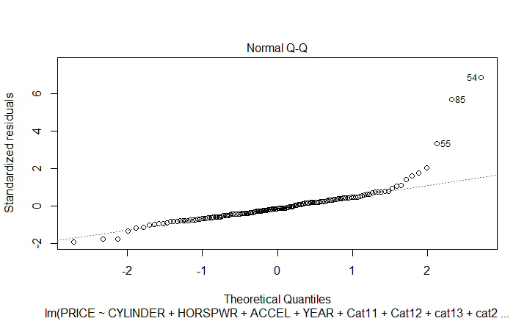
Check for Linearity and HOMOSCEDATICITY
MODEL 3:
Price ~ Cylinder + Horspwr + Accel + Year + Cat11 + Cat12 + Cat13 + Cat 24
Test of Linearity and Homoscedasticity :-

Slide 22
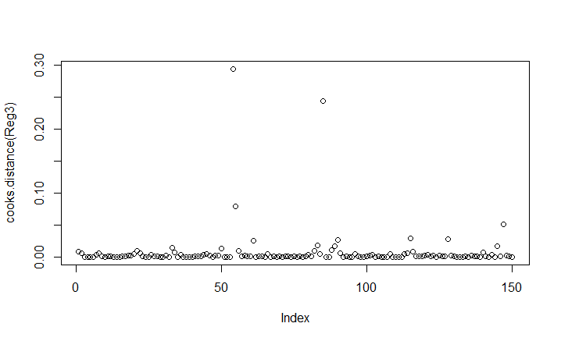
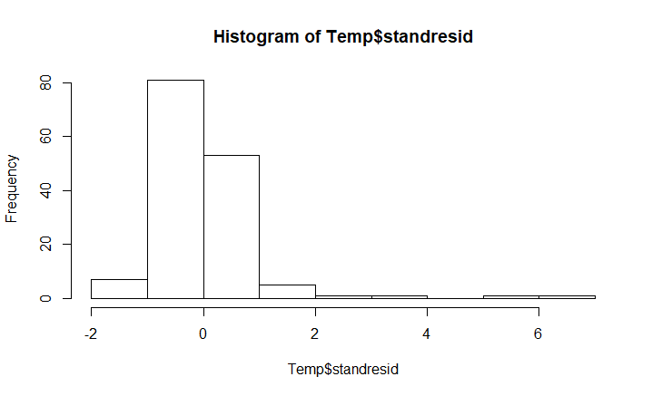
Removal of Influential observations
MODEL 3:
Price ~ Cylinder + Horspwr + Accel + Year + Cat11 + Cat12 + Cat13 + Cat 24
Test of Influential Observations:-

Slide 23
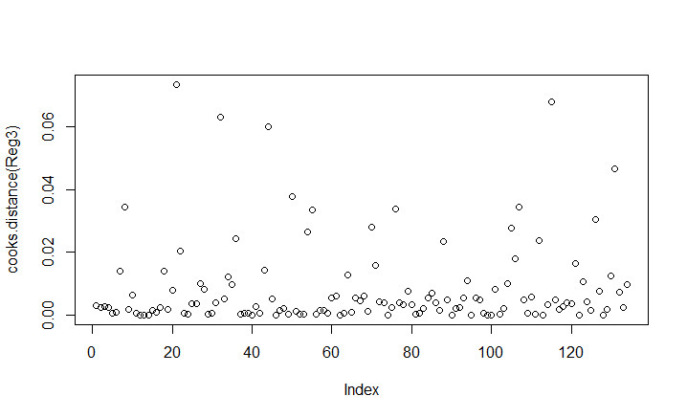
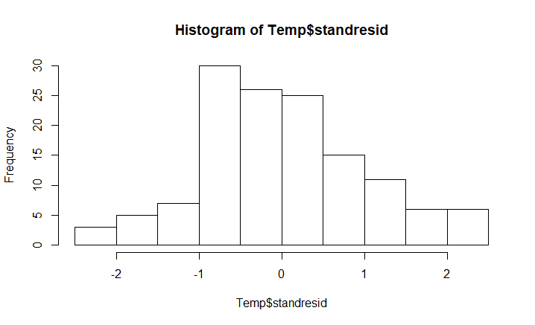
Removal of Influential observations
MODEL 3:
After stepwise removing the Observations where |Residuals| > 2.5, we were left with 134 observations.

Slide 24
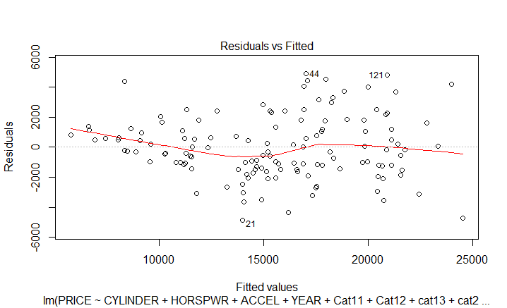
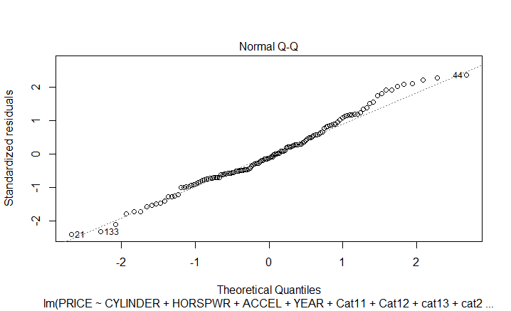
Check for Linearity and HOMOSCEDATICITY
MODEL 3:
Price ~ Cylinder + Horspwr + Accel + Year + Cat11 + Cat12 + Cat13 + Cat 24
Test of Linearity and Homoscedasticity once again with the latest Reg model:-

Slide 25
Coefficients in the Regression model
MODEL 3: Summary.
 | Estimate | Std. Error | t value | Pr(>|t|)
(Intercept) | -270517 | 13167.9 | -20.54 | 2.00E-16
Cylinder | 11.97 | 243.8 | 0.049 | 0.960924
Horspwr | 113.45 | 15.19 | 7.47 | 1.21E-11
Accel | 43.06 | 95.83 | 0.449 | 0.654003
Year | 3072.42 | 140.53 | 21.862 | < 2e-16
Cat11 | -1408.63 | 606.84 | -2.321 | 0.021893
Cat12 | -2222.39 | 630.14 | -3.527 | 0.000589
Cat13 | -2410.82 | 563.44 | -4.279 | 3.70E-05
Cat24 | 3277.72 | 665.85 | 4.923 | 2.64E-06

Slide 26
Business questions
1. Factors that significantly affect price?
Cylinder (+)
Accel (+)
Weight (+)
Year (+)
Cat11 (-) : Country - US, Company -American Motors
Cat12 (-) : Country - US, Company – Apex Motors
Cat13 (-) : Country - US, Company – Smith Motors
Cat24 (+) : Country – Europe, Company - Others
As Compared to
Country- Japan, Company- Others

