Slide 1
DMX SENDER
HEAKEME WILLIAMS
CRYSTAL FOUNTAINS

Slide 2
INTRODUCTION TO THE DMX-SENDER PURPOSE ON THE CRYSTAL FOUNTAINS PROJECT
The crystal fountain uses a DMX-Generator which produces the DMX differential signals, this then travels to the DMX-Sender board through the XLR cables in which it is translated into single-ended signal for data in the module. The signal then travels to the DMX-Receiver board via the antennae. The receiver board then converts this single-ended signal back to differential using one the chips and then plugs it right back into the light, which results in the different light sequence based on what is being produced from the generator device.

Slide 3
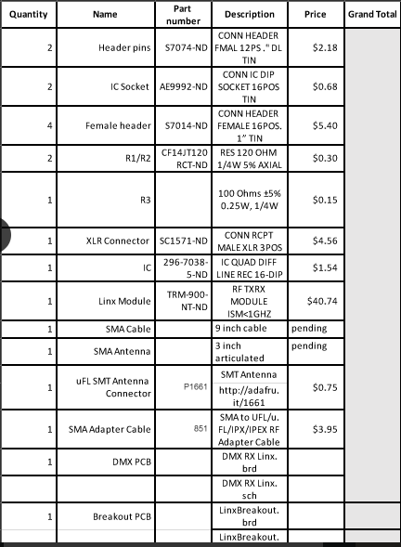
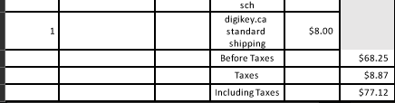
BUDGET
Budget started off to be $200 in which $90 was spent on my raspberry pi kit, and another $60 was spent on my parts needed for the DMX-Sender board. After, the module problem $40 was spent to get the correct module and now with the major problem another $60 dollars is needed. Hence, Budget left is -$50.

Slide 4
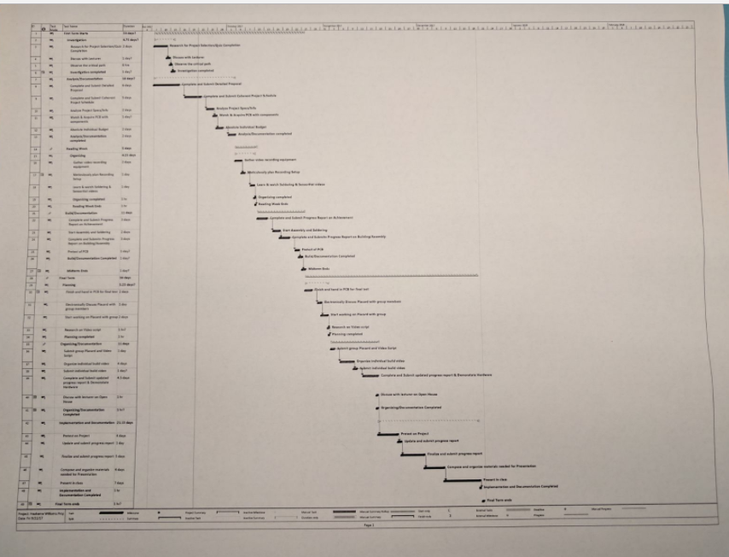
SCHEDULES
The project was broken down into main points which then contained subpoints expounding how the main ones would be achieved.

Slide 5
BUILD VIDEO
BY HEAKEME WILLIAMS
CRYSTAL FOUNTAINS

Slide 6
COURSE KNOWLEDGE UTILIZED
Management of finances
Planning and organizing of a schedule
Soldering techniques
Proposing an idea coherently
Updating/Reporting the progress of a project
Using Eagle to design boards
Time management skills
Troubling Shooting Errors

