Slide 2
Shifted and Scaled Regression Returns the Correlation Coefficient

Slide 3
Returning r to Original Coord System is Not Equivalent to Regular Regression

Slide 4
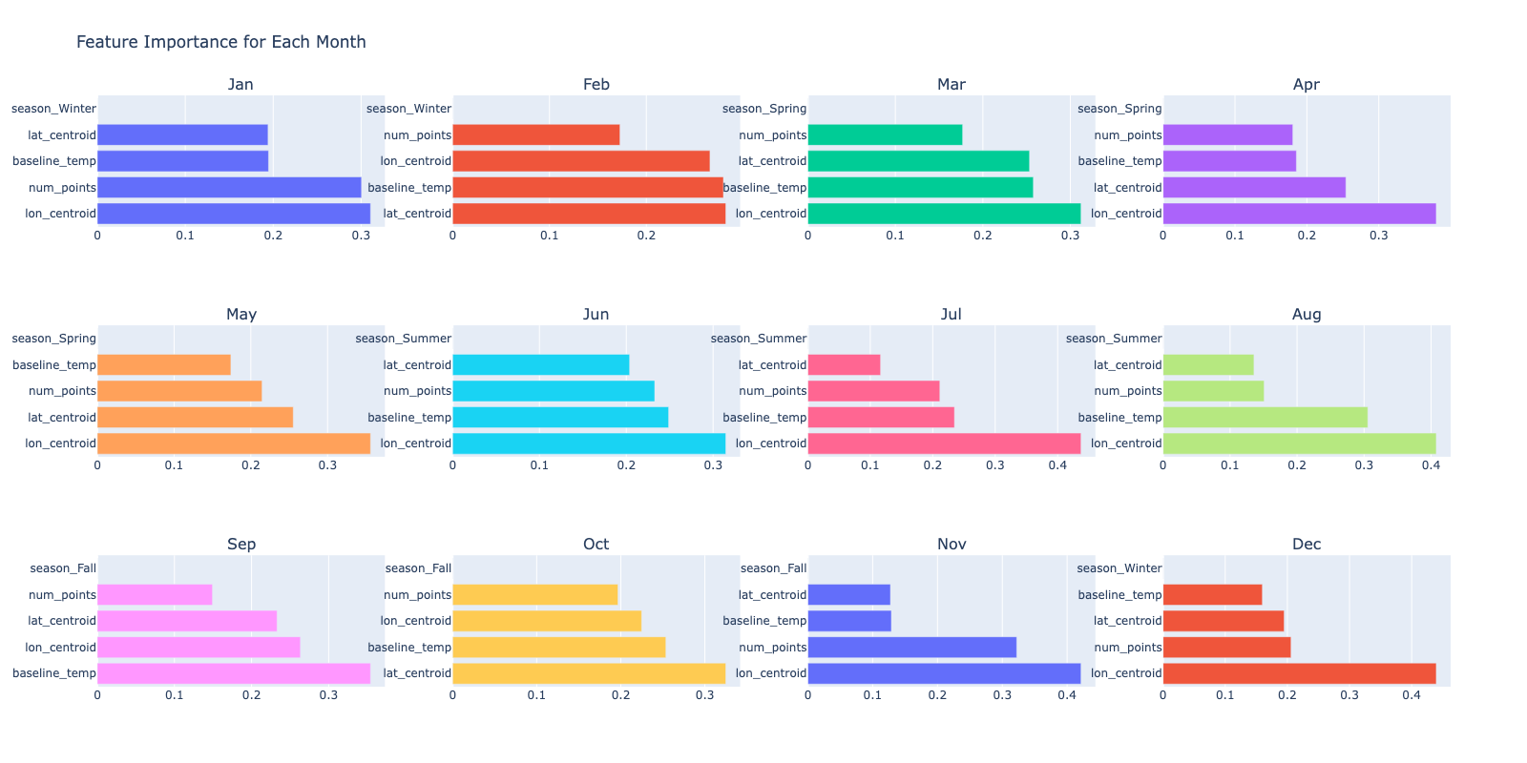
Random Forest – Center and Scale

Slide 5
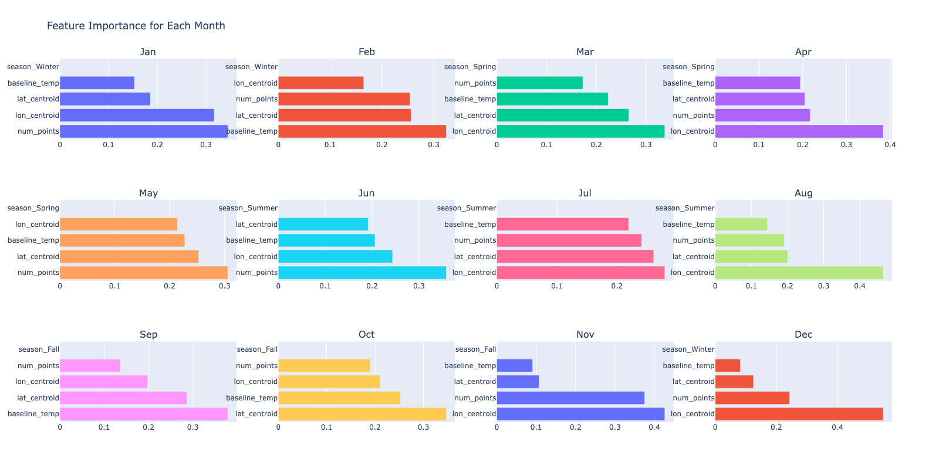
Random Forest – Simple Regression

Slide 6
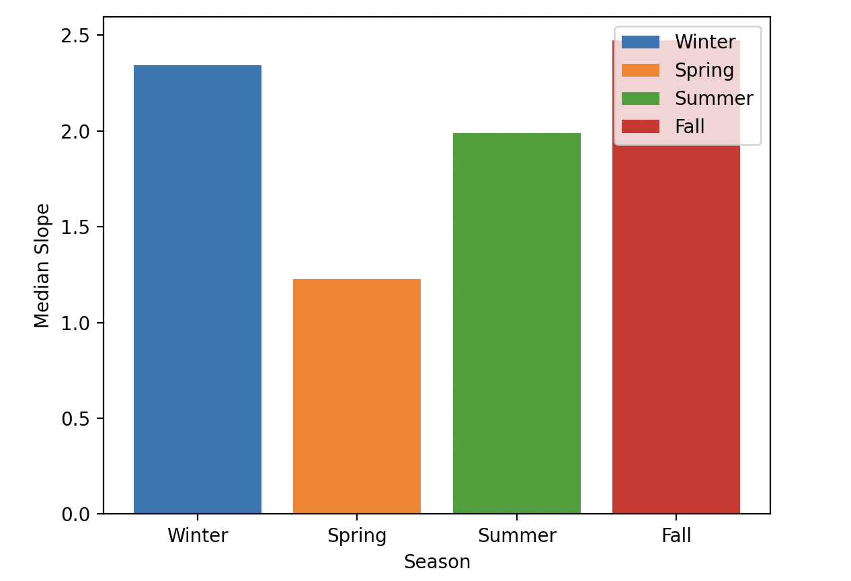
Season vs. Slope, Simple Regression

Slide 7
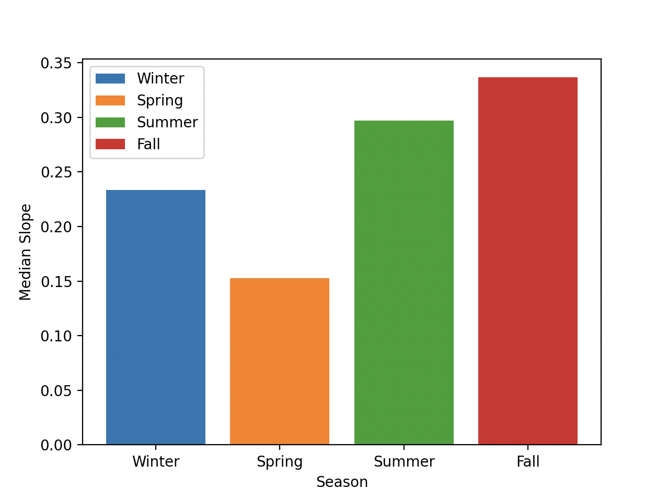
Season vs. Slope, Center and Scale

