Slide 1


Report topic : DATA MINING ON RETAIL SALES AND BANK DATA
Instructors: GV. Nguyen Van Thanh
Class: Data Mining
Implementation group : Group 6
Lê Vũ Thế Khôi MSSV : 20133057
Ngô Văn Khánh MSSV : 20133067
Nguyễn Võ Song Toàn MSSV : 20133097
23/05/2023

Slide 2
Work assignment
Phân công nhiệm vụ | Decision Tree | Association Rule | Microsoft Clustering | Trực quan hoá trên Python | Trực quan hóa trên Power BI | Tiến độ
Lê Vũ Thế Khôi | x | x | x |  | x | 100%
Ngô Văn Khánh |  |  | x | x |  | 100%
Nguyễn Võ Song Toàn | x |  |  |  | x | 100%

Slide 3
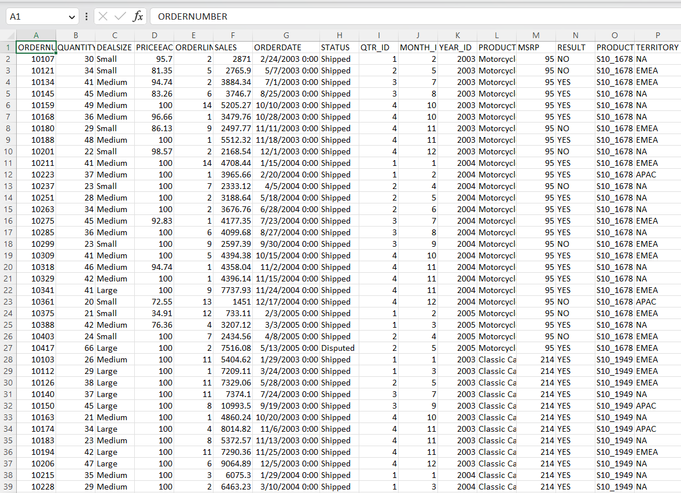
Data source of the topic
Source SalesData https://www.kaggle.com/kyanyoga/sample-sales-data
This is a descriptive dataset of sample sales data taken on www.kaggle.com including a lot of information about sales data, customer information, order information, revenue, delivery, etc.
About data: 25 columns, nearly ~ 2800 rows.

Slide 4
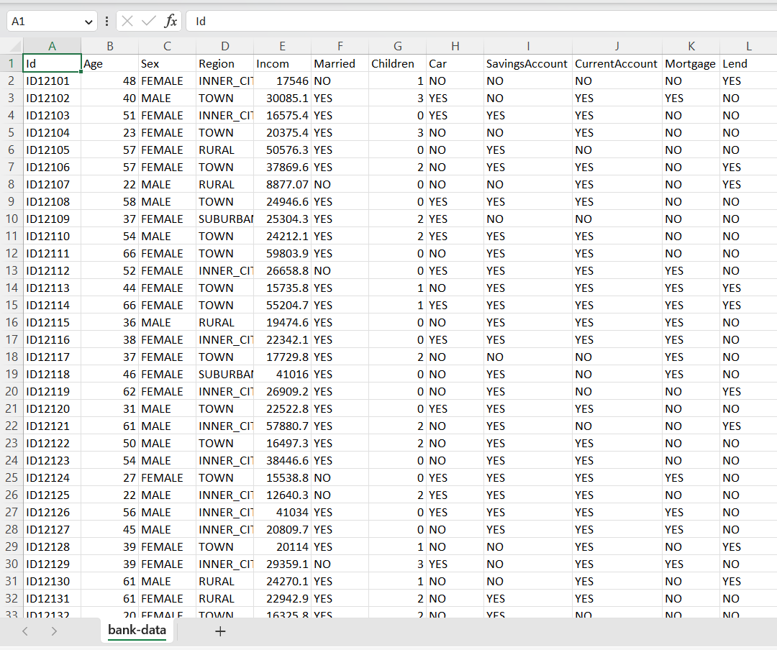
Data source of the topic
source https://www.kaggle.com/kyanyoga/sample-sales-data
This dataset describes a bank's data about the criteria it considers to agree to lend money to a customer. Some criteria such as whether this customer has a family, how many children, has a car, has a savings account, has a current account... and then will decide whether to agree to a loan or not. Are not
About data: 12 columns, nearly ~ 600 rows.

Slide 5
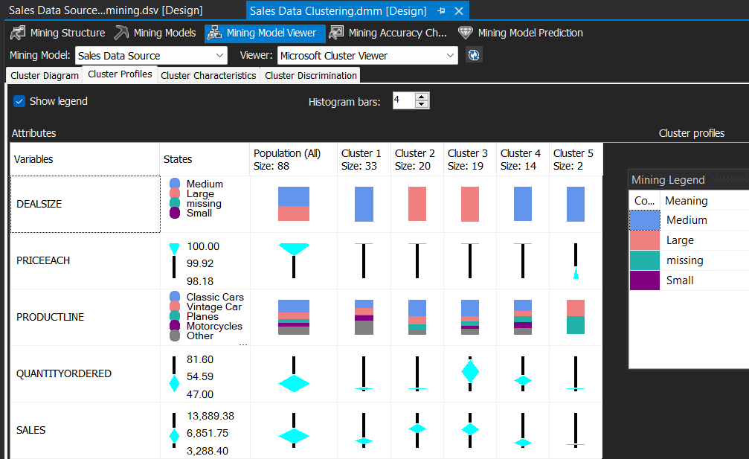
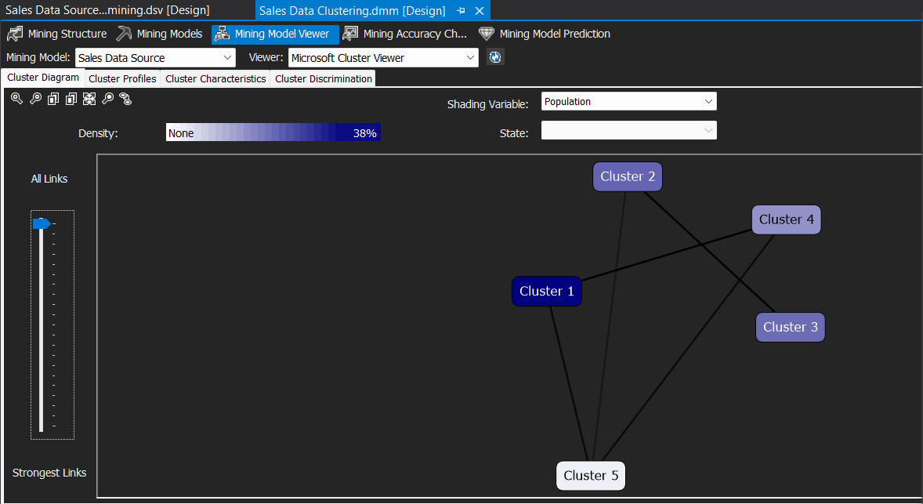
1. SSIS
Microsoft Clustering

Slide 6
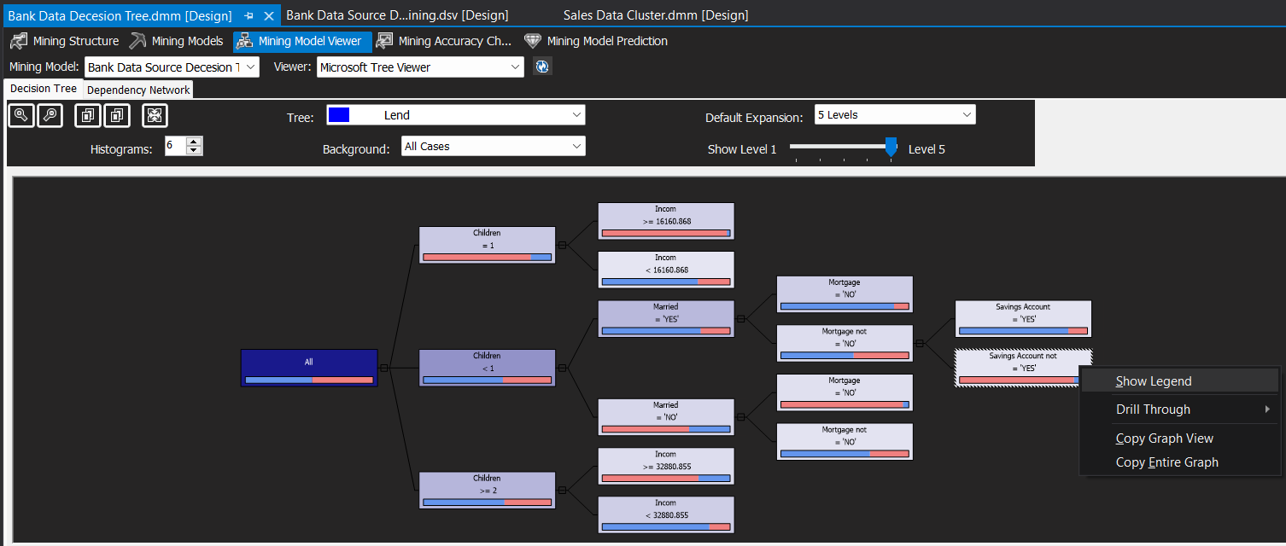
1. SSIS
Microsoft Decision Tree

Slide 7
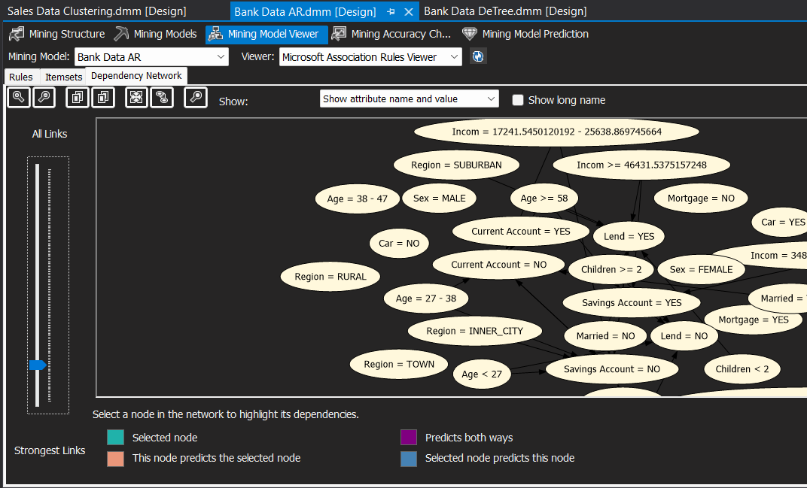
1. SSIS
Association Rule

Slide 8
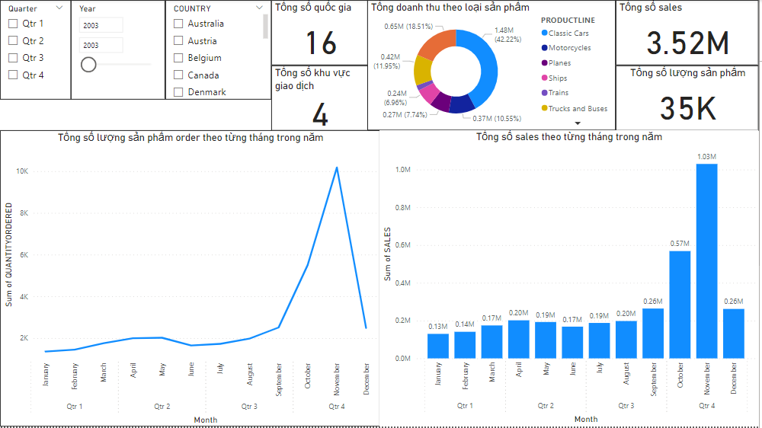
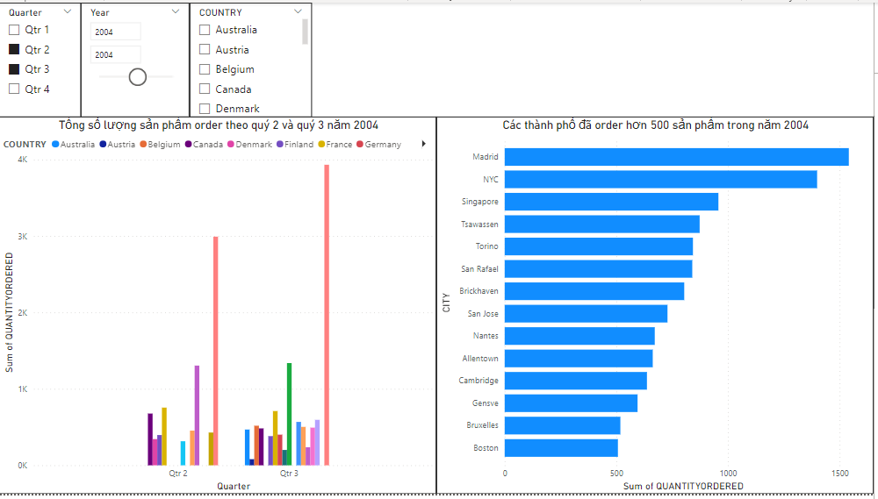
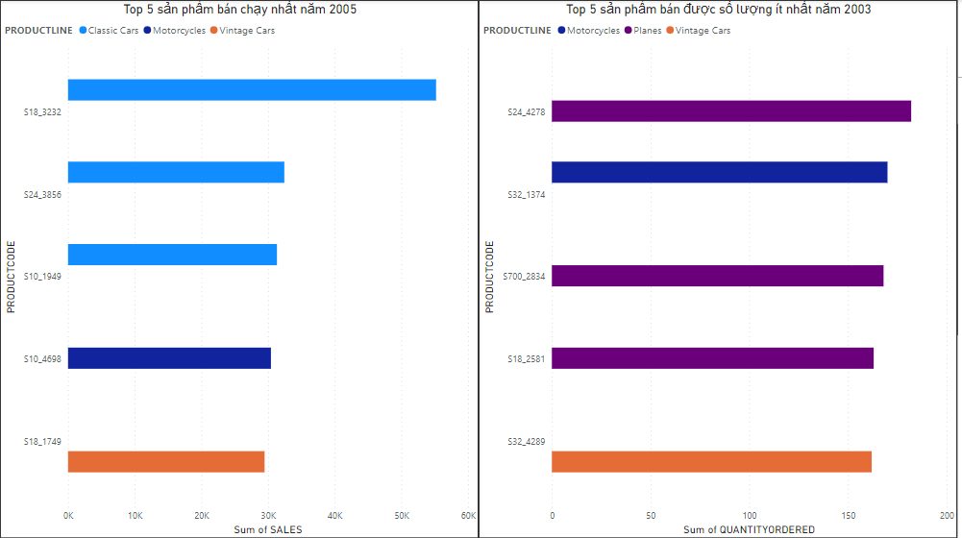
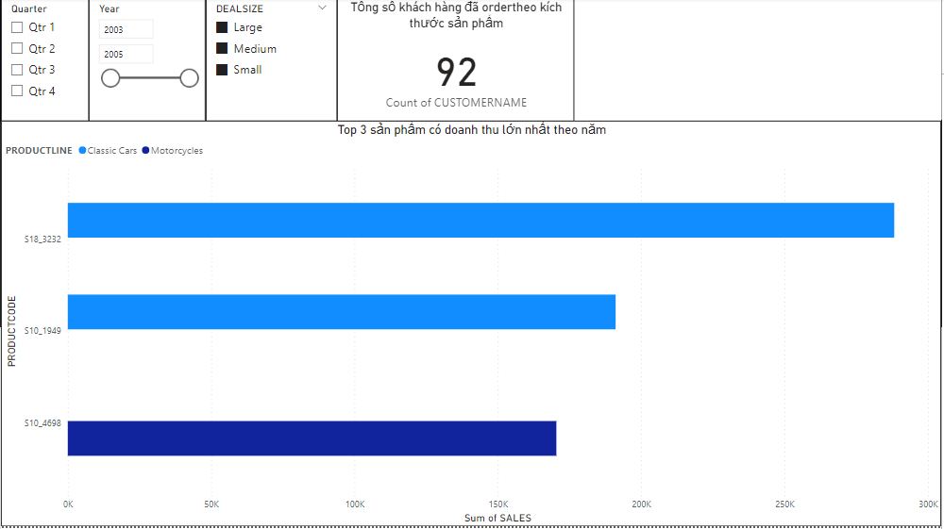
2. Data visualization with Power BI

Slide 9
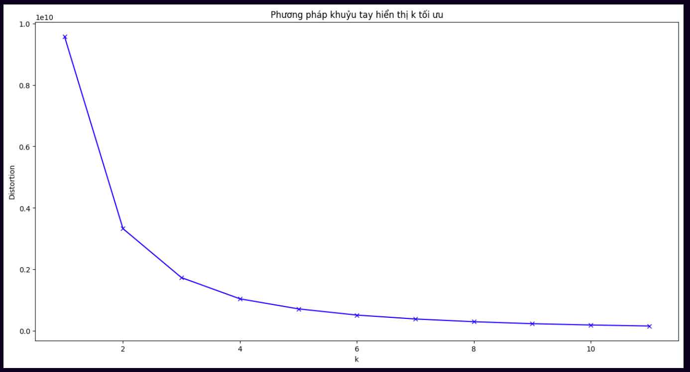
3. Data visualization with Python
3.1 Sử dụng phương pháp khuỷu tay để tìm số cụm- ELBOW
X

Slide 10
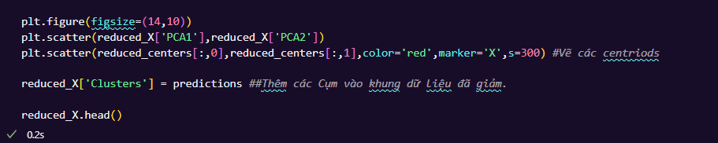
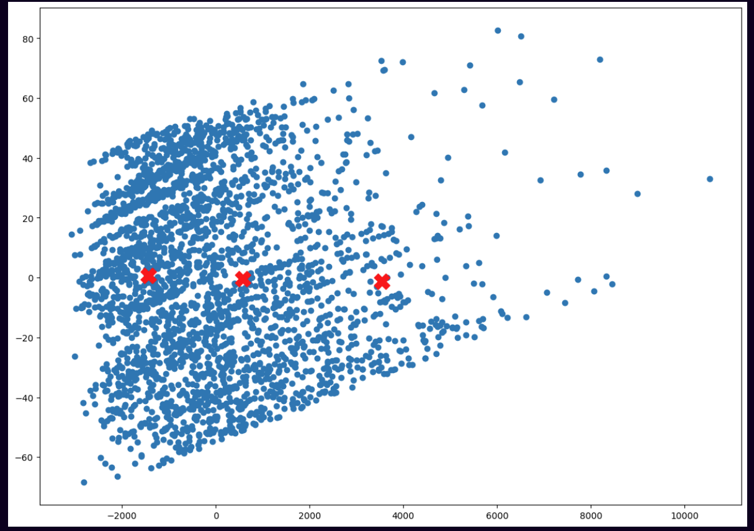
3.2 Dùng các thư viện matplotlib, seaborn, sklearn để xác định phân vùng cụm và vẽ tâm cụm

Slide 11
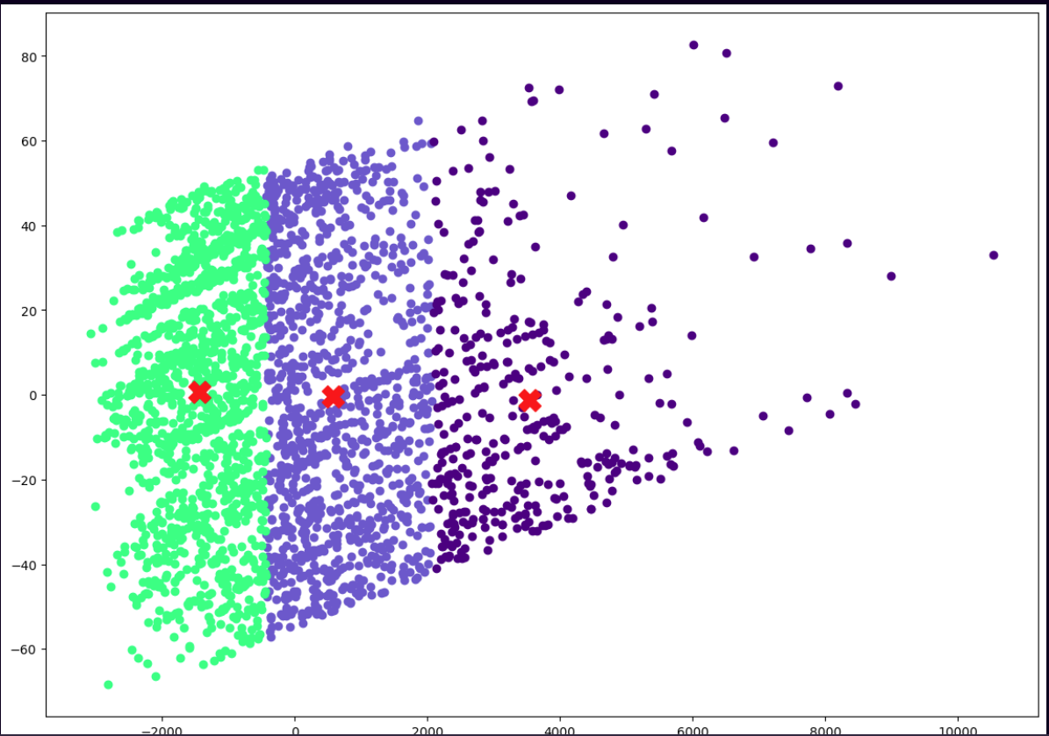
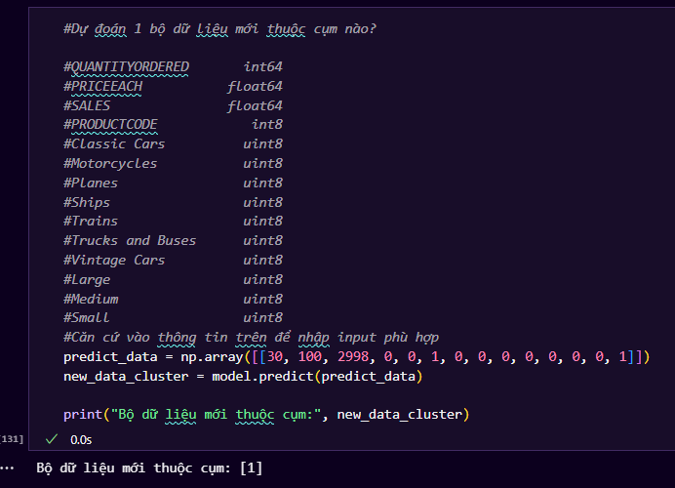
3.3 Tô màu để nổi bật các cụm và tâm cụm
3.4 Dự đoán 1 bộ dữ liệu mới sẽ thuộc cụm nào
Sử dụng model.predict(new_predict_data)

