Slide 1

IMPROVED ROUND ROBIN-BASED SCHEDULING ALGORITHM
TECHNIQUES TO IMPROVE LINUX PROCESS SCHEDULING
AYUSH MANGUKIA, MOHAMMED IBRAHIM, SOORYA GOLAMUDI, NISHANT KUMAR

Slide 2
INTRODUCTION
CPU or process Scheduling, which is an important part in any operating systems, allocates processes to the CPU in specific order to optimize some objective functions.
The efficiency of any operating system relies strongly on the scheduling algorithms used. Several scheduling algorithms exists. Among them, Round Robin (RR) is the most widely utilized algorithm.
RR has proved to be effective in several types of operating systems, such as time-sharing systems. This is due to the reasonable response time it gives.
However, it suffers from some shortcomings such as high average turnaround time, high average waiting time.
So, we devise an improved Round – Robin Algorithm.

Slide 3
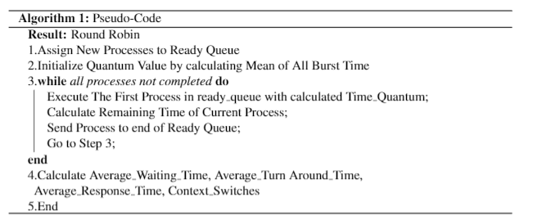
Literature Survey THE ORIGINAL
ROUND ROBIN ALGORITHM

Slide 4
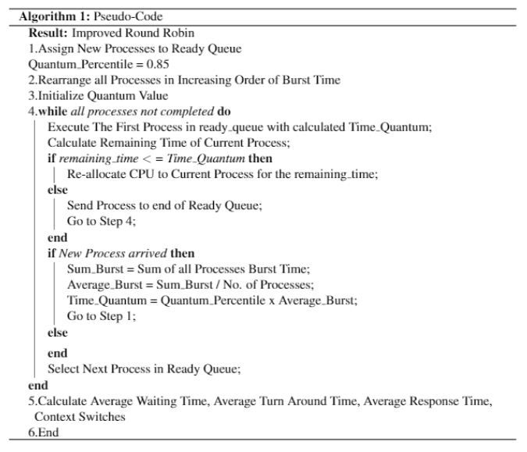
Literature Survey THE PROPOSED
ROUND ROBIN ALGORITHM

Slide 5
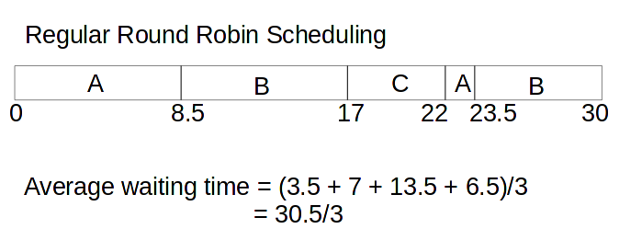
Literature Survey Comparison (Gantt Chart)
Process | Arrival Time | Burst Time
A | 0 | 10
B | 5 | 15
C | 10 | 5

Slide 6
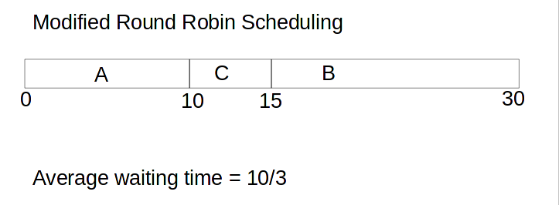
Literature Survey Comparison (Gantt Chart)
Process | Arrival Time | Burst Time
A | 0 | 10
B | 5 | 15
C | 10 | 5

Slide 7
Predicted Improvements with the Algorithm
Using the Algorithm helps in reducing Average Waiting, Turn Around and Responsive Time as the Quantum Time is not fixed and is variable depending on the Tasks given to it.
Reduces number of context switches since the CPU is re-allocated to the current process if the remaining time is less than the time quantum.

Slide 8

Results Found
For Dataset of Size 50, we find that a Quantum of Range 0.7 to 0.95 Produce Low Average Waiting and Turnaround Time with Context Switches almost equal to Size
For Dataset of Size 100, we find that a Quantum of Range 0.8 to 0.95 Produce Low Average Waiting and Turnaround Time with Context Switches almost equal to Size
For Dataset of Size 150, we find that a Quantum of Range 0.75 to 0.95 Produce Low Average Waiting and Turnaround Time with Context Switches almost equal to Size
For Dataset of Size 200, we find that a Quantum of Range 0.8 to 0.95 Produce Low Average Waiting and Turnaround Time with Context Switches almost equal to Size

Slide 9
Results for Quantum Values
Quantum | N | AWT | ART | ATT | #CS
0.8 | 50 | 95.40816 | 90.66816 | 101.46816 | 56
0.85 | 50 | 93.81462 | 92.37462 | 99.87462 | 53
0.9 | 50 | 93.12 | 93.12 | 99.18 | 49
0.95 | 50 | 93.12 | 93.12 | 99.18 | 49
0.8 | 100 | 222.1464 | 216.2964 | 229.0364 | 109
0.85 | 100 | 219.36 | 219.36 | 226.25 | 99
0.9 | 100 | 219.36 | 219.36 | 226.25 | 99
0.95 | 100 | 219.36 | 219.36 | 226.25 | 99
0.8 | 150 | 239.78 | 239.78 | 244.9066667 | 149
0.85 | 150 | 239.78 | 239.78 | 244.9066667 | 149
0.9 | 150 | 239.78 | 239.78 | 244.9066667 | 149
0.95 | 150 | 239.78 | 239.78 | 244.9066667 | 149
0.8 | 200 | 329.36 | 329.36 | 334.675 | 199
0.85 | 200 | 329.36 | 329.36 | 334.675 | 199
0.9 | 200 | 329.36 | 329.36 | 334.675 | 199
0.95 | 200 | 329.36 | 329.36 | 334.675 | 199

Slide 10
A New Concept – Parallel Processing into Round Robin
Ib Fill This LUL

Slide 11
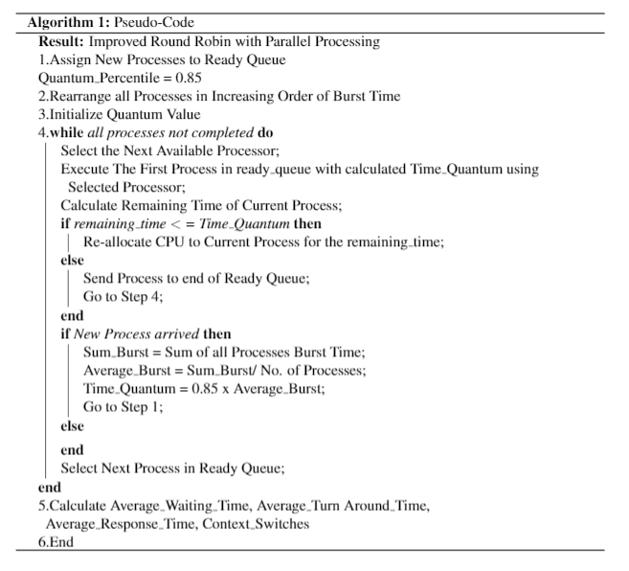
ROUND ROBIN with Parallel processing

Slide 12
Improvements using Parallel processing
Method | N_Processes | Avg Response Time | Avg Waiting Time | Avg Turnaround Time | Context Switches
Round Robin | 50 | 94.66864 | 176.18346 | 182.24346 | 82
Improved Round Robin | 50 | 92.37462 | 93.81462 | 99.87462 | 53
Improved Round Robin Dual (2) Processor | 50 | 43.24 | 43.24 | 49.3 | 48
Improved Round Robin Quad (4) Processor | 50 | 21.2 | 21.14797 | 27.20797 | 49
Round Robin | 70 | 117.5181714 | 230.4090286 | 235.8518857 | 120
Improved Round Robin | 70 | 121.2 | 121.2 | 126.6428571 | 69
Improved Round Robin Dual (2) Processor | 70 | 56.01428571 | 56.01428571 | 61.45714286 | 68
Improved Round Robin Quad (4) Processor | 70 | 24.08571429 | 24.08571429 | 29.52857143 | 66
Round Robin | 100 | 218.596035 | 424.161765 | 431.051765 | 173
Improved Round Robin | 100 | 219.36 | 219.36 | 226.25 | 99
Improved Round Robin Dual (2) Processor | 100 | 100.69 | 100.69 | 107.58 | 98
Improved Round Robin Quad (4) Processor | 100 | 42.721415 | 42.66761 | 49.55761 | 97

Slide 13
Improvements using Parallel processing
Method | N_Processes | Avg Response Time | Avg Waiting Time | Avg Turnaround Time | Context Switches
Round Robin | 150 | 235.0491067 | 470.3493067 | 475.4759733 | 255
Improved Round Robin | 150 | 239.78 | 239.78 | 244.9066667 | 149
Improved Round Robin Dual (2) Processor | 150 | 106.0133333 | 106.0133333 | 111.14 | 148
Improved Round Robin Quad (4) Processor | 150 | 40.78876333 | 40.76796667 | 45.89463333 | 147
Round Robin | 200 | 328.83582 | 639.1362 | 644.4512 | 332
Improved Round Robin | 200 | 329.36 | 329.36 | 334.675 | 199
Improved Round Robin Dual (2) Processor | 200 | 147.21 | 147.21 | 152.525 | 198
Improved Round Robin Quad (4) Processor | 200 | 58.005 | 58.005 | 63.32 | 196

Slide 14

Repository of Work Done
GitHub Repo : https://github.com/TheKillingAMD/OS-Algorithm-Improved-Round-Robin

